Slide 1
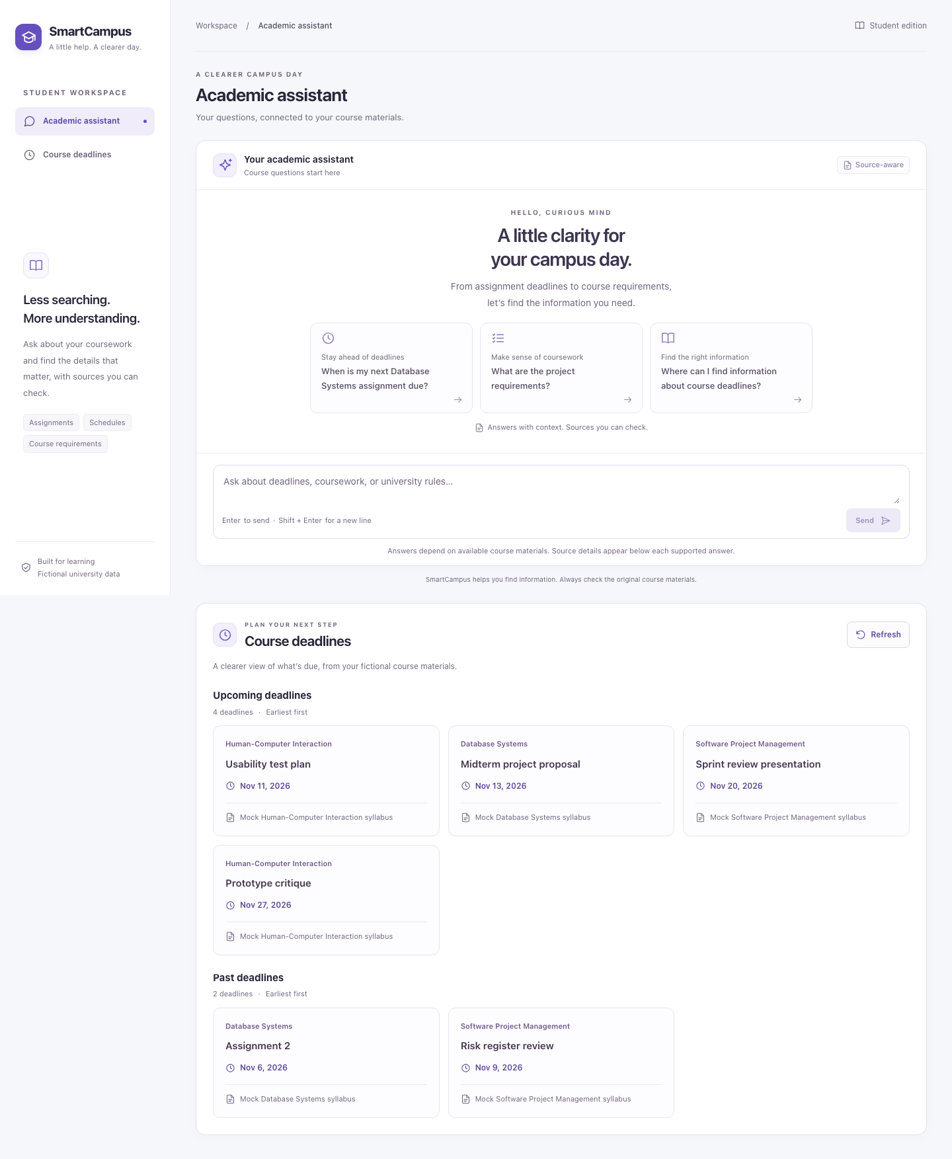
SmartCampus
01
SIS 10–11
SmartCampus
Product testing, improvements
and answer feedback
Yerassyl Babayev / Danaya Aliyeva
Ratislav Ovchinnikov / Gleb Yurtayev
SIS 10–11 defense / 10 November 2026 / Fictional course data
Yerassyl 0:00–0:35
Notes:
Yerassyl · 0:00–0:35
SmartCampus brings an academic assistant and course deadlines into one workspace. A student can ask a question about the course materials or use the dashboard to check the next due date. React renders the workspace. FastAPI retrieves the evidence from a local SQLite database with three fictional courses. Today we will show the baseline we tested, the two weaknesses we corrected and the new way a student can flag an answer. The academic client and its data are fictional.
https://github.com/yerassyl-clou/SmartCampus/pull/6

Slide 2
SmartCampus
02
Three product paths were tested
33
10/12
6/7
Chat checks
AI baseline probes
Dashboard UX cases
Intercepted HTTP: answer, sources, fallback, retry and keyboard.
Two failures exposed evidence from an unrelated course.
Live seeded records plus controlled loading and error responses.
Integrated regression
126 backend and 70 Playwright regression checks passed. Live Chromium exercised FastAPI and SQLite at three widths.
Baseline 42dcac9 / Evidence in PRs #6, #13 and #17
Yerassyl 0:35–1:30
Notes:
Yerassyl · 0:35–1:30
We pinned the baseline to commit 42dcac9 so that every finding could be replayed. We tested three paths. In chat we checked that an answer can cite its evidence, that a missing answer is clearly marked and that retry leaves the conversation usable. In retrieval we tested whether the candidates came from the requested course. For the dashboard, the baseline probe used a real FastAPI request and six seeded deadlines, then simulated slow or failing responses to check the UI states. The three baseline counts come from separate suites. After integration, 126 backend tests and 70 standard browser checks passed. We also ran a separate browser suite against the live provider and validated the new feedback flow against the real database.
https://github.com/yerassyl-clou/SmartCampus/pull/6
https://github.com/yerassyl-clou/SmartCampus/pull/13
https://github.com/yerassyl-clou/SmartCampus/pull/17

Slide 3
SmartCampus
03
Three issues shaped the sprint
P1 SC-ISS-001
Expired work appeared under Upcoming deadlines. Dashboard fix in PR #18.
P1 SC-ISS-002
A named HCI query retrieved Database Systems evidence. Retrieval fix in PR #14.
P2 SC-ISS-003
A built-in chat prompt led to a dead end despite available course data. Deferred.
The first two issues affect which deadline or source a student trusts.
Prioritized issue log #7 / Updated stories and backlog #9
Yerassyl 1:30–2:15
Notes:
Yerassyl · 1:30–2:15
The issue log records the reproduction, priority and owner for each weakness. The first item made already expired work appear under Upcoming deadlines. The second could give the assistant evidence from an unrelated course. Both directly affect what a student sees and were selected for this sprint. We deferred the third item. The built-in deadline prompt can lead to a safe fallback even though the dashboard has the records. A direct question such as List upcoming deadlines still works. The backlog records the two fixes and the deferred prompt. Danaya will show the dashboard comparison with the same data and date.
https://github.com/yerassyl-clou/SmartCampus/pull/7
https://github.com/yerassyl-clou/SmartCampus/pull/9

Slide 4
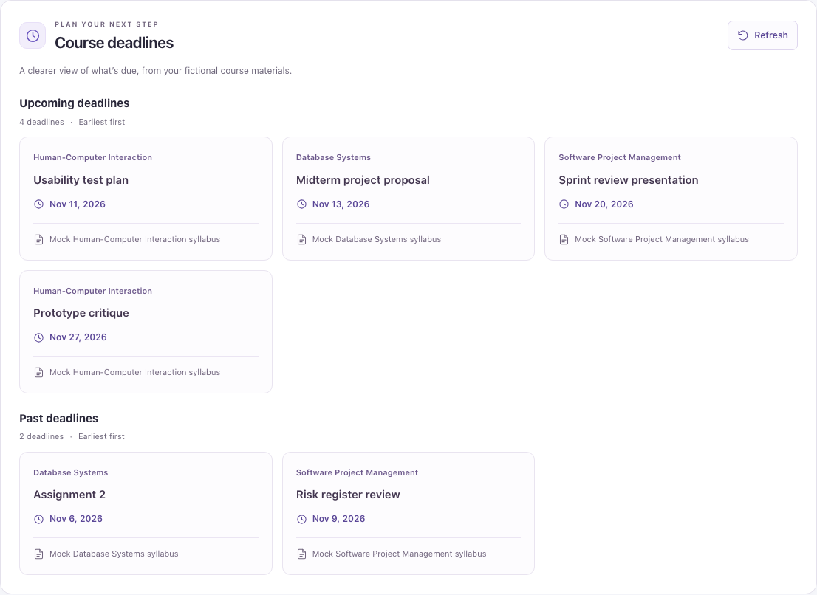
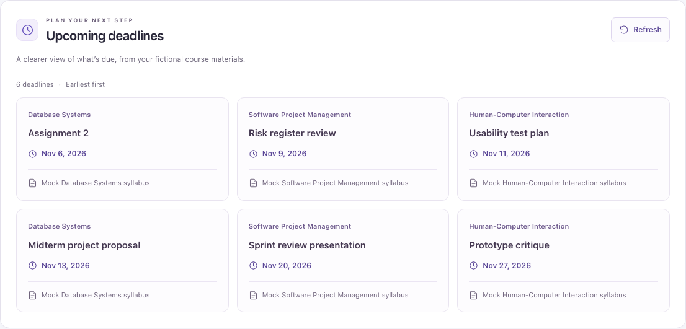
SmartCampus
04
Past deadlines now have their own section
Before / 2 expired records shown as upcoming
After / 4 upcoming and 2 past
SC-ISS-001 / Same seed and fixed campus date / PRs #17 and #18
Danaya 2:15–3:20
Notes:
Danaya · 2:15–3:20
Both images are Chromium captures with the same six deadline records and the same fixed reference time, noon on 10 November in Asia/Almaty. In the baseline, 6 and 9 November are at the top of Upcoming deadlines. The fixed dashboard keeps those records and their course and source labels in a separate Past deadlines group. The four upcoming records remain in chronological order. A date equal to today remains upcoming. The date-only test runs in a Los Angeles browser timezone and still uses the Almaty calendar day. The regression checks also cover loading, the empty response, a failed refresh with the last good data still visible, and recovery with Retry. We checked the page at desktop, tablet and mobile widths.
https://github.com/yerassyl-clou/SmartCampus/pull/17
https://github.com/yerassyl-clou/SmartCampus/pull/18

Slide 5
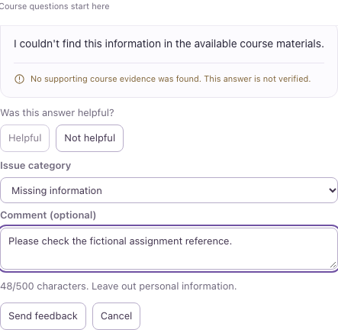
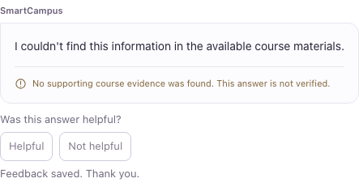
SmartCampus
05
Students can rate an assistant answer
Report an issue
After a real 201
One UUID per answer
Keeps source IDs and the draft across a retry.
70 browser checks
Feedback and chat regressions include retry, keyboard access and mobile layout.
CR-001 / Live React, FastAPI and SQLite / PR #19
Danaya 3:20–4:30
Notes:
Danaya · 3:20–4:30
The feedback controls appear when an assistant answer arrives, including a safe fallback answer. Helpful sends one request. Not helpful opens the form and focuses the category selector. The user chooses a category and may leave a short plain-text comment. The limit is 500 characters. In the live replay we submitted a helpful rating on one response and reported missing information on the next. Both requests reached FastAPI. We intentionally interrupted the second request before it reached the server. The UI showed a network error and kept the selected category and comment. Using the keyboard to send again reused the same UUID. The saved state in this image came after the API replied with HTTP 201. We also captured the form at 375 pixels.
https://github.com/yerassyl-clou/SmartCampus/pull/19

Slide 6
SmartCampus
06
Retrieval respects the named course
“When is the Human-Computer Interaction Assignment 2 due?”
[1, −1]
[ ]
Before
After
Database Systems sources were eligible for an HCI question.
No HCI assignment match. The API returns its safe fallback.
Integrated replay returned HTTP 200 with grounded=false and no sources.
SC-ISS-002 / Live FastAPI fallback and SQLite retrieval / PRs #13 and #14
Ratislav 4:30–5:45
Notes:
Ratislav · 4:30–5:45
The baseline question named Human-Computer Interaction and asked about Assignment 2. That course has no matching assignment. The older retriever admitted the Database Systems syllabus and deadline as candidates, with IDs one and minus one. The change recognizes a named course when the client has not supplied an explicit course ID. It scopes the candidate search to that course. On the integrated API, the same question returned HTTP 200 with grounded false and an empty source list. The Database Systems control still retrieved its own materials. The separate Groq suite verified actual source titles, IDs and exact phrases from the sample SQLite data. The API checks that the selected quotes occur in the retrieved excerpts before using them to answer.
https://github.com/yerassyl-clou/SmartCampus/pull/13
https://github.com/yerassyl-clou/SmartCampus/pull/14

Slide 7
SmartCampus
07
Feedback saves through a separate endpoint
React
FastAPI
SQLite
Rate one answer and keep its UUID
Validate POST /api/feedback
Commit one row per UUID
201 saved 422 invalid 409 duplicate 503 unavailable
Live browser run: two HTTP 201 responses. Both rows persisted across API restart. Duplicate and invalid requests added zero rows.
Route tests now exercise the production schema and storage helper.
CR-001-A academic decision / PRs #8, #15, #16, #19 and #20
Ratislav 5:45–7:15
Notes:
Ratislav · 5:45–7:15
The academic approval for CR-001 added anonymous answer feedback. React attaches a UUID version four to each received answer and keeps the source IDs with that answer. FastAPI validates the rating, category, UUID, source IDs and comment before the SQLite helper writes a row. A successful insert returns 201. Invalid input returns 422. The database uniqueness constraint makes concurrent duplicate submissions safe and returns 409 for a repeated UUID. A storage problem returns a controlled 503. We saw a schema collision when joining the API and persistence branches. Thirty-five route tests failed during setup because a test fixture tried to create the table again. The route suite now uses the production storage helper and the same seeded schema as the app. Both real browser submissions persisted after the API restarted. We queried SQLite to check their ratings, category, comment and source IDs, then repeated a UUID and checked that the original row stayed intact.
https://github.com/yerassyl-clou/SmartCampus/pull/8
https://github.com/yerassyl-clou/SmartCampus/pull/15
https://github.com/yerassyl-clou/SmartCampus/pull/16
https://github.com/yerassyl-clou/SmartCampus/pull/19
https://github.com/yerassyl-clou/SmartCampus/pull/20

Slide 8
SmartCampus
08
CR-001 adds 40 planned person-hours
Workload
Technical debt
10 h database / 8 h API
8 h frontend / 10 h QA
4 h contingency
P1
Seed resets fictional course tables
P1
Python dependency ranges lack a lockfile
P2
Shared CI checks are missing
Five working days. Separate feedback route and table preserve existing chat and dashboard contracts.
Change impact and technical debt / Gleb’s PR #20
Gleb 7:15–8:30
Notes:
Gleb · 7:15–8:30
The impact analysis covers one added feedback workflow. The chat and deadline response shapes stay compatible. The estimate allocates ten hours to the database, eight to the API, eight to the interface, ten to testing and four to contingency. This is a 40-hour workload with five working days from the simulated approval. The audit identified two high-priority debts. The seed intentionally resets the course fixtures, and the backend dependency ranges lack a lockfile. The additive feedback table can be applied without reseeding existing course rows. For our tests we used isolated databases. The storage check proved that a fresh seed and an upgrade preserve the expected data. We also recorded the lack of shared CI, so the defense evidence points to the actual executed local test logs.
https://github.com/yerassyl-clou/SmartCampus/pull/20

Slide 9
SmartCampus
09
The fictional offer totals $1,177
$1,177
Payment schedule
40% Written start
$470.80
Fixed implementation
40% Implementation review
$470.80
Illustrative labor of $1,070 plus $107 contingency.
20% Acceptance package
$235.40
Five days from approval. Fourteen-day warranty for in-scope defects after acceptance.
Written change approval and acceptance evidence govern additional scope. Hosting and API costs are separate.
Educational offer and unsigned contract / PR #20
Gleb 8:30–9:30
Notes:
Gleb · 8:30–9:30
The fictional offer and unsigned fixed-price contract use the same figures. Estimated labor costs 1,070 dollars, with 107 dollars of contingency. The total is 1,177 dollars for implementation. The payment schedule is 470 dollars and 80 cents at written start, the same amount at implementation review and 235 dollars and 40 cents at delivery of the acceptance package. The five working days start with approval. The provider supplies the UI, endpoint, storage, test evidence and handover. The client supplies access and reviews against the acceptance criteria. Further scope requires a written change approval, and the 14-day warranty covers in-scope defects. Hosting and API usage are separate from this price.
https://github.com/yerassyl-clou/SmartCampus/pull/20

Slide 10
SmartCampus
10
Submission and final QA
1–4
Test results, issue log, debt audit, two MVP fixes
5–9
Backlog, change request, impact, feedback feature, QA report
10–12
Commercial offer, fixed-price contract, defense deck
The integrated build passed both improvement replays and browser-to-SQLite feedback acceptance.
Submission matrix and review / SIS1011-08, -16 and -20
Yerassyl 9:30–10:00
Notes:
Yerassyl · 9:30–10:00
The submission checklist maps each of the twelve course outputs to its evidence. The integrated build reproduced and verified both improvement cases. The feedback workflow saved two distinct responses, recovered after a network error and retained both rows across an API restart. The team can show the actual product and explain the test evidence, the approved coursework change and the commercial assumptions.
https://github.com/yerassyl-clou/SmartCampus/pull/10
https://github.com/yerassyl-clou/SmartCampus/pull/11
https://github.com/yerassyl-clou/SmartCampus/pull/12

