Slide 1
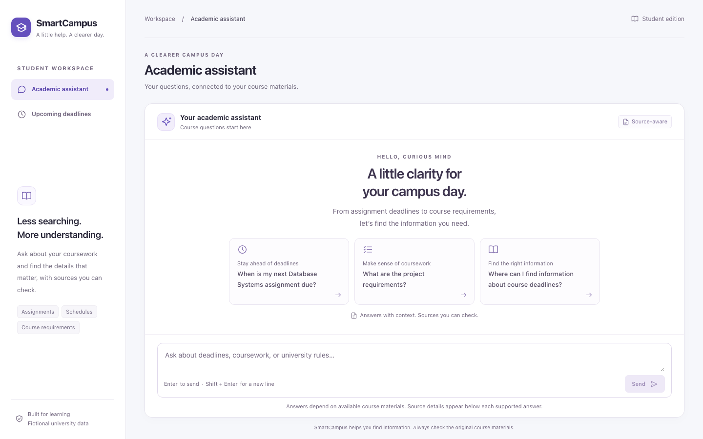
SmartCampus
01
SIS 10–11
SmartCampus
Product testing, improvements
and answer feedback
Yerassyl Babayev / Danaya Aliyeva
Ratislav Ovchinnikov / Gleb Yurtayev
SIS 10–11 defense / 10 November 2026 / Fictional course data
Yerassyl 0:00–0:35
Notes:
Yerassyl | 0:00–0:35
SmartCampus helps a student answer questions about courses and see due dates in one workspace. The baseline uses React, FastAPI and a fictional SQLite dataset. In this defense we will show the three tested product paths, the two defects we addressed, and the feedback change requested for the coursework scenario. Our evidence distinguishes the main baseline from feature branches and a separate combined checkout.
Source: https://github.com/yerassyl-clou/SmartCampus/pull/6

Slide 2
SmartCampus
02
Three product paths were tested
33
10/12
6/7
Chat checks
AI baseline probes
Dashboard UX cases
Intercepted HTTP: answer, sources, fallback, retry and keyboard.
Two failures exposed evidence from an unrelated course.
Live seeded records plus controlled loading and error responses.
Dashboard replay
Real Chromium, FastAPI and SQLite at 1440, 768 and 375 px. Refresh returned 200 at all three widths.
Baseline 42dcac9 / Evidence in PRs #6, #13 and #17
Yerassyl 0:35–1:30
Notes:
Yerassyl | 0:35–1:30
We pinned main at 42dcac9 so each finding has a reproducible baseline. Chat was checked for grounded answer, source display, and safe fallback. The retrieval probe checked whether candidates came from the named course. The dashboard used a real GET through FastAPI to SQLite to check six records, source labels, keyboard refresh and responsive layouts. The dashboard suite also used intercepted responses for loading and error states. Counts on this slide are separate test sets and must not be added together as a single total.
Sources: https://github.com/yerassyl-clou/SmartCampus/pull/6 https://github.com/yerassyl-clou/SmartCampus/pull/13 https://github.com/yerassyl-clou/SmartCampus/pull/17

Slide 3
SmartCampus
03
Three issues shaped the sprint
P1 SC-ISS-001
Expired work appeared under Upcoming deadlines. Dashboard fix in PR #18.
P1 SC-ISS-002
A named HCI query retrieved Database Systems evidence. Retrieval fix in PR #14.
P2 SC-ISS-003
A built-in chat prompt led to a dead end despite available course data. Deferred.
The first two issues affect which deadline or source a student trusts.
Prioritized issue log #7 / Updated stories and backlog #9
Yerassyl 1:30–2:15
Notes:
Yerassyl | 1:30–2:15
The issue log separates evidence, impact and priority. SC-ISS-001 makes expired assignments look actionable and was assigned to Danaya. SC-ISS-002 can return the wrong course as evidence, so Ratislav tightened retrieval scope. SC-ISS-003 is a discoverability problem in the suggested chat prompt. Its workaround is the dashboard or a supported direct question, so the team deferred that item. These priorities drove the backlog update. Danaya will show the dashboard retest using exactly the same seed and date.
Sources: https://github.com/yerassyl-clou/SmartCampus/pull/7 https://github.com/yerassyl-clou/SmartCampus/pull/9

Slide 4
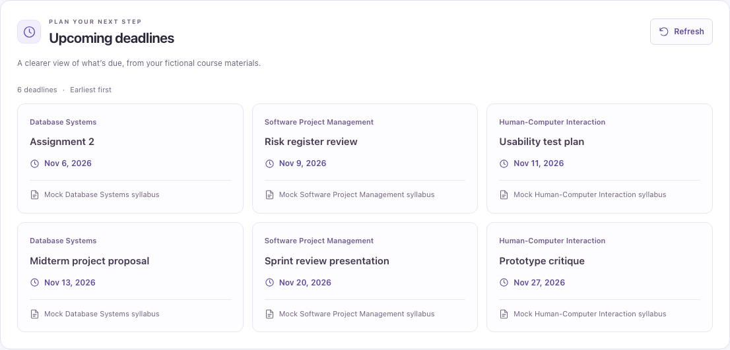
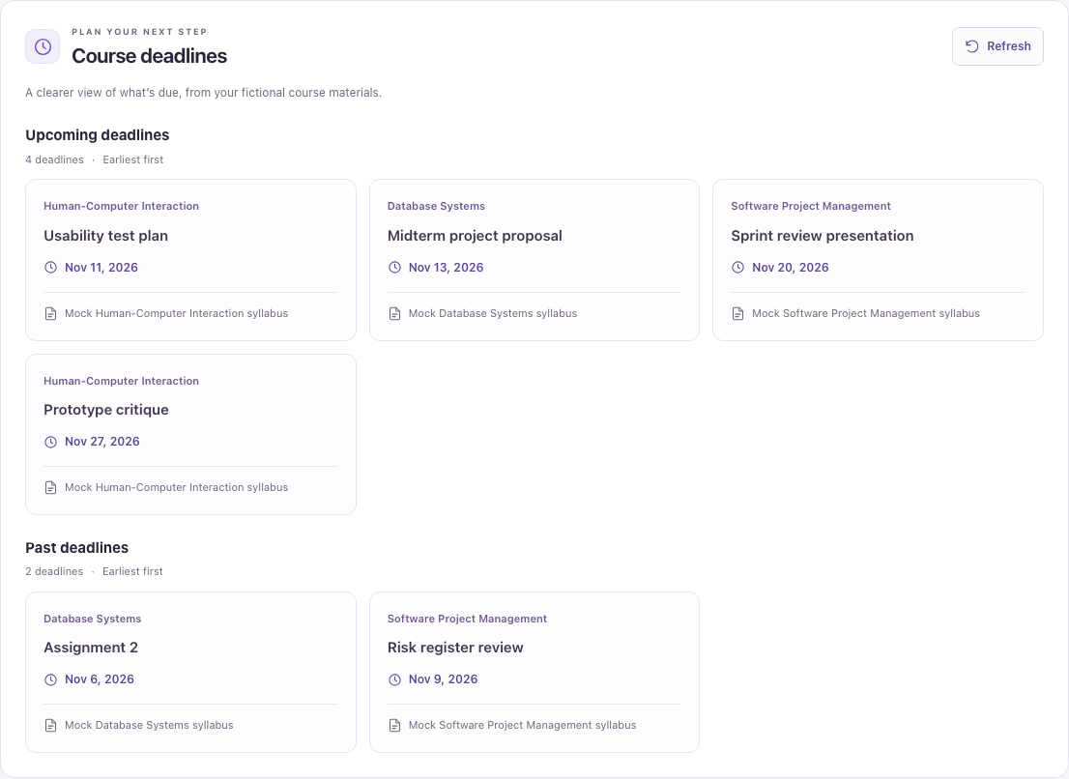
SmartCampus
04
Past deadlines now have their own section
Before / 2 expired records shown as upcoming
After / 4 upcoming and 2 past
SC-ISS-001 / Same seed and fixed campus date / PRs #17 and #18
Danaya 2:15–3:20
Notes:
Danaya | 2:15–3:20
Both images came from Chromium on 10 November, with the clock fixed to noon in Asia/Almaty and the same six records served by a real local API. Before, the November 6 and 9 dates appeared together with four upcoming dates. The fixed version compares date-only values against the campus calendar day and keeps today in the upcoming group. All six records and sources remain visible. Regression checks used yesterday, today and tomorrow even with the browser timezone set to Los Angeles. Build and 55 chat/dashboard checks passed. The seeded replay also checked keyboard refresh and three viewport widths.
Sources: https://github.com/yerassyl-clou/SmartCampus/pull/17 https://github.com/yerassyl-clou/SmartCampus/pull/18

Slide 5
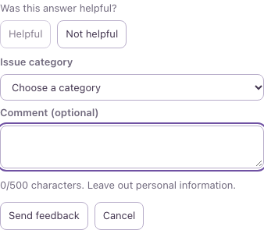
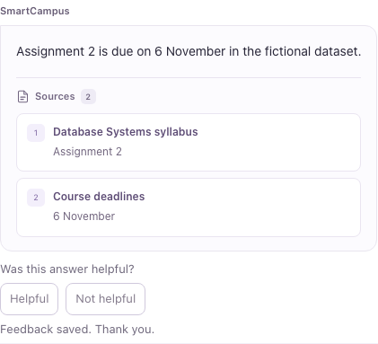
SmartCampus
05
Students can rate an assistant answer
Report an issue
After a real 201
One UUID per answer
Keeps source IDs and the draft across a retry.
66 browser checks
13 feedback, 33 chat and 20 dashboard checks with HTTP fixtures.
CR-001 / Actual React UI / PR #19 and combined branch evidence
Danaya 3:20–4:30
Notes:
Danaya | 3:20–4:30
The feedback buttons belong to a received assistant answer, including safe fallback answers. Helpful sends one request. Not helpful opens a category selector and a plain-text optional comment. The UI validates the 500-character limit and retains the draft if the service fails. Each answer has one UUID, so a retry keeps the same identity. The saved message on the right came from a real 201 in our combined local environment. The question and answer were seeded browser fixtures so the feedback test did not depend on a live language model.
Sources: https://github.com/yerassyl-clou/SmartCampus/pull/19 https://github.com/yerassyl-clou/SmartCampus/pull/15

Slide 6
SmartCampus
06
Retrieval respects the named course
“When is the Human-Computer Interaction Assignment 2 due?”
[1, −1]
[ ]
Before
After
Database Systems sources were eligible for an HCI question.
No HCI assignment match. The API returns its safe fallback.
85 backend tests passed on the retrieval branch. Independent integrated QA remains with SIS1011-08.
SC-ISS-002 / Isolated SQLite and mocked providers / PRs #13 and #14
Ratislav 4:30–5:45
Notes:
Ratislav | 4:30–5:45
The query was “When is the Human-Computer Interaction Assignment 2 due?” The HCI fixtures have no Assignment 2. Before the change, candidates 1 and minus 1 came from Database Systems and a mocked selector could turn them into a grounded reply. The fix finds explicit course names in the database and limits ranking to that course. The identical query now produces no candidates and the safe fallback with no source cards. The Database Systems control query still retrieves the relevant records. The regression suite failed five cases on baseline, then the full backend run passed 85 checks on the fix. The teammate probe reported twelve passes. No live Groq result is claimed.
Sources: https://github.com/yerassyl-clou/SmartCampus/pull/13 https://github.com/yerassyl-clou/SmartCampus/pull/14

Slide 7
SmartCampus
07
Feedback saves through a separate endpoint
React
FastAPI
SQLite
Rate one answer and keep its UUID
Validate POST /api/feedback
Commit one row per UUID
201 saved 422 invalid 409 duplicate 503 unavailable
Combined local run: 2 browser submissions, 2 rows after restart and reseed, 0 extra rows after duplicate and invalid requests.
Before merge: reconcile the route test fixture with the seeded feedback table.
CR-001-A academic decision / PRs #8, #15, #16, #19 and #20
Ratislav 5:45–7:15
Notes:
Ratislav | 5:45–7:15
The fictional Academic Services request adds answer quality signals without storing an identity or chat transcript. CR-001-A is an academic approval to implement. React sends a UUID version four, rating, optional issue details and signed source IDs. FastAPI validates the request before calling the SQLite store. The store commits one row per UUID. The route returns 201 when saved, 422 for validation, 409 for duplicates and a safe 503 if storage is unavailable. In the earlier route-only check we observed 503 and safe retry. With PR #20 added locally, browser Helpful and Not helpful both returned 201. The original rows survived backend restart and reseeding. The combined backend suite still needs a fixture update: the route test fixture recreates the table that the storage schema already creates. The unmodified suite had 35 setup errors. A local fixture-only experiment reached 118 passes. The independent acceptance run and merge review remain separate from this evidence.
Sources: https://github.com/yerassyl-clou/SmartCampus/pull/8 https://github.com/yerassyl-clou/SmartCampus/pull/15 https://github.com/yerassyl-clou/SmartCampus/pull/16 https://github.com/yerassyl-clou/SmartCampus/pull/19 https://github.com/yerassyl-clou/SmartCampus/pull/20

Slide 8
SmartCampus
08
CR-001 adds 40 planned person-hours
Workload
Technical debt
10 h database / 8 h API
8 h frontend / 10 h QA
4 h contingency
P1
Seed resets fictional course tables
P1
Python dependency ranges lack a lockfile
P2
Shared CI checks are missing
Five working days. Separate feedback route and table preserve existing chat and dashboard contracts.
Change impact and technical debt / Gleb’s PR #20
Gleb 7:15–8:30
Notes:
Gleb | 7:15–8:30
The change adds one optional feature, while leaving existing ChatResponse and the dashboard API unchanged. The impact analysis allocates ten hours to data, eight to API, eight to frontend, ten to QA and four to contingency. The five-day schedule is an educational estimate. The audit found two P1 debt items: the seed intentionally resets course fixtures and would be risky on a shared database, and Python dependency ranges make fresh installations less reproducible. Missing CI is a P2 follow-up. The additive feedback table survives reseeding, but that does not make the course reset safe for operational data.
Source: https://github.com/yerassyl-clou/SmartCampus/pull/20

Slide 9
SmartCampus
09
The fictional offer totals $1,177
$1,177
Payment schedule
40% Written start
$470.80
Fixed implementation
40% Implementation review
$470.80
Illustrative labor of $1,070 plus $107 contingency.
20% Acceptance package
$235.40
Five days from approval. Fourteen-day warranty for in-scope defects after acceptance.
Written change approval and acceptance evidence govern additional scope. Hosting and API costs are separate.
Educational offer and unsigned contract / PR #20
Gleb 8:30–9:30
Notes:
Gleb | 8:30–9:30
The illustrative fixed price is 1,070 dollars in assumed labor plus 107 dollars in contingency. The offer and contract use the same five-day timeline and payment milestones: 40 percent at written start, 40 percent at the implementation review, 20 percent at delivery of the acceptance package. The simulated provider supplies the UI, API, storage, test evidence and handover. The simulated client provides access, reviews acceptance and approves any change in writing. There is a 14-day in-scope warranty after acceptance. Hosting and API usage are separate. The historic subscription forecast is separate from the fixed price. These are coursework documents without signatures.
Source: https://github.com/yerassyl-clou/SmartCampus/pull/20

Slide 10
SmartCampus
10
Acceptance depends on independent QA
1–4
Test results, issue log, debt audit, two MVP fixes
5–9
Backlog, change request, impact, feedback feature, QA report
10–12
Commercial offer, fixed-price contract, defense deck
Next: replay both fixes, verify the combined feedback path, and record acceptance.
Submission matrix and review / SIS1011-08, -16 and -20
Yerassyl 9:30–10:00
Notes:
Yerassyl | 9:30–10:00
The package covers twelve required outputs. The issue log and backlog, the two product fixes, and the UI, route and storage are available for review. The combined checkout provides local evidence of saved feedback across restart and reseed. Next I will repeat the critical checks in the reviewed integration, confirm the submission matrix, and record final acceptance.
Sources: https://github.com/yerassyl-clou/SmartCampus/pull/10 https://github.com/yerassyl-clou/SmartCampus/pull/11 https://github.com/yerassyl-clou/SmartCampus/pull/12 https://app.clickup.com/t/z8q7hbuc8r

