Slide 1

DATA ANALYSIS
Movie Ticket Booking System
BY DIYA BALAJI YERFULE

Slide 2
OBJECTIVES : 1. to store movie details : we can quickly find information about any movie. 2 To maintain customer information : Helpful for booking history and communication. 3 To manage show timings and dates : users know when and where movies are available. 4 To record ticket bookings : Keeps track of seats booked by each customer. 5 To check seat availability easily : Prevents double booking and confusion.

Slide 3
Keywords : 1.Movie Database – Stores all movie information in one place. 2. Ticket Booking – Process of reserving seats for a movie show. 3.SQL Queries – Commands used to retrieve and manage data. 4. Customers – Users who book movie tickets. 5. Show Timings – Date and time when a movie is shown.

Slide 4
SQL QUERIES

Slide 5
CREATE DATABASE MovieBookingSimple; USE MovieBookingSimple; CREATE TABLE Movie ( movie_id INT PRIMARY KEY AUTO_INCREMENT, title VARCHAR(100), genre VARCHAR(50), duration INT ); CREATE TABLE Customer ( customer_id INT PRIMARY KEY AUTO_INCREMENT, name VARCHAR(100), email VARCHAR(100), phone VARCHAR(15)); CREATE TABLE ShowDetails ( show_id INT PRIMARY KEY AUTO_INCREMENT, movie_id INT, show_time VARCHAR(50), show_date DATE, FOREIGN KEY (movie_id) REFERENCES Movie(movie_id)); CREATE TABLE Booking ( booking_id INT PRIMARY KEY AUTO_INCREMENT, customer_id INT, show_id INT, seats INT, FOREIGN KEY (customer_id) REFERENCES Customer(customer_id), FOREIGN KEY (show_id) REFERENCES ShowDetails(show_id));

Slide 6
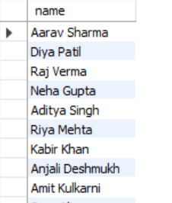
1. WAQTD all names from customer data select name from customer;

Slide 7
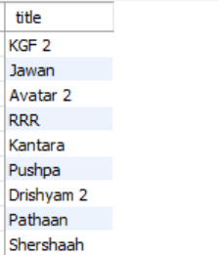
2. WAQTD all Action Movies select title from movie;

Slide 8
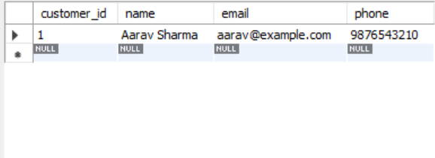
3. WAQTD customers whose name is 'Aarav Sharma'. (USING WHERE CLAUSE) select * from customer where name = 'Aarav Sharma';

Slide 9
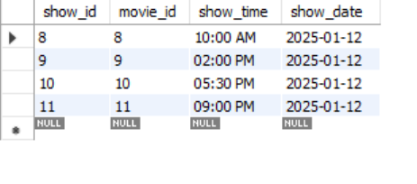
4. WAQTD shows happening on 2025-01-12. select * from ShowDetails where show_date = '2025-01-12';

Slide 10
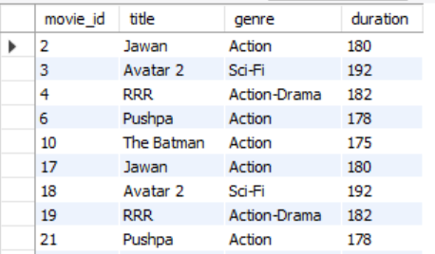
5. WAQTD movies longer than 170 minutes. select* from Movie where duration > 170;

Slide 11
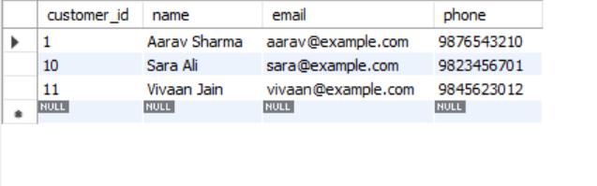
6. Customers with phone number starting with '98'. (Special Operators) select * from customer where phone like '98%';

Slide 12
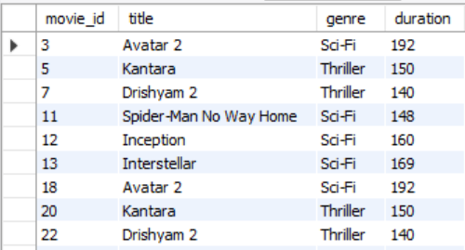
7. WAQTD movies where genre is Sci-Fi or Thriller. select* from movie where genre IN('Sci-fi' , 'Thriller');

Slide 13
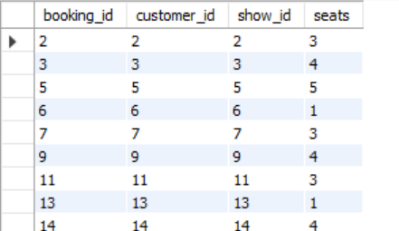
8. WAQTD Show bookings where seats are NOT 2. select * from booking where seats NOT IN (2);

Slide 14
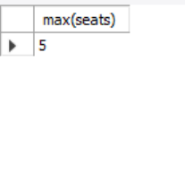
9. WAQTD Maximum seats booked in any booking. select max(seats) from booking;

Slide 15
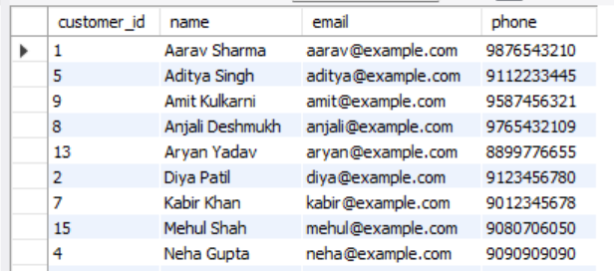
10, WAQTD customers ordered by name alphabetically. (order by clause) select * from customer order by name asc;

Slide 16
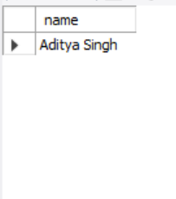
11. WAQTD Find customers who booked show_id = 5. (Sub queries) select name from customer where customer_id = (select customer_id from booking where show_id = '5');

Slide 17
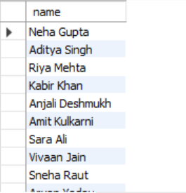
12. WAQTD the customer name who booked more than 3 seats select name from customer where customer_id IN ( select customer_id from booking wherecustomer_id > 3 );

Slide 18
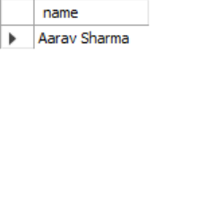
13. WAQTD the name of the customer who has booking_id = 1. select name from customer where customer_id = (select customer_id from booking where customer_id = 1);

Slide 19
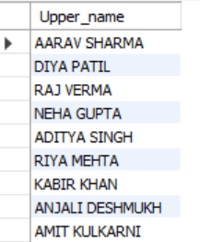
14.WAQTD customer names in UPPERCASE . selectupper(name) AS Upper_name from customer;

Slide 20
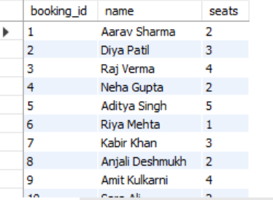
15. WAQTD booking details with customer names. SELECT Booking.booking_id, Customer.name, Booking.seatsFROM BookingJOIN Customer ON Booking.customer_id = Customer.customer_Id;

