Slide 1
Ch. 2
Introduction to Meta‐Heuristic
& Evolutionary Algorithms

Slide 2
INDEX
Finding optimum method
Elements & Principles
Convergence

Slide 3
Finding optimum method
Trial-and-Error Search
(1) sampling grid
- evaluating all possible solutions
- relatively small problems only
(2) random sampling
- possible solutions are chosen randomly
- The best solution among the chosen possible solutions -> the optimum.
(3) targeted sampling
- basis of meta-heuristic & evolutionary algorithm
- learning about previous solutions
- focuses in decision space with high probability
Not efficient or practical
No learning about previous search
For Complex problems

Slide 4
Finding optimum method
Meta-heuristic & Evolutionary :
never guarantee to find optimal,
but guarantee to find near- optimal

Slide 5
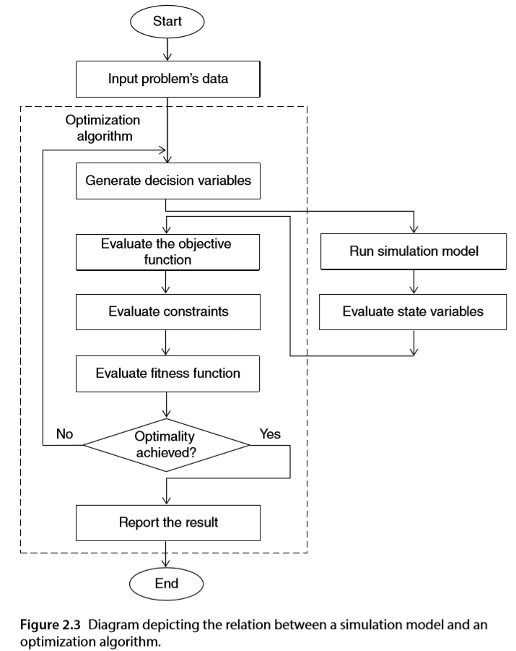
2. Elements & Principles

Slide 6
2. Elements & Principles
generates random values
of the decision variables
→ the uniform distribution is widely applied

Slide 7
2. Elements & Principles
Simulation Model:
evaluates the values of the state variables in response to the values of the decision variables

Slide 8
2. Elements & Principles
To avoid infeasible decision variables:
Removal Method
Refinement Method
Penalty Function

Slide 9
2. Elements & Principles
When the algorithm employs
a transformed form of the objective function:
→ Fitness function
= Penalized objective function

Slide 10
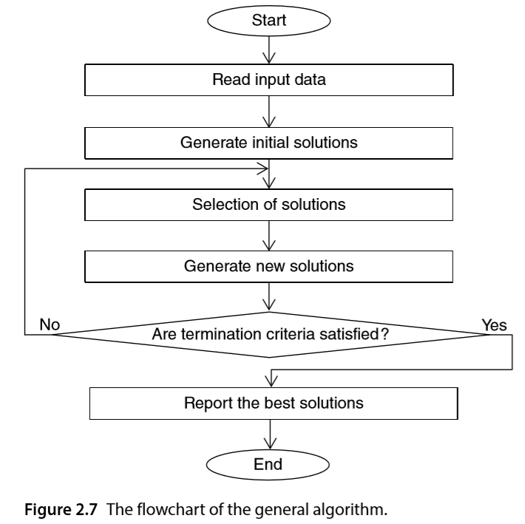
2. Elements & Principles
Termination Criteria
The number of iterations
Threshold of improvement
The run time

Slide 11
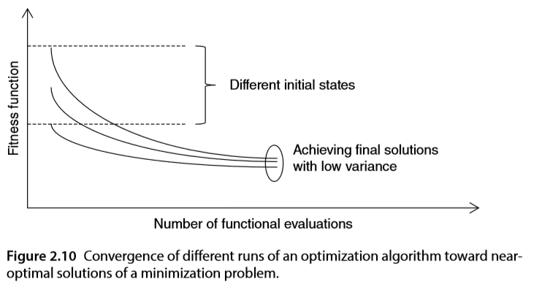
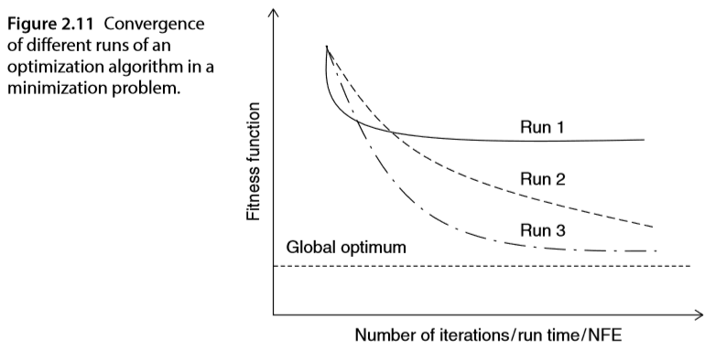
3. Convergence

Slide 12
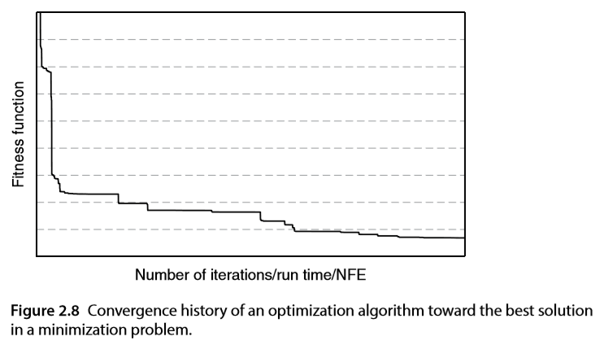
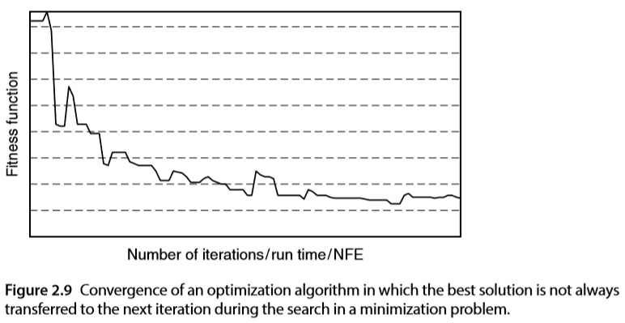
3. Convergence
The convergence of an algorithm
→ traced by graphing
Number of Functional Evaluations (NFE)
= # of evaluations of the fitness function
→ to measure the speed

Slide 13
Thank You!

