Slide 1
Ch. 4
Genetic Algorithm

Slide 2
Index
Basic Idea
Algorithm Overview
Creating an Initial Population
Selection of Parents
Reproduction
Code for TSP problem – 124 cities
Limitations of GA

Slide 3
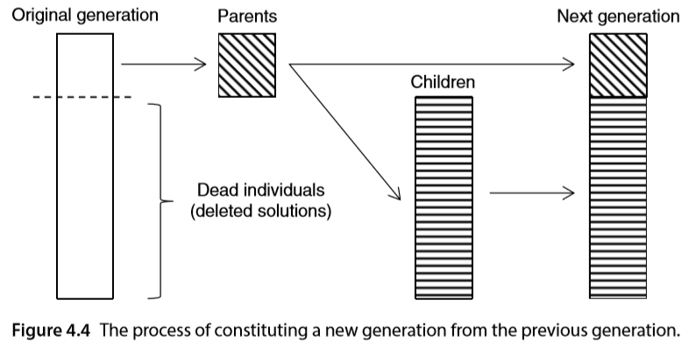
1. Basic Idea
Genetic Algorithm
Basic Idea
→Darwinian principle of survival of the fittest among organisms
→ their offspring may inherit their traits genetic mutations occur randomly

Slide 4
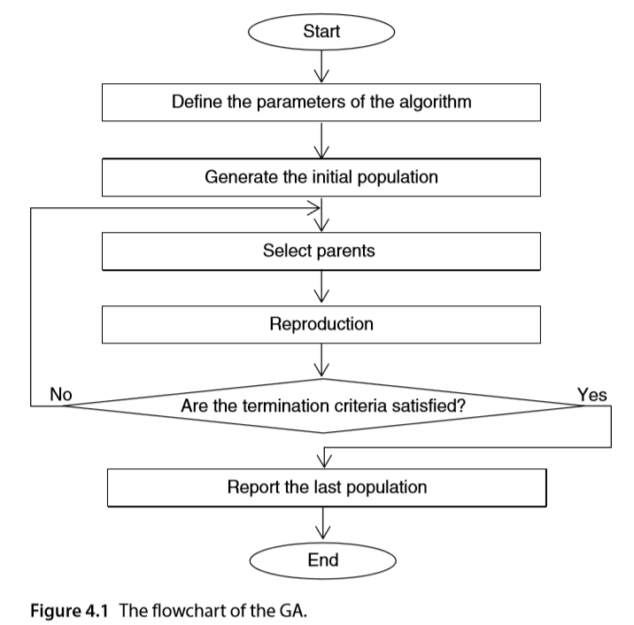
2. Algorithm Preview

Slide 5
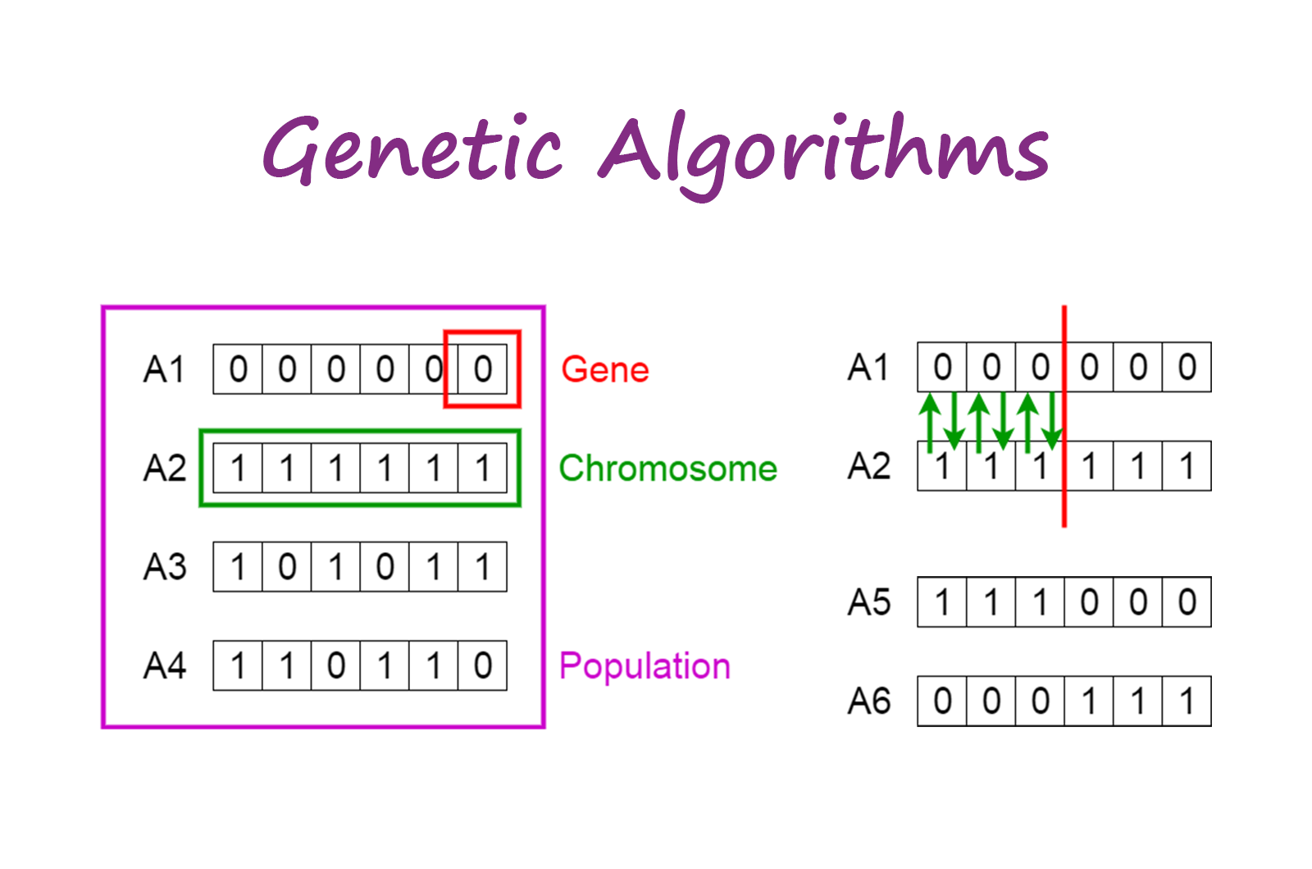
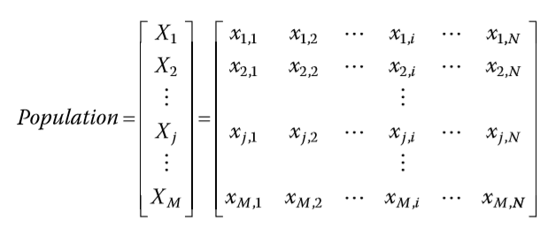
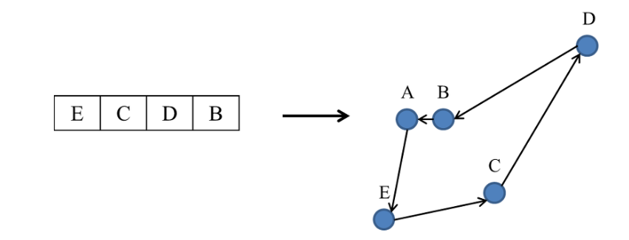
3. Creating an Initial Population

Slide 6
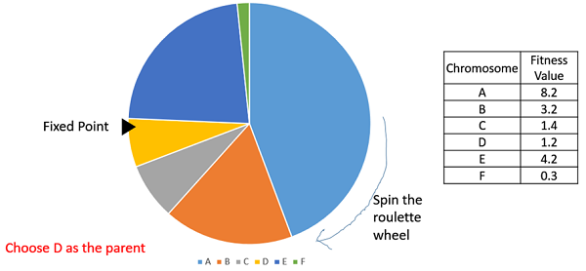
4. Selection of Parents
4-1) Proportionate Selection
-> Roulette Wheel Selection
※ fitness proportionate selection methods don’t work for cases where the fitness can take a negative value

Slide 7
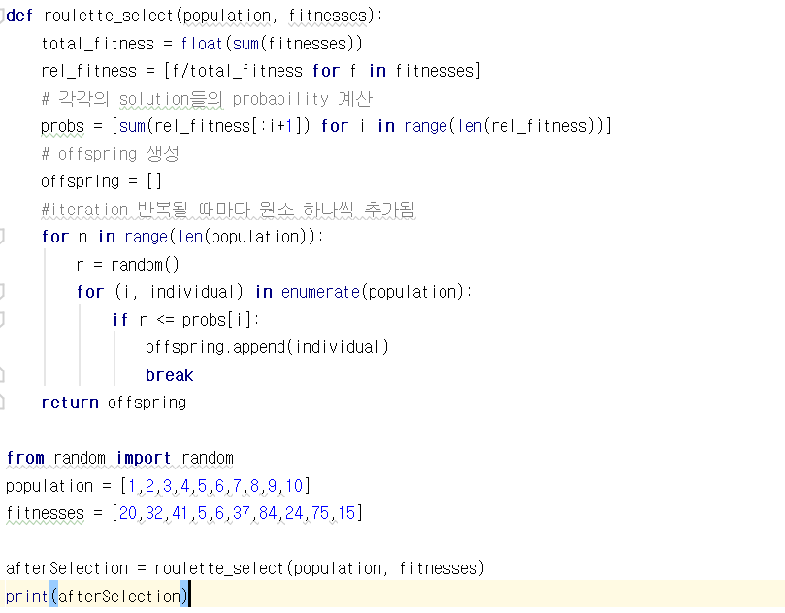
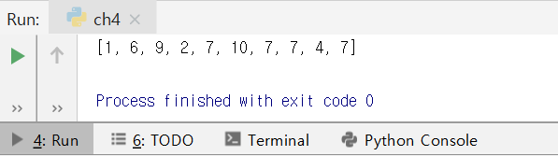
4. Selection of Parents
4-1) Proportionate Selection
-> Roulette Wheel Selection
individual | fitness
1 | 20
2 | 32
3 | 41
4 | 5
5 | 6
6 | 37
7 | 84
8 | 24
9 | 75
10 | 15
individual | fitness | # of pop
7 | 84 | 4
9 | 75 | 1
3 | 41
6 | 37 | 1
2 | 32 | 1
8 | 24
1 | 20 | 1
10 | 15
5 | 6
4 | 5 | 1

Slide 8
4. Selection of Parents
4-1) Proportionate Selection
- Selection Error
※ doesn’t work when the fitness can take a negative value.
Premature convergence of GA <- large differences between the fitness function value
Stagnation <- small differences between the fitness function value
Scaling Functions
Linear scaling
Sigma truncation
Power law scaling
Logarithmic scaling
Boltzmann selection

Slide 9
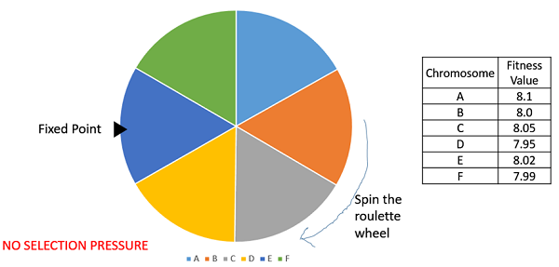
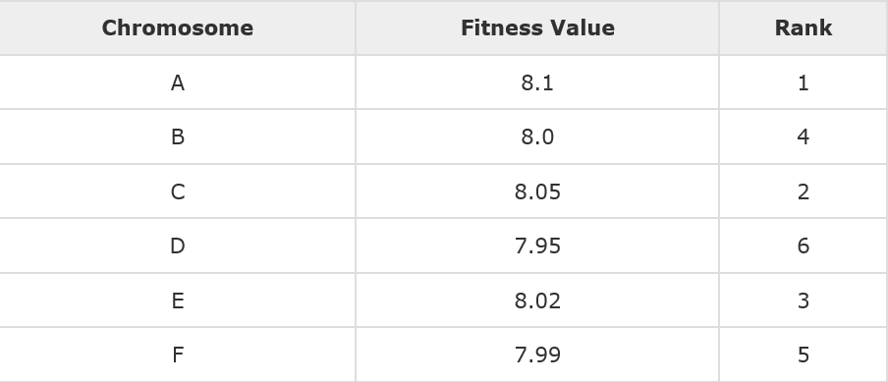
4. Selection of Parents
4-2) Ranking Selection
When having very close fitness
-> a loss in the selection pressure towards fitter individuals
-> Ranking Selection is mostly used
(this happens usually at the end of the run)
※ works with negative fitness values

Slide 10
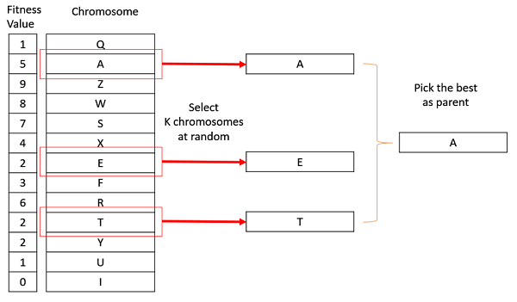
4. Selection of Parents
4-3) Tournament Selection
select K individuals at random with uniform distribution
-> select the best out of these
※ works with negative fitness values.

Slide 11
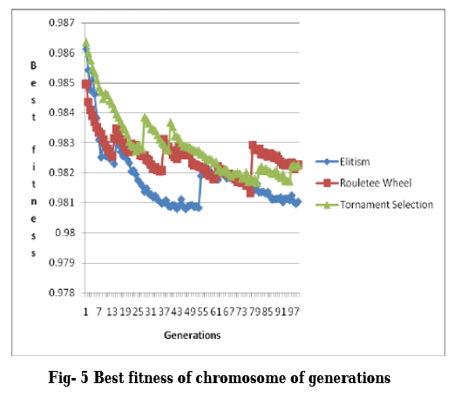

Slide 12
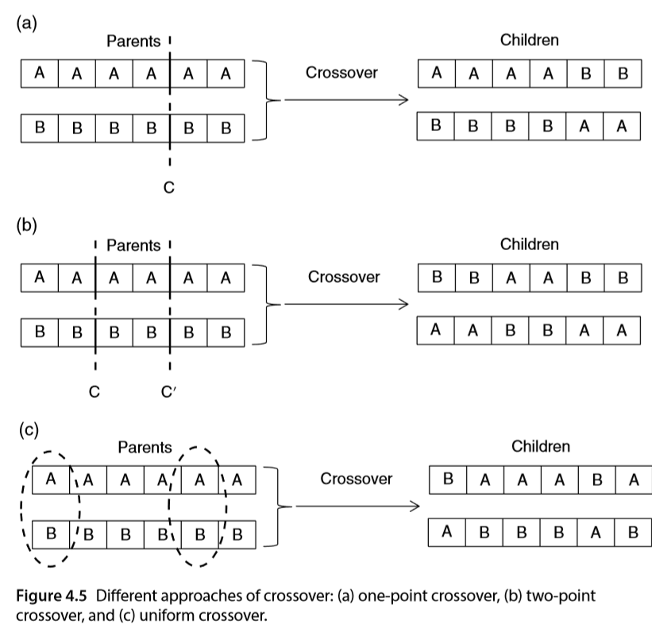
5. Reproduction
5-1) Crossover
chosen pairwise with the uniform distribution

Slide 13
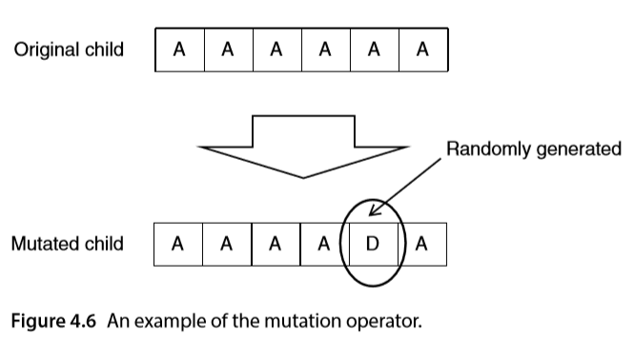
5. Reproduction
5-2) Mutation

Slide 14
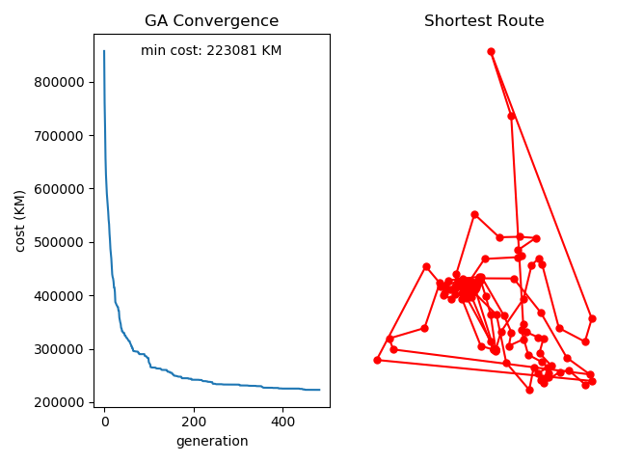
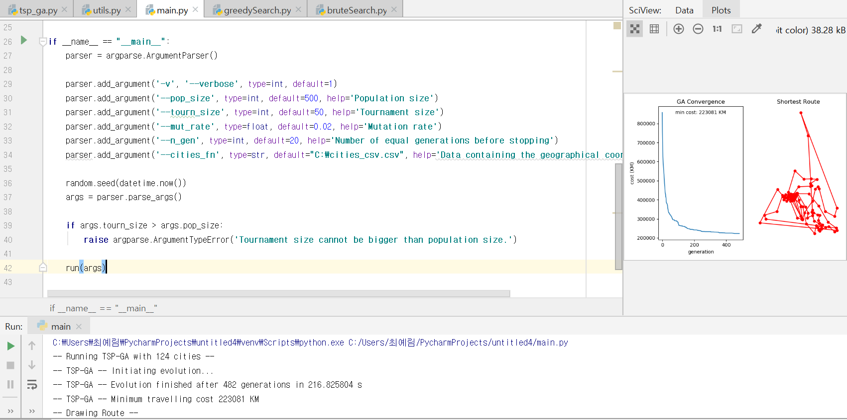
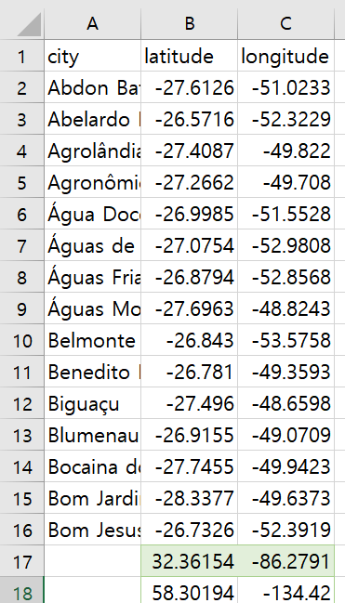
6. Code for TSP problem – 124 cities, GA Algorithm

Slide 15
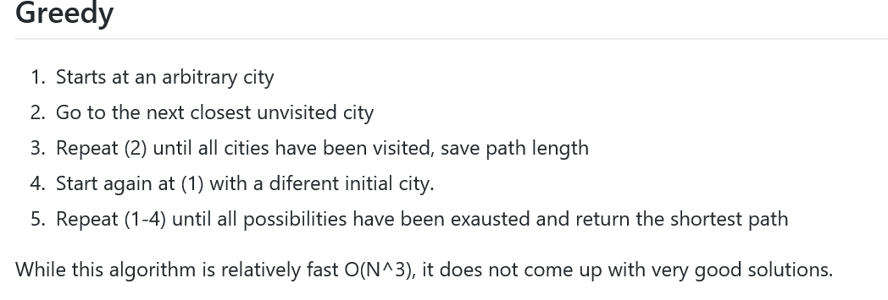
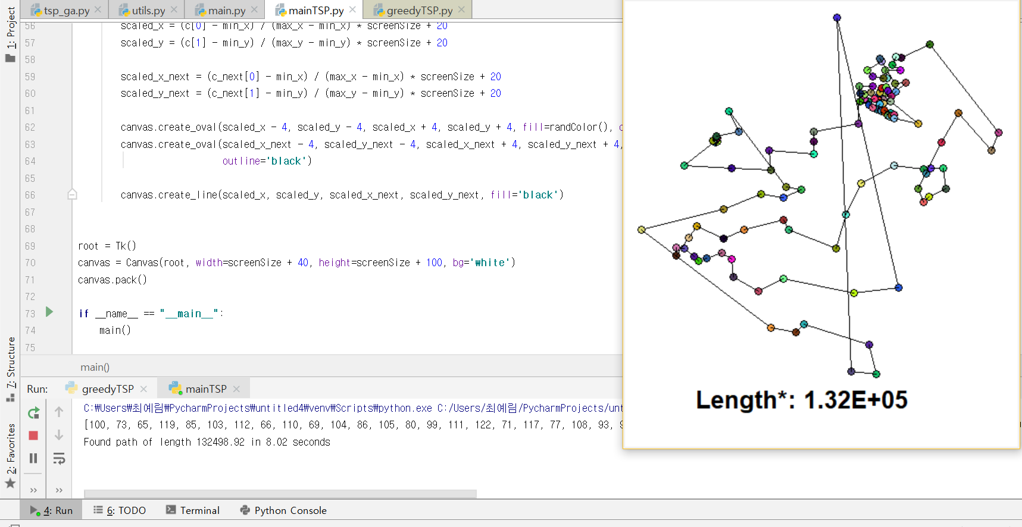
6. Code for TSP problem – 124 cities, GreedySearch Algorithm

Slide 16

6. Code for TSP problem – 124 cities
GA Algorithm
223081km, 216s
Greedy Algorithm
132498km, 8.02s

Slide 17
7. Limitations of GA
Highly dependent on initial value
The probability of crossover, selection, mutation
Unguided mutation
Often wait days for solution

