Slide 1
Fault Localization Algorithms Group 23
SARTAYEVA Yerkezhan, 16094821d
ZHANG Ziwei, 15103037d
HO Tin Yau 15070597d

Slide 2
Contents
Coverage Matrix Generation
Tarantula
Crosstab
BPNN
Analysis
Contributions
Demo
Reference

Slide 3
Coverage Matrix Generation

Slide 4
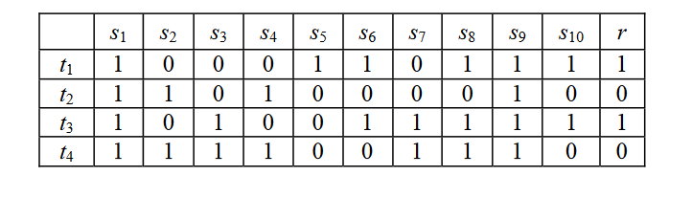
Coverage matrix
All of the three programs share the same format of coverage matrix
A Sample Coverage Matrix [4]

Slide 5
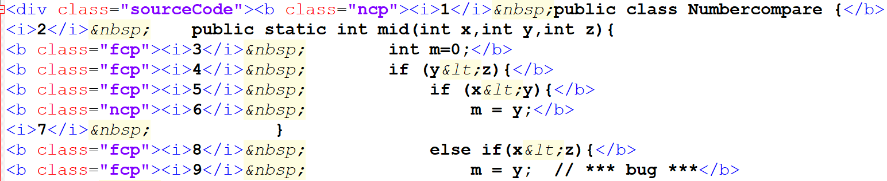
Coverage matrix Generation
Add “p” in the class label of the html file to denote a passed test case
HTML Coverage Result

Slide 6
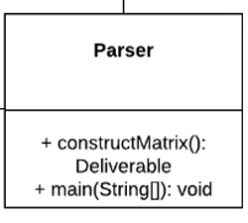
Coverage matrix Generation
Some lines without the <class> label (e.g. function name) are ignored
The parser output is the coverage matrix together with the line number
HTML Coverage Result

Slide 7
tarantula

Slide 8

theory
Variable | Description
s | A statement in the source code
passed(s) | The number of passed test cases (with correct output) that covered s
totalpassed | The total number of passed test cases
failed(s) | The number of failed test cases (with incorrect output) that covered s
totalfailed | The total number of passed test cases
hue(s) | Hue ranges between 0 and 1. A lower hue indicates that s it is not covered by many passed cases. Therefore, the lower the hue, the higher the suspiciousness.
$suspiciousness\left(s\right)=1− hue\left(s\right)$
$hue\left(s\right)= \frac{\frac{passed\left(s\right)}{totalpassed}}{\frac{passed\left(s\right)}{totalpassed}+ \frac{failed\left(s\right)}{totalfailed}}$

Slide 9
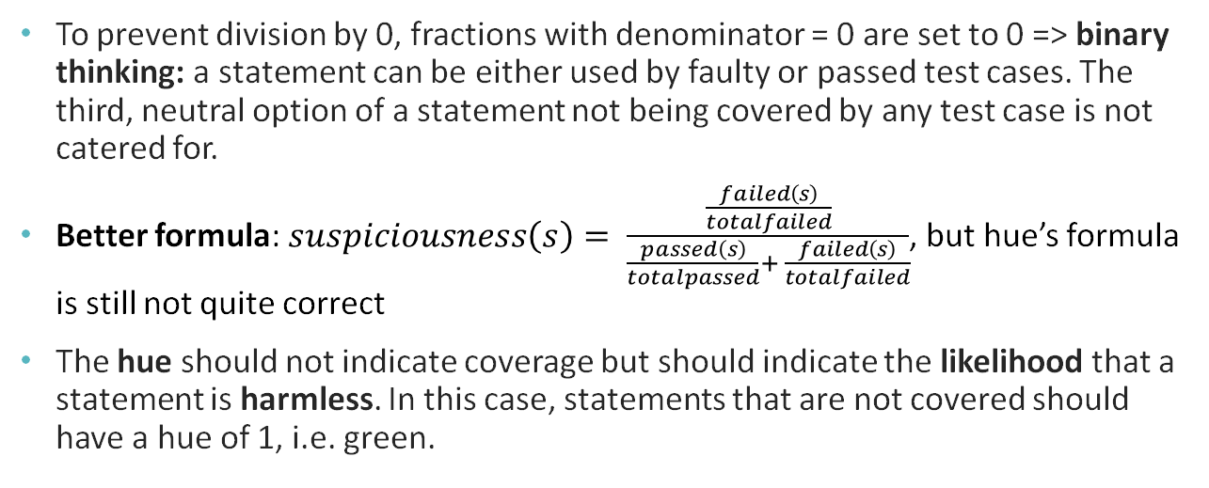
theory
To prevent division by 0, fractions with denominator = 0 are set to 0 => binary thinking: a statement can be either used by faulty or passed test cases. The third, neutral option of a statement not being covered by any test case is not catered for.
Better formula: $suspiciousness\left(s\right)= \frac{\frac{failed\left(s\right)}{totalfailed}}{\frac{passed\left(s\right)}{totalpassed}+ \frac{failed\left(s\right)}{totalfailed}}$, but hue’s formula is still not quite correct
The hue should not indicate coverage but should indicate the likelihood that a statement is harmless. In this case, statements that are not covered should have a hue of 1, i.e. green.

Slide 10
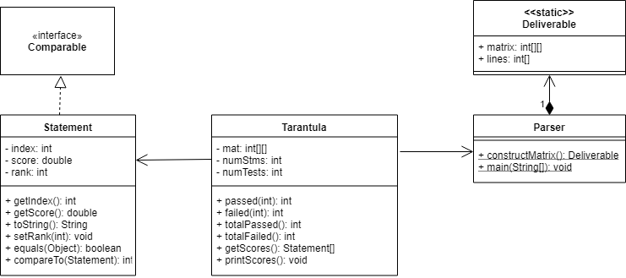
implementation

Slide 11
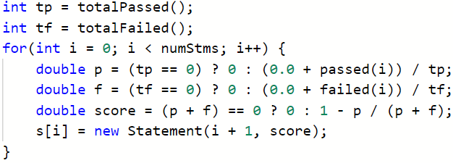
(1) Calculate suspicion scores
The Statement class stores the rank, the suspiciousness score and the index to facilitate sorting

Slide 12
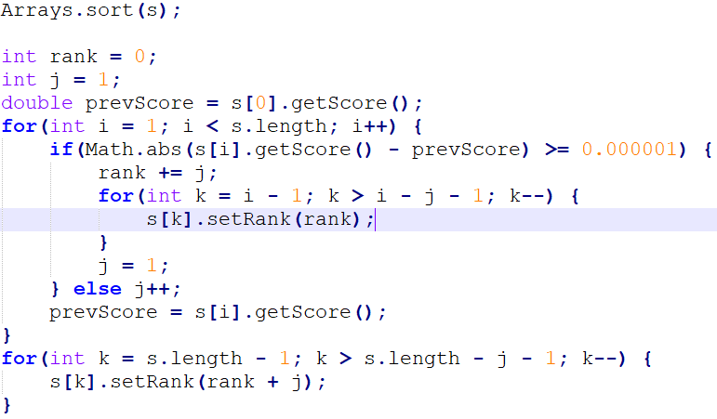
(2) sort and rank
(1) Sort by suspicion scores
(2) Rank as in the paper

Slide 13
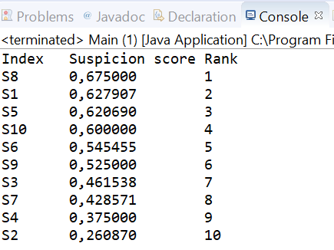

Output (crosstab matrix)
Different ranks for different suspicion scores

Slide 14
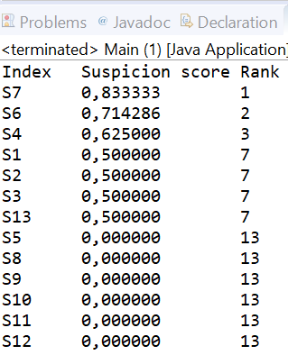
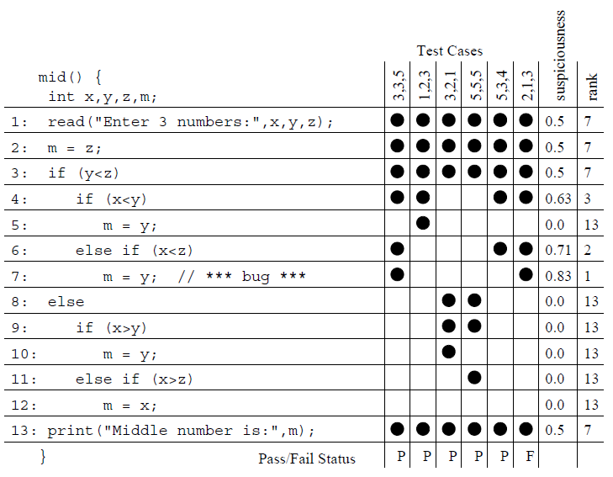
Output (tarantula matrix)
Same rank for statements with the same suspiciousness

Slide 15
Crosstab

Slide 16

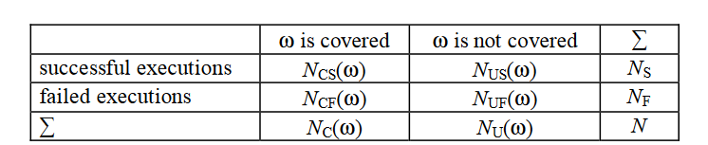
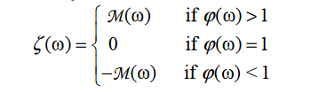
theory
The Chi-square statistics [4]
The Contingency Coefficient [4]
The Suspiciousness [4]
The Crosstab for a Statement [4]

Slide 17
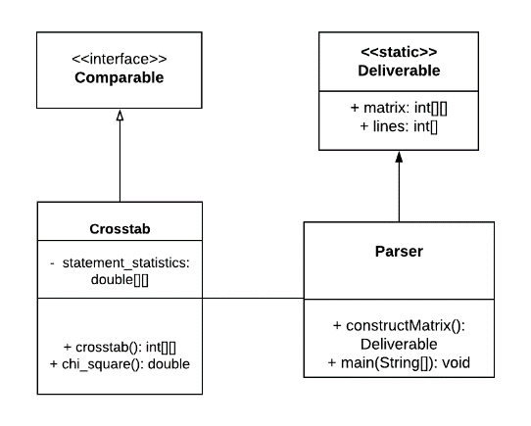
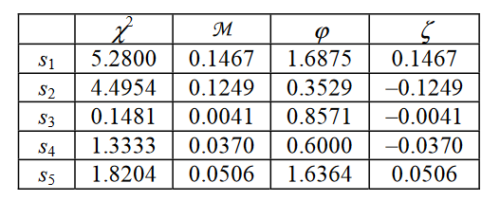
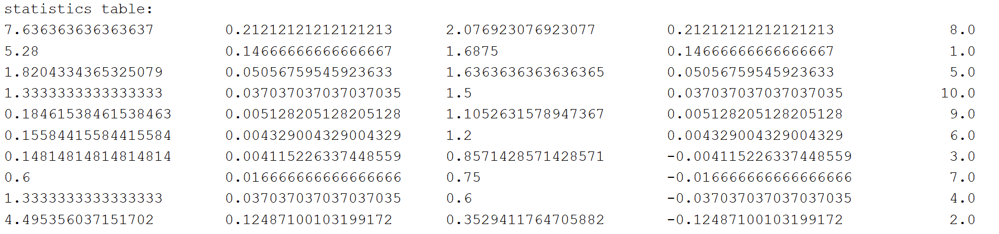
IMPLEMENTATION
Statement Statistics [4]
UML Class Diagram of the Crosstab Module
The Sample Output of Crosstab

Slide 18
bpnn

Slide 19
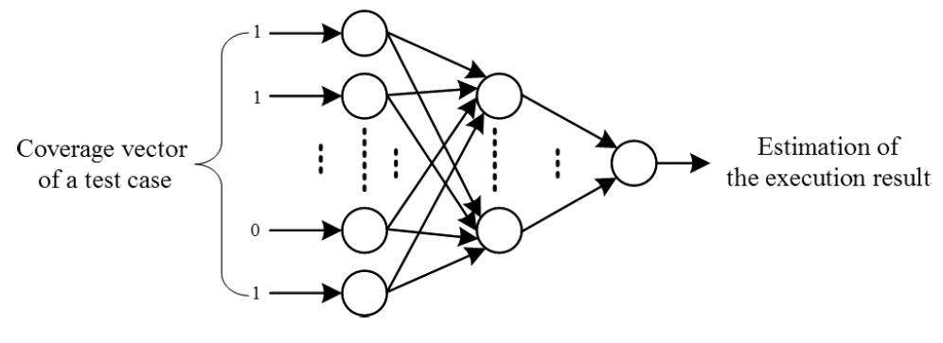
Neural network structure
Find the relationship between input and output as a function x → y by reducing error through repetition
Output Layer
Hidden Layer
Input Layer

Slide 20
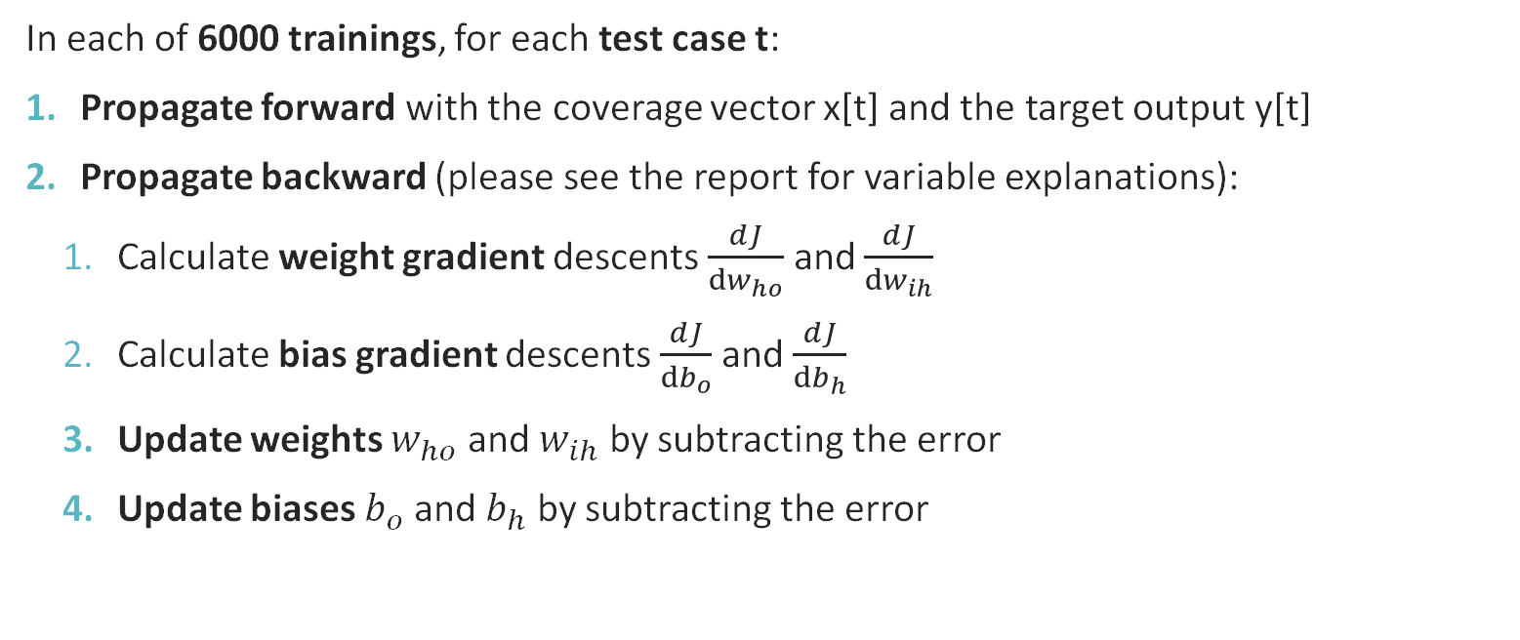
training
In each of 6000 trainings, for each test case t:
Propagate forward with the coverage vector x[t] and the target output y[t]
Propagate backward (please see the report for variable explanations):
Calculate weight gradient descents $\frac{dJ}{dw_{ho}}$ and $\frac{dJ}{dw_{ih}}$
Calculate bias gradient descents $\frac{dJ}{db_{o}}$ and $\frac{dJ}{db_{h}}$
Update weights $w_{ho}$ and $w_{ih}$ by subtracting the error
Update biases $b_{o}$ and $b_{h}$ by subtracting the error

Slide 21
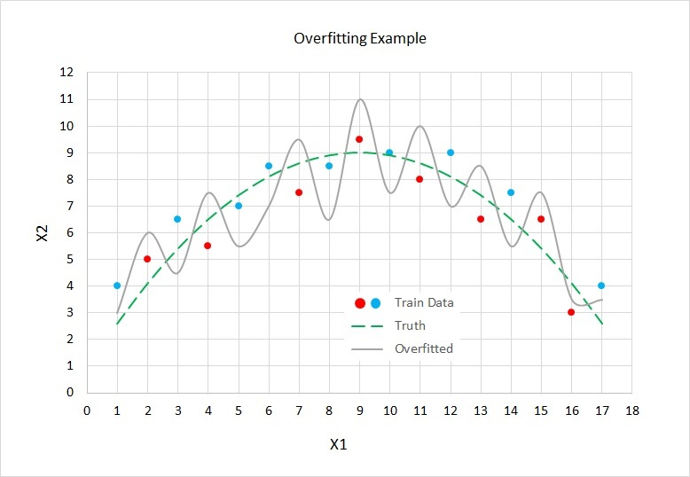

Over-fitting
L2 Regularisation
$\frac{dJ}{dw_{ij}}=−\left(y_{j}−{out}_{j}\right)∗{out}_{j}∗\left(1−{out}_{j}\right)∗{out}_{i}+ λ∗ w_{ij}$

Slide 22
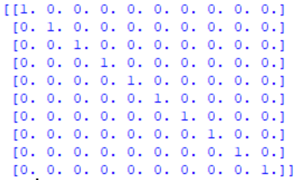
How to get Suspicion scores?
After training, feed an identity matrix of size m * m to the model (m = number of statements)
Identity matrix is an unrealistic coverage matrix, in which for a test case i, statement i is faulty

Slide 23
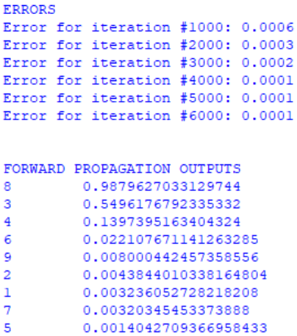
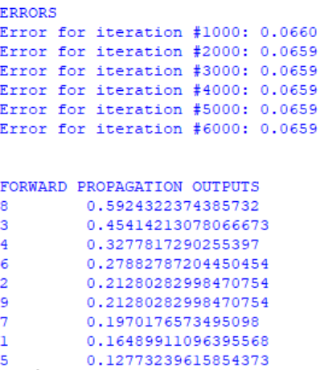
output
Without L2
With L2
The higher the score, the more suspicious the statement is
Low error

Slide 24
Evaluation and Analysis

Slide 25
Test program
We wrote a simple program that provides certain information about a year, e.g. whether it is a leap year, whether it is in the future, etc. The source code is provided in the report for reference
Many if statements, no loops for more representative coverage

Slide 26

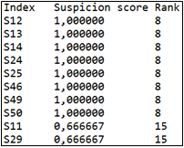
Assessment Criteria
Let X_{algorithm} be the score reflecting the performance of a fault localisation algorithm, where n is the total number of statements and b is the order number of the faulty statement. It reflects the percentage statements that need to be checked before the bug
For example, consider the output one the right:
Suppose the bug is at line 13, so b = 2 because statement 13 is in the second place.
If n = 50, then Xalgorithm= (2−1)/50= 2%.
That means that the lower Xalgorithm is, the better the algorithm performs.

Slide 27
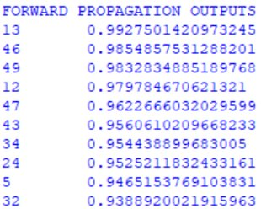

Analysis 1: 1 BUG
Bug at line 13
6 test cases were generated randomly(random years between 1850 and 2050)
$X_{BPNN} = 0\%$
$X_{Tarantula} =2\%$

Slide 28
Analysis 1: 1 BUG
In the below experiments, 100 test cases are used
BPNN performs worse than Tarantula in this particular case.
Position | X_{Tarantula} | X_{BPNN}
#40 | 0% | 10%

Slide 29
Analysis 2: More THAN 1 BUG
2/3 bugs are considered.
In the two-bug case, the bugs are located at statement 13 and 22. The X score is denoted by the number of statements has to be examined before finding both of the bugs.
X_{Tarantula} = 64% and X_{BPNN} = 56%

Slide 30
Analysis 2: More THAN 1 BUG
3/3 bugs are considered.
In the three-bug case, the bugs are located at statement 13, 22 and 40.
X_{Tarantula} = 82% and X_{BPNN} = 56%
BPNN performs better in terms of multiple bugs.

Slide 31
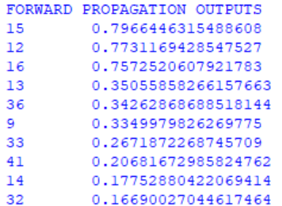
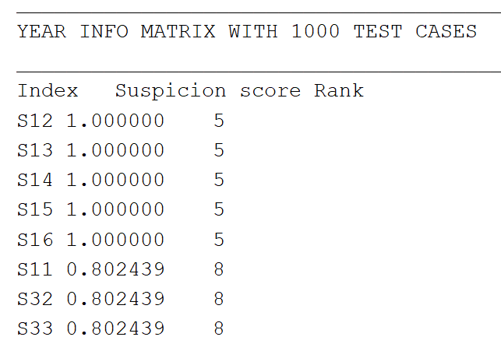
Analysis 3: More TEST CASES
In this part, we use 1000 test cases and the bug is located at statement 13.
X_{Tarantula} = 2% and XBPNN = 6%.
When increasing no of test cases, Tarantula performs significantly better than BPNN.

Slide 32
Analysis 4: ADJUSTING THE NO. OF FAILED CASes
X_{algorithm} (%)
Define RF as the proportion of failed test cases in the coverage matrix, i.e. if RF = 1/3, then 33.3% of test cases are failed.
RF * 10 (%)

Slide 33
Contributions
Yerkezhan Sartayeva, 16094821d
Test program (information about a year, implementation)
BPNN (implementation + report + presentation)
Tarantula (implementation + report + presentation)
Analysis (sections 6.1 and 6.5 + presentation)
Demo code preparation
ZHANG Ziwei, 15103037d
Crosstab (implementation + report + presentation)
Coverage Matrix Generation (implementation + report + presentation)
Comparison of BPNN and Tarantula (report + presentation)
HO Tin Yau, 15070597d
Evaluation and Analysis(Report + Presentation)

Slide 34
Reference
[1] J. A. Jones and M. J. Harrold, "Empirical evaluation of the tarantula automatic fault- localization technique," presented at the Proceedings of the 20th IEEE/ACM international Conference on Automated software engineering, Long Beach, CA, USA, 2005.
[2] W. E. Wong and Y. U. Qi, "BP Neural Network-based Effective Fault Localization," International Journal of Software Engineering and Knowledge Engineering, vol. 19, no. 04, pp. 573-597, 2009/06/01 2009.
[3] J. McCaffrey. (2017). Neural Network L2 Regularization Using Python. Available: https://visualstudiomagazine.com/articles/2017/09/01/neural-network-l2.aspx
[4] W. E. Wong, T. Wei, Y. Qi, and L. Zhao, A Crosstab-based Statistical Method for Effective Fault Localization. 2008, pp. 42-51.
[5] M. Mazur. (2015). A Step by Step Backpropagation Example. Available: https://mattmazur.com/2015/03/17/a-step-by-step-backpropagation-example/
[6] J. McCaffrey. (2017) Neural Network Back-Propagation Using Python. Visual Studio Magazine. Available: https://visualstudiomagazine.com/Articles/2017/06/01/Back- Propagation.aspx?Page=1
[7] ‘Chi-squared distribution’. Wikipedia. Available: https://en.wikipedia.org/wiki/Chi- squared_distribution#/. Accessed: 28 November 2018.

Slide 35
Demo

