Slide 1



Text & Image Parsing
Google NLP or Image Processor
Sentiment Analysis & Processing
Web Source
Download
Input Parameter (Company, Time Frame)
Correlation and Visualization
Market Data Processing
Stock Market
Data Download

Slide 2
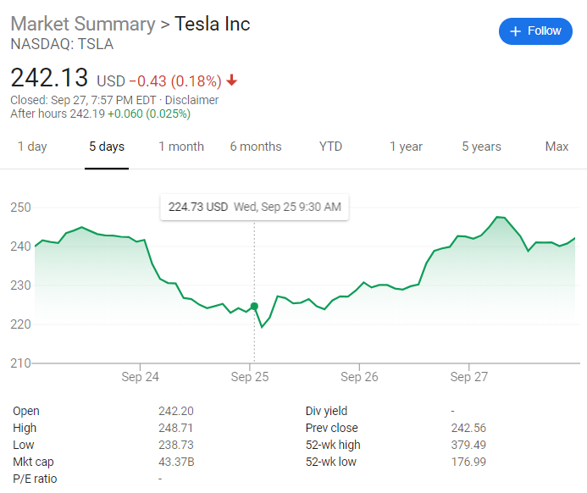
Can Twitter Help Investors Predict the Value of a Company’s Stock?
A Boston University team aims to find out
With Twitter users generating ample data during a day on multiple topics, the team mines such data, with mentions of a specific company. The sentiment of these tweets is then correlated to the closing value of a stock by day.
Shareholders and company executives may then be able to predict if dissatisfaction affects the value of their company and holdings
TESLA INC. Closing Value per Share as of 27 September 2019

Slide 3



Natural Language Processor
Stock Market
Data Download
Web Source
Download
Where?: Twitter
What?: #hashtag mentions of company, e.g. Tesla
Why?: More than 1 billion Twitter users – large source of data
Where?: Google
What?: Score of the general sentiment of data acquired from Twitter users
Why?: Google’s machine learning model is efficient at analyzing English text
Where?: Alpha Vantage
What?: Stock Market Data for any company since 2002
Why?: Time series data from AV provides snapshots like average, open, close, low and high stock value for any listed company

Slide 4
How To Use:
Need:
Company name and stock market abbreviation
Date range for needed analysis

Slide 5
Lessons Learned
Open-source API’s are tricky because there is no direct assistance from the API’s owners
API’s are discontinued from time to time, e.g. the Yahoo Finance stock market API; and often, the data is limited, e.g. the Quandl stock market API provides data up to March 26, 2018
There is a lot of potential with the Twitter API, aside from a sentiment analysis: the team can imagine extensive models which return most used words, heatmaps on where a product is used the most, etc. allowing entities such as small businesses or indie artists to thrive in the digital economy

