Slide 1

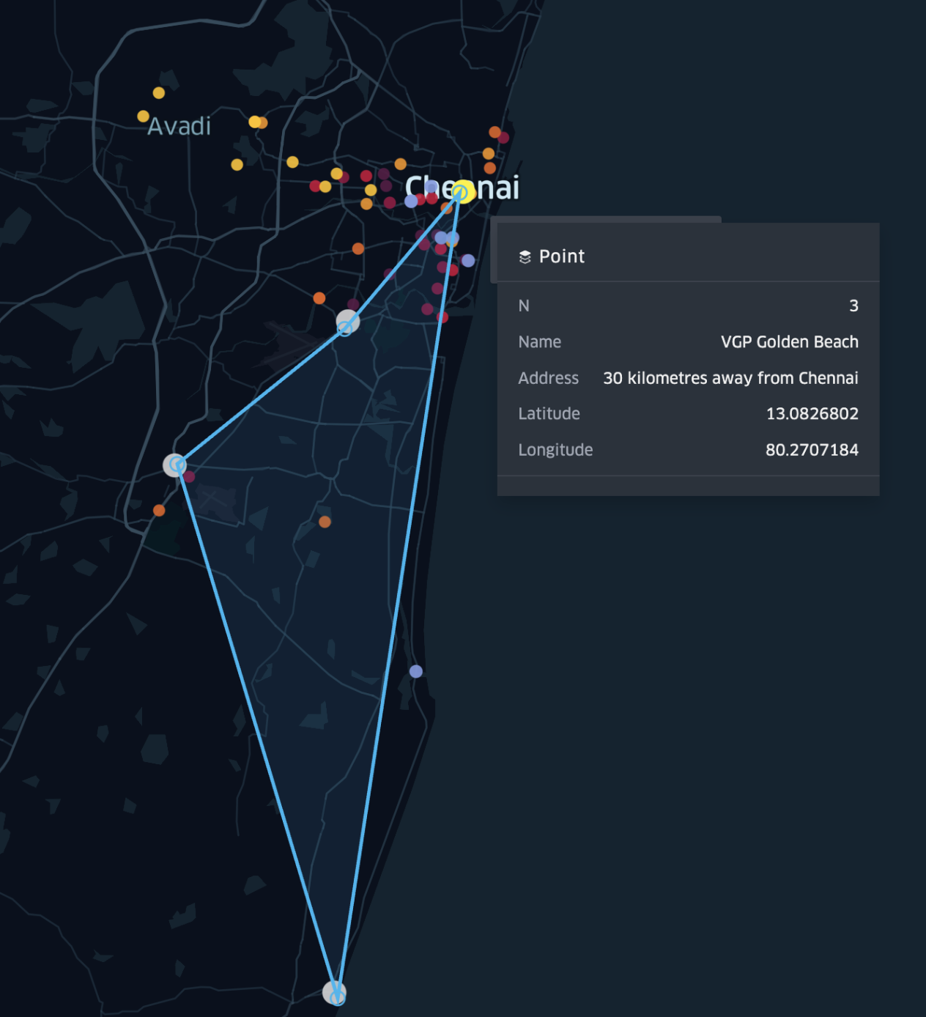
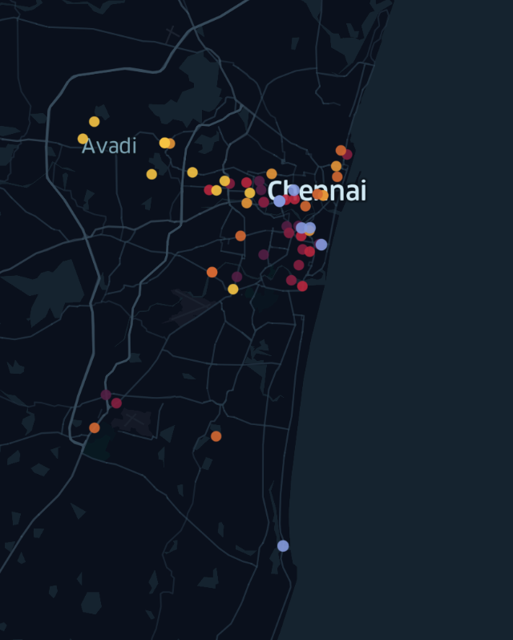
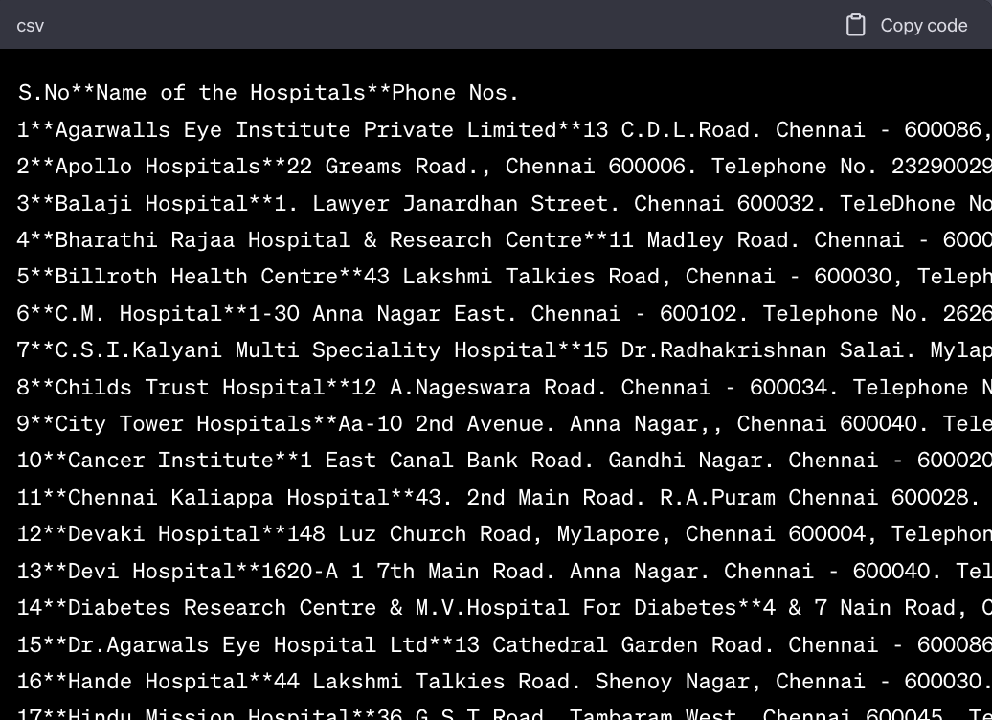
Spatial Data Representation
Yernar Mukayev
NYUAD- About Introduction to Digital Arts and Humanities- Fall 2023
Abstract/Intro/Motivation
Objectives
Results/Discussion
The core objective is to develop a prototype visualization tool that could potentially evolve into a comprehensive travel recommendation system.
This study explores the application of spatial data analysis to enhance the visualization of tourist destinations, using Chennai's Travel Guide as the primary source. Motivated by personal experiences of travel challenges, such as efficiently navigating unfamiliar locations, this project aims to demonstrate the practical utility of visualizing travel guides in day-to-day life.
Work Plan/Process
1) Convert data from LLMs to csv
2) Using google-maps API get longitude and latitude
3) Create a comprehensive table for each entry with its geo location
4) Import this file to the geo-visualization tool
Data Preparation
In order to obtain different places from written Guide, we used OCR( text recognition tool) and then fetched required locations by their type, address, phone, etc - using LLMs.
Future Directions/Reflection
I believe attempting to visualize a travel guide will help understand how useful this can be for day-to-day life. In the future, I would love to see a tool that creates a recommendation system based on the places you input and displays the best route.
.
Notes:
feel free to change background colors & text boxes and use sections for difference purposes!

