Slide 1

Docker for Java
A Software Containerization platform
Jeroen Lankheet
May 27, 2018

Slide 2
Docker
https://www.docker.com
And more Java-specific…
https://github.com/docker/labs/tree/master/developer-tools/java/
Jeroen Lankheet
May 2018

Slide 3
TODO
Prepare ZIP images for workshop
Prepare excercises
Assemble file with code snippets
Embed screenshots etcetera

Slide 4
Audience
Developers
Testers
Test automation developers
Required knowledge
Little Java/coding

Slide 5
Contents
Introduction
What is Docker
Why do we use Docker
Docker compared with a hypervisor
Images, containers, docker files
How about Ansible
Exercise: First Java app in Docker
Docker compose

Slide 6
What is Docker
Docker, Inc. the company
Docker the open source project (this is now called Moby)
  Upstream for Docker
  Modularization (swapping of components)
Docker the container runtime and orchestration technology

Slide 7

Open Container Initiative
Governance council
  Standardization of the fundamental components
Current specs
  Image-spec
  Runtime-spec
Rail tracks
Common acceptation
Slowing down innovation

Slide 8
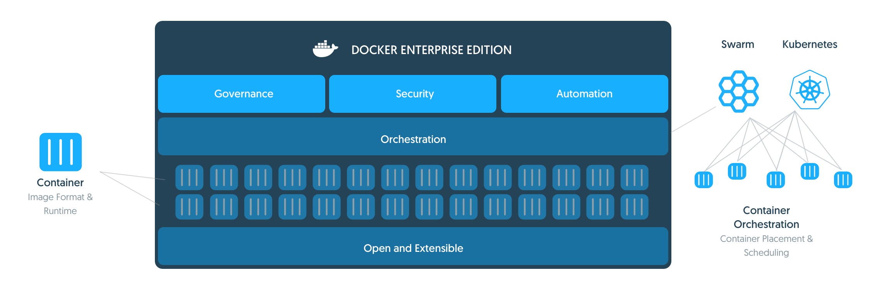
What is Docker Runtime
Windows, Linux, Mac
true independence between applications and infrastructure
No architecture and infrastructure lock-in

Slide 9
Why do we use Docker
Build, ship and run applications
Standard operating environment for your application
Run it anywhere
Use the same container for development, test and production
Party instead of writing installation manuals

Slide 10
Docker terminology
DockerHub:
ImagesRepo
Images
  Build component
  Read-only template defining an application operating env.
Containers
  Run components
  Created from images with scripting
  Adds a read/write layer on top of the image
  (union file system)
  They can be run, started, stopped, moved, deleted
Dockerfile
  A file containing the recipe for building the container
Registry
  Local
  Remote: http://store.docker.com (a.k.a. Docker Hub)
Registry
Image
Container
Dockerfile
Runtime:
C

Slide 11
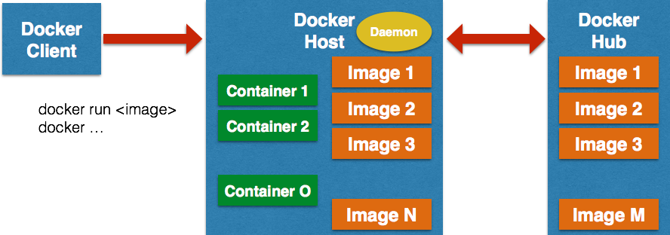
Docker architecture
Client runs on client machine
Client communicates with local or remote Docker daemon

Slide 12
Docker hub
Internet registry
Contains multiple repositories
  https://hub.docker.com/explore/
You can have your own (private) repository
You need an account
Used when an image is not locally available
  docker image pull <repository>:<tag>

Slide 13
Control your universe
Written in Golang
Bindings for Python, Java, and others
  For managing the container
  Reading logs
  monitoring

Slide 14
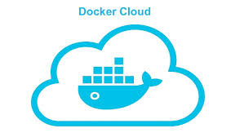
Docker Cloud
Everything Docker
But then in the cloud
Not in scope
https://cloud.docker.com/

Slide 15
What about Ansible?
IT automation tool; manage everything around the Docker container
  configure systems (networking, firewall, database configurations)
  deploy software, and
  orchestrate more advanced IT tasks such as:
    continuous deployments or
    zero downtime rolling updates
Repeatable, audit-able

Slide 16
Ansible integration with Docker
http://docs.ansible.com/ansible/latest/scenario_guides/guide_docker.html
Use Ansible playbooks for Docker automation
  Description language of the tasks that need to be run
When built with Ansible playbook, it can be run in Docker, Vagrant, bare metal or in a cloud environment.
http://docs.ansible.com/ansible/latest/user_guide/playbooks.html
Notes:
Focus on scenario's that should be supported. Don't loose time on error guessing.
But it is common practise to do exploratory testing (time slot based) when implemented (finding uncovered scenario's)

Slide 17
Getting busy: Workflow
Pull or run command
  Download image from registry
  Use Ubuntu, Fedora, Wildfly or any other as starting point
Modify to your special needs
  Script your Dockerfile by adding instructions
  Each instruction creates a new layer in your image
Build the image
  The Dockerfile is examined and an image is built using a new layer for each instruction
Update your application
  Instead of modifying your image, a new layer is added with the new Application
  Build it again

Slide 18
Get busy
https://github.com/wsargent/docker-cheat-sheet
Pre-conditions
  Alpine-Linux-java image
  MySQL image
  Mosquitto image
  Eclipse (or IntelliJ) with Java client
Start the Alpine Linux container and connect a terminal
Create a Dockerfile and add the application to our container
Inspect logging
Test it with our Java client
Update our application

Slide 19
Get busy 2
Pre-conditions
  Mosquitto image
  MySQL image
Run the mosquitto container
Run the mysql container
Run our app container
Inspect logging
Update our application

Slide 20
Get busy 3
Pre-conditions
  Mosquitto container
  MySQL image
Dockerfile the mosquitto container
Dockerfile the mysql container
Run our app container
Inspect logging
Update our application

Slide 21
Useful references
https://github.com/wsargent/docker-cheat-sheet
http://www.baeldung.com/docker-java-api

Slide 22


