Slide 1
REAL-ESTATE PRICE PREDICTION
PREDICTING PROPERTY PRICES IN THE CITY OF NEW-YORK
MAHESH YERRA – DATA SCIENCE – CAPSTONE1

Slide 2
PROJECT SCORE
Scope of this project is to explore and analyze the property sales in the city of New-York and examine the correlation between criminal activity in a particular location with the price of property sale.
Predict the price of the property based on number of crime incidents reported in and around the area where property is located and other characteristics of the property(eg: Land Area, location, number of bed-rooms.. )

Slide 3
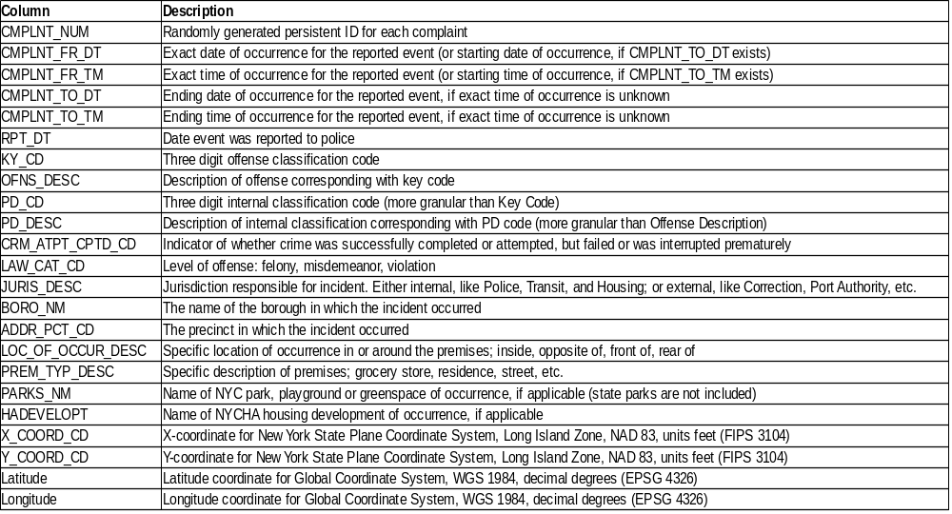
DATA UNDERSTANDING
Data sets used in this study are extracted from “NYC Open Data” Archives:
Crime Data

Slide 4
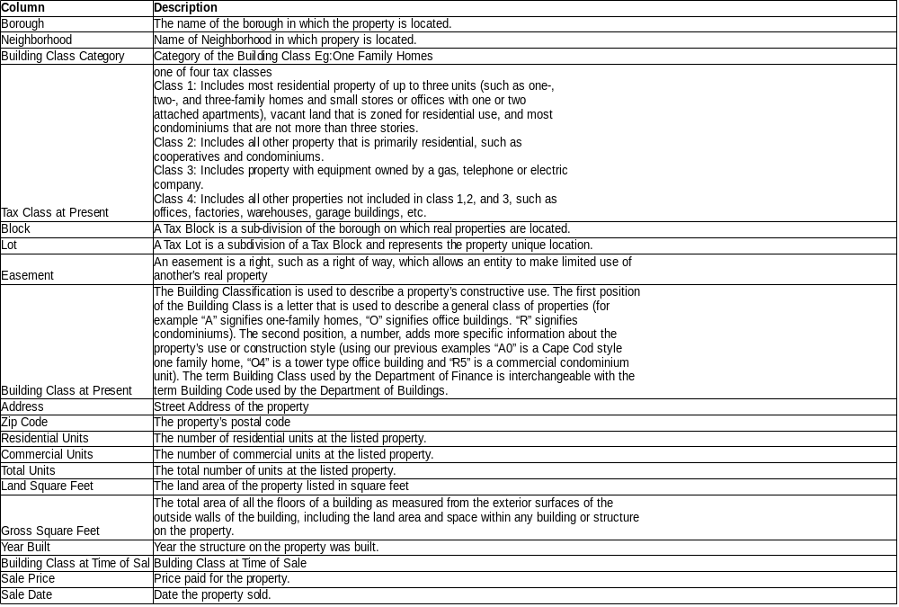
Sales Data

Slide 5
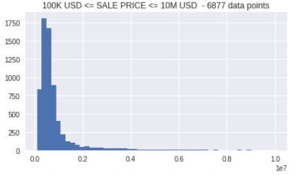
EXPLORATORY DATA ANALYSIS
Distribution of sales price:
count 8.000000e+03
mean 2.652798e+06
std 3.595869e+07
min 1.000000e+00
25% 3.250000e+05
50% 5.450000e+05
75% 8.500000e+05
max 1.791829e+09
Sales-Price follows an exponential distribution. Has very high variance.

Slide 6
CORRELATION TABLE
CRIME-DATA VS. SALE-DATA
Feature | corr_coef | p_value
past_FELONY_count | 0.0970 | 0.00000
past_MISDEMEANOR_count | 0.0905 | 0.00000
past_crime_count | 0.0889 | 0.00000
past5Y_crime_count | 0.0695 | 0.00000
past3Y_crime_count | 0.0654 | 0.00000
past2Y_crime_count | 0.0652 | 0.00000
past1Y_crime_count | 0.0592 | 0.00000
past_VIOLATION_count | 0.0575 | 0.00000
past6M_crime_count | 0.0547 | 0.00000
All crime counts are in positive correlation with Sale-Price.

Slide 7
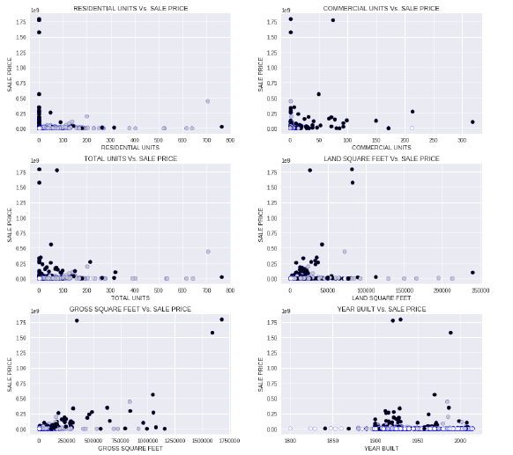
SCATTER PLOTS

Slide 8
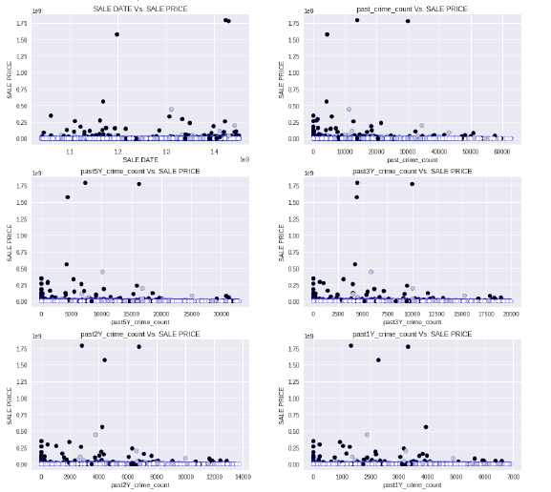
SCATTER PLOTS

Slide 9
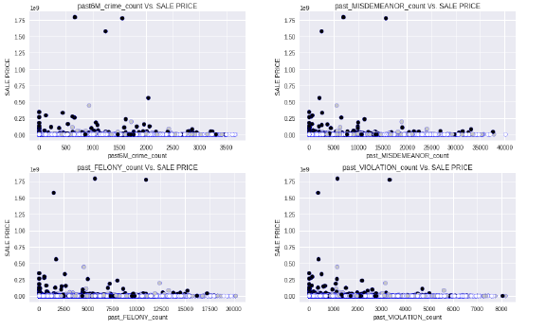
SCATTER PLOTS

Slide 10
MODELING & EVALUATION
We have started our modeling with linear-regressor. Linear regressor has
produced very poor results with a negative R-Square value. A Negative R-Square indicates that
variance of predicted values from actual values is much higher than that of variance in actual
values from actual mean.
Then we tried Ridge-Regression and Lasso Regression which can supress curse of
dimensionality inherent to our data with 470+ features. These 2 models are similar to Linear-
Regression but they impose penalty terms in regression equation to deal with curse of
Dimensionality. Lasso Regression, in addition will help in choosing right features. Though
these models have improved prediction accuracy, they still have low R-square(0.44) and high
Root-Mean-Squared Errors > 990000.

Slide 11
MODELING & EVALUATION .CONTINUED
Then we tried ensemble methods Random-Forest Regressor and Gradient Boost Regressor.
Random-Forest constructs multiple decision-trees by randomly selecting a subset of features and a subset of records from given training data. These random samples and random features for each decision-tree are chosen using boot-strap method. Values at each node are determined by weighted average while predicting continuous data. Random-Forest has given best results with R-Square 0.65 and RMSE = $788955.
We also tried running Gradient Boost – Regressor. Gradient-boost starts with single tree. After validating results, algorithm will assign more weights to miscalssified/high variance records and runs the model again. This cycle repeats until errror is minimized. Gradient Boost has also performed well with R-square of 0.61 and RMSE of 833002.

Slide 12
RESULTS
Model Name | RMSE | Rsquare
Linear – Regression | 34143520.00 | -659.30
Ridge-Regression | 991083.00 | 0.44
Lasso-Regression | 992962.00 | 0.44
Random-Forest | 788955.90 | 0.65
Gradient-Boost | 833002.90 | 0.61

Slide 13
THANK YOU
MAHESH YERRA

