Slide 1

Data Structures and Algorithms -3 (25CS2103E)
String Matching Using the Z-Algorithm
Team 03 | Section 05
Rakesh Medikonda (2520030035)
Abhishek Kumar (2520030448)
Y. Venkat Sai (2520030278)
Under the esteemed guidance of
Swathi D
Assistant Professor, CSE

Slide 2
Contents
1
Abstract
2
Introduction
3
Literature Survey
4
Problem Statement and Objectives
5
Flow Chart and Working
6
Results
7
Hardware and Software Requirements
8
Conclusion and Future Scope

Slide 3
Abstract
String matching: find every position where a pattern occurs inside a larger text.
Z-Algorithm: builds a Z-array over pattern + delimiter + text to detect all matches without repeating comparisons.
Comparison: implemented alongside the Naive method to compare execution time for different input sizes.
Field: Algorithms and Data Structures - string algorithms / pattern matching.
Uses: search engines and Ctrl+F, plagiarism detection, DNA sequence analysis, text editors.
Implementation: Java with a Swing desktop interface and a console benchmark.
O(n + m)
Z-Algorithm time, guaranteed
O(n × m)
Naive method, worst case
1,000
test records validated

Slide 4
Introduction
Searching a large text character by character becomes slow.
When a pattern occurs many times, the application must report every starting position.
The Naive approach checks the pattern at every position, repeating many comparisons.
This project builds a string matching application around the Z-Algorithm, which pre-processes the input to avoid repeated comparisons.
The system takes a text and a pattern, finds every occurrence, and shows the results in a desktop interface.
Text
a
b
a
b
c
a
b
a
b
Pattern: abab
Occurs at positions 0 and 5 (0-based). Every occurrence must be found.
Highlighted letters mark the two matches.

Slide 5
Literature Survey
Existing System
Proposed System
Uses simple (Naive) string matching.
Compares the pattern at every position of the text.
Worst-case time is O(n × m).
Performance drops sharply for large, repetitive text.
Uses the Z-Algorithm for pattern searching.
Z-array avoids repeated comparisons.
Time is O(n + m).
Shows all matching positions and compares time with the Naive method.
Java Swing interface and console benchmark.

Slide 6
Problem Statement and Objectives
Problem: Searching for a word or pattern in a large text is time-consuming with a basic character-by-character method. Build an efficient application, based on the Z-Algorithm, that accepts a text and a pattern and returns every occurrence.
1
Implement the Z-Algorithm to find all occurrences of a pattern.
2
Build a Z-array to eliminate repeated character comparisons.
3
Compare performance of the Z-Algorithm with the Naive algorithm.
4
Provide an interactive interface to enter text/pattern and view results.

Slide 7
How the Z-Algorithm Works
Z-array: Z[i] = length of the longest substring starting at i that equals a prefix of the string.
Combine: S = pattern + "#" + text. The "#" keeps every Z-value at most m.
Detect: Z[i] = m means the pattern starts at text position i - (m + 1).
Z-box [l, r): reuse earlier Z-values inside the box, so each character is matched successfully only once. Total time O(n + m).
i | 0 | 1 | 2 | 3 | 4 | 5 | 6 | 7 | 8 | 9
S[i] | a | a | b | # | b | a | a | b | a | a
Z[i] | 0 | 1 | 0 | 0 | 0 | 3 | 1 | 0 | 2 | 1
Example: pattern "aab", text "baabaa". Z[5] = 3 = m, so the pattern occurs at text position 5 - 4 = 1.

Slide 8
Flow Chart
User input
text + pattern
Pre-process
pattern + # + text
Build Z-array
one pass, Z-box
Detect matches
Z[i] = m
Time both
Z vs Naive
Display
highlight + chart
>
>
>
>
>
StringMatcherApp
combine()
buildZArray()
search()
NaiveMatcher
StringMatcherApp
Method / class that implements each step

Slide 9
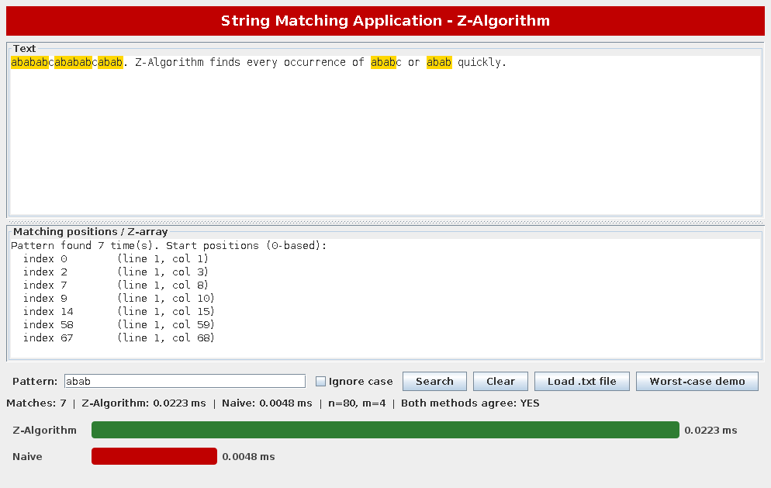
Results: Application
Type text or load a .txt file.
Highlights every occurrence.
Lists positions with line and column.
Bar chart of Z vs Naive time.
Checks both methods agree.
Worst-case demo button.
Pattern "abab": 7 matches highlighted, positions listed, Z vs Naive time shown.

Slide 10
Results: 1,000 Test Records
Size | Records | Avg. text length | Z (ms) | Naive (ms) | Identical output
Small | 400 | 543 | 0.1135 | 0.0211 | Yes
Medium | 400 | 55,601 | 0.4488 | 0.3096 | Yes
Large | 200 | 351,332 | 2.5690 | 1.8867 | Yes
1,000 / 1,000
On random text over a 4-letter alphabet the Naive method rarely matches more than a few characters, so it runs almost linearly and is slightly faster. The Z-Algorithm advantage is its guaranteed O(n + m) bound, shown next.
records: Z output identical to Naive

Slide 11
Results: Worst Case
747x
faster at n = 160,000
Text = "aaa...a", pattern = "aa...ab". Naive time grows about 4x when n doubles (O(n × m)); Z time only doubles (O(n + m)).

Slide 12
Hardware and Software Requirements
Software
Hardware
Java (JDK 11 or later; tested on 21) - core language.
Java Swing - graphical interface, no external libraries.
VS Code with Extension Pack for Java - development.
GitHub - version control.
Standard PC / laptop with a multi-core processor.
Minimum 4 GB RAM (8 GB recommended for larger tests).
Internet connection for GitHub access.

Slide 13
Conclusion
The Z-Algorithm provides efficient pattern searching with guaranteed O(n + m) time.
Validated on 1,000 records: identical results to the Naive method.
Worst-case tests show the Naive method degrading to O(n × m) while Z stays linear.
Useful for document search, keyword identification and plagiarism-related pattern detection.
The Swing interface makes the tool easy to demonstrate and extend.
747x
faster on worst-case input
100%
output agreement with Naive

Slide 14
Future Scope
1
Approximate (fuzzy) string matching for near-matches
2
Search across multiple documents or files at once
3
Add KMP, Boyer-Moore and Rabin-Karp for a broader comparison
4
Full plagiarism-detection module built on this engine
5
Web version (e.g. Spring Boot) or runnable JAR for wider access

Slide 15
Thank you
Questions?

