Slide 1
String Matching Using the Z-Algorithm and Other Advanced Pattern Matching Techniques
25CS2103E · DATA STRUCTURES & ALGORITHMS · PROJECT DEFENSE
Naive · Z-Algorithm · KMP · Boyer-Moore · Rabin-Karp, built and benchmarked in a Java Swing workbench
Yarramasu Venkat Sai
Rakesh Medikonda
Abhishek Kumar
Roll No: 2520030278
Roll No: 2520030035
Roll No: 2520030448
Notes:
THEME: dark opening slide, crimson accent matching our GUI header. LAYOUT: kicker, big title, team cards. Good morning, Professor. We are Venkat Sai, Rakesh and Abhishek, and our project for 25CS2103E is a string matching workbench. We implemented five algorithms from scratch, with the Z-Algorithm as our centrepiece, and built a Java Swing application so every algorithm can be run, timed and explained on screen. I'll walk you through the problem, the design, each algorithm, and finally our comparison.

Slide 2
Problem Statement & Real-World Motivation
THE PROBLEM
Given text T[0..n−1] and pattern P[0..m−1], report every shift i where T[i..i+m−1] = P. Brute force costs O(n·m).
Bioinformatics
Compilers
Text Editors
Locate gene motifs in genomes of billions of bases over a tiny alphabet {A, C, G, T}.
Lexical analysis scans source text for keywords, identifiers and tokens in a single pass.
Find and Replace must feel instant on large files while the user types.
Goal: reach O(n+m) and compare five strategies on real behaviour.
25CS2103E · 2 / 13
Notes:
THEME: light content slide. LAYOUT: dark problem banner, three motivation cards, goal line. Our problem is simple to state: find every place a pattern occurs inside a text. The naive method can cost n times m, which hurts when n is a genome or a huge source file. Bioinformatics searches DNA motifs over a four-letter alphabet, compilers scan code for tokens, and every text editor's Find box does this. So our goal was to reach linear time and to see how five different ideas behave in practice.

Slide 3
System Architecture & Dual-Pane GUI Design
TOP PANEL · Control
Target Text · Search Pattern · Select Algorithm (1–5)
Buttons: Search & Show Process · Clear · Load .txt file · Worst-case demo
Data flow
1. User enters T, P and picks an algorithm
2. GUI calls the chosen PatternMatcher
3. Time is measured around the search
4. Both bottom panes update together
BOTTOM 1 · Match Results & Metrics
Algorithm, n and m, execution time (ms), match count, positions as index (L:line, C:column)
Built in Java Swing; a draggable divider separates the two result panes.
BOTTOM 2 · Step-by-Step Process
Algorithm mechanics at a glance: core concept, complexity, Z-array or LPS preview
25CS2103E · 3 / 13
Notes:
THEME: light. LAYOUT: left, the three GUI zones stacked like the real window (crimson top, teal bottom panes); right, data-flow steps. Our window has two panes. The top holds the inputs: target text, pattern, an algorithm dropdown, and four buttons including a worst-case demo. The bottom is split in two. Pane one shows the numbers: n, m, execution time, match count and positions. Pane two explains the algorithm, including the Z-array or LPS table. So the professor sees the result and the reasoning together.

Slide 4
Custom Data Structures & Engineering Integrity
CustomArrayList
PatternMatcher interface
Hand-built dynamic array that stores match positions, with no java.util collections.
Indexed access: O(1)
Append: amortized O(1) by growing capacity
Holds the result list for every algorithm
One contract, five implementations, so the GUI never depends on a specific algorithm.
Add a sixth algorithm without touching the GUI
Same input, same output type, fair timing
PatternMatcher
→
Naive
Z
KMP
Boyer-Moore
Rabin-Karp
25CS2103E · 4 / 13
Notes:
THEME: light. LAYOUT: two cards (data structure, interface) above a polymorphism strip. This slide is about engineering integrity. We built our own CustomArrayList, a dynamic array that grows as matches are found, instead of leaning on library collections. And every algorithm implements one PatternMatcher interface. That means the GUI just calls the interface, the dropdown picks the implementation, and all five are timed under identical conditions. Adding a sixth algorithm would not change the GUI at all.

Slide 5
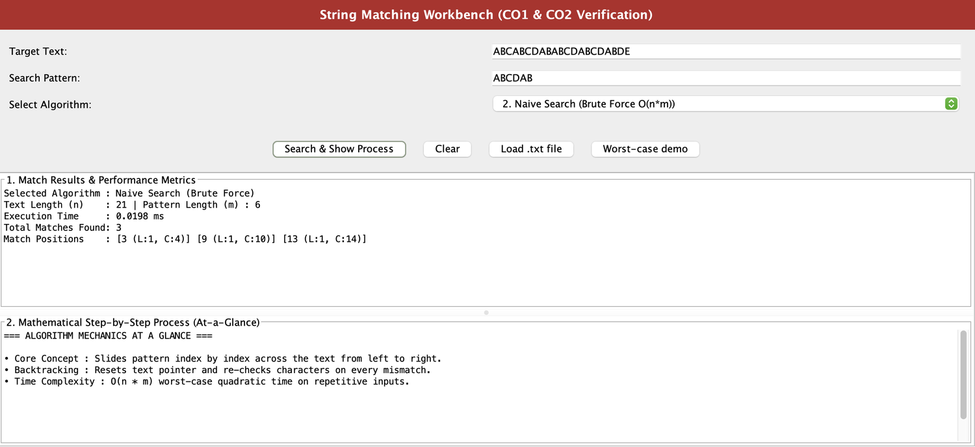
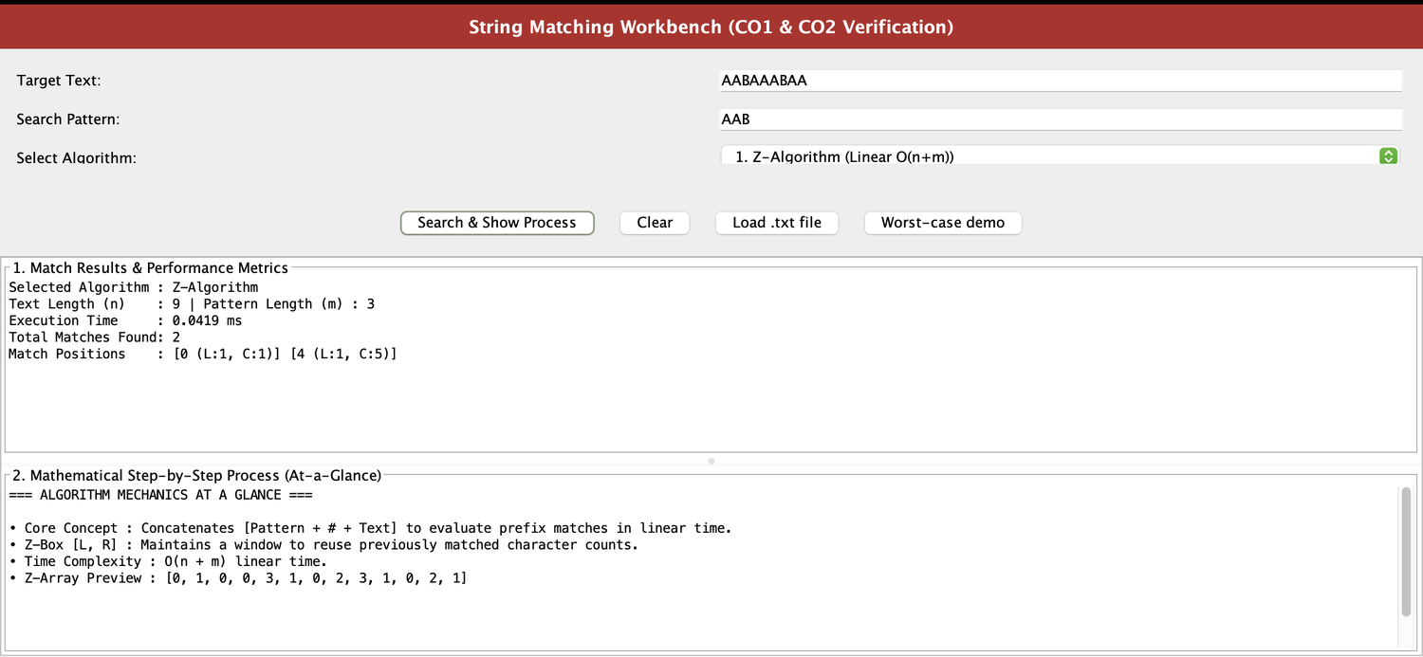
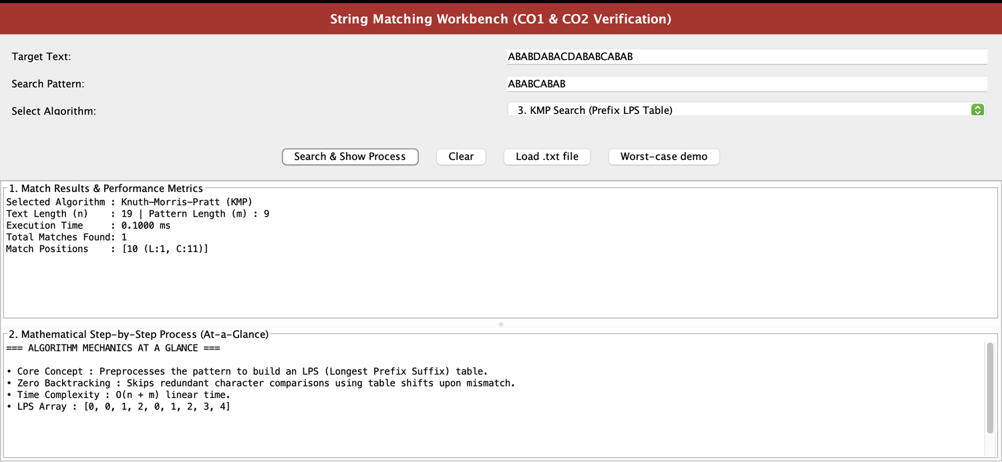
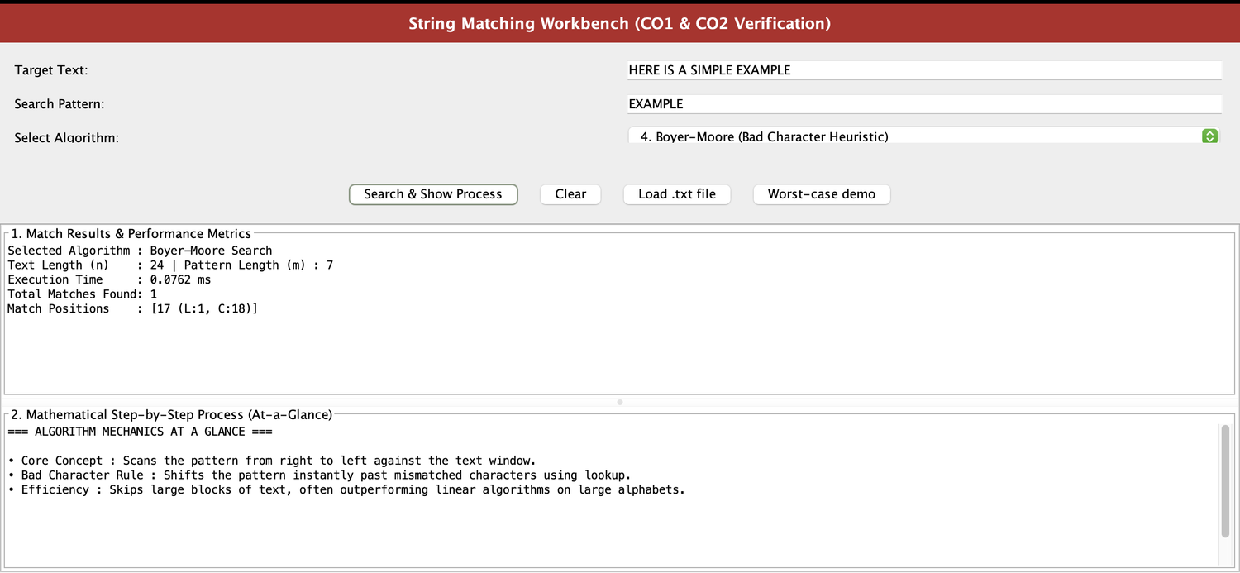
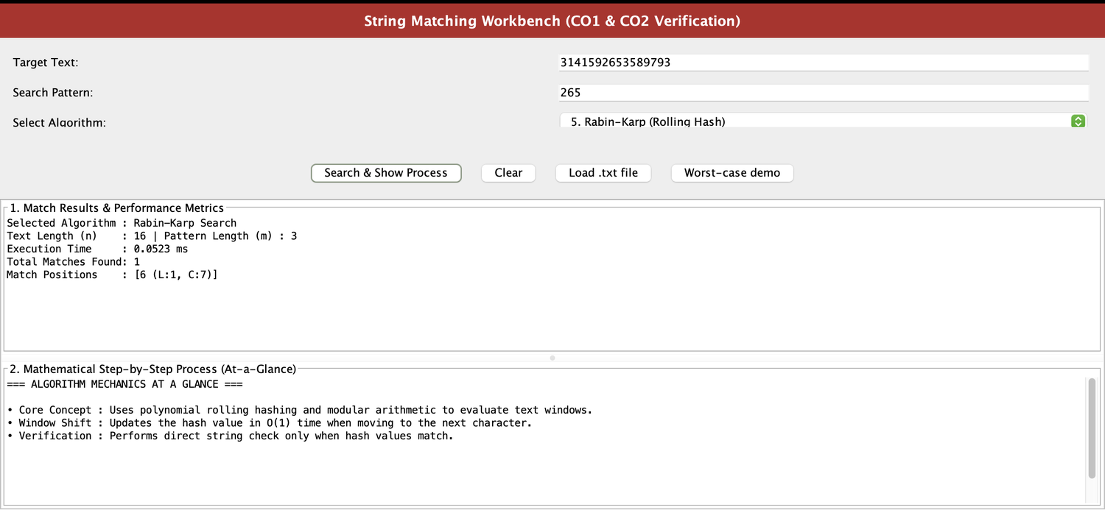
Application Screenshots & Execution Proof
1 · Naive Search
2 · Z-Algorithm
3 · KMP
n=21, m=6 → 3 matches at 3, 9, 13 in 0.0198 ms
AAB in AABAAABAA → matches at 0, 4 in 0.0419 ms
n=19, m=9 → 1 match at 10; LPS [0,0,1,2,0,1,2,3,4]
How to read each screen
Top: input and algorithm. Pane 1: metrics and match positions (index, L:1, C = index + 1). Pane 2: the algorithm's mechanics.
4 · Boyer-Moore
5 · Rabin-Karp
EXAMPLE in a 24-char text → match at 17 in 0.0762 ms
265 in digits of π → match at 6 in 0.0523 ms
25CS2103E · 5 / 13
Notes:
THEME: light proof slide. LAYOUT: 3×2 grid, five annotated screenshots plus a reading guide. These are our real runs, one per algorithm. Naive found three matches of ABCDAB, at 3, 9 and 13. Z found AAB at 0 and 4, and pane two previews the Z-array. KMP found its single match at 10 and shows the LPS array. Boyer-Moore located EXAMPLE at 17 and Rabin-Karp found 265 inside the digits of pi at 6. Positions are zero-based indices; the C value is index plus one. Note these timings are single runs on tiny inputs, so differences of hundredths of a millisecond are noise; the real comparison is slide 12.

Slide 6
Naive Search (Brute Force)
ALGORITHM 1
Slide P across T one index at a time; compare left to right.
On a mismatch, restart the text pointer at shift s+1 (backtracking).
Comparisons ≤ (n − m + 1) · m
Best case: O(n)
Every shift fails on the first character, e.g. T = AAAA…A, P = B.
Worst case: O(n·m)
T = Aⁿ, P = Aᵐ⁻¹B: almost m comparisons at all n−m+1 shifts.
Space: O(1)
Our run: ABCDAB in ABCABCDABABCDABCDABDE → shift 0 matches ABC, then A ≠ D; matches at 3, 9, 13.
25CS2103E · 6 / 13
Notes:
THEME: light. LAYOUT: mechanics left, best/worst/space cards right, evidence line below. Naive search is our baseline. It tries every alignment and compares character by character. When a mismatch happens it throws away what it learned and moves to the next shift. If the first character always fails, it's linear, O(n). If the text is all A's and the pattern is A's ending in B, it does nearly m comparisons at every shift, which gives O(n times m). It needs no extra memory. In our run, shift zero matched A, B, C and failed at the fourth character, which is exactly this backtracking.

Slide 7

Z-Algorithm: Linear O(n+m)
ALGORITHM 2 · CENTREPIECE
Concatenate S = P # T. The # never occurs in the text, so Z[i] ≤ m.
Z[i] = length of the longest substring starting at i that equals a prefix of S.
Match when Z[i] = m, at text index i − m − 1.
Z-box [L, R]: rightmost matched window so far.
If i ≤ R: Z[i] = min(R − i + 1, Z[i − L]); else extend by comparing.
R never moves left, so total work is O(n+m). Space: O(n+m).
Our run: P = AAB, T = AABAAABAA, so S = AAB#AABAAABAA
A
A
B
#
A
A
B
A
A
A
B
A
A
0
1
0
0
3
1
0
2
3
1
0
2
1
Z = [0, 1, 0, 0, 3, 1, 0, 2, 3, 1, 0, 2, 1]: Z = 3 = m at i = 4 and 8, so matches at 4−4 = 0 and 8−4 = 4.
25CS2103E · 7 / 13
Notes:
THEME: light, the visual centrepiece. LAYOUT: two explanation columns above a Z-array strip with the two matches highlighted in crimson. This is our main algorithm. We glue the pattern, a hash separator and the text into one string. The Z-array says, for each position, how long a prefix of that string starts there. Because the separator can't appear in the text, a value of exactly m means a full pattern match, and the text index is i minus m minus one. The Z-box [L, R] remembers the rightmost window we have matched so we can copy earlier answers instead of re-comparing. R only moves right, so total work is linear. Here the Z-array has threes at positions 4 and 8, giving matches at 0 and 4, exactly what our GUI printed.

Slide 8
Knuth-Morris-Pratt (KMP) Search
ALGORITHM 3
Prefix analysis of P builds the LPS table: lps[i] = length of the longest proper prefix of P[0..i] that is also a suffix.
On mismatch: j ← lps[j − 1]. The text pointer i never moves backward.
Time: O(n + m)
O(m) to build LPS + O(n) to scan; each j decrease is paid by an earlier increase.
Space: O(m)
Our run: P = ABABCABAB in T = ABABDABACDABABCABAB
A
B
A
B
C
A
B
A
B
0
0
1
2
0
1
2
3
4
LPS = [0, 0, 1, 2, 0, 1, 2, 3, 4] → 1 match at index 10 (L:1, C:11)
25CS2103E · 8 / 13
Notes:
THEME: light. LAYOUT: mechanics and complexity cards over the LPS table from our screenshot. KMP's insight is that a mismatch still tells us something about the text we already read. We precompute the LPS table: for each prefix of the pattern, the longest proper prefix that is also a suffix. After a mismatch we use that table to slide the pattern forward without ever moving the text pointer back, so there is zero text backtracking. The pointer j can only drop as far as it has climbed, which amortizes to O(n plus m) time and O(m) space. Our LPS for ABABCABAB is 0,0,1,2,0,1,2,3,4 and it found the match at index 10.

Slide 9
Boyer-Moore (Bad Character Heuristic)
ALGORITHM 4
Right-to-left scan of the pattern against the text window.
Bad character rule: on a mismatch at pattern index j with text char c,
shift = max(1, j − last[c]), where last[c] is the rightmost index of c in P (−1 if absent).
Best case: O(n/m)
Every probe hits a char absent from P, so we jump m.
Worst case: O(n·m)
With bad-char only, e.g. T = Aⁿ, P = BAᵐ⁻¹.
Space: O(σ) table
Our run: P = EXAMPLE, T = HERE IS A SIMPLE EXAMPLE → match at 17 (L:1, C:18)
last[ ] = E:6 · X:1 · A:2 · M:3 · P:4 · L:5. First window: compare P[6] = E with T[6] = S; S is not in P, so shift = 6 − (−1) = 7 and the whole pattern is skipped.
25CS2103E · 9 / 13
Notes:
THEME: light. LAYOUT: mechanics left, complexity cards right, worked shift example in a card below. Boyer-Moore flips the direction: it compares the pattern right to left. When the last character mismatches, the bad character rule tells us how far we can jump, using a lookup table of each character's rightmost position in the pattern. If the text character isn't in the pattern at all, we skip the entire pattern length. That is why the best case is sub-linear, about n over m. Honestly, with only this heuristic the worst case is still n times m; the good suffix rule would improve it and we note that as future work. In our example the first compare was S against E, S is not in EXAMPLE, so we jumped seven places.

Slide 10
Rabin-Karp (Rolling Hash, q = 101)
ALGORITHM 5
Expected: O(n + m)
POLYNOMIAL HASH
h(s) = (s₀·d^(m−1) + s₁·d^(m−2) + … + s_(m−1)) mod q
Rolling update, O(1):
h_(i+1) = (d·(h_i − T[i]·H) + T[i+m]) mod q, with H = d^(m−1) mod q
Worst: O(n·m)
Many spurious hash hits.
Space: O(1)
Our run: P = 265 in T = 3141592653589793, base d = 10
h(265) = 265 mod 101 = 63. Window hashes: 314→11, 141→40, 415→11, 159→58, 592→87, 926→17, 265→63 (match at 6).
Collision handling: 314 and 415 both give 11, so equal hashes trigger a character-by-character check before reporting.
25CS2103E · 10 / 13
Notes:
THEME: light with one dark formula card. LAYOUT: formula card and complexity cards on top, worked hash numbers below. Rabin-Karp turns each window of text into a number using a polynomial hash modulo q, where we use q equals 101. The trick is the rolling update: to move one character right we subtract the outgoing digit, multiply by the base, and add the incoming digit, all in constant time. If the hash equals the pattern's hash we still verify character by character, because collisions happen: in our example 314 and 415 both hash to 11. Expected time is O(n plus m), worst case O(n times m) if many windows collide, and space is O(1). It found 265 at index 6, where the hash was 63.

Slide 11
Comparative Asymptotic Analysis & Space
Algorithm | Preprocessing | Best case | Worst case | Auxiliary space
Naive | None | O(n) | O(n·m) | O(1)
Z-Algorithm | O(n+m) | O(n+m) | O(n+m) | O(n+m)
KMP | O(m) | O(n+m) | O(n+m) | O(m)
Boyer-Moore | O(m+σ) | O(n/m) | O(n·m) | O(σ)
Rabin-Karp | O(m) | O(n+m) | O(n·m) | O(1)
σ = alphabet size. Only Z and KMP guarantee linear time; Boyer-Moore (bad-char only) wins on average with large alphabets; Rabin-Karp's worst case needs many hash collisions.
25CS2103E · 11 / 13
Notes:
THEME: light master-table slide. LAYOUT: full-width zebra table, crimson for quadratic worst cases and teal for guaranteed linear. This is our master summary. Naive, Boyer-Moore with bad character only, and Rabin-Karp can all reach n times m in the worst case; Z and KMP are the two that guarantee O(n plus m). The price is memory: Z builds an array over the concatenated string, O(n plus m), KMP needs only O(m), naive and Rabin-Karp use constant space, and Boyer-Moore uses a table the size of the alphabet. So the right choice depends on the input: guaranteed linear, minimal memory, or fast on average.

Slide 12
Empirical Benchmarking on 4,000-Character Inputs
LIVE PROOF · WORST-CASE DEMO BUTTON
Degrades: Naive
Resilient: Z-Algorithm & KMP
Highly repetitive text forces near-m comparisons at every shift.
Bound: (n − m + 1)·m. For n = 4,000, m = 1,000: ≈ 3.0 × 10⁶ comparisons.
Measured: [__ ms]
Same input, work stays proportional to n + m.
Bound: ≈ 5 × 10³ steps for the same n and m.
Measured Z: [__ ms] · KMP: [__ ms]
Expected gap ≈ n·m / (n+m) = 1,000 × 4,000 / 5,000 = 800× fewer steps for linear algorithms. Wall-clock ratios will be smaller because of JVM warm-up and constant factors.
Click “Worst-case demo” in the GUI and read pane 1. Replace the [__] values with your measured times.
25CS2103E · 12 / 13
Notes:
THEME: dark accent slide for the live demo. LAYOUT: two contrasting cards (degrades vs resilient), ratio statement, demo instruction. Now the live demonstration. I'll click Worst-case demo, which loads a 4,000-character repetitive input. [Fill in your measured numbers before presenting.] For the naive algorithm, the comparison count is bounded by n minus m plus one, times m; with n at 4,000 and m at 1,000 that is about three million comparisons. Z and KMP stay near n plus m, about five thousand. Wall-clock differences will be smaller than the 800 times gap in operations, because of JVM warm-up and constant factors, and I'll say that openly. The point is the shape: quadratic degradation versus linear resilience.

Slide 13
Conclusion, Learnings & Open Viva Defense
Findings
Learnings
Future work
Z and KMP guarantee O(n+m).
Boyer-Moore is sub-linear on average (best O(n/m)).
Naive and Rabin-Karp can reach O(n·m).
Amortized analysis (Z-box, KMP pointer).
Hand-built CustomArrayList.
Interface-driven design for fair benchmarks.
Good-suffix rule for Boyer-Moore.
Multi-pattern search (Aho-Corasick).
Larger real-world datasets.
The right algorithm depends on the input, but only linear-time guarantees make a search engine safe. Thank you, Professor, we are happy to take your questions.
25CS2103E · 13 / 13
Notes:
THEME: light closing slide with a dark closing-statement banner. LAYOUT: findings, learnings and future-work cards, then the statement. To conclude: we built five algorithms and a workbench to compare them. Z and KMP guarantee linear time, Boyer-Moore is fastest on average, and naive and Rabin-Karp can degrade to quadratic. We learned amortized analysis, clean interface design and honest benchmarking. LIKELY VIVA QUESTIONS: (1) Why a # separator? So Z-values can't exceed m and prefix matches can't run into the text. (2) Why does KMP stay linear? j drops only as far as it has risen. (3) Why is Boyer-Moore O(n times m) worst case? Bad-character shifts can be as small as 1 on repetitive input. (4) Why verify on a Rabin-Karp hash match? Collisions, as 314 and 415 both hash to 11 mod 101. (5) Why do tiny inputs show Naive faster than Z? Constant factors and JVM warm-up dominate when n is tiny. Thank you, Professor, we are happy to take your questions.

