Slide 1

POSTMAN

Slide 2

AGENDA
WHAT IS POSTMAN
TERMINOLOGIES RELATED TO POSTMAN
HOW TO USE POSTMAN
POSTMAN NAVIGATION
METHODS
ADVANTAGES OF POSTMAN
DISADVANTAGES OF POSTMAN

Slide 3

WHAT IS POSTMAN

Slide 4
WHAT IS POSTMAN
Postman is one of the most popular software testing tools which is used for API testing.
Postman is a standalone software testing API (Application Programming Interface) platform to build, test, design, modify, and document APIs.
It is a simple Graphic User Interface for sending and viewing HTTP requests and responses.
While using Postman, for testing purposes, one doesn't need to write any HTTP client network code.
Instead, we build test suites called collections and let Postman interact with the API.
In this tool, nearly any functionality that any developer may need is embedded.
This tool has the ability to make various types of HTTP requests like GET, POST, PUT, PATCH, and convert the API to code for languages like JavaScript and Python.

Slide 5
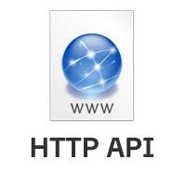
TERMINOLOGIES RELATED TO POSTMAN

Slide 6
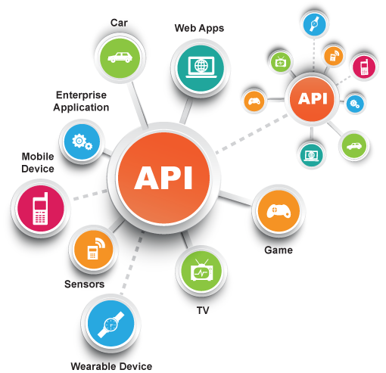
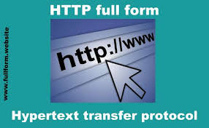
TERMINOLOGIES RELATED TO POSTMAN
API:
Application Programming Interface (API) is software that acts as an intermediary for two apps to communicate with each other.
We use APIs whenever we use an application like Twitter, Facebook, sending text messages, or checking the weather over the phone.
HTTP:
HTTP (Hypertext Transfer Protocol) is the collection of rules for the transmission of data on the World Wide Web, like graphic images, text, video, sound, and other multimedia data.
The Web users implicitly make use of HTTP as soon as they open their Web browser.
Example:
A user or browser enters the HTTP request to the server; the server then returns the user response. This response includes the request status information and may consist of the requested material as well.

Slide 7


Slide 8
HOW TO USE POSTMAN
Following are the reasons why Postman is used:
Accessibility- One can use it anywhere after installing Postman into the device by simply logging in to the account.
Use Collections-Postman allows users to build collections for their API-calls. Every set can create multiple requests and subfolders. It will help to organize the test suites.
Test development- To test checkpoints, verification of successful HTTP response status shall be added to every API- calls.
Automation Testing-Tests can be performed in several repetitions or iterations by using the Collection Runner or Newman, which saves time for repeated tests.
Creating Environments- The design of multiple environments results in less replication of tests as one can use the same collection but for a different setting.
Debugging- To effectively debug the tests, the postman console helps to track what data is being retrieved.
Collaboration- You can import or export collections and environments to enhance the sharing of files. You may also use a direct connection to share the collections.
Continuous integration-It can support continuous integration.

Slide 9


Slide 10
POSTMAN NAVIGATION
We can split the postman navigation into four UI structures, as shown in the below:
Header bar
Sidebar
Builder section
Response section
1.Header bar:
Header bar contains the following options-
New:
The new option is used for the following tasks
Request:
It is used to create a new request, where you can create and save requests by entering the request name and can use it in the future.

Slide 11
Collection:
It saves your requests in the form of a collection for reusing and sharing.
Environment:
Environments are variables with key-values. Every variable name represents its key. So if we reference the name of the variable, it enables us to access its corresponding value. So it basically saves the values you frequently use in an environment.
The new button also provides some advanced features like
Documentation - to create documentation for API,
Mock server- to create in-development APIs,
Monitor- to test API performance,
API - for managing all aspects of APIs, including design, development, and testing.

Slide 12
Import
You may use the Import option for importing files in different formats into the software.
Runner
This option helps to directly run the loaded collections in the Postman.
Open new icon
This option is used to open a new Tab, a new Postman window, and a new Runner window.
My Workspace
This option helps you to view, manage, and create personal as well as team workspaces. Collections, monitors, environments, and mocks are components of the workspace.
Invite
This is used to invite other users into your team to collaborate with them for team workspace. As seen in the image below, this can be done by entering the email address or uploading the list of people to invite them.
Sync icon
This option is used to synchronize the API requests that you send from other devices and updates your postman account status.

Slide 13
Interceptor icon
The interceptor option is a proxy server, used to capture all the requests that you send through browser or phone or from any other device.
Notification icon
It shows all the notification of the Postman app.
2. Sidebar:
History:
The history option is situated below the filter section of the app. The History tab automatically keeps a record of all your API requests, just like any other browser. It keeps handy all your past searches.
Collections:
The collection is the group of related requests which are displayed under the collection tab. In the collection tab, you can also create a new collection, as shown in the picture below. There is also a Trash section from where you can recover your lost or deleted collections.

Slide 14
APIs
All the APIs are listed in this section. New API can also be created from this tab.
3. Builder or Request section:
Untitled Request:
Untitled request' is basically the default request title you are working on.
The title depends on the type of request method you are working on.
HTTP request:
This option opens a drop-down list of all the HTTP request methods, as shown in the image like GET, DELETE, PATCH, OPTIONS, LINK, POST, COPY, UNLOCK, PURGE, etc. In general, we mostly use POST and GET. We will discuss these requests in later chapters.
Request URL or Endpoint
This URL option is like any other browser URL. In this, we mention the link to where the API will communicate with.

Slide 15
Params
This option is used to write the parameters of the request. These parameters include key values and descriptions.
Authorization
The authorization process is required to access the APIs. This process verifies whether you have permission from the server to access the data you want. We will discuss this as a complete chapter later.
Headers
An HTTP request header is the additional data that is required to send along with the request. This header information is required for proper two-direction communication between the client and the server.
Body
It let you specify the data type that you need to send with a request. There are various types of body data that you can send to match your API.
Pre-request script
These are written in JavaScript, and as the name suggests, these are executed before sending the request. Generally, these scripts are for setting the environment and ensuring that the request is running in the right environment.

Slide 16
Test scripts
It is executed during the request. It is also written in JavaScript. This helps you to ensure that API works as intended. Testing is important as it sets up checkpoints to verify whether the response status is ok and retrieved data is as expected.
4. Response section:
The API responses which are sent back from the server are shown in the response window.
These are generated after you send an API request to the server.
As we have not sent any request, so there is no response in our case.

Slide 17

METHODS

Slide 18
METHODS
Some commonly used methods are POST, GET, DELETE, PUT, and PATCH.
GET: This HTTP method is used to access the data from an API.
POST: This method transmits new data.
DELETE: This is used to remove or delete the existing data.
PATCH: This method is used to update the existing data.
PUT: This method is used to update the existing data.
Without any terminal or code, we can make API requests and review the answers with the help of postman. Just build a new request and select the send button, you'll get the API response.

Slide 19

ADVANTAGES OF POSTMAN

Slide 20
ADVANTAGES OF POSTMAN
Easy APIs import and export:
A collection can be imported or exported. Thus, it can save time for transferring the requests.
Request categorization:
Requests can be grouped into folders and collections for easy access.
Passing data among requests:
Scripts can be used to pass data between API requests.
Running collections/ folders.:
You can run individual requests or folder or collection as a whole in the Postman.
API documentation:
Postman provides you an option to add a name and description to your request, folder, and collections.
Building Test suits:
Test scripts can be added to requests, and integration test suites can be built.
Time-saving:
Setting any variable for collections will automatically apply the same to the folders generated under the collection and requests; thus, it saves time.

Slide 21
DISADVANTAGES OF POSTMAN

Slide 22
DISADVANTAGES OF POSTMAN
Postman Monitors are non-functional provided the Postman server resides in the same server where we are.
Thus, it makes it difficult to determine the performance of a Collection in a different network.
To solve this problem, we need to buy the Postman pro-version.
On doing so, the Postman shall then give us another IP address with which we would be able to execute Monitors.
Postman Monitors are incapable of handling Global variables.
While creating a Monitor, we must copy all the Global variables as local ones within a newly created Environment.
The free version of Postman Monitor can only help us to get familiarized with its features.
Also, we can make a thousand API requests in each month with the free version.

Slide 23

THANK YOU

