Slide 1


Slide 2
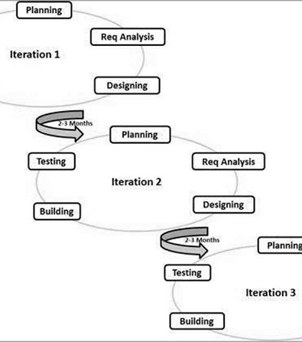
Agenda
AGILE METHOLOGY
ROLES IN AGILE
ADVANTAGES AND DISADVANTAGES OF AGILE
PRINCIPLES OF AGILE MANIFESTO
AGILE CHARACTERISTIC
SCRUM
PRINCIPLE OF KANBAN
EXTREME PROGRAMMING
PRINCIPLES AND VALUES OF EXTREME PROGRAMMING

Slide 3

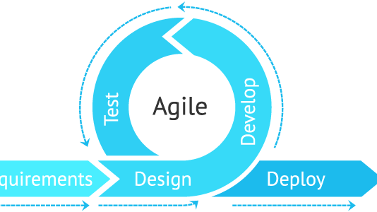
Introduction
Agile is an iterative approach to project management and software development that helps teams deliver value to their customers faster and with fewer headaches. Instead of betting everything on a "big bang" launch, an agile team delivers work in small, but consumable, increments.

Slide 4

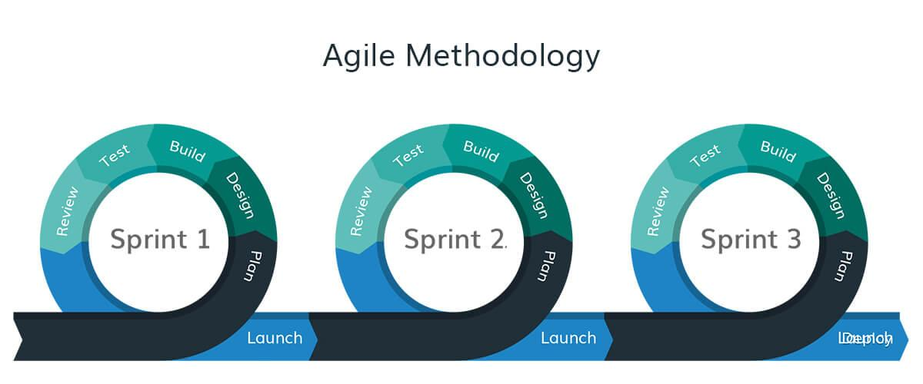
AGILE METHODOLOGY
The Agile methodology is a way to manage a project by breaking it up into several phases. It involves constant collaboration with stakeholders and continuous improvement at every stage. Once the work begins, teams' cycle through a process of planning, executing, and evaluating.

Slide 5
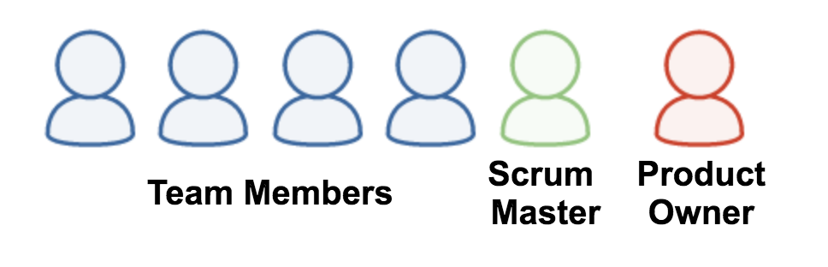

ROLES IN AGILE
There are two different roles in an Agile methodology. These are the Scrum Master and Product Owner.
1. Scrum Master
The Scrum Master is a team leader and facility provider who helps the team member to follow agile practices, so that the team member meets their commitments and customers requirements.

Slide 6
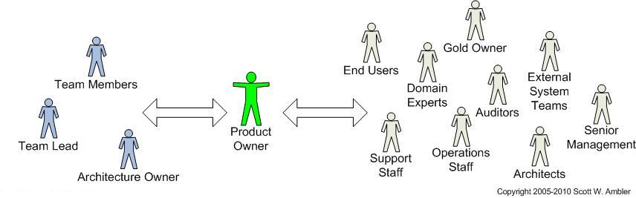
The scrum master plays the following responsibilities: co-operation between all the roles and functions. They remove all the blocks which occur. They safeguard the team from any disturbances. They work with the organization to track the progress and processes of the company.
2. Product Owner
The Product Owner is one who runs the product from a business perspective. The Product Owner plays the following responsibilities:
He defines the requirements and prioritizes their values.
He sets the release date and contents.
He takes an active role in iteration and releasing planning meetings.

Slide 7
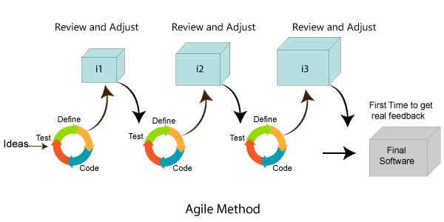
Advantages and Disadvantages of agile
Advantages of Agile
Customer, Developer, and Product Owner interact regularly to emphasize rather than processes and tools.
Product Customer satisfaction is rapid, continuous development and delivery of useful software.
is developed fast and frequently delivered (weeks rather than months.)
A face-to-face conversation is the best form of communication.
It continuously gave attention to technical excellence and good design.
Daily and close cooperation between businesspeople and developers.
Regular adaptation to changing circumstances.
Even late changes in requirements are welcomed.

Slide 8

Disadvantages of agile
It is not useful for small development projects.
There is a lack of intensity on necessary designing and documentation.
It requires an expert project member to take crucial decisions in the meeting.
Cost of Agile development methodology is slightly more as compared to other development methodology.
The project can quickly go out off track if the project manager is not clear about requirements and what outcome he/she wants.

Slide 9
Principle of agile manifesto
The Twelve Principle of Agile Manifesto
Customer Satisfaction: Manifesto provides high priority to satisfy the costumer's requirements. This is done through early and continuous delivery of valuable software.
Welcome Change: Making changes during software development is common and inevitable. Every changing requirement should be welcome, evening the late development phase. Agile process works to increase the customers' competitive advantage.
Deliver the Working Software: Deliver the working software frequently, ranging from a few weeks to a few months with considering the shortest time period.
Collaboration: Businesspeople (Scrum Master and Project Owner) and developers must work together during the entire life of a project development phase.
Motivation: Projects should be built around motivated team members. Provide such environment that supports individual team members and trust them. It makes them feel responsible for getting the job done thoroughly.
Face-to-face Conversation: Face-to-face conversation between Scrum Master and development team and between the Scrum Master and customers for the most efficient and effective method of conveying information to and within a development team.

Slide 10
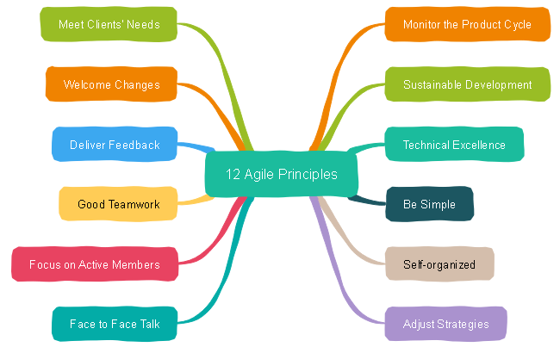
Measure the Progress as per the Working Software: The working software is the key and primary measure of the progress.
Maintain Constant Pace: The aim of agile development is sustainable development. All the businesses and users should be able to maintain a constant pace with the project.
Monitoring: Pay regular attention to technical excellence and good design to maximize agility.
Simplicity: Keep things simple and use simple terms to measure the work that is not completed.
Self-organized Teams: The Agile team should be self-organized. They should not be depending heavily on other teams because the best architectures, requirements, and designs emerge from self-organized teams.
Review the Work Regularly: The work should be reviewed at regular
intervals, so that the team can reflect on how to become more
productive and adjust its behavior accordingly.

Slide 11
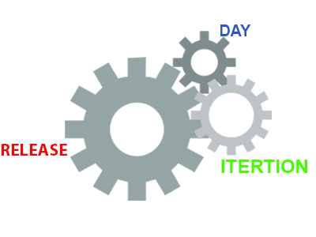
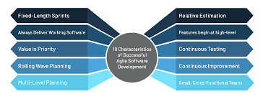
Agile Characteristics
The product developed under agile methodology has seen several important characteristics that are given below.
Agile Development Releases and Fixed-Length Iterations
Agile Development Delivers-Working, Tested Software
Value-Driven Development
Continuous (Adaptive) Planning
Multi-Level Planning in Agile Development
Relative Estimation
Emergent Feature Discovery
Continuous Testing
Continuous Improvement
Small, Cross-functional Teams

Slide 12
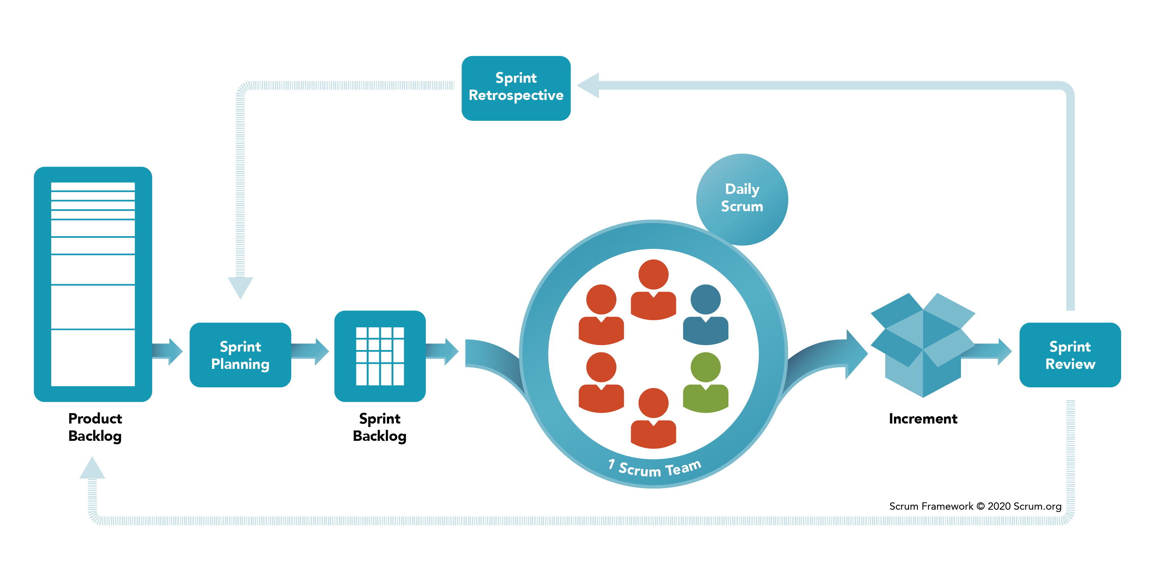
Scrum
Scrum is a framework that helps agile teams to work together. Using it, the team members can deliver and sustain the complex product. It encourages the team to learn through practice, self-organize while working on the problem. Scum is a work done through the framework and continuously shipping values to customers.
The framework
Scrum and agile are not the same thing because Scrum focused on continuous improvement, which is a core foundation of agile. Scrum framework focuses on ongoing getting work done.

Slide 13
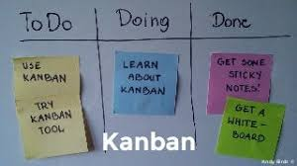
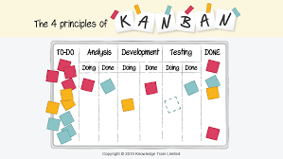
Kanban
Kanban is a popular framework which is used to implement agile software development. It takes real time communication of capacity and complete transparency of work. The work items are represented in a Kanban board visually, allowing team members to see the state of every piece of work at any time.
Principles of Kanban
.Visualize
•Limit work in progress
•Manage flow
•Make policies explicit
•Implement feedback loops
•Improve collaboratively , evolve experimentally

Slide 14
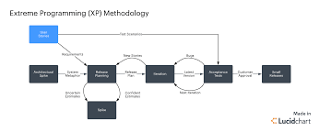
Extreme Programming
Extreme programming is a software development methodology that’s part of what’s collectively known as agile methodologies. XP is built upon values, principles, and practices, and its goal is to allow small to mid-sized teams to produce high-quality software and adapt to evolving and changing requirements.

Slide 15

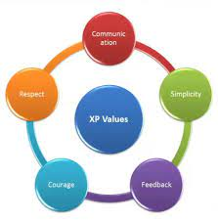
Principles and values of extreme programming
Principles:
Rapid feedback
Assumed simplicity
Incremental changes
Embracing change
Quality work
Values:
Communication
Simplicity
Feedback
Respect
courage

Slide 16


