Slide 1


Slide 2

Agenda
AUTOMATION
TESTING AUTOMATION
WHY YOU REQUIRE THIS AUTOMATION
REASONS
WHICH KIND OF TEST CASE IN AUTOMATION
CRITERIA
STEPS
FRAMEWORK FOR AUTOMATION

Slide 3





Automation
Automation is the implementation of a system that completes easily replicated tasks. Once you’ve found a task that you’re regularly repeating that doesn’t require extensive thought or creativity, there’s a good chance that you’ll be able to teach a computer how to automate it.

Slide 4
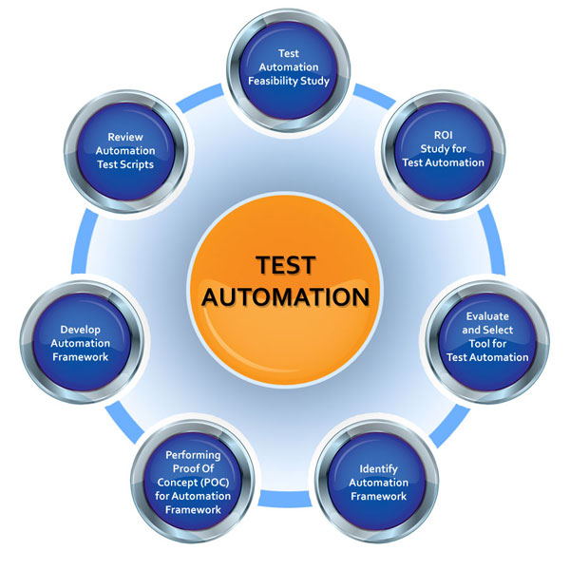
Test Automation
•Automation Testing is a software testing technique that performs using special automated testing software tools to execute a test case suite. On the contrary, Manual Testing is performed by a human sitting in front of a computer carefully executing the test steps.
•The automation testing software can also enter test data into the System Under Test, compare expected and actual results and generate detailed test reports. Software Test Automation demands considerable investments of money and resources.

Slide 5

WHY YOU REQUIRE THIS AUTOMATION
Automated Testing Saves Time and Money
Manually repeating these tests is costly and time consuming. Once created, automated tests can be run repeatedly at no additional cost and they are much faster than manual tests. Automated software testing can reduce the time to run repetitive tests from days to hours.

Slide 6

Reasons
To increase labor productivity. ...
To reduce labor cost. ...
To mitigate the effects of labor shortages. ...
To reduce or eliminate routine manual and clerical tasks. ...
To improve worker safety. ...
To improve product quality. ...
To reduce manufacturing lead time. ...
To accomplish processes that cannot be done manually.

Slide 7

WHICH KIND OF TEST CASE IN AUTOMATION
TEST CASES USED IN AUTOMATION
Unit Testing: Unit testing is the fastest method of testing and, therefore, should be the highest priority for your automation....
Integration Testing: Integration testing, where we're testing our interfaces or modules, should also take high priority.....
Functional Testing: It is a type of testing that seeks to establish whether each application feature works as per the software requirements.

Slide 8
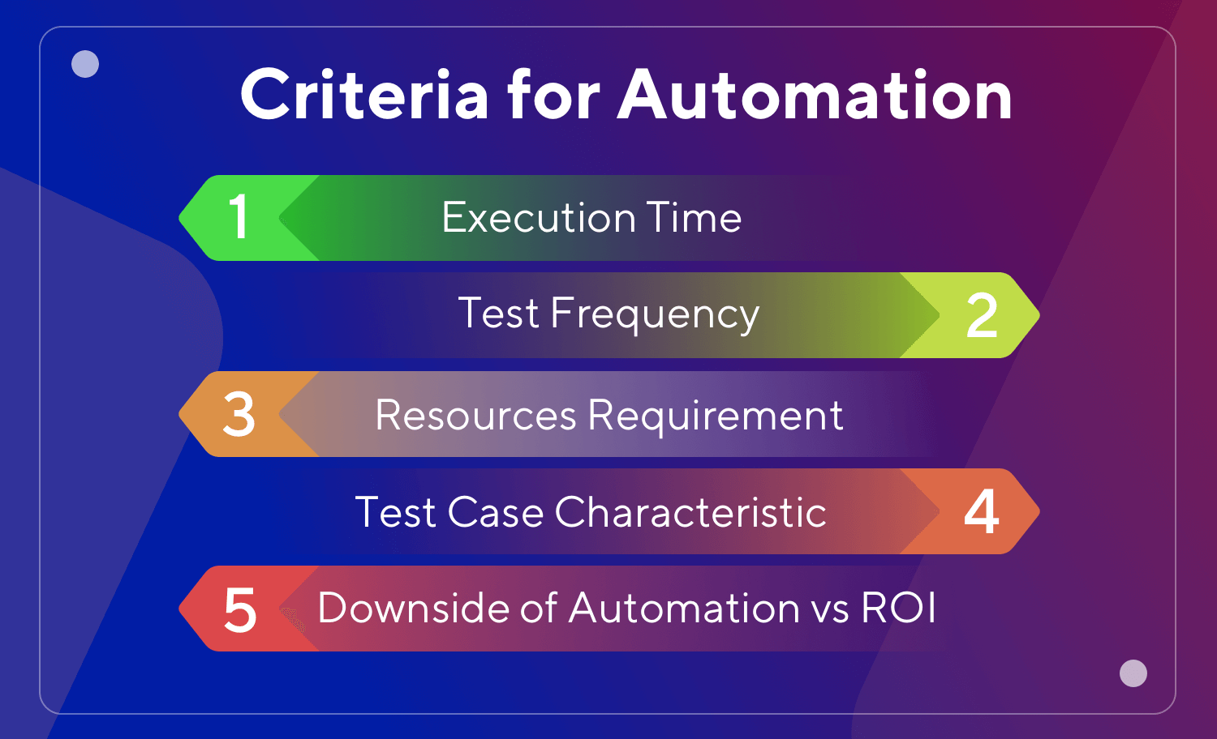
Criteria for Automation
High risk
Repeatedly executed
Difficult to perform
Time Consuming

Slide 9
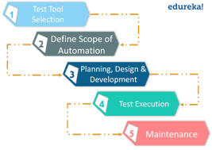
Steps
Test tool selection
.Define scope of automation
Planning,design,develop
Test execution
Test automation maintaince Approach

Slide 10

FRAMEWORK FOR AUTOMATION
Testing frameworks are an essential part of any successful automated testing process. They can reduce maintenance costs and testing efforts and will provide a higher return on investment (ROI) for QA teams looking to optimize their agile processes.
The goal of this article is to walk through the most common types of frameworks used today and the benefits and disadvantages of each. For QA professionals new to automated testing, or those who need a quick refresher, this article will provide a high-level overview of each type of framework and how they can contribute to the success of any automated testing process.

Slide 11

Thank You!
Sravani

