Slide 1

Selenium
Sravani

Slide 2
Agenda
What is Selenium
Prerequirities
Selenium features
Selenium limitations
Selenium Tool suite
Selenium ide
Selenium ide features
Selenium ide commands

Slide 3
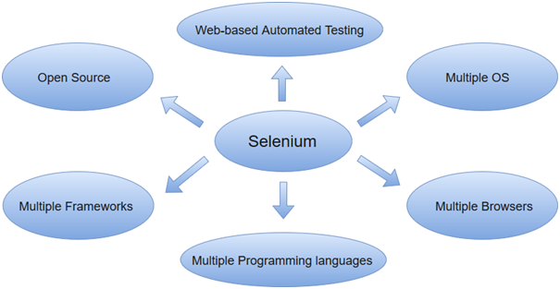
What is Selenium
Selenium is one of the most widely used open-source Web UI (User Interface) automation testing suite . It was originally developed by Jason Huggins in 2004 as an internal tool at Thought Works. Selenium supports automation across different browsers, platforms and programming languages.
Selenium can be easily deployed on platforms such as Windows, Linux, Solaris and Macintosh. Moreover, it supports OS (Operating System) for mobile applications like iOS, windows mobile and android.

Slide 4
Prerequisites
Before learning the concepts of Selenium, you should have a basic understanding of java or any other object-oriented programming language.
Languages supported by Selenium include C#, Java, Perl, PHP, Python and Ruby. Currently, Selenium Web driver is most popular with Java and C#. So, if you know any of the languages then it won't be tough to understand the concepts of Selenium. In addition, you should have prior knowledge of software testing techniques like automation testing, functional testing, etc.

Slide 5
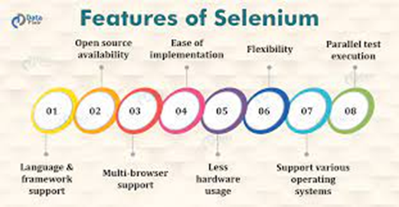
Selenium Features
Selenium is an open source and portable Web testing Framework.
Selenium IDE provides a playback and record feature for authoring tests without the need to learn a test scripting language.
Selenium can be integrated with frameworks like Ant and Maven for source code compilation.
Selenium can also be integrated with testing frameworks like TestNG for application testing and generating reports.
Selenium requires fewer resources as compared to other automation test tools.

Slide 6
Selenium Limitations
Selenium does not support automation testing for desktop applications.
Selenium requires high skill sets in order to automate tests more effectively.
Since Selenium is open-source software, you have to rely on community forums to get your technical issues resolved.
We can't perform automation tests on web services like SOAP or REST using Selenium.
We should know at least one of the supported programming languages to create tests scripts in Selenium WebDriver.

Slide 7
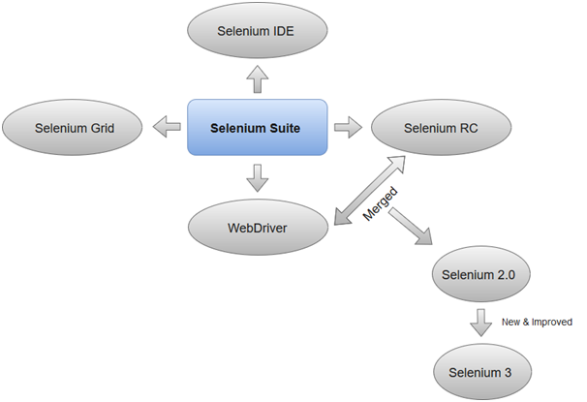
Selenium Tool Suite
Selenium is not just a single tool but a suite of software, each with a different approach to support automation testing. It comprises of four major components which include:
Selenium Integrated Development Environment (IDE)
Selenium Remote Control (Now Deprecated)
WebDriver
Selenium Grid

Slide 8
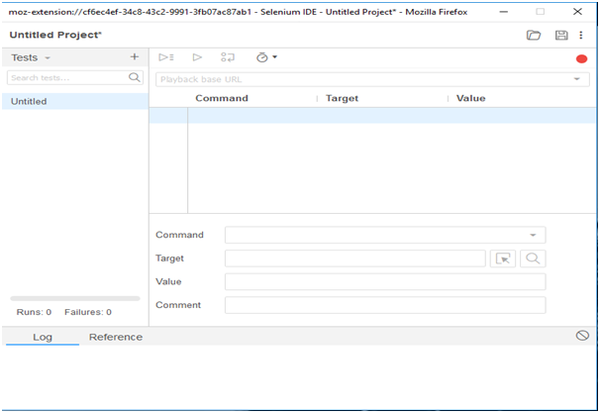
Selenium ide
Selenium IDE (Integrated Development Environment) is an open- source web automation testing tool under the Selenium Suite. Unlike Selenium WebDriver and RC, it does not require any programming logic to write its test scripts rather you can simply record your interactions with the browser to create test cases. Subsequently, you can use the playback option to re-run the test cases.

Slide 9
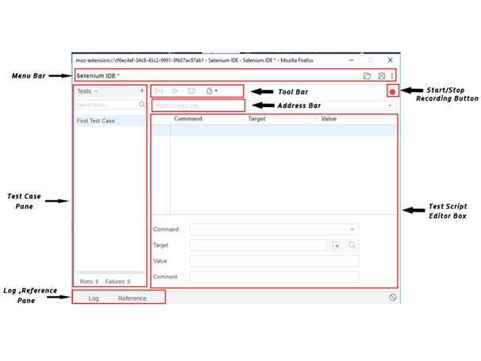
Selenium ide Features
Selenium IDE is divided into different components, each having their own features and functionalities . We have categorized seven different components of Selenium IDE, which includes:
Menu Bar
Tool Bar
Address Bar
Test Case Pane
Test Script Editor Box
Start/Stop Recording Button
Log, Reference Pane

Slide 10
Selenium IDE- Commands (Selenese)
Selenium commands, also known as "Selenese" are the set of commands used in Selenium IDE that run your tests. Using selenese, one can perform activities like:
Testing the existence of UI elements based on their HTML tags.
Test for specific
content.
Test for broken
links.
Testing input fields, selection list options, submitting forms and table data among other things.
. Testing of window size, mouse options, alerts, Ajax functionality, pop-up windows, event handling and many other web application features.

Slide 11
Types of Selenium Commands
1.Actions
2.Accessors.
3.assertions.

Slide 12
Actions :
Actions are commands that manipulate the state of the application. Upon execution, if an action fails the execution of the current test is stopped. For Example, "click a link" and "select an option".
•Click
•Click At
•Close()
•Double Click
•Drag and drop
•Echo
•Mouse down

Slide 13
Accessors:
Accessors evaluate the state of the application and store the results in a variable which are used in assertions. For Example, "store Title".
Store All Buttons(Variable Name)
Store All Fields(Variable Name)
Store All Links(variable Name)
Store All Window ld. (Variable Name)
Assertions:
Assertions enable us to verify the state of an application and compares against the expected. It is used in 3 modes, viz. - "assert", "verify", and "wait for". For Example, "verify if an item form the dropdown is selected".
verify Selected(select Locator , option Locator)
Wait For Selected (select Locator,
Option Locator) verify Alert (pattern)
verify All Buttons (pattern)
Verify All Links (pattern)
Verify All Window Id (pattern)

Slide 14

Thank You……

