Slide 1

Cucumber

Slide 2
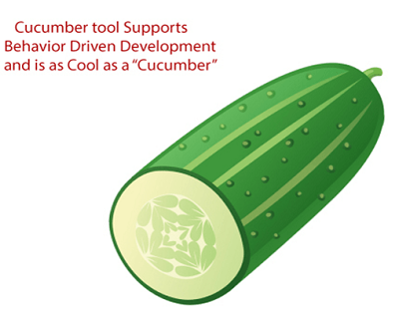
Cucumber is a testing tool that supports Behavior Driven Development (BDD).
It offers a way to write tests that anybody can understand, regardless of their technical knowledge.
Cucumber is a software tool used by the testers to develop test cases for the testing of behavior of the software.
In the Cucumber testing, the test cases are written in a simple English text, which anybody can understand without any technical knowledge.
This simple English text is called the Gherkin language.

Slide 3
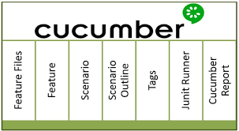
Advantages of cucumber
It is helpful to involve business stakeholders who can’t easily read code
Cucumber Testing tool focuses on end-user experience
Style of writing tests allow for easier reuse of code in the tests
Quick and easy set up and execution
Cucumber test tool is an efficient tool for testing

Slide 4
Behavior Driven Development (BDD)

Slide 5
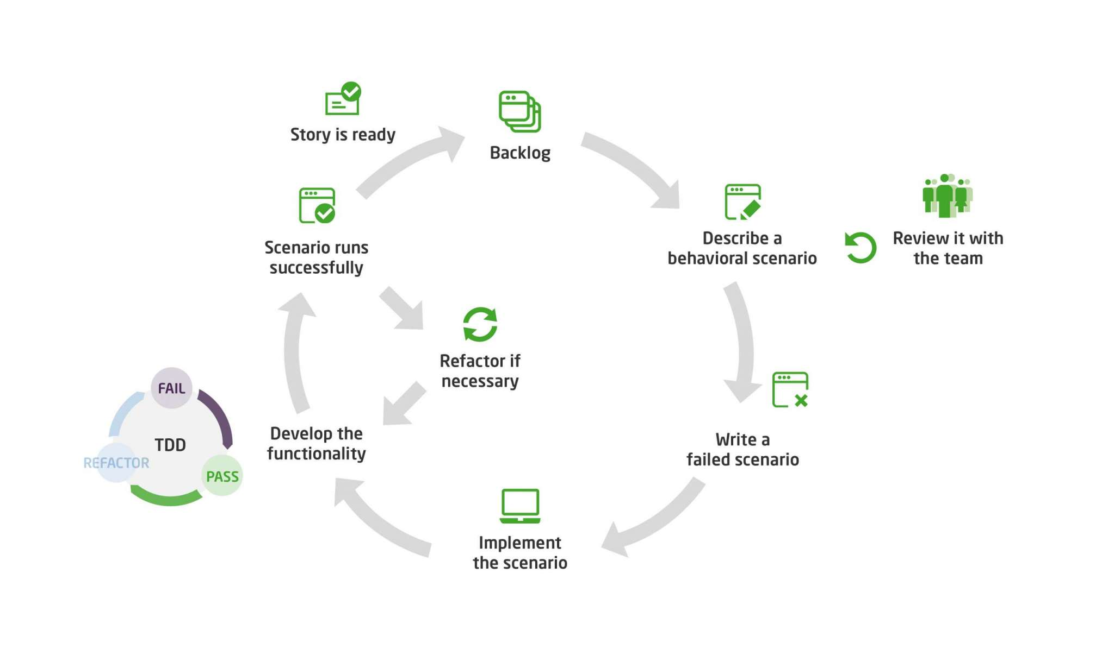
BDD (Behavioral Driven Development) is a software development approach that was developed from Test Driven Development (TDD).
BDD includes test case development in the form of simple English statements inside a feature file, which is human-generated.
Test case statements are based on the system's behavior and more user-focused.
BDD is written in simple English language statements rather than a typical programming language, which improves the communication between technical and non-technical teams and stakeholders.

Slide 6
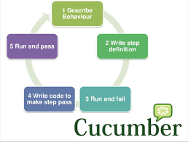
Characteristics of BDD
Strong collaboration
High Visibility
The software design follows the business value
The Ubiquitous Language
Software development meets the user need
More confidence from the developers' side
Lower Costs

Slide 7
Test driven development (TDD)

Slide 8
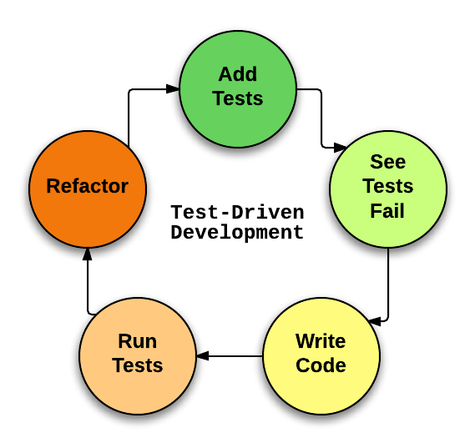
Test-driven development, or TDD for short, is a software development process.
As the name implies, involves utilizing tests to guide application development, resulting in simple, iterative implementation with good test coverage right from the start.
Test-Driven Designing and building tests for each single function of an application is the first step in development.
Only when an automated test fails, the TDD framework tell developers to write new code. It prevents code duplication.

Slide 9
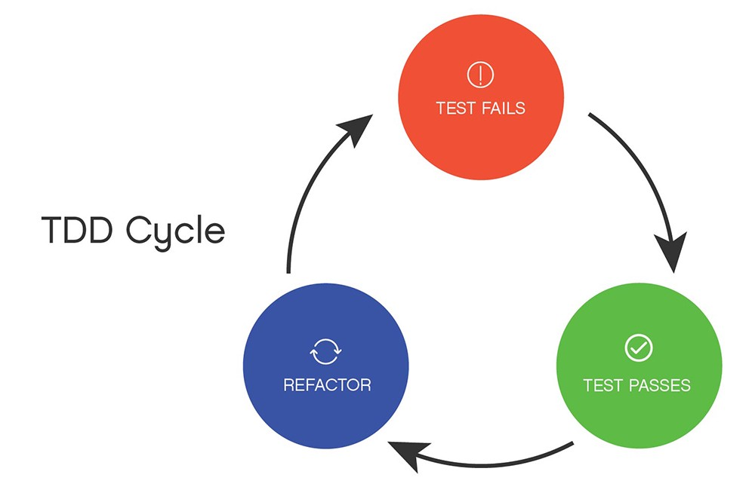
The TDD cycle identifies
Make a test
Allow it to run.
Refactoring is the process of changing the code to make it better.
Repeat the procedure.
Clarifications about TDD
The TDD technique isn't about "testing" or "design."
TDD does not imply that you should "create some tests, then construct a system that passes them."
TDD does not imply that you should test a lot.

Slide 10
Thankyou

