Slide 1

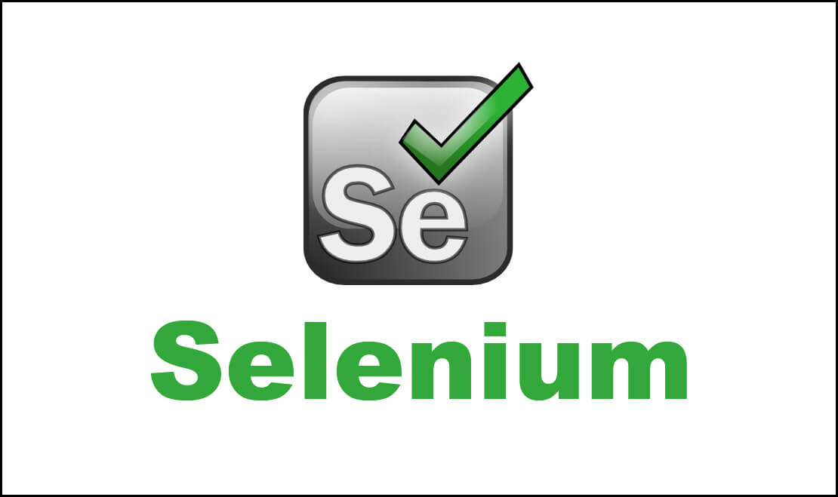

Slide 2
WHAT IS SELENIUM ?
PREREQUIRITIES
SELENIUM FEATURES
SELENIUM LIMITATIONS
SELENIUM TOIOL SUITE
SELENIUM IDE
SELENIUM IDE FEATURES
SELENIUM IDE COMMANDS
CONTENT

Slide 3
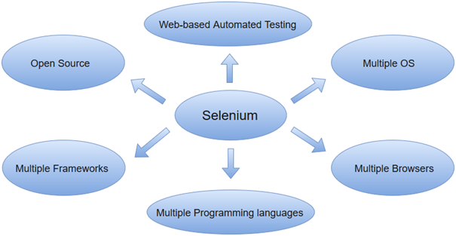
Selenium
Selenium is one of the most widely used open source Web UI (User Interface) automation testing suite.It was originally developed by Jason Huggins in 2004 as an internal tool at Thought Works. Selenium supports automation across different browsers, platforms and programming languages.
Selenium can be easily deployed on platforms such as Windows, Linux, Solaris and Macintosh. Moreover, it supports OS (Operating System) for mobile applications like iOS, windows mobile and android.
Selenium supports a variety of programming languages through the use of drivers specific to each language.Languages supported by Selenium include C#, Java, Perl, PHP, Python and Ruby.Currently, Selenium Web driver is most popular with Java and C#. Selenium test scripts can be coded in any of the supported programming languages and can be run directly in most modern web browsers. Browsers supported by Selenium include Internet Explorer, Mozilla Firefox, Google Chrome and Safari.

Slide 4
Prerequisites
Languages supported by Selenium include C#, Java, Perl, PHP, Python and Ruby.Currently, Selenium Webdriver is most popular with Java and C#. So, if you know any of the languages then it won't be tough to understand the concepts of Selenium. In addition, you should have prior knowledge of software testing techniques like automation testing, functional testing, etc.
Selenium Features
Selenium is an open source and portable Web testing Framework.
Selenium IDE provides a playback and record feature for authoring tests without the need to learn a test scripting language.
It can be considered as the leading cloud-based testing platform which helps testers to record their actions and export them as a reusable script with a simple-to-understand and easy-to-use interface.
Selenium supports various operating systems, browsers and programming languages. Following is the list:
Programming Languages: C#, Java, Python, PHP, Ruby, Perl, and JavaScript
Operating Systems: Android, iOS, Windows, Linux, Mac, Solaris.
Browsers: Google Chrome, Mozilla Firefox, Internet Explorer, Edge, Opera, Safari, etc.
It also supports parallel test execution which reduces time and increases the efficiency of tests.

Slide 5
Selenium does not support automation testing for desktop applications.
Selenium requires high skill sets in order to automate tests more effectively.
Since Selenium is open source software, you have to rely on community forums to get your technical issues resolved.
We can't perform automation tests on web services like SOAP or REST using Selenium.
We should know at least one of the supported programming languages to create tests scripts in Selenium WebDriver.
Selenium Limitations

Slide 6
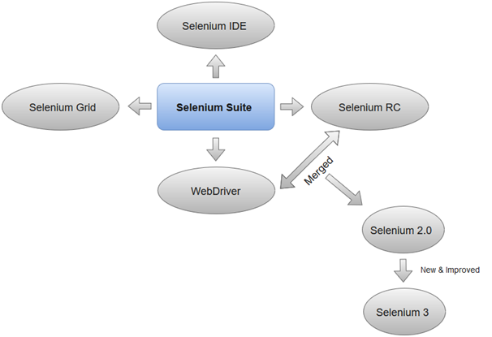
Selenium Tool Suite
Selenium Integrated Development Environment (IDE)
Selenium IDE (Integrated Development Environment) is an open source web automation testing tool under the Selenium Suite. Unlike Selenium WebDriver and RC, it does not require any programming logic to write its test scripts rather you can simply record your interactions with the browser to create test cases. Subsequently, you can use the playback option to re-run the test cases.

Slide 7
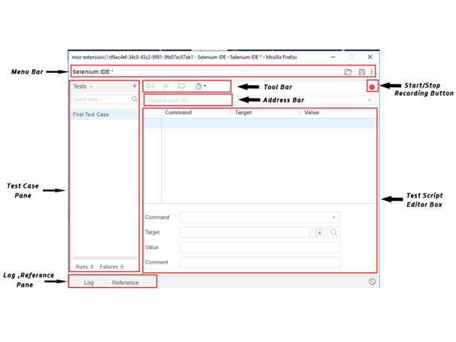
Selenium IDE-Features
Selenium IDE is divided into different components, each having their own features and functionalities.We have categorized seven different components of Selenium IDE, which includes:
Menu Bar
Tool Bar
Address Bar
Test Case Pane
Test Script Editor Box
Start/Stop Recording Button
Log, Reference Pane

Slide 8
Selenium IDE- Commands (Selenese)
Selenium commands, also known as "Selenese" are the set of commands used in Selenium IDE that run your tests. Using selenese, one can perform activities like:
Testing the existence of UI elements based on their HTML tags.
Test for specific content.
Test for broken links.
Testing input fields, selection list options, submitting forms and table data among other things.
Testing of window size, mouse options, alerts, Ajax functionality, pop-up windows, event handling and many other web application features.
A sequence of Selenium commands (Selenese) together is known as test script.
Types of Selenium Commands
Selenium commands are basically classified in three categories:
Actions
Accessors
Assertions

Slide 9


