Slide 1




Slide 2

contents
Introduction of postman
Terminologies Related to Postman
Use of Postman
Postman sending your first request
Creating the First Collection
Creating Requests
GET Request in Postman
POST Request in Postman

Slide 3
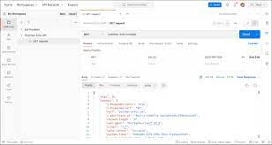
Introduction of postman
Postman is a standalone software testing API (Application Programming Interface) platform to build, test, design, modify, and document APIs. It is a simple Graphic User Interface for sending and viewing HTTP requests and responses.
While using Postman, for testing purposes, one doesn't need to write any HTTP client network code. Instead, we build test suites called collections and let Postman interact with the API.

Slide 4

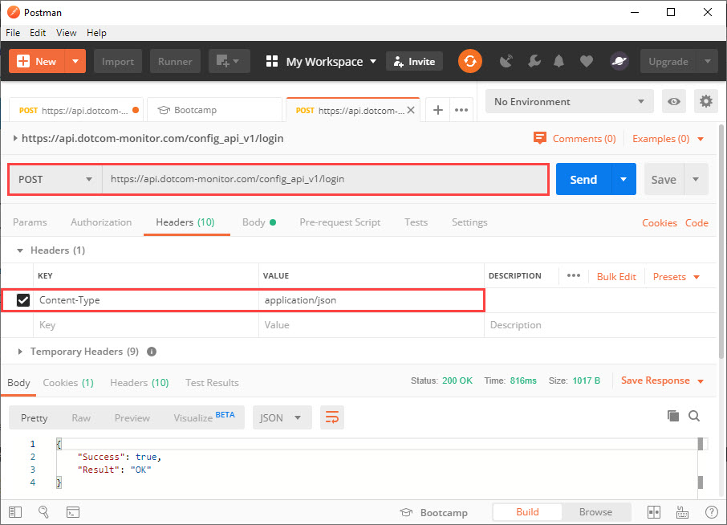
Terminologies Related to Postman
API
Application Programming Interface (API) is software that acts as an intermediary for two apps to communicate with each other. We use APIs whenever we use an application like Twitter, Facebook, sending text messages, or checking the weather over the phone.
HTTP
HTTP (Hypertext Transfer Protocol) is the collection of rules for the transmission of data on the World Wide Web, like graphic images, text, video, sound, and other multimedia data. The Web users implicitly make use of HTTP as soon as they open their Web browser.

Slide 5
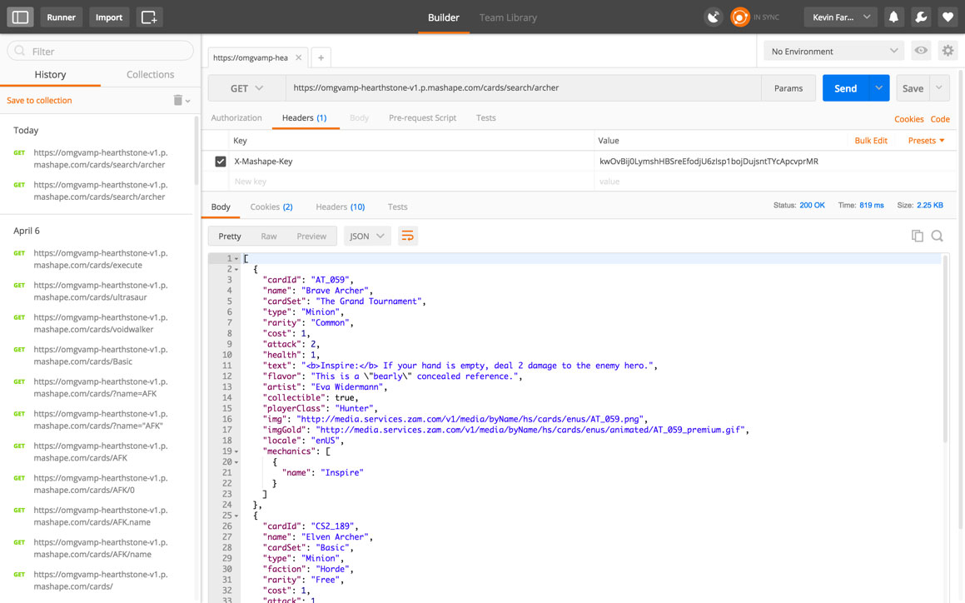
Use of Postman
Postman is based on a wide range of extremely user-friendly power tools. For more than 8 million users, Postman has become a tool of convenience. Following are the reasons why Postman is used:
Accessibility
Use Test development
Automation Testing
Creating
Environments
Debugging
Collaboration
Continuous integration

Slide 6
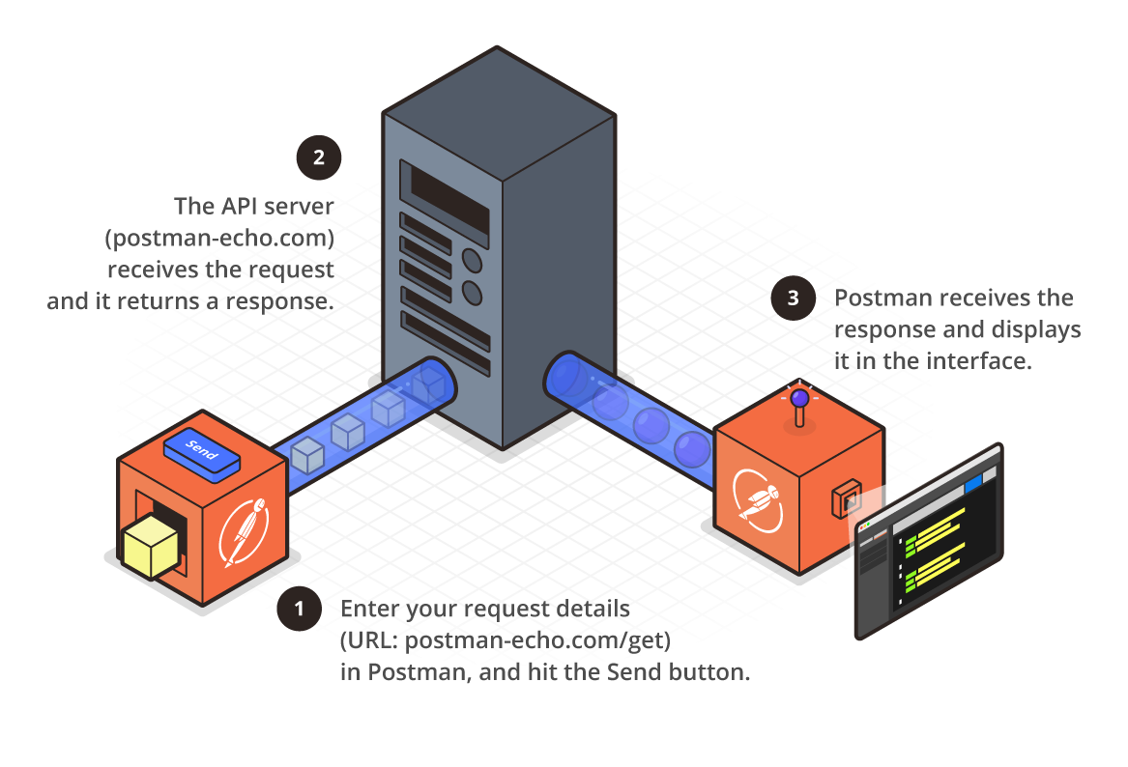
Postman sending your first request
ending a request is as easy as posting a URL into your web browser.
We can easily send requests to APIs in Postman.
An API request helps you to access, or send, data from a data source.
To send the API request, we need an HTTP method. Some commonly used methods are POST, GET, DELETE, PUT, and PATCH.
GET: This HTTP method is used to access the data from an API.
POST: This method transmits new data.
DELETE: This is used to remove or delete the existing data.
PATCH: This method is used to update the existing data.
PUT: This method is used to update the existing data.

Slide 7
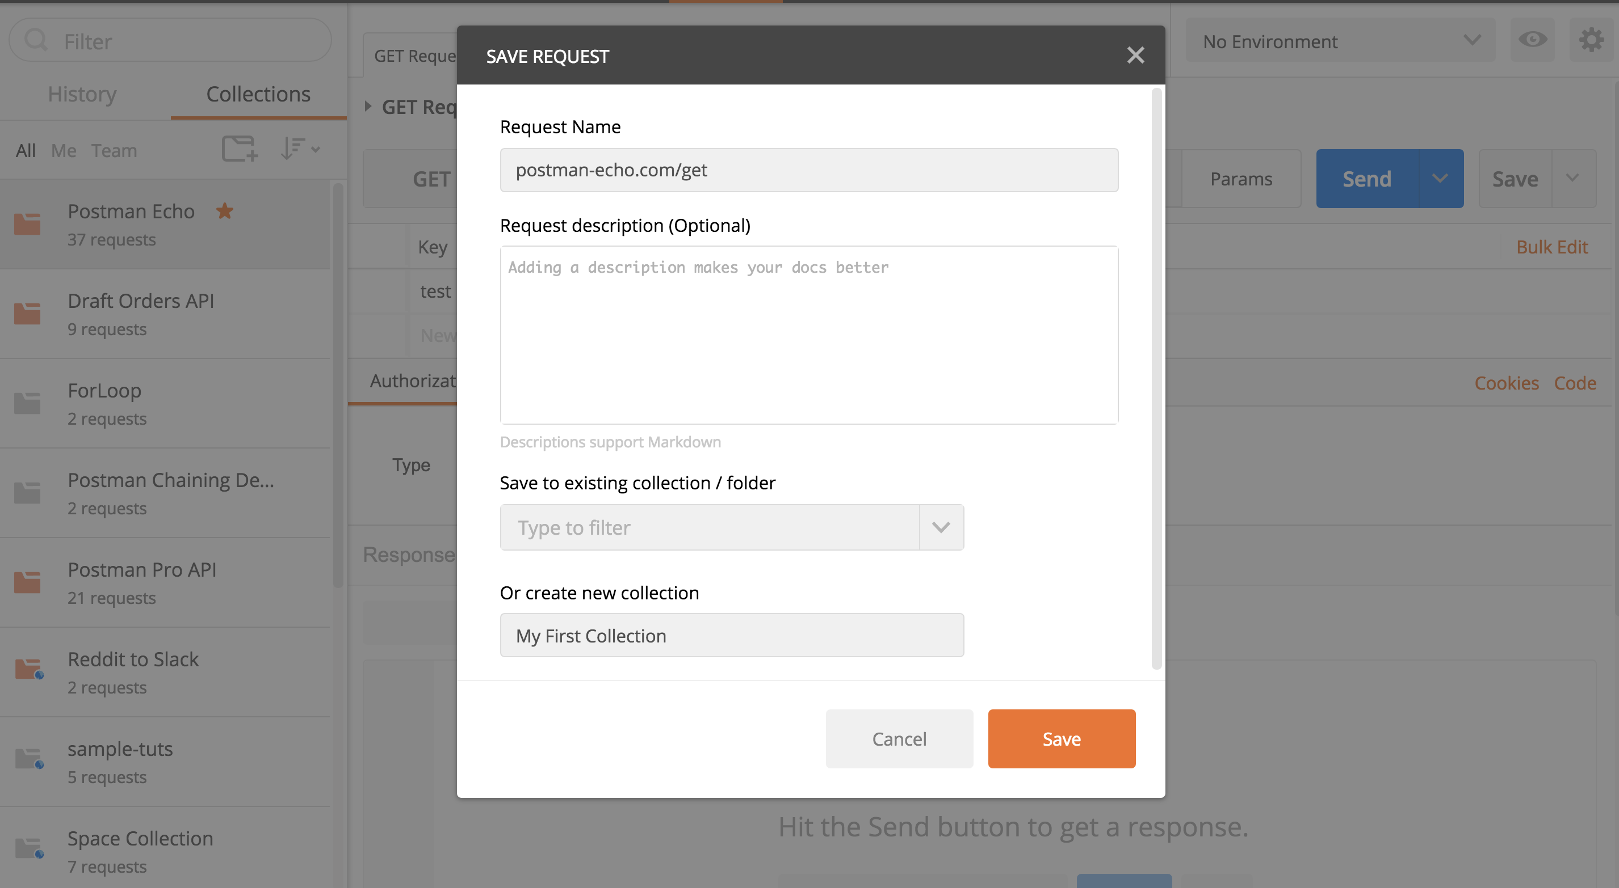
Creating the First Collection
Collection in Postman means a group of API requests that you have already saved in the Postman. You can arrange these requests into folders.
Steps to Create the First Collection
Enter the new request in the Request URL option, which is present in the Builder section.
You can change the Request name, or by default, Request URL will be displayed as the Request name.
You can also write the Request description as an optional step.
Now go to create a collection option and write a name to your collection. I have named it First Collection, as you can see in the image above.
Save your collection by clicking on the Save button.
Now, after saving, you can see your collection in the sidebar under the Collection tab, as shown in the image below.
Within a collection, any number of requests can be added.

Slide 8
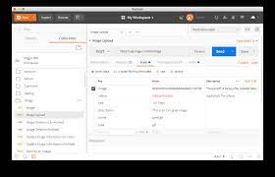
Advantages of creating collections
Easy APIs import and export
Request categorization
Passing data among requests
Running collections/folders.
API documentation
Building Test suits
Time-saving

Slide 9
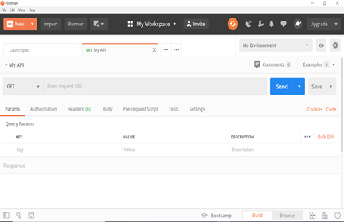
Creating Requests
To create a request, follow the following steps:
Step 1: Launch the Postman.
Step 2: Click on New option from the top left corner of the Postman homepage window. Once you click on the button, a drop-down menu will open.
Step 3: Click on the Request option from the drop-down list.
Step 4: Once you select the Request option, you will be prompted to enter the request name, and you can also describe that API for future use. The description section is optional; we can leave it blank.
Here my Request name is "My API."
Step 5: Scroll down and click on + Create Collection.
Step 6: Click on the Save button to create your request.
Step 7: Enter www.javatpoint.com in the address bar and click on Send.

Slide 10
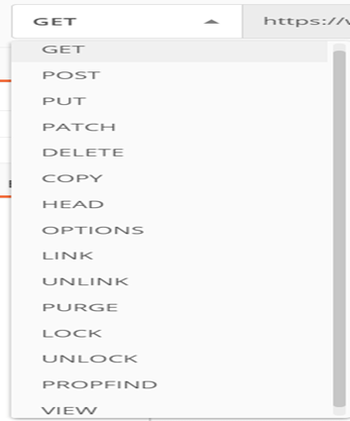
GET Request in Postman
To create the first GET request in Postman, follow the following steps:
Step 1: Create a request. To create a new request, open a new tab, click from the + plus button.
Step 2: Enter the URL in the address bar. We will use www.javatpoint.com.
Step 4: Now press send.
Step 5: Once you press the send button, you will get the response from the server. Make sure you have a proper internet connection; otherwise, you will not get a response

Slide 11
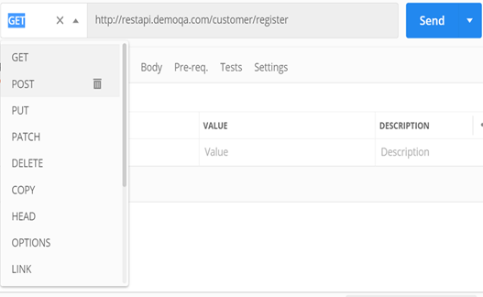
POST Request in Postman
The post is an HTTP method like GET.
The POST request is a fundamental method, and this method is mostly used when a user wants to send some sensitive data to the server like to send a form or some confidential data.
Important points of the POST request:
POST requests will not take the cookies.
POST requests are not left in the history of browsers.
We cannot bookmark the POST requests.
There is no restriction of data length in POST requests.

Slide 12
Thank you

