Slide 1
Agenda
•SELENIUM
•SELENIUM FEATURES
•SELENIUM LIMITATIONS
Commands in Selenium
SELENIUM IDE
•SELENIUM IDE FEATURES
•SELENIUM IDE COMMANDS

Slide 2
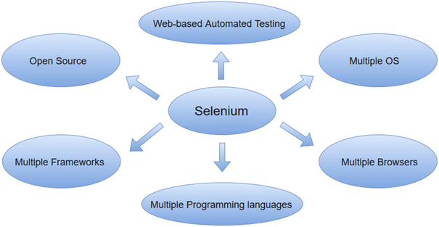
Selenium
selenium is an open-source and a portable automated software testing tool for testing web applications. it has capabilities to operate across different browsers and operating systems. selenium is not just a single tool but a set of tools that helps testers to automate web-based applications more efficiently.
tools available in the selenium suite and their usage.
selenium ide
selenium RC
selenium Web driver
selenium grid

Slide 3
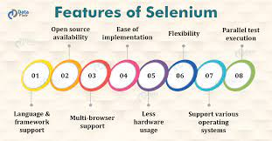
Features of Selenium
Language & framework support
Open- Source Availability
Multi-browser Support
Ease of Implementation
Less Hardware Usage
Flexibility
Support Various Operating System
Parallel test execution

Slide 4
Types Of Selenium Commands
Actions
Accessors
Assertions

Slide 5
Actions :
Actions are commands that manipulate the state of the application. Upon execution, if an action fails the execution of the current test is stopped. For Example, "click a link" and "select an option".
Click
Click At
Close()
Double Click
Drag and drop
Echo
Mouse down
Open(url)
Open Window(url , WindowID)
Pause()

Slide 6
Accessors:
Accessors evaluate the state of the application and store the results in a variable which are used in assertions. For Example, "store Title".
Store All Buttons(Variable Name)
Store All Fields(Variable Name)
Store All Links(variable Name)
Store All Windowld(Variable Name)
Assertions:
Assertions enable us to verify the state of an application and compares against the expected. It is used in 3 modes, viz. - "assert", "verify", and "wait for". For Example, "verify if an item form the dropdown is selected".
verify Selected(select Locator , option Locator)
Wait For Selected (select Locator,
Option Locator) verify Alert (pattern)
verify All Buttons (pattern)

Slide 7
Selenium Limitation
Selenium does not support automation testing for desktop applications.
Selenium requires high skill sets in order to automate tests more effectively.
Since Selenium is open -source software, you have to rely on community forums to get your technical issues resolved.
We can't perform automation tests on web services like SOAP or REST using Selenium.
We should know at least one of the supported programming languages to create tests scripts in Selenium WebDriver.

Slide 8
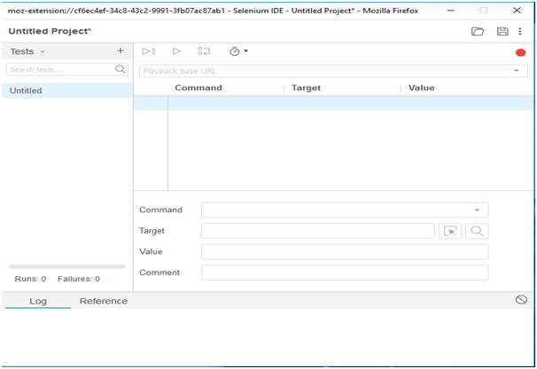
Selenium IDE
Selenium IDE (Integrated Development Environment) is primarily a record/run tool that a test case developer uses to develop Selenium Test cases. Selenium IDE is an easy-to-use tool from the Selenium Test Suite and can even be used by someone new to developing automated test cases for their web applications

Slide 9
Features of Selenium IDE
There are several features provided in the IDE under the toolbar, using which one can control the execution of test cases:
Speed Control – Helps control the speed of test cases
Run All – Allows execution of the entire Test Suite
Run – Runs the currently selected test
Pause/Resume – Allows a user to pause and resume a particular test case
Step – Helps step into each specific command in the test script
Rollup – Helps group all the Selenese Commands together and make them execute as a single operation

Slide 10
Selenium IDE Commands
Selenium commands, also known as "Selenese" are the set of commands used in Selenium IDE that run your tests. Using selenese, one can perform activities like:
•Testing the existence of UI elements based on their HTML tags.
•Test for specific content.
•Test for broken links.
•Testing input fields, selection list options, submitting forms and table data among other things.
•Testing of window size, mouse options, alerts, Ajax functionality, pop-up windows, event handling and many other web application features.

Slide 11

Thank you

