Slide 1
Introduction of Junit and Xunit
Junit:
java provides a framework called JUnit to perform the unit testing of our Java code.
In the development of test-driven development, JUnit is very important.
The JUnit is one of the frameworks available in the unit testing frameworks.
Xunit:
The xunit is the unit testing framework family, and JUnit is the part of the xUnit.
All X Unit frameworks share the following basic component architecture, with some varied implementation details

Slide 2
JUnit Annotations
S.No. | Annotations | Description
1. | @Test | This annotation is a replacement of org.junit.TestCase which indicates that public void method to which it is attached can be executed as a test Case.
2. | @Before | This annotation is used if you want to execute some statement such as preconditions before each test case.
3. | @BeforeClass | This annotation is used if you want to execute some statements before all the test cases for e.g. test connection must be executed before all the test cases.
4. | @After | This annotation can be used if you want to execute some statements after each Test Case for e.g resetting variables, deleting temporary files ,variables, etc.
5. | @AfterClass | This annotation can be used if you want to execute some statements after all test cases for e.g. Releasing resources after executing all test cases.

Slide 3
TestNG
TestNG is one of the most widely used opensource testing framework used in automation testing suite.
TestNG provides you full control over the test cases and the execution of the test cases. Due to this reason, TestNG is also known as a testing framework.

Slide 4
Assertions In Selenium
Assertions are used to perform various kinds of validations in the test cases, which in turn helps us to decide whether the test case has passed or failed.
Junit Assert Methods
AssertEquals: assertequals method compares the expected result with that of the actual result. It throws an AssertionError if the expected result does not match with that of the actual result and terminates the program execution at assert equals method.
Example: Assert.assertEquals(expected, actualURL);

Slide 5
Assert True : Asserttrue method asserts that a specified condition is true.
Example: assert. assertTrue(“Assert True test message”, true);
Assert False: assert false method asserts that a specified condition is false.
Example: assert. assertFalse(“Assert false test message” false);
AssertNull: assert null is used to verify if the provided object contains a null value.
Example: DemoClass demo = new DemoClass(); Assert.assertNull(demo);
assertNotNull: assert not null is used to verify that a provided object does not hold a null value.
Example: DemoClass demo = new DemoClass(); Assert.assertNotNull(demo);

Slide 6
TestNG Assert Methods
TestNG Assert methods will be the same as the Junit assertion methods
TestNG provides more advanced assertion handling techniques such as dependent classes, Group tests, Parameterized tests, etc.
assertEquals: This method is used to assert if two data values are equal.
Syntax: Assert.assertEquals(actual,expected)
assertNotEquals: assertNotEquals is used to verify if two data values are not equal
Syntax: Assert.assertNotEquals(actuals,expected)
AssertTrue: assertTrue is used to verify if a given Boolean condition is true
Syntax: Assert.assertTrue(BooleanCondition);

Slide 7
assertNotEquals : assertNotEquals is used to verify if two data values are not equal
Syntax: Assert.assertNotEquals(actuals,expected)
AssertTrue : assertTrue is used to verify if a given Boolean condition is true
Syntax: Assert.assertTrue(BooleanCondition);
AssertFalse : assertFalse is used to verify if a given Boolean condition is false.
Syntax: Assert.assertFalse(BooleanCondition);
AssertNull : This assertion is used to verify if an object has a null return value. In other words, it checks if the result is null. When the object is Null, the assertion is passed without any exception.
Syntax: AssertNull(Object)

Slide 8
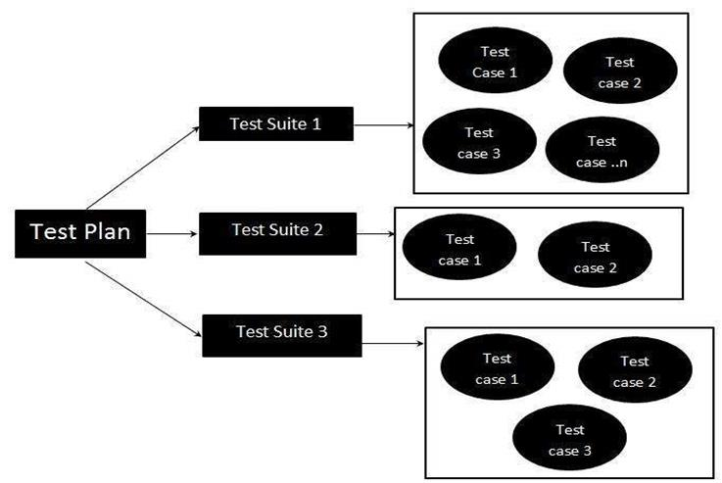
Test Suits
Test suite is a container that has a set of tests which helps testers in executing and reporting the test execution status.
It can take any of the three states namely Active, In progress and completed.
A Test case can be added to multiple test suites and test plans.
After creating a test plan, test suites are created which in turn can have any number of tests.
Test suites are created based on the cycle or based on the scope. It can contain any type of tests, viz - functional or Non-Functional.

Slide 9
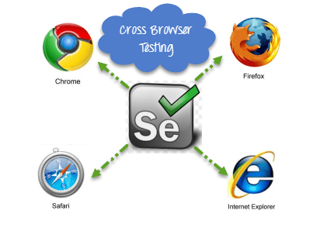
Cross Browser Testing in Selenium WebDriver
Cross Browser Testing refers to testing a website in multiple browsers like IE, Chrome, Firefox to check its efficacy on each.
Cross-browser compatibility is the ability of the website or web application to function across different browsers and operating systems.

Slide 10
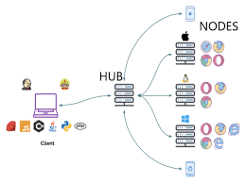
Selenium Grid
Selenium Grid is a feature in Selenium that allows you to run test cases in different machines across different platforms. The control of triggering the test cases is on the local machine, and when the test cases are triggered, they are automatically executed by the remote machine.
•It supports distributed test execution. Initially, you have a local machine where you write the test cases and executes on the same machine. However, in a big organization, you have multiple test cases, and it's not possible to run all the test cases in the same machine. In a large organization, you have multiple servers, so local machine distributes the test cases across different machines/servers.
•You can also run the test cases in parallel in multiple machines on Selenium Grid.

Slide 11

Thank you

