Slide 1

AGILE TESTING
-By G Pavan Kumar

Slide 2
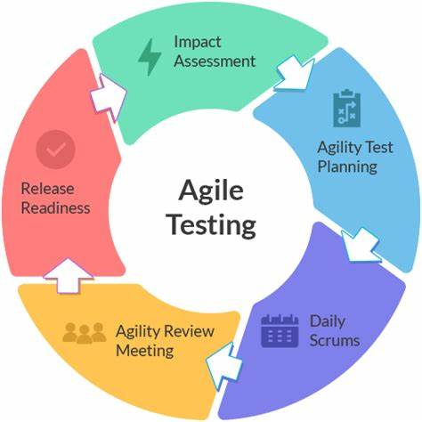
Agile Model
Agile development model is also known as Incremental model. Software is developed in incremental, rapid cycles. This results is small increment releases with each release building on previous functionality. Each release is thoroughly tested to ensure software quality is maintained.
It is used for time critical applications. Extreme programming(XP) is currently one of the most well known agile development life cycle mode.

Slide 3
Diagram Agile Model
Kickoff
Sprint
planning
Sprint
planning
Sprint
planning
Demo
Dev
Demo
Dev
Demo
Dev
Test
Test
Test
Deployment
Deployment
Deployment

Slide 4
Principles of Agile
Customer Satisfaction: Our highest priority is to satisfy the customer through early and continuous delivery of valuable Software.
Welcome change: Welcome change requirements, even late in development. Agile process harness change for the customer’s competitive advantage.
Deliver Working software frequently, from a couple of weeks to couple months, with a preference to the shorter timescale.
Collaboration: Business people and developers must works together daily thought the project.
Motivation: Build projects around motivated individuals, give them the environment and support they need, and trust to get the job done.

Slide 5
6) Face-to- Face conversation: The most efficient and effective method of conveying information to and within a development team is face-to-face conversation.
7) Working software is the primary measure of progress.
8) Maintain constant page: Agile process promote sustainable development, The sponsors, developers, and End users should be able to maintain a constant pace indefinitely.
9) Monitoring: Continuous attention to technical excellence and good design enhances agility.
10) Simplicity: The art of maximizing the amount of work not done- in essential.
11) Self-Organizing: The best Architectures, Requirements, and designs emerge from self-organizing teams.
12) Review the work regularly: At regular intervals, the teams reflects on the how to become more effective, then the tunes and adjusts its behaviour accordingly.

Slide 6
Advantages of Agile Model
Customer satisfaction by rapid, continuous delivery of useful software.
People and interactions are emphasized rather than process and tools, Customers, developers and Testers constantly interact with each other.
Face-to-Face conversation is the best for communication.
Regular adaption to changing circumstances.
Even late changes in requirements are welcomed.
Continuous attention to technical excellence and good design.

Slide 7
Disadvantages of Agile Model
In case of some software deliverables, especially the large ones, it is difficult to assess the effort required at the beginning of the software development life cycle.
Cost is very high.
It is not useful for small projects.
In the middle of the project it requires the Expert to take decisions.
There is lack of emphasis on necessary designing and documentation.

Slide 8
Roles and Responsibilities in an Agile Team
Product Owner: Product owners are responsible for managing the product roadmap and prioritizing the backlog. They are responsible for defining the product vision, managing stakeholders, and maximizing ROI.
2.Team Lead/Scrum Master: Depending on the methodology used by the Agile team, the role of the Scrum Master is while the team leader is a role in an Agile team doing Kanban.
3.Development Team Members: A development team is a group of people who are responsible for building a product. They may be working in an Agile environment, which means that they are using Agile methodologies.
4.Stakeholders: The stakeholders are those who have an interest in the project that is being undertaken. They can be internal or external to the organization, and they may have a financial, operational, or strategic interest in the project.

Slide 9
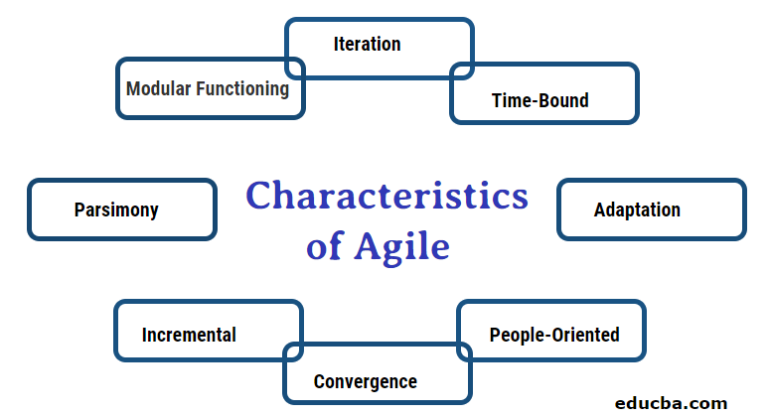
Characteristics of Agile model

Slide 10
1. Modular Functioning:
Modularity is considered one of the key elements of a good process. Modularity is the element that allows the components to break down and that broken component is called activities. The software development process is just the set of activities that frames or transforms the vision of the software system into reality.
2. Iteration:
The agile software development process acknowledges the working on attempting wrong before its correct. So, for this reason, agile processes focus on small cycles. Each cycle has a task of defined activities, and those activities must be completed in a correct manner, these cycles have a time slot of a week, from starting to completing the activities.
3. Time-Bound:
Software development comes with time limits, or the development team must give a delivery date to the customer, to keep things under track the iterations play a good role as it keeps time limit between one and six weeks on each iteration and it can be scheduled accordingly.
4. Parsimony:
Agile software development is considered an upgraded version of the traditional approach with time constrains add on.
5. Adaptation:
During the development or during iterations there are higher chances of unknown risks they may be exposed; the agile approach is prepared to deal with these unknown risks. If there are changes in different results during the functionality, new activities or functionality can be added to reach the goal.

Slide 11
6. Incremental
Agile system is not built entirely at once, the system is partitioned and look out for increments that can be parallelly developed, at a different time and a different rate. Each increment is tested independently and if found ok then all are integrated into the one system for the result.
7. Convergence
It means that the risks are attacked actively because it is worth to know the risks. This takes the system closer to the results. Risks solving during each iteration is one of the great processes that leads to a successful iteration.
8. People-Oriented
The agile process is known for its priority towards customers over process and technology. The involvement of the customer is done organically. The developers evolve through adaptation and are empowered to raise their productivity and performance. These developers are very aware of dealing with the changes in the system at every stage.
9. Collaboration
The agile process has a very practical approach for discussions that is face-to-face discussion whether it is with the customer or with the team members itself. Good communications play an important role in the success of the project in the software development field.

Slide 12
Kanban-Agile

Slide 13
KANBAN- AGILE
Definition Kanban is a popular framework used to implement agile software development. It requires real-time communication of capacity and full transparency of work.
Agile Kanban is Agile Software Development with Kanban approach. In Agile Kanban, the Kanban board is used to visualize the workflow. The Kanban board is normally put up on a wall in the project room. The status and progress of the story development tasks is tracked visually on the Kanban board with flowing Kanban cards.
It is to indicate the program.
It is a kind of technique.
And we can visualize what is going on.

Slide 14
Principles of Agile-Kanban
1. Visualize Workflow:
Kanban was designed to visualize the workflow. Anyone looking to implement the Kanban method will need to visualize their workflow. What that means is putting your workflow on a board. That board, as mentioned above, could be an actual board, or Kanban software. Then, you need to detail the steps in your process or production that deliver the service or product.
2. Limit Work in Progress (WIP):
Work in progress (WIP) is a term that refers to the tasks that are being worked on at the time, whether by the team or a single team member. This is an important Kanban principle, as it can help prevent work overloads and improve workflow.

Slide 15
3. Focus on Flow:
The Kanban process is about visualizing workflow and in so doing managing it to improve that flow. Therefore, focusing on the flow of your board is a guiding Kanban principle. These principles are in order, therefore, once you do the above two Kanban principles, you can begin to manage the flow.
4. Continuous Improvement:
Since Kanban is evolutionary, which means change, you will be always reviewing and modifying your Kanban process to improve the flow. This can be done by experimenting with small changes and making incremental improvements that can be easily handled by the whole team using the scientific management method.

Slide 16
THANKYOU

