Slide 1

JAVA

Slide 2
What is Java?
Java is a programming language and a platform. Java is a high level, robust, object-oriented and secure programming language.
Java was developed by Sun Microsystems (which is now the subsidiary of Oracle) in the year 1995. James Gosling is known as the father of Java. Before Java, its name was Oak. Since Oak was already a registered company, so James Gosling and his team changed the name from Oak to Java.
Platform: Any hardware or software environment in which a program runs, is known as a platform. Since Java has a runtime environment (JRE) and API, it is called a platform.

Slide 3
Application
According to Sun, 3 billion devices run Java. There are many devices where Java is currently used. Some of them are as follows:
Desktop Applications such as acrobat reader, media player, antivirus, etc.
Web Applications such as irctc.co.in, javatpoint.com, etc.
Enterprise Applications such as banking applications.
Mobile
Embedded System
Smart Card
Robotics
Games, etc.
Types of Java Applications
1) Standalone Application
AWT and Swing are used in Java for creating standalone applications.
2) Web Application
Currently, Servlet, JSP, Struts, Spring, Hibernate, JSF, etc. technologies are used for creating web applications in Java.
3) Enterprise Application
In Java, EJB is used for creating enterprise applications.
4) Mobile Application
Currently, Android and Java ME are used for creating mobile applications.

Slide 4
Java Platforms / Editions
There are 4 platforms or editions of Java:
1) Java SE (Java Standard Edition)
It is a Java programming platform. It includes Java programming APIs such as java.lang, java.io, java.net, java.util, java.sql, java.math etc. It includes core topics like OOPs, String, Regex, Exception, Inner classes, Multithreading, I/O Stream, Networking, AWT, Swing, Reflection, Collection, etc.
2) Java EE (Java Enterprise Edition)
It is an enterprise platform that is mainly used to develop web and enterprise applications. It is built on top of the Java SE platform. It includes topics like Servlet, JSP, Web Services, EJB, JPA, etc.
3) Java ME (Java Micro Edition)
It is a micro platform that is dedicated to mobile applications.
4) JavaFX
It is used to develop rich internet applications. It uses a lightweight user interface API.

Slide 5
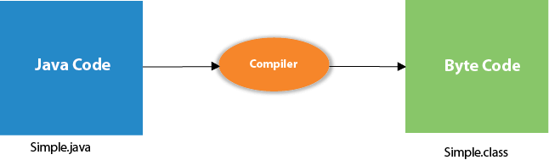
The requirement for Java Hello World Example
For executing any Java program, the following software or application must be properly installed.
Install the JDK if you don't have installed it, download the JDK and install it.
Set path of the jdk/bin directory. http://www.javatpoint.com/how-to-set-path-in-java
Create the Java program
Compile and run the Java program
Compilation Flow:
When we compile Java program using javac tool, the Java compiler converts the source code into byte code.
class Simple{
public static void main(String args[])
{
System.out.println("Hello Java");
}
}
To compile: | javac Simple.java
To execute: | java Simple

Slide 6
Parameters used in First Java Program
Let's see what is the meaning of class, public, static, void, main, String[], System.out.println().
class keyword is used to declare a class in Java.
public keyword is an access modifier that represents visibility. It means it is visible to all.
static is a keyword. If we declare any method as static, it is known as the static method. The core advantage of the static method is that there is no need to create an object to invoke the static method. The main() method is executed by the JVM, so it doesn't require creating an object to invoke the main() method. So, it saves memory.
void is the return type of the method. It means it doesn't return any value.
main represents the starting point of the program.
String[] args or String args[] is used for command line argument. We will discuss it in coming section.
System.out.println() is used to print statement. Here, System is a class, out is an object of the PrintStream class, println() is a method of the PrintStream class. We will discuss the internal working of System.out.println() statement in the coming section.

Slide 7
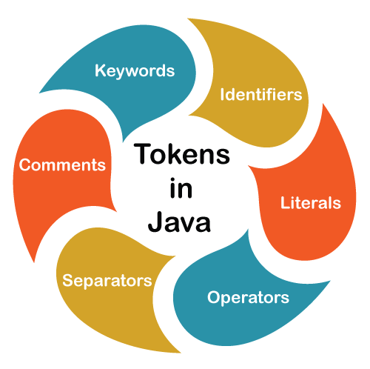
token <= identifier | keyword | separator | operator | literal | comment
public class Demo
{
public static void main(String args[])
{
System.out.println("javatpoint");
}
}
In the above code snippet, public, class, Demo, {, static, void, main, (, String, args, [, ], ), System, ., out, println, javatpoint, etc. are the Java tokens.

Slide 8
Keywords: These are the pre-defined reserved words of any programming language. Each keyword
has a special meaning. It is always written in lower case. Java provides the following keywords:
01. abstract | 02. boolean | 03. byte | 04. break | 05. class
06. case | 07. catch | 08. char | 09. continue | 10. default
11. do | 12. double | 13. else | 14. extends | 15. final
16. finally | 17. float | 18. for | 19. if | 20. implements
21. import | 22. instanceof | 23. int | 24. interface | 25. long
26. native | 27. new | 28. package | 29. private | 30. protected
31. public | 32. return | 33. short | 34. static | 35. super
36. switch | 37. synchronized | 38. this | 39. thro | 40. throws
41. transient | 42. try | 43. void | 44. volatile | 45. while
46. assert | 47. const | 48. enum | 49. goto | 50. strictfp

Slide 9
Identifier: Identifiers are used to name a variable, constant, function, class, and array. It usually defined by the user. It uses letters, underscores, or a dollar sign as the first character.
The first letter of an identifier must be a letter, underscore or a dollar sign. It cannot start with digits but may contain digits.
The whitespace cannot be included in the identifier.
Identifiers are case sensitive.
Some valid identifiers are:
PhoneNumber
PRICE
radius
a
a1
_phonenumber
$circumference
jagged_array
12radius //invalid

Slide 10
Literals: In programming literal is a notation that represents a fixed value (constant) in the source code. It can be categorized as an integer literal, string literal, Boolean literal, etc. It is defined by the programmer. Once it has been defined cannot be changed.
Literal | Type
23 | int
9.86 | double
false, true | boolean
'K', '7', '-' | char
"javatpoint" | String
null | any reference type

Slide 11
Operators: In programming, operators are the special symbol that tells the compiler to perform a special operation. Java provides different types of operators that can be classified according to the functionality they provide. There are eight types of operators in Java
Operator | Symbols
Arithmetic | + , - , / , * , %
Unary | ++ , - - , !
Assignment | = , += , -= , *= , /= , %= , ^=
Relational | ==, != , < , >, <= , >=
Logical | && , ||
Ternary | (Condition) ? (Statement1) : (Statement2);
Bitwise | & , | , ^ , ~
Shift | << , >> , >>>

Slide 12
Separators: The separators in Java is also known as punctuators. There are nine separators in Java, are as follows:
separator <= ; | , | . | ( | ) | { | } | [ | ]
Comments: Comments
allow us to specify information about the program inside our Java code. Java compiler recognizes these comments as tokens but excludes it form further processing. The Java compiler treats comments as whitespaces. Java provides the following two types of comments:
Line Oriented: It begins with a pair of forwarding slashes (//).
Block-Oriented: It begins with /* and continues until it founds */.

