Slide 1
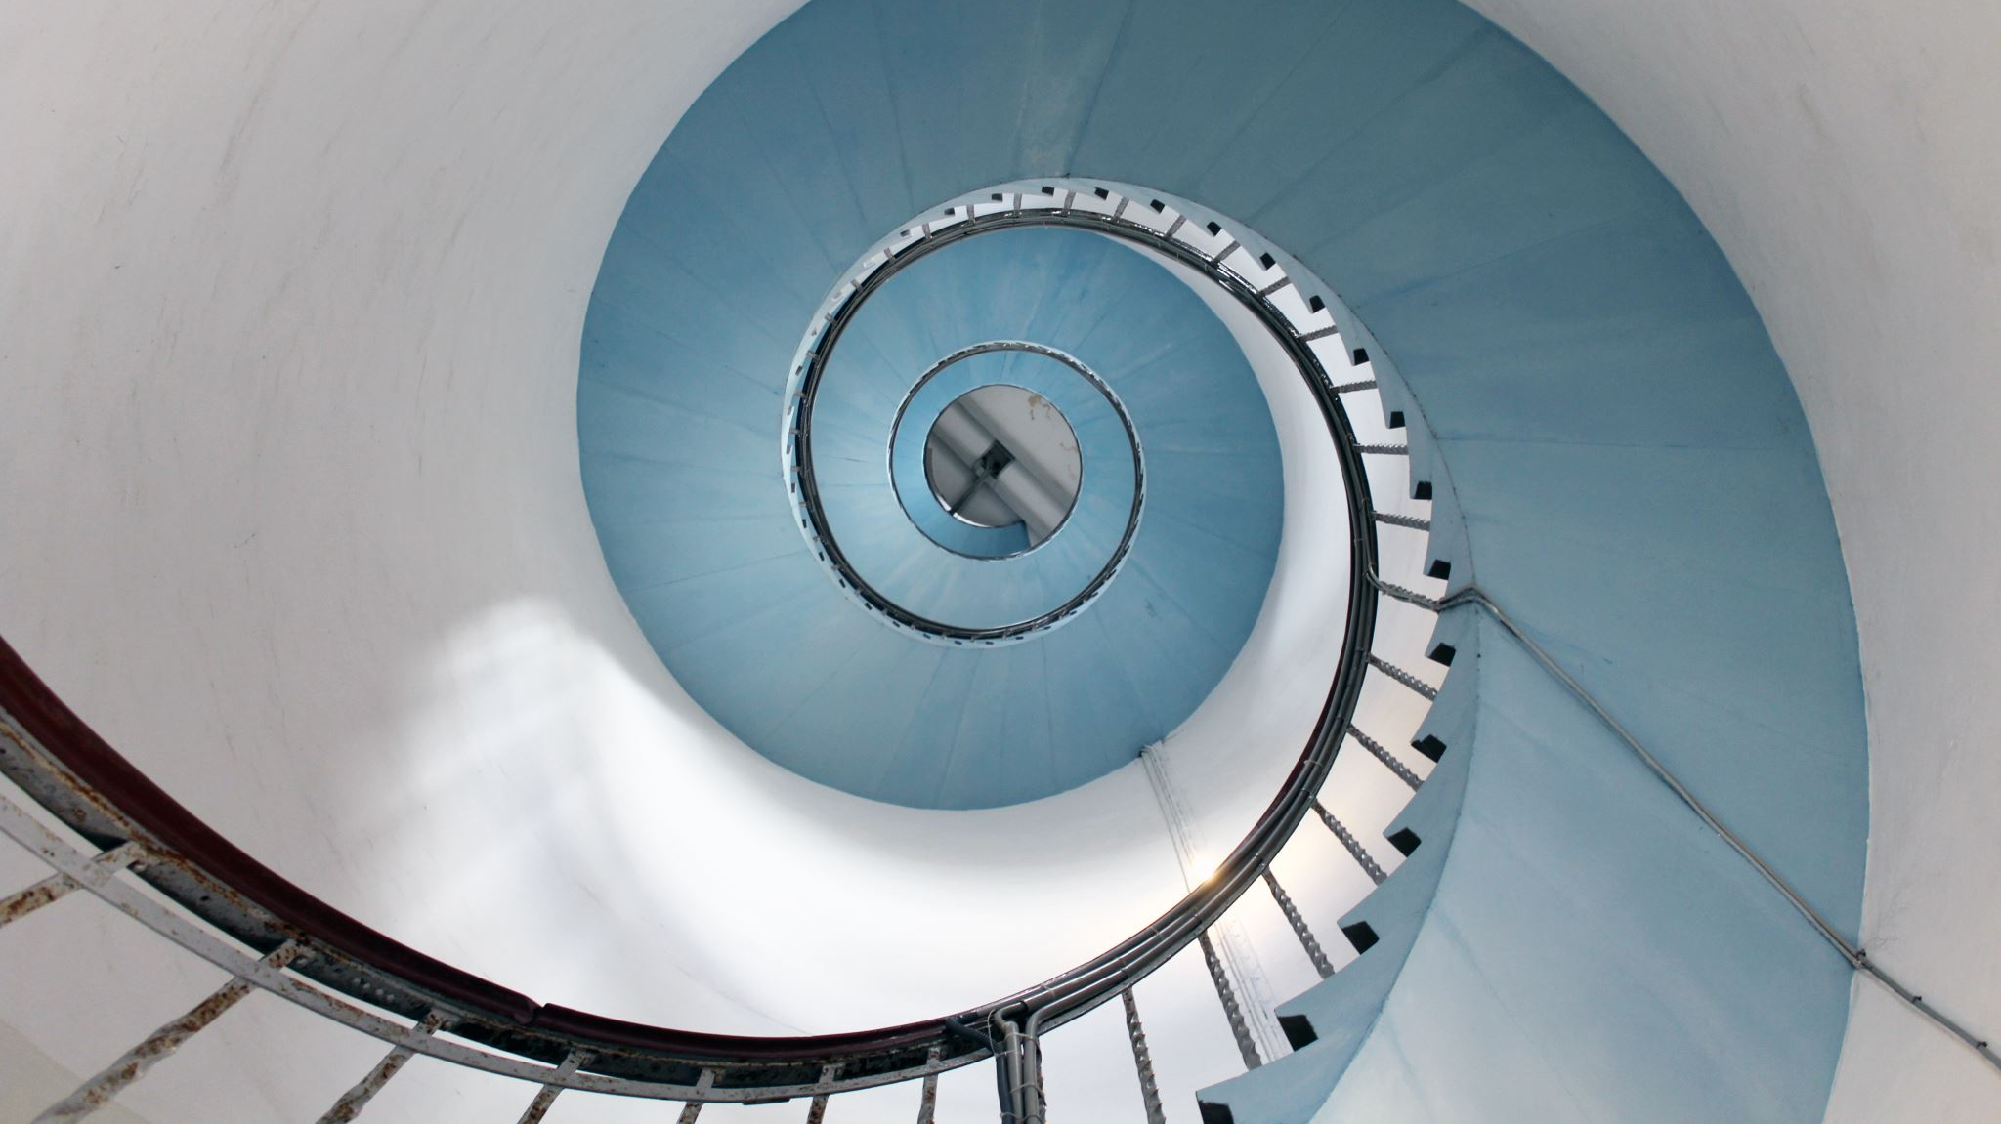
Agile

Slide 2
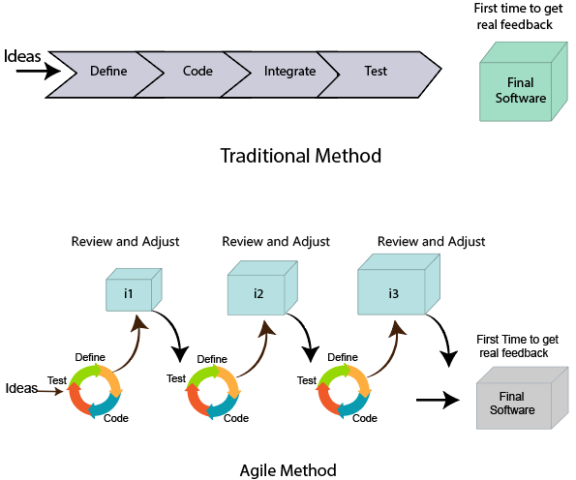
What is Agile Methodology?
An agile methodology is an iterative approach to software development. Each iteration of agile methodology takes a short time interval of 1 to 4 weeks. The agile development process is aligned to deliver the changing business requirement. It distributes the software with faster and fewer changes.
The single-phase software development takes 6 to 18 months. In single-phase development, all the requirement gathering and risks management factors are predicted initially.
The agile software development process frequently takes the feedback of workable product. The workable product is delivered within 1 to 4 weeks of iteration.

Slide 3
Roles in Agile
There are two different roles in a Agile methodology. These are the Scrum Master and Product Owner.
1. Scrum Master
The Scrum Master is a team leader and facility provider who helps the team member to follow agile practices, so that the team member meets their commitments and customers requirements. The scrum master plays the following responsibilities:
They enable the close co-operation between all the roles and functions.
They remove all the blocks which occur.
They safeguard the team from any disturbances.
They work with the organization to track the progress and processes of the company.
They ensure that Agile Inspect & Adapt processes are leveraged correctly which includes
Planned meetings
Daily stand-ups
Demo
Review
Retrospective meetings, and
Facilitate team meetings and decision-making process.

Slide 4
2. Product Owner
The Product Owner is one who runs the product from a business perspective. The Product Owner plays the following responsibilities:
He defines the requirements and prioritizes their values.
He sets the release date and contents.
He takes an active role in iteration and releasing planning meetings.
He ensures that the team is working on the most valued requirement.
He represents the voice of the customer.
He accepts the user stories that meet the definition of done and defined acceptance criteria.

Slide 5
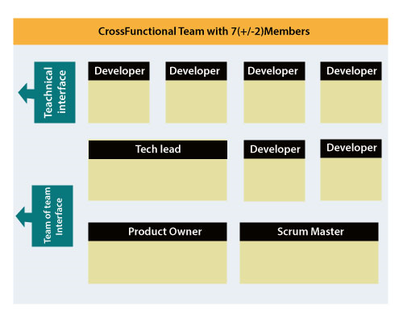
Cross-functional team
Every agile team contains self-sufficient team with 5 to 9 team members. The average experience of each member ranges from 6 to 10 years. The agile team contains 3 to 4 developers, 1 tester, 1 technical lead, 1 scrum master and 1 product owner.
The Scrum master and Product owner are considered as a part of Team Interface, on the other hand remaining members are the part of Technical Interface.

Slide 6
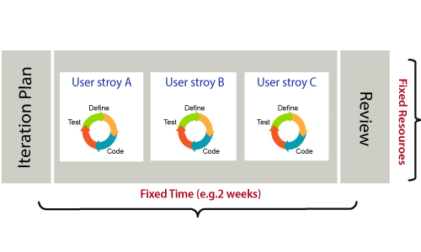
How an Agile Team plan their work?
An Agile methodology is not a specific set of ceremonies or specific development techniques. Rather, it is a group of methodologies that demonstrate a commitment to tight feedback cycles and continuous improvement. An Agile team works in iterations to deliver the customer requirement, and each iteration takes 10 to 15 days. However, the original Agile Manifesto didn't set the time period of two-week iterations or an ideal team size.
Each user requirement is a planned based and their backlog prioritization and size. The team decides, how much scope they have and how many hours available with each team to perform their planed task.

Slide 7
What is a user requirement?
The user requirement defines the requirements of the user in terms of functionalities. There may be of two type of functionality.
As a <User Role> I want <Functionality> so that <Business Value>
In order to <Business value> as a <User Role> I want <Functionality>.
During software release planning, a rough estimate is given to a user requirement using relative scale points. During iteration planning, the requirement is broken down into tasks.

Slide 8
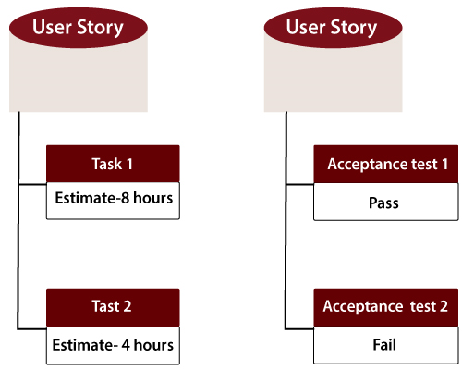
Relation between User requirement and Task
User requirement talks about what is to be done. It defines the needs of users.
Task talks about how it is to be done. It defines how functionality is implemented.
User requirements are implemented by tasks. Every requirement is gathering as the task.
User requirement is divided into different tasks when it is planned in current iteration.
User tasks are estimated in hours based, generally it is between 2 to 12 hours.
Requirements are validated using acceptance test.

Slide 9
When the requirement is completed
The Agile team decides the meaning of task done. There may be different criteria for it:
When the entire task (development, testing) are completed.
When all the acceptance tests are running and are passed.
When no defects found.
Product owner has accepted the requirement.
When the software product is delivered to the end user.

Slide 10
Advantages of Agile Methodology
Customer satisfaction is rapid, continuous development and delivery of useful software.
Customer, Developer, and Product Owner interact regularly to emphasize rather than processes and tools.
Product is developed fast and frequently delivered (weeks rather than months.)
A face-to-face conversation is the best form of communication.
It continuously gave attention to technical excellence and good design.
Daily and close cooperation between business people and developers.
Regular adaptation to changing circumstances.
Even late changes in requirements are welcomed.
Disadvantages of Agile methodology:
It is not useful for small development projects.
There is a lack of intensity on necessary designing and documentation.
It requires an expert project member to take crucial decisions in the meeting.
Cost of Agile development methodology is slightly more as compared to other development methodology.
The project can quickly go out off track if the project manager is not clear about requirements and what outcome he/she wants.

Slide 11
Agile Manifesto
In February 2001, at the Snowbird resort in Utah, a team of 17 software developers met to discuss lightweight development methods. The result of their meeting was the following Agile Manifesto for software development:-
We are uncovering the better ways of developing software by doing it and helping others to do it. Through this meeting, we have come to value -
Individuals and interactions over Processes and tools.
Working software over comprehensive documentation.
Customers are collaboration over contact negotiation.
Responding to change over following a plan.
So that, while there is value in the items on the right, we value the items on the left more.

Slide 12
The Twelve Principle of Agile Manifesto
Customer Satisfaction: Manifesto provides high priority to satisfy the costumer's requirements. This is done through early and continuous delivery of valuable software.
Welcome Change: Making changes during software development is common and inevitable. Every changing requirement should be welcome, even in the late development phase. Agile process works to increase the customers' competitive advantage.
Deliver the Working Software: Deliver the working software frequently, ranging from a few weeks to a few months with considering the shortest time period.
Collaboration: Business people (Scrum Master and Project Owner) and developers must work together during the entire life of a project development phase.
Motivation: Projects should be build around motivated team members. Provide such environment that supports individual team members and trust them. It makes them feel responsible for getting the job done thoroughly.

Slide 13
Face-to-face Conversation: Face-to-face conversation between Scrum Master and development team and between the Scrum Master and customers for the most efficient and effective method of conveying information to and within a development team.
Measure the Progress as per the Working Software: The working software is the key and primary measure of the progress.
Maintain Constant Pace: The aim of agile development is sustainable development. All the businesses and users should be able to maintain a constant pace with the project.
Monitoring: Pay regular attention to technical excellence and good design to maximize agility.
Simplicity: Keep things simple and use simple terms to measure the work that is not completed.
Self-organized Teams: The Agile team should be self-organized. They should not be depending heavily on other teams because the best architectures, requirements, and designs emerge from self-organized teams.
Review the Work Regularly: The work should be reviewed at regular intervals, so that the team can reflect on how to become more productive and adjust its behavior accordingly.

Slide 14
What is Scrum?
Scrum is a framework that helps agile teams to work together. Using it, the team members can deliver and sustain the complex product. It encourages the team to learn through practice, self-organize while working on the problem. Scum is a work done through the framework and continuously shipping values to customers.
It is the most frequent software that is used by the development team. Its principle and lessons can be applied to all kinds of teamwork. Its policy and experiences is a reason of popularity of Scrum framework. The Scrum describes a set of tools, meetings, and roles that help the teams structure. It also manages the work done by the team

Slide 15
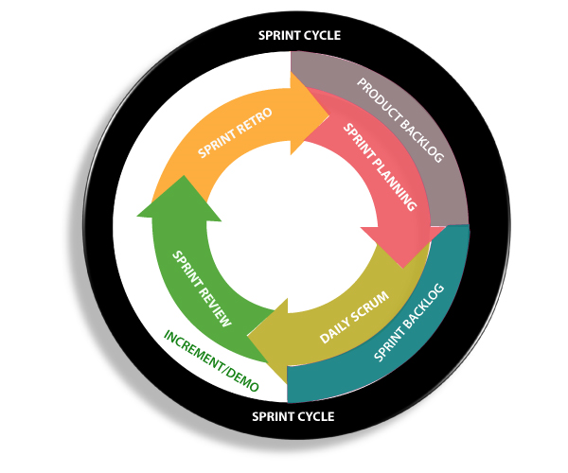
What are sprints?
With scrum, a product is built in a series of repetition called sprints. It breaks down big complex projects into bite-size pieces. It makes projects more manageable, allows teams to ship high quality, work faster, and more frequently. The sprints give them more flexibility to adapt to the changes.
Sprints are a short, time-boxed period for Scrum team that works to complete a set amount of work. Sprints are the core component of Scrum and agile methodology. The right sprints will help our agile team to ship better software.

Slide 16
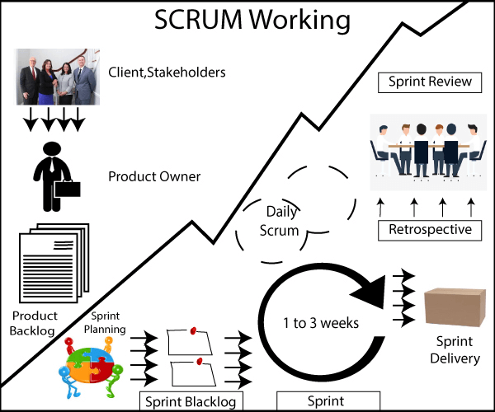

Slide 17
Sprint Backlog: Sprint Backlog is a backlog that has taken some of the activities from the product backlog which needs to be completed within this sprint.
Scrum Board: Scrum Board is a board that shows the status of all the activities that need to be done within this sprint.
Scrum Board consists of four status:
Open
The 'Open' status means that the tasks which are available in 'Open' are not yet started.
In progress
The 'In progress' status means the developers completed their tasks.
Testing
The 'testing' means that the task is in a testing phase.
Closed
The 'closed' means the task has been completed.

