Slide 1

Yerram Sneha

Slide 2
What is Appium?
Appium is an open-source automation mobile testing tool, which is used to test the application. It is developed and supported by Sauce Labs to automate native and hybrid mobile apps. It is a cross-platform mobile automation tool, which means that it allows the same test to be run on multiple platforms. Multiple devices can be easily tested by Appium in parallel.
In today's development area, the demand for mobile applications is high. Currently, people are converting their websites into mobile apps. Therefore, it is very important to know about mobile software automation testing technology and also stay connected with new technology. Appium is a mobile application testing tool that is currently trending in Mobile Automation Testing Technology.
Appium is used for automated testing of native, hybrid, and web applications. It supports automation test on the simulators (iOS) and emulators (Android) as well as physical devices (Android and iOS both). Previously, this tool mainly focused on IOS and Android applications that were limited to mobile application testing only. Few updates back, Appium declared that it would now support desktop application testing for windows as well.

Slide 3
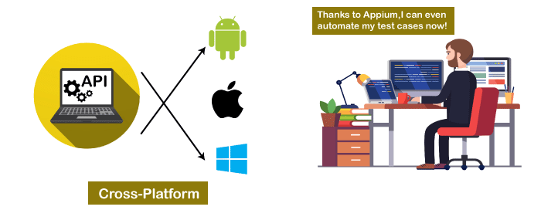

Slide 4
Features of Appium
Appium does not require application source code or library.
Appium provides a strong and active community.
Appium has multi-platform support i.e., it can run the same test cases on multiple platforms.
Appium allows the parallel execution of test scripts.
In Appium, a small change does not require re-installation of the application.
Appium supports various languages like C#, Python, Java, Ruby, PHP, JavaScript with node.js, and many others that have Selenium client library.
Advantages of Appium
Appium is an open-source tool, which means it is freely available. It is easy to install.
It allows the automated testing of hybrid, native, and web applications.
Unlike other testing tools, you do not need to include any additional agents in your app to make Appium compatible with automation. It tests the same app, which is going to upload in App Store.
An additional feature added to Appium. Now it would support desktop application testing for windows as well along with mobile application testing.
Appium is a cross-platform, freely available mobile testing tool, which allows us the cross-platform mobile testing. This means you can test on multiple platforms (single API for both Android and IOS platforms).

Slide 5
Disadvantages of Appium
Along with some features and advantages, Appium has some drawbacks too, which are as follows-
Lack of detailed reports.
Since the tests depend on the remote web driver, so it is a bit slow.
It is not a limitation, but an overhead that Appium uses UIAutomator for Android that only supports Android SDK, API 16, or higher. However, Appium supports older APIs, but not directly. It uses another open-source library Selendroid to support older APIs.
In iOS, only one instance (iOS Script) can run on one Mac OS device, which means one test can be executed at a time per Mac. If you want to run your tests on multiple iOS devices at the same time, you need to arrange the same number of Mac machines. But it would be expensive to arrange various Mac machines.
Solution: This problem can be resolved if you will run your script in the mobile cloud of Sauce Lab. Currently, it allows scripts to run on multiple iOS simulators at the same time.

Slide 6
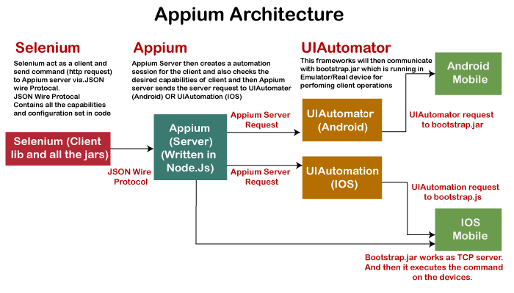

Slide 7
How Appium work?
When we install the Appium, a server is also installed with it on our machine that exposes the REST API.
It receives command and connection requests from the client and executes that command on devices like iOS or Android.
It replies with the HTTP responses.
To execute requests, it uses a mobile test automation framework to run the user interface of the app. For Example -
Apple instruments used for iOS
Selendroid used for Android API 15 or less
UIAutomator used for Android API 16 or higher

Slide 8
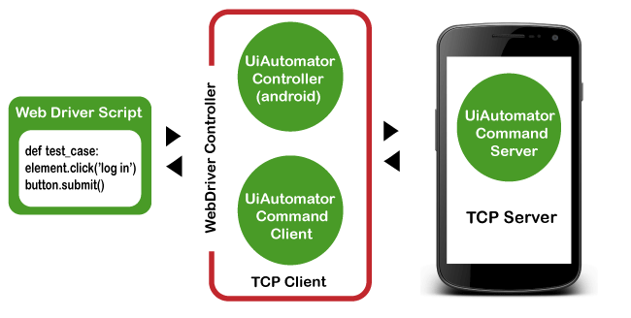
Appium in Android
On Android, Appium proxies the command to a UIAutomator script running on the device. UIAutomator is a native UI automation framework of Android that allows you to run Junit test cases directly into the device using command line. Although it uses Java programming language, but Appium allows to run it from any WebDriver supported language.
Android uses bootstrap.jar, which works as a TCP server. It is used to send the test commands to perform the actions on Android device using UIAutomator.

Slide 9
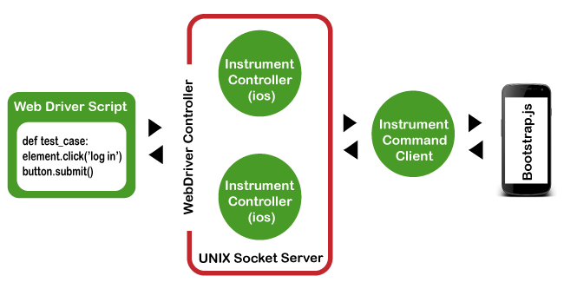
Appium in iOS
As Android uses UIAutomator, iOS uses UIAutomation. Similar to the Android, Appium proxies the command to a UIAutomation test case running on the Mac instruments environment. Apple provides this application "instrument" that performs various activities like building, profiling, and controlling iOS apps. On the other hand, it also has an automation component where you can write commands in JavaScript. It uses UIAutomation API to interact with Application UI. Appium uses same libraries to automate iOS Apps.

Slide 10
Types of Mobile Applications
Native Applications
Web Applications
Web applications are not real applications, they are websites that run on browsers. These applications are developed using HTML, CSS, and JavaScript at a very low price. Unlike Android and iOS apps, they do not require a Software Development Kit (SDK) for developers to work with. Web applications are not developed for a particular platform. Since the web applications run on web browsers, they don't require any installation.
Some web application examples are - Flipkart, Ali Express, twitter, etc.
Native applications are software programs that are developed by keeping a certain platform in mind. These applications are developed using a specific software development kit. Native apps are developed for use on a specific device and can be installed from the App Store, such as Google Play Store or Apple's App Store. They can work offline and can also use the device notification system.
Some native application examples are - Pinterest, Skype, Snapchat, etc.
Hybrid Applications
Hybrid application is a combination of native and web applications. Like native applications, these applications can be downloaded from the App Store and also can take advantage of device features, but actually they are web applications inside. They are developed using web development languages - HTML, CSS, and JavaScript like the hybrid app, which allows them to run on any platform.
Some hybrid application examples are - OLA, Instagram, Basecamp, etc.

Slide 11
Prerequisites to use Appium
Install Java (JDK)
Install Android Studio
Install additional Android SDK tools
Install Appium jar file
js (Not required - It by default comes with "node.js" and "NPM", whenever the Appium server is installed. Therefore, it is not required to install node.js and NPM separately. It is already included in current version of Appium.)
Install Appium Desktop Client
Install Eclipse IDE for Java

Slide 12
Appium Installation on windows
Install and setup Java
Install and setup Android Studio
installation of Appium Desktop Client
Download Eclipse IDE for Java
Appium Doctor
To check the Appium installation and dependencies, you can install appium-doctor from here
.
Appium-doctor is an application tool to verify Appium installation. It shows all the missing things that you need to do. So, this will be very useful to run appium-doctor whenever you get any issue. It will install through npm.

Slide 13
Limitation of Appium
Microsoft Windows does not support running Appium Inspector.
Appium does not allow the testing for Android versions lower than 4.2.
Appium provides limited support for testing Hybrid applications. E.g., Switching action of application is not possible to test i.e., web app to native app and vice versa.
Competitors of Appium
There are several tools available for automated testing mobile applications, such as Robotium, Appium, Experitest, Selendroid, Kobiton, and Testdroid, etc. They all are tough contestants for Appium. But Selendroid and Robotium are one of the top competitors of Appium. Let us know some differences and see how they differ from each other.

Slide 14
Appium vs Selendroid
Appium is an open-source automation tool that supports both iOS and Android, while Selendroid is a test automation framework that only supports Android.
In Appium, a small change does not require reinstallation of the application. But Selendroid requires reinstallation of the application.
Appium has a strong and active community, whereas Selendroid does not have a strong community like Appium.
Appium supports many frameworks and languages. On the other hand, Selendroid is compatible with Jenkin and Selenium.
Appium does not require application source code/library, while Selendroid requires application source code or library.
Appium supports all Android APIs with a limitation. Appium uses UIAutomator for tests running on API>=17, while for older APIs, it runs tests using Selendroid.
Appium vs Robotium
Appium is a cross-platform tool that supports both iOS and Android. Whereas Robotium only supports Android.
Appium supports various languages while Robotium only supports Java programming language.
Appium does not require application source code/library, whereas Robotium tool requires application source code or library.
Appium can be used to test native, web, and hybrid mobile applications, whereas Robotium can only test native and hybrid applications.
Appium supports many frameworks like Selenium. But Robotium is not compatible with Selenium at all.
In Appium, you don't have to reinstall the application for a small change. But Robotium code leads to complete rebuild for a small change.

