Slide 1
ClinVar: What 9 Million Genetic Records Tell Us
PTF10 Introduction to Data Science · Final Project
From raw dataset to cleaning to insights
Notes:
[Presenter 1 · about 0:25]
Good morning everyone. We are [group name], and our project is about ClinVar, the world's biggest public database of genetic variants. Today we will walk you through the whole process: the dataset, how we cleaned it, and what it taught us.

Slide 2



Our project in three parts
1 · The Dataset
2 · Data Cleaning
3 · Insights
What ClinVar is, key terms, what the data looks like
Loading 9M rows, missing values, outliers, data types
8 charts, what they show and why it matters
Notes:
[Presenter 1 · about 0:25]
We split this into three parts. I will introduce the dataset. [Presenter 2] will explain how we cleaned more than nine million rows. And [Presenter 3] will show the insights from our charts. Let's start with a few words you need to know.

Slide 3
The Dataset
PART 1
What ClinVar is and what is inside it
Notes:
[Presenter 1 · about 0:05]
Part one: the dataset.

Slide 4




Four terms you need first
DNA
Gene
The instruction manual in every cell, written in 4 letters: A, C, G, T.
One section of DNA that tells the body how to make one part.
Variant
Genome build
A change in the DNA letters, like a typo in a book. Some are harmless, some cause disease.
A standard "map" of human DNA. GRCh37 is the old map, GRCh38 the new one.
Notes:
[Presenter 1 · about 0:40]
First, DNA is the instruction manual inside every cell, written in four letters. A gene is one section of that manual. A variant is a change in those letters, like a typo in a book. Some typos are harmless, and some cause disease. Finally, a genome build is a standard map of human DNA. There is an old map, GRCh37, and a new one, GRCh38. Remember that, because it matters for cleaning.

Slide 5
ClinVar: the world's public variant archive
Run by NCBI, part of the U.S. National Institutes of Health
Labs and experts share what each variant does to health
Free download: variant_summary.txt.gz (tab-separated)
We used the November 2026 release
9.35M
43
rows in the raw file
columns
440 MB
30K+
compressed file size
genes covered
Notes:
[Presenter 1 · about 0:35]
ClinVar is run by NCBI, part of the U.S. National Institutes of Health. Labs and experts share what they think each variant does to health. We downloaded the November 2026 file. It has nine point three five million rows, forty-three columns, and covers more than thirty thousand genes. It is about four hundred forty megabytes even when compressed.

Slide 6

How ClinVar labels a variant
Clinical significance: the experts' verdict
P / LP
VUS
B / LB
Conflicting
Pathogenic
Causes disease
Uncertain
Not enough evidence
Benign
Harmless
Labs disagree
Different verdicts
Review status: how much to trust the label (0–4 stars)
0 stars
No evidence
1 star
One lab
2 stars
Labs agree
3 stars
Expert panel
4 stars
Guideline
Notes:
[Presenter 1 · about 0:35]
Each variant gets a label. Pathogenic means it causes disease. Benign means it is harmless. VUS means uncertain: there is not enough evidence yet. And conflicting means labs disagree. Each label also has a review status from zero to four stars. One star means one lab's opinion. Three or four stars means an expert panel or an official guideline checked it.

Slide 7
The 11 columns we used (of 43)
Column | What it holds | Example
VariationID | Unique ID of the variant | 12375
GeneSymbol | Gene the variant is in | BRCA1
Type | Kind of DNA change | single nucleotide variant
ClinicalSignificance | The label | Likely pathogenic
ReviewStatus | How it was reviewed | reviewed by expert panel
NumberSubmitters | How many labs reported it | 3
PhenotypeList | Linked condition(s) | Familial cancer of breast
Assembly / Chromosome / Start / Stop | Where it is on the DNA map | GRCh38 / 17 / 43045712
LastEvaluated | Date of the latest review | Mar 05, 2019
Notes:
[Presenter 1 · about 0:25]
Out of forty-three columns, we used eleven. These include the gene, the type of change, the label, the review status, how many labs reported it, the linked condition, its location on the DNA map, and the date it was last reviewed.

Slide 8

Our questions, and what we don't do
1
How much do we actually know about variants?
2
How much can we trust the labels?
We study the data, we don't diagnose
3
Where do experts disagree?
No patients, no medical advice. Doctors decide what a variant means; we check how well that knowledge is recorded.
4
Which genes and changes matter most?
Notes:
[Presenter 1 · about 0:35]
We asked four questions. How much do we really know? How much can we trust the labels? Where do experts disagree? And which genes and changes matter most? One important point: we study the data, we do not diagnose anyone. Doctors decide what a variant means; we check how well that knowledge is recorded. Now [Presenter 2] will explain the cleaning.

Slide 9
Data Cleaning
PART 2
Turning 9.35 million messy rows into data we can trust
Notes:
[Presenter 2 · about 0:10]
Thank you. Part two: data cleaning.

Slide 10
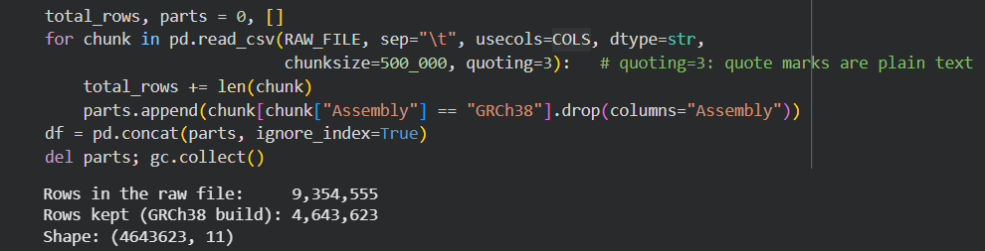
Loading a file too big to open
1
Download
2
Peek
3
Read in chunks
4
Filter
wget from NCBI into Colab
Read 5 rows: 43 columns
500,000 rows at a time; peak memory 3.7 of 12 GB
Keep only the newer map (GRCh38)
Notes:
[Presenter 2 · about 0:50]
Our first problem was size. Nine million rows can crash Google Colab. So we downloaded the file, looked at five rows first, then read it in chunks of five hundred thousand rows, keeping only twelve columns and only the new DNA map. Below is our actual code. The loop reads one chunk at a time, and the output shows nine point three five million rows read and four point six four million kept. Memory stayed at about three point seven gigabytes, well under Colab's twelve.

Slide 11
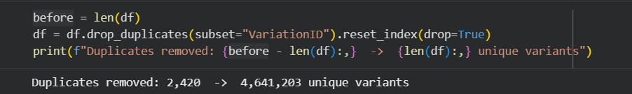
Cleaning cut the data in half
Every variant appeared twice: once per DNA map
2,420 more exact duplicates removed
250K tumor-only records have no germline label
Notes:
[Presenter 2 · about 0:45]
Here is the first big finding from cleaning. Every variant was listed twice, once for each DNA map. Keeping only the new map took us from nine point three five million rows to four point six four million. We then removed two thousand four hundred twenty more exact duplicates. At the bottom you can see it took just one line of code: drop duplicates. If we had skipped this, every number in our project would be doubled.

Slide 12
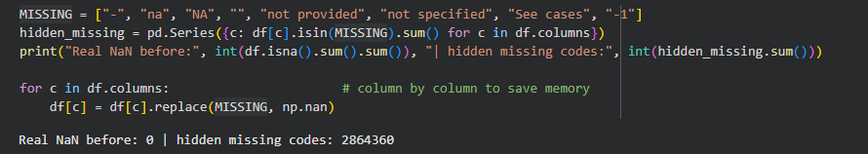
Missing data hides behind codes
pandas found 0 missing values, but 2.86 million cells held codes like "-" or "not provided"
Replaced them with real empty values (NaN) and kept the rows
Notes:
[Presenter 2 · about 0:50]
Next, missing values. When we checked with pandas, it said there were zero missing values. That was wrong. ClinVar writes missing data as a dash, 'na', 'not provided', 'See cases' or minus one. In the code at the bottom you can see it: 'Real NaN before: zero', but two point eight six million hidden codes. We replaced them all with real empty values. The biggest gap: forty-five percent of variants name no condition. We kept those rows, because one empty field does not make the whole row useless.

Slide 13
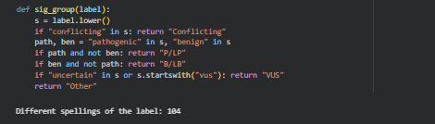
104 label spellings, grouped into 5
These all become one group (P/LP):
"Pathogenic"
"Pathogenic/Likely pathogenic"
"Pathogenic, low penetrance"
Review-status text became a 0–4 star score the same way.
Notes:
[Presenter 2 · about 0:40]
The label column was also messy. We found one hundred four different spellings, like 'Pathogenic', 'Pathogenic slash Likely pathogenic', and 'Pathogenic, low penetrance'. Here is the function we wrote: it looks for the words conflicting, pathogenic, benign and uncertain, and sorts every spelling into one of five groups. The output confirms the one hundred four spellings. We did the same for review status, turning long text into a simple zero-to-four star score.

Slide 14



Outliers and data types
Fake dates
Many submitters
Huge variants
111 review dates before 1990 (oldest: 1965). ClinVar began in 2013.
The IQR rule flags 22.5% of rows, but popular variants really do get many labs.
A few span up to 159 million DNA letters and squash the charts.
Set to missing
Kept: real data
Top 0.1% left out of length chart
Data types: all text at load → numbers (positions, submitters), real dates (review date), categories (type, label) to save memory.
Notes:
[Presenter 2 · about 0:50]
For outliers, we checked three things. First, one hundred eleven review dates were before 1990, even though ClinVar started in 2013, so we set them to missing. Second, the standard IQR rule flagged twenty-two percent of the submitter counts as outliers, but those are real: popular variants really are reported by many labs, so we kept them. Not every outlier is an error. Third, a few variants are huge, up to one hundred fifty-nine million letters long, so we left the top zero point one percent out of the length chart.

Slide 15
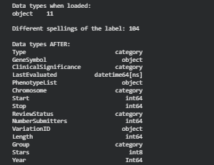
Outliers and data types, in code
Outlier checks: output
Data types after converting
Dates: 111 placeholder dates set to missing
Submitters: the IQR rule would flag 22.5% of rows, so we kept them (real data)
Length: 4,642 extreme rows left out of the length chart only
Types: all 11 columns loaded as text (object), now numbers, dates and categories
Notes:
[Presenter 2 · about 0:40]
Here is the proof from our notebook. The top line shows the one hundred eleven dates we removed, then the IQR check we chose not to apply, then the length cut-off. Below, you can see the data types after converting: everything loaded as plain text, and now we have numbers, real dates and categories. Now [Presenter 3] will show what the clean data tells us.

Slide 16
Analysis & Insights
PART 3
What the clean data shows
Notes:
[Presenter 3 · about 0:10]
Thank you. Part three: what we found.

Slide 17
More than half is still "we don't know"
54.6%
are uncertain (VUS)
8.6%
are known to cause disease
Notes:
[Presenter 3 · about 0:30]
Our first insight: fifty-five percent of all labeled variants are uncertain. Only eight point six percent are known to cause disease. So when a person gets a DNA test and the result is a VUS, the doctor cannot say if it is dangerous. That is the biggest gap in genetic testing today.

Slide 18
Unknowns are growing faster than answers
1.36M
reviews in 2025 (only 33K in 2017)
877K
uncertain results in 2025 alone
Notes:
[Presenter 3 · about 0:30]
And that gap is growing. The number of variants reviewed per year jumped from about thirty-three thousand in 2017 to one point three six million in 2025. Look at the amber line: uncertain results grow much faster than the red line for disease-causing ones. DNA testing is growing faster than our ability to interpret it.

Slide 19
Most labels rest on one lab's opinion
77.4%
reported by only one lab
0.5%
checked by an expert panel
Notes:
[Presenter 3 · about 0:25]
Can we trust the labels? Seventy-eight percent of variants have just one star, meaning one lab's opinion. Seventy-seven percent are reported by only one lab. Only half a percent were checked by an expert panel. So most labels have never been double-checked.

Slide 20
Experts disagree most on breast-cancer genes
BRCA2: 1 in 4 variants has conflicting labels
BRCA1/2 are the most-tested genes in the world
More labs testing = more chances to disagree
Notes:
[Presenter 3 · about 0:25]
Where do experts disagree most? On BRCA2 and BRCA1, the main breast and ovarian cancer genes. One in four BRCA2 variants has conflicting labels. These are the most-tested genes in the world, so more labs means more chances to disagree.

Slide 21
Bigger genes, more disagreement
0.68
rank correlation: size vs. conflict (7,288 genes)
BRCA2
top right: biggest and most disputed
Notes:
[Presenter 3 · about 0:20]
This scatter plot shows that pattern for all genes. Each dot is a gene. Bigger genes, further right, tend to have more conflicts, higher up. The correlation is zero point six eight, which is strong.

Slide 22
Big DNA changes are easier to judge
61%
of deletions are pathogenic
57%
of single-letter changes are uncertain
Notes:
[Presenter 3 · about 0:25]
The type of change matters too. Sixty-one percent of deletions are disease-causing, because cutting out a piece usually breaks the gene. But single-letter changes are fifty-seven percent uncertain. Most of the unknown problem comes from these small, one-letter typos.

Slide 23
Which genes and diseases come up most
Notes:
[Presenter 3 · about 0:20]
The genes with the most disease-causing variants are TTN, the largest human gene, then BRCA2, NF1 and BRCA1. And the most common linked condition is hereditary cancer, far ahead of everything else.

Slide 24



Key takeaways
55% unknown
Little double-checking
Most variants are still uncertain, and that pile grows every year.
77% come from one lab; only 0.5% were expert-reviewed.
Disagreement where it matters
Cleaning was essential
BRCA1/2, the most-tested genes, have the most conflicts.
Without it, every number would be doubled or wrong.
Why it matters: clearer data means clearer test results for patients, better-aimed research, and knowing which labels to trust.
Notes:
[Presenter 3 · about 0:40]
To sum up. One: fifty-five percent of variants are still unknown, and that pile grows every year. Two: most labels come from one lab and are rarely expert-checked. Three: experts disagree most on the genes that matter most. And four: cleaning was essential; without it, our numbers would be doubled or wrong. Clearer data means clearer test results, better-aimed research, and knowing which labels to trust.

Slide 25
Thank you! Questions?
Data: NCBI ClinVar, November 2026 release · Code: ClinVar_Final_Project.ipynb
Patterns in a public database, not medical advice.
Notes:
[Presenter 3 · about 0:10]
Thank you for listening. We are happy to take your questions.

