Slide 1
ClinVar: What 9 Million Genetic Records Tell Us
PTF10 Introduction to Data Science · Final Project
From raw dataset to cleaning to insights
Notes:
[Presenter 1 · 0:20]
Good morning everyone. We are [group name]. For our project we took ClinVar, the world's biggest public database of genetic variants, and analyzed it in Python from start to finish: getting the raw file, cleaning it, and turning it into charts.

Slide 2
Our project in four parts
1
2
3
4
The Dataset
Python Notebook
Power BI
Insights
What ClinVar is, key terms, the columns we kept
Cleaning with pandas, then comparing four machine-learning models
The same cleaning in Power Query, one interactive dashboard
What the data shows, and what it means
Notes:
[Presenter 1 · 0:25]
Our project has four parts. First the dataset: what ClinVar is and what is inside it. Then the Python notebook: how we cleaned 9 million rows with pandas and compared machine-learning models. Then the same project in Power BI: Power Query cleaning and an interactive dashboard. And last, the insights both tools gave us.

Slide 3
The Dataset
PART 1
What ClinVar is and what is inside it
Notes:
[Presenter 1 · 0:10]
Let's start with the dataset.

Slide 4




Four terms you need first
DNA
Gene
The instruction manual in every cell, written in 4 letters: A, C, G, T.
One section of DNA that tells the body how to make one part.
Variant
Genome build
A change in the DNA letters, like a typo in a book. Some are harmless, some cause disease.
A standard "map" of human DNA. GRCh37 is the old map, GRCh38 the new one.
Notes:
[Presenter 1 · 0:30]
Four words come up all the time. DNA is the instruction manual in every cell, written in four letters. A gene is one section of it. A variant is a change in those letters, like a typo. And a genome build is a standard map of human DNA. ClinVar uses two maps, GRCh37 and GRCh38, and that turned out to matter a lot when we cleaned the data.

Slide 5
ClinVar: the world's public variant archive
Run by NCBI, part of the U.S. National Institutes of Health
Labs and experts share what each variant does to health
Free download: variant_summary.txt.gz (tab-separated)
We used the November 2026 release
9.35M
43
rows in the raw file
columns
440 MB
30K+
compressed file size
genes covered
Notes:
[Presenter 1 · 0:35]
We got the data straight from NCBI's download site. The file is called variant summary, a tab-separated text file of about four hundred forty megabytes. Before loading it all, we read only the first five rows with read CSV and nrows equals five. That quick look told us the file has forty-three columns and showed us how each value is written. Our full run later counted nine point three five million rows.

Slide 6

How ClinVar labels a variant
Clinical significance: the experts' verdict
P / LP
VUS
B / LB
Conflicting
Pathogenic
Causes disease
Uncertain
Not enough evidence
Benign
Harmless
Labs disagree
Different verdicts
Review status: how much to trust the label (0–4 stars)
0 stars
No evidence
1 star
One lab
2 stars
Labs agree
3 stars
Expert panel
4 stars
Guideline
Notes:
[Presenter 1 · 0:30]
From that first look, the most important column is the clinical significance label: pathogenic, benign, uncertain, or conflicting when labs disagree. The second is the review status, which ClinVar turns into zero to four stars. One star means a single lab's opinion; three or four means an expert panel or a guideline. We later converted this text into a star number ourselves.

Slide 7
The 11 columns we used (of 43)
Column | What it holds | Example
VariationID | Unique ID of the variant | 12375
GeneSymbol | Gene the variant is in | BRCA1
Type | Kind of DNA change | single nucleotide variant
ClinicalSignificance | The label | Likely pathogenic
ReviewStatus | How it was reviewed | reviewed by expert panel
NumberSubmitters | How many labs reported it | 3
PhenotypeList | Linked condition(s) | Familial cancer of breast
Assembly / Chromosome / Start / Stop | Where it is on the DNA map | GRCh38 / 17 / 43045712
LastEvaluated | Date of the latest review | Mar 05, 2019
Notes:
[Presenter 1 · 0:30]
Next we decided which columns to keep. We picked the ones that answer our questions: the ID, gene, type, label, review status, number of labs, condition, position and review date. We skipped the rest after checking them. For example, the cancer columns at the end were over ninety-nine percent empty when we ran value counts on them. Keeping only eleven columns is also what made the file fit in memory.

Slide 8

Our questions, and what we don't do
1
How much do we actually know about variants?
2
How much can we trust the labels?
We study the data, we don't diagnose
3
Where do experts disagree?
No patients, no medical advice. Doctors decide what a variant means; we check how well that knowledge is recorded.
4
Which genes and changes matter most?
Notes:
[Presenter 1 · 0:20]
These are the four questions we set out to answer. And to be clear about scope: we analyze the data; we don't diagnose anyone. We never change a label; we only check how well the information is recorded. Next, how we loaded a file this big.

Slide 9
Data Cleaning
PART 2
Turning 9.35 million messy rows into data we can trust
Notes:
[Presenter 1 · 0:10]
Now the cleaning, in the order we did it.

Slide 10
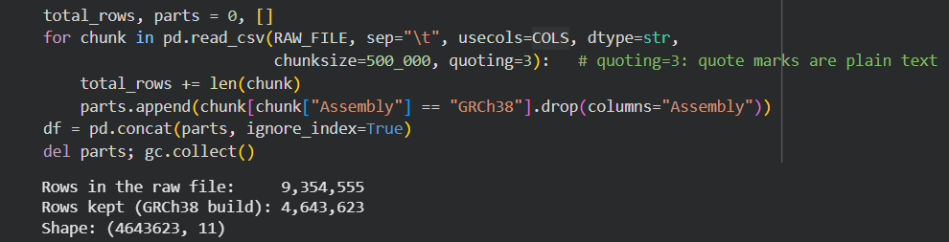
Loading a file too big to open
1
Download
2
Peek
3
Read in chunks
4
Filter
wget from NCBI into Colab
Read 5 rows: 43 columns
500,000 rows at a time; peak memory 3.7 of 12 GB
Keep only the newer map (GRCh38)
Notes:
[Presenter 1 · 0:40]
Step one was loading. Reading nine million rows at once can crash Colab, so we used read CSV with the chunksize option, which reads five hundred thousand rows at a time. We also passed usecols, so only our columns are read, and dtype string, so nothing gets misread. Inside the loop, we kept only rows where Assembly equals GRCh38, then joined the pieces with concat. The output shows nine point three five million rows read and four point six four million kept. Peak memory was three point seven gigabytes.

Slide 11
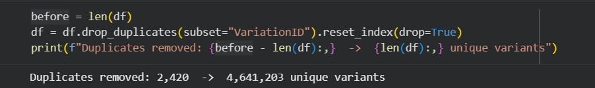
Cleaning cut the data in half
Every variant appeared twice: once per DNA map
2,420 more exact duplicates removed
250K tumor-only records have no germline label
Notes:
[Presenter 1 · 0:35]
Why did half the rows disappear? Every variant is listed once per DNA map, so keeping one map removes the copy. Then we called drop duplicates on the Variation ID column, which removed two thousand four hundred twenty more repeats. You can see the output at the bottom. Without these two steps, every count we report would be doubled. Now [Presenter 2] will show how we cleaned it and what machine learning added.

Slide 12
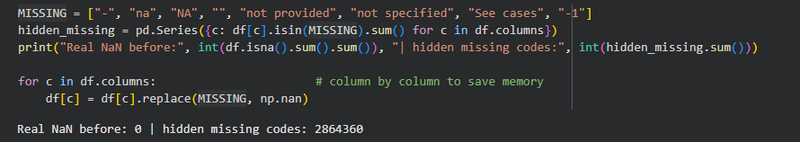
Missing data hides behind codes
pandas found 0 missing values, but 2.86 million cells held codes like "-" or "not provided"
Replaced them with real empty values (NaN) and kept the rows
Notes:
[Presenter 2 · 0:45]
Thank you. Next, missing values. When we ran is-n-a, pandas said zero values were missing, which didn't make sense. So we listed the codes ClinVar uses instead, like a dash, 'na', 'not provided' and minus one, and counted them with isin: two point eight six million hidden codes. We replaced them with real empty values using replace, one column at a time to save memory. The chart shows the result: forty-five percent of rows have no condition. We kept those rows and only skip the empty values in charts that need that column.

Slide 13
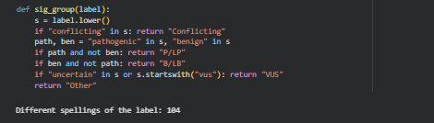
104 label spellings, grouped into 5
These all become one group (P/LP):
"Pathogenic"
"Pathogenic/Likely pathogenic"
"Pathogenic, low penetrance"
Review-status text became a 0–4 star score the same way.
Notes:
[Presenter 2 · 0:45]
The label column had one hundred four different spellings. So we wrote this function, sig group. It lowercases the label and checks keywords in order: 'conflicting' first, then 'pathogenic' without 'benign', then 'benign' without 'pathogenic', then 'uncertain'. Order matters, because a label like 'conflicting pathogenic' would otherwise land in the wrong group. To keep it fast, we ran the function on the one hundred four unique labels and then used map to apply the result to all four point six million rows. We did the same thing to turn review status into stars.

Slide 14



Outliers and data types
Fake dates
Many submitters
Huge variants
111 review dates before 1990 (oldest: 1965). ClinVar began in 2013.
The IQR rule flags 22.5% of rows, but popular variants really do get many labs.
A few span up to 159 million DNA letters and squash the charts.
Set to missing
Kept: real data
Top 0.1% left out of length chart
Data types: all text at load → numbers (positions, submitters), real dates (review date), categories (type, label) to save memory.
Notes:
[Presenter 2 · 0:45]
Then outliers, using three different checks. For dates, we converted the text with to-datetime, then found one hundred eleven dates before 1990, even though ClinVar started in 2013, so we set them to empty. For the number of labs, we calculated the IQR: both quartiles are one, so the rule flags anything above one, which is twenty-two percent of rows. Those are real, popular variants, so we deliberately kept them. For length, we computed stop minus start plus one, and left the top zero point one percent out of the length chart only.

Slide 15
Machine learning: which model spots harmful variants?
Winner
Random Forest
AUC 0.812 vs. 0.779 for logistic regression; better in cross-validation too.
60,497
uncertain variants (2.5%) score ≥ 0.8: candidates for expert review, not a diagnosis.
Notes:
[Presenter 2 · 0:55]
We then used machine learning to test whether recorded features can tell a pathogenic variant from a benign one. We trained on 200 thousand labeled variants and compared three models on the same split: a baseline that always says benign, logistic regression and a random forest. Notice the baseline: 79 percent accuracy, but it finds zero harmful variants. That's why we compare ROC-AUC and recall. The random forest wins on every measure: AUC 0.81 against 0.78, and it finds 60 percent of pathogenic variants. Both models agree the type of DNA change matters most. Applied to the 2.4 million uncertain variants, about 60 thousand look strongly pathogenic. That's a list for experts to review first, not a diagnosis.

Slide 16
Machine learning: predicting disagreement per gene
A tie, so pick the simpler model
+6.6
points of conflict per extra lab
+0.6
points for a gene with 10× more variants
Notes:
[Presenter 2 · 0:50]
Our second model predicts how often labs disagree on a gene, using its size, the average number of labs per variant and the share of single-letter changes, for about 7,300 genes. Here linear regression and the random forest tie: both explain about 72 percent of the differences, against zero for the baseline. When a flexible model can't beat a straight line, the simpler, explainable model is the better choice. Its coefficients tell the story: each extra lab per variant adds about 6.6 points of conflict, while a gene ten times bigger adds only 0.6. Disagreement follows testing, which is why BRCA1 and 2 stand out.

Slide 17
Part 3 · The Power BI Version
The same cleaning in Power Query, and one interactive dashboard
Notes:
[Presenter 2 · 0:10]
We then rebuilt the project in Power BI, to make the results interactive.

Slide 18
Loading 4.6 million rows into Power BI
1
2
3
4
5
Get Data
Parse
Headers
Combine
Choose columns
Folder → 21 .txt parts
Tab-separated, QuoteStyle.None
First row → headers, once per file
Stack into one table
Keep 12 of 43
Every step is recorded in Power Query's Applied Steps, so the whole cleaning re-runs on Refresh.
Notes:
[Presenter 2 · 0:40]
For Power BI we kept the GRCh38 rows and saved them as 21 tab-separated parts. Get Data, Folder reads every part and stacks them into one table. Two settings matter: QuoteStyle None, because ClinVar text has stray quote marks that would shift values into the wrong columns, and promoting the first row to headers once per file. Every step is recorded in Applied Steps, so the whole cleaning re-runs on Refresh. Now [Presenter 3] will compare the two tools, show the dashboard live and walk through the insights.

Slide 19
Same cleaning, two tools
Step | Python (pandas) | Power BI (Power Query + DAX)
Load | read_csv in chunks of 500K rows | Get Data → Folder, 21 parts
Duplicates | drop_duplicates(VariationID) | Remove Duplicates
Missing codes | replace(codes, NaN) | One replace step, whole cells only
Data types | to_numeric · to_datetime | Change Type (dates read as English, US)
Outliers | Dates < 1990 · IQR · 99.9th pct | DatePlaceholder flag · DAX measures
Label groups | sig_group() and stars() functions | Custom columns Group and Stars
Output | 8 static charts (matplotlib) | 1 interactive dashboard + slicers
Notes:
[Presenter 3 · 0:40]
Thank you. Every cleaning step from the notebook has a Power BI version. Duplicates: drop duplicates becomes Remove Duplicates. Hidden missing codes: one replace step, matching whole cells only. Data types: to_numeric and to_datetime become Change Type, with US English for the dates. Outliers: we flag the placeholder dates, and the IQR and percentile checks become DAX measures. The label groups and stars become custom columns. The big difference is the output: eight static charts in Python, one interactive dashboard in Power BI.

Slide 20
Live demo: the dashboard reacts
1
Tick “P/LP”
2
Pick chromosome 17
Clinical significance slicer: only harmful variants remain
BRCA1 climbs in the Top 10 genes chart
3
Year range 2023–2025
4
Click the Deletion bar
KPIs and charts show recent reviews only
Every other visual filters to deletions
Clear all slicers (eraser icon) before and after the demo, so the numbers match the slides.
Notes:
[Presenter 3 · 0:35]
Switch to Power BI. Clear all slicers first. One: tick P/LP; the cards and charts show only harmful variants. Two: pick chromosome 17, where BRCA1 sits; BRCA1 rises in the gene chart. Three: drag the year range to 2023 to 2025. Four: click the Deletion bar in the variant-type chart and every other visual filters to deletions. Clear everything with the eraser icon, then come back to the slides for the insights.

Slide 21
Analysis & Insights
PART 4
What the clean data shows
Notes:
[Presenter 3 · 0:10]
Now that the data is clean, here is what it shows.

Slide 22
More than half is still "we don't know"
54.6%
are uncertain (VUS)
8.6%
are known to cause disease
Notes:
[Presenter 3 · 0:30]
For this chart, we took the variants that have a label and ran value counts with normalize equals true on our group column, which gives the share of each group. The result: fifty-five percent are uncertain, and only eight point six percent are known to cause disease. So a DNA test result is more likely to say 'we don't know' than anything else.

Slide 23
Unknowns are growing faster than answers
1.36M
reviews in 2025 (only 33K in 2017)
877K
uncertain results in 2025 alone
Notes:
[Presenter 3 · 0:25]
Here we grouped by the year column we created and the label group, counted with size, and used unstack to get one line per group. Reviews jumped from about thirty-three thousand in 2017 to one point three six million in 2025, and the amber uncertain line rises fastest. We stopped at 2025 because 2026 isn't finished.

Slide 24
Most labels rest on one lab's opinion
77.4%
reported by only one lab
0.5%
checked by an expert panel
Notes:
[Presenter 3 · 0:20]
This uses the stars column Presenter 2 built. Counting it shows seventy-eight percent of variants have one star, and only half a percent were checked by an expert panel. We also checked the number of submitters directly: seventy-seven percent were reported by just one lab.

Slide 25
Experts disagree most on breast-cancer genes
BRCA2: 1 in 4 variants has conflicting labels
BRCA1/2 are the most-tested genes in the world
More labs testing = more chances to disagree
Notes:
[Presenter 3 · 0:30]
To compare genes, we first split cells like 'BRCA1 semicolon NBR2' with split and explode, so each gene gets its own row. Then for every gene we computed the share of conflicting labels, keeping only genes with at least two thousand variants so small genes don't skew it. BRCA2 comes out on top: one in four of its variants has conflicting labels, then BRCA1.

Slide 26
Big DNA changes are easier to judge
61%
of deletions are pathogenic
57%
of single-letter changes are uncertain
Notes:
[Presenter 3 · 0:25]
Here we used crosstab between variant type and label group, normalized by row, so each bar adds up to one hundred percent. Sixty-one percent of deletions are pathogenic, because removing a piece usually breaks the gene. But fifty-seven percent of single-letter changes are uncertain. That is where most of the unknowns come from.

Slide 27
Which genes and diseases come up most
Notes:
[Presenter 3 · 0:25]
For these two, we filtered to pathogenic variants and ran value counts, once on genes and once on conditions. Conditions also needed split and explode, on the pipe symbol, and we removed placeholders like 'not provided'. TTN, the largest human gene, leads the genes; hereditary cancer leads the conditions by far.

Slide 28




Key takeaways
55% unknown
Little double-checking
Most variants are still uncertain, and that pile grows every year.
77% come from one lab; only 0.5% were expert-reviewed.
Disagreement where it matters
Cleaning was essential
BRCA1/2, the most-tested genes, have the most conflicts.
Without it, every number would be doubled or wrong.
Why it matters: clearer data means clearer test results for patients, better-aimed research, and knowing which labels to trust.
Notes:
[Presenter 3 · 0:25]
To sum up. Fifty-five percent of variants are still unknown, and that pile grows every year. Most labels come from one lab and are rarely expert-checked. Experts disagree most on the genes tested most. And none of this was visible until we cleaned the data: without the cleaning steps, every number would have been doubled or wrong.

Slide 29
Thank you! Questions?
Data: NCBI ClinVar, November 2026 release · Notebook: ClinVar_Final_Project.ipynb · Dashboard: Power BI
Patterns in a public database, not medical advice.
Notes:
[Presenter 3 · 0:10]
Thank you for listening. We're happy to answer questions, and we can show any part of the notebook if you'd like to see the code.

