Slide 1
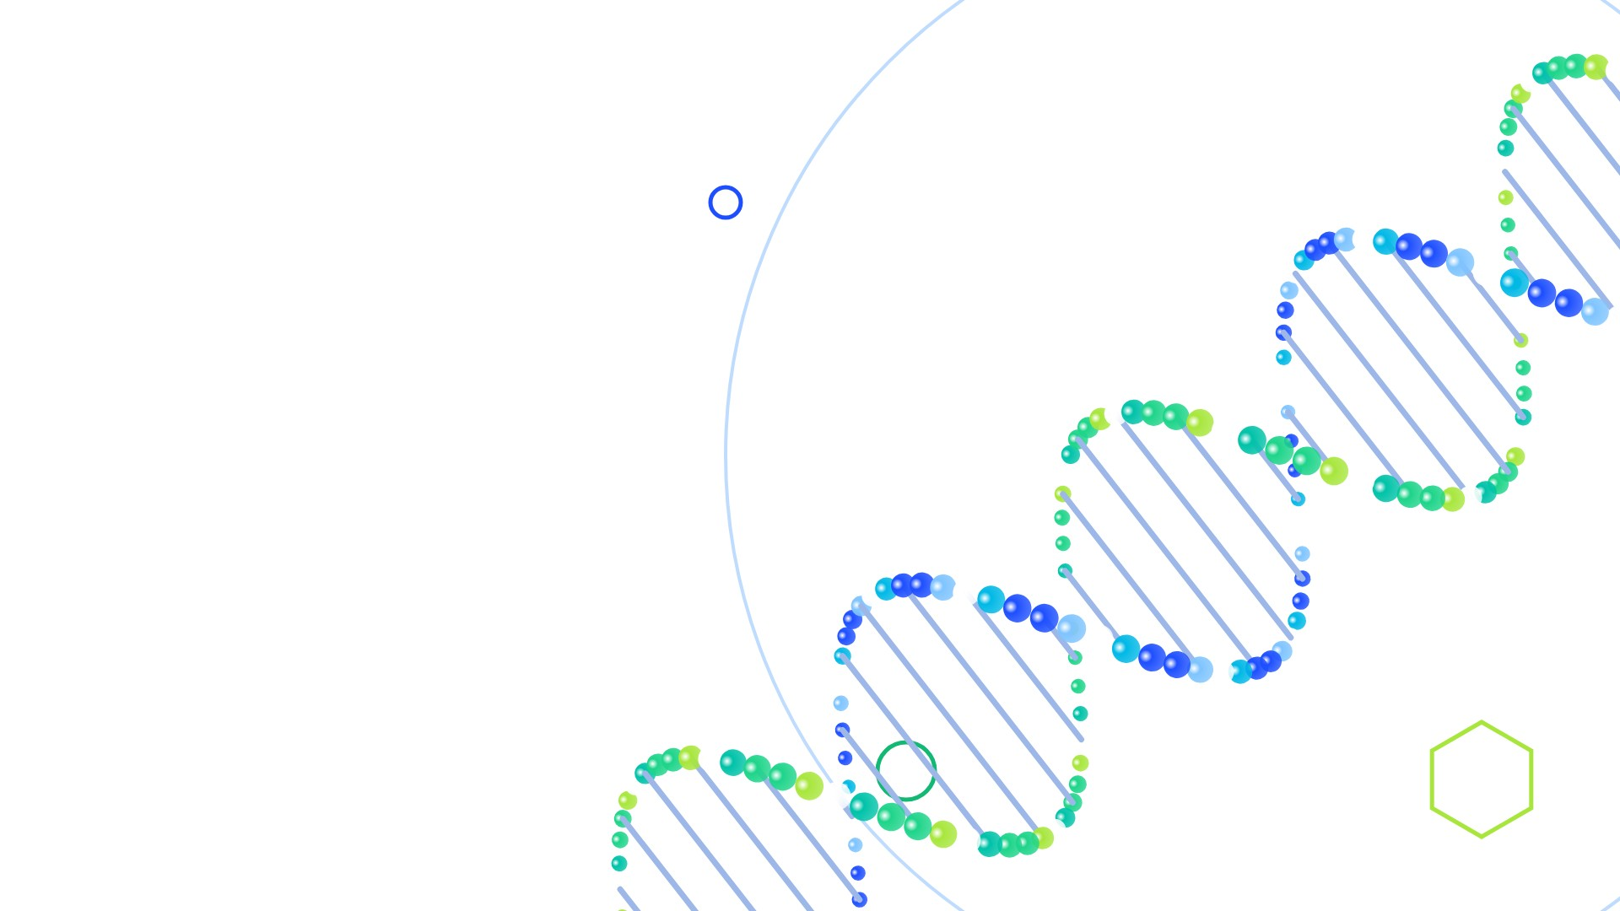
ClinVar
What 9 Million Genetic Records Tell Us
From raw dataset to cleaning to insights
PTF10 · INTRO TO DATA SCIENCE · FINAL PROJECT

Slide 2

OVERVIEW
Our project in four parts
1
2
3
4
The Dataset
Python Notebook
Power BI
Insights
What ClinVar is, key terms, the columns we kept
Cleaning with pandas, then comparing four machine-learning models
The same cleaning in Power Query, one interactive dashboard
What the data shows, and what it means
2

Slide 3

PART 1
THE DATASET
What ClinVar is and what is inside it

Slide 4

THE DATASET
Four terms you need first
D
DNA
G
Gene
The instruction manual in every cell, written in 4 letters: A, C, G, T.
One section of DNA that tells the body how to make one part.
V
Variant
B
Genome build
A change in the DNA letters, like a typo in a book. Some are harmless, some cause disease.
A standard “map” of human DNA. GRCh37 is the old map, GRCh38 the new one.
4

Slide 5
THE DATASET
ClinVar: the world’s public variant archive
Run by NCBI, part of the U.S. National Institutes of Health
Labs and experts share what each variant does to health
Free download: variant_summary.txt.gz (tab-separated)
We used the November 2026 release
9.35M
43
rows in the raw file
columns
440 MB
30K+
compressed file size
genes covered
5

Slide 6
THE DATASET
How ClinVar labels a variant
Clinical significance: the experts’ verdict
P / LP
VUS
B / LB
Conflicting
Pathogenic · causes disease
Uncertain · not enough evidence
Benign · harmless
Labs disagree · different verdicts
Review status: how much to trust the label (0–4 stars)
0
1
2
3
4
No evidence
One lab
Labs agree
Expert panel
Guideline
6

Slide 7
THE DATASET
The 11 columns we used (of 43)
Column | What it holds | Example
VariationID | Unique ID of the variant | 12375
GeneSymbol | Gene the variant is in | BRCA1
Type | Kind of DNA change | single nucleotide variant
ClinicalSignificance | The label | Likely pathogenic
ReviewStatus | How it was reviewed | reviewed by expert panel
NumberSubmitters | How many labs reported it | 3
PhenotypeList | Linked condition(s) | Familial cancer of breast
Assembly / Chromosome / Start / Stop | Where it is on the DNA map | GRCh38 / 17 / 43045712
LastEvaluated | Date of the latest review | Mar 05, 2019
7

Slide 8

OVERVIEW
Our questions, and what we don’t do
1
How much do we actually know about variants?
We study the data, we don’t diagnose
2
How much can we trust the labels?
No patients, no medical advice. Doctors decide what a variant means; we check how well that knowledge is recorded.
3
Where do experts disagree?
4
Which genes and changes matter most?
8

Slide 9

PART 2
DATA CLEANING
Turning 9.35 million messy rows into data we can trust

Slide 10
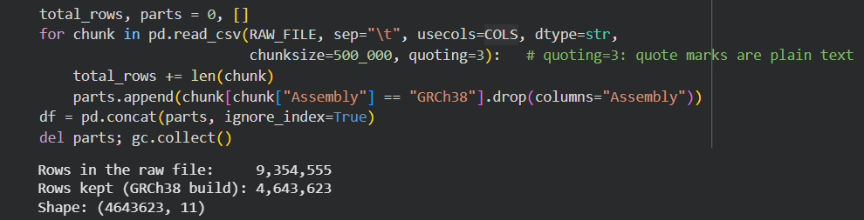
DATA CLEANING
Loading a file too big to open
1
Download
2
Peek
3
Read in chunks
4
Filter
wget from NCBI into Colab
Read 5 rows: 43 columns
500,000 rows at a time; peak memory 3.7 of 12 GB
Keep only the newer map (GRCh38)
10

Slide 11
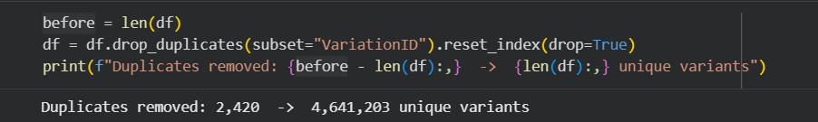
DATA CLEANING
Cleaning cut the data in half
Every variant appeared twice: once per DNA map
2,420 more exact duplicates removed
250K tumor-only records have no germline label
11

Slide 12
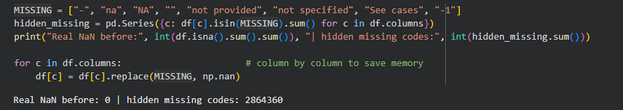
DATA CLEANING
Missing data hides behind codes
pandas found 0 missing values, but 2.86 million cells held codes like “-” or “not provided”
Replaced them with real empty values (NaN) and kept the rows
12

Slide 13
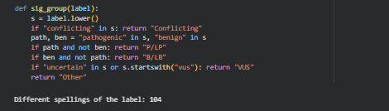
DATA CLEANING
104 label spellings, grouped into 5
These all become one group (P/LP):
“Pathogenic”
“Pathogenic/Likely pathogenic”
“Pathogenic, low penetrance”
Review-status text became a 0–4 star score the same way.
13

Slide 14
DATA CLEANING
Outliers and data types
1
2
3
Fake dates
Many submitters
Huge variants
111 review dates before 1990 (oldest: 1965). ClinVar began in 2013.
The IQR rule flags 22.5% of rows, but popular variants really do get many labs.
A few span up to 159 million DNA letters and squash the charts.
Set to missing
Kept: real data
Top 0.1% left out of length chart
Data types: all text at load → numbers (positions, submitters), real dates (review date), categories (type, label) to save memory.
14

Slide 15
PYTHON NOTEBOOK
Machine learning: how we trained and tested the models
1
Pick the answer
2
Take a sample
3
Build the inputs
4
Split the data
Keep variants labeled pathogenic (1) or benign (0). Uncertain ones are left out: their true answer is unknown.
200,000 variants, with the same 21% pathogenic share as the full data.
38 numbers per variant: type, chromosome, length, labs, stars and year.
160,000 to train. 40,000 stay hidden for the final test.
5
Choose the models
6
Cross-check
7
Final exam
8
Apply
Baseline (always benign), Logistic Regression and Random Forest, on the same data.
5-fold cross-validation on the training data: a score and its spread for each model.
Fit on all training data, then score once on the 40,000 unseen variants.
The winner scores the 2.4M uncertain (VUS) variants.
Fair-test rules: same inputs · same split · a baseline to beat · no input that already contains the answer
15

Slide 16
PYTHON NOTEBOOK
Machine learning: which model spots harmful variants?
Winner
Random Forest
AUC 0.812 vs. 0.779 for logistic regression; better in cross-validation too.
60,497
uncertain variants (2.5%) score ≥ 0.8: candidates for expert review, not a diagnosis.
16

Slide 17
PYTHON NOTEBOOK
Machine learning: why the random forest wins
Random Forest · confusion matrix
Predicted benign
Predicted pathogenic
True benign
28,929
2,709
True pathogenic
3,380
4,982
Green: Random Forest (AUC 0.812) · Blue: Logistic Regression (AUC 0.779) · Grey: random guess
Finds 4,982 of 8,362 pathogenic variants (60%). Logistic Regression finds 4,687 (56%).
Both models learn the same story: the type and length of the DNA change matter most.
17

Slide 18
PYTHON NOTEBOOK
Machine learning: scoring the uncertain variants
≈ 60K
uncertain variants (2.5%) score ≥ 0.8: they look like known pathogenic ones, so expert review could start there.
Limits
Still misses ~40% of pathogenic variants (3,380 of 8,362)
Inputs say what kind of change it is, not what it does to the protein
A way to prioritise, not a diagnosis
18

Slide 19
PYTHON NOTEBOOK
Machine learning: predicting disagreement per gene
A tie, so pick the simpler model
+6.6
points of conflict per extra lab
+0.6
points for a gene with 10× more variants
19

Slide 20
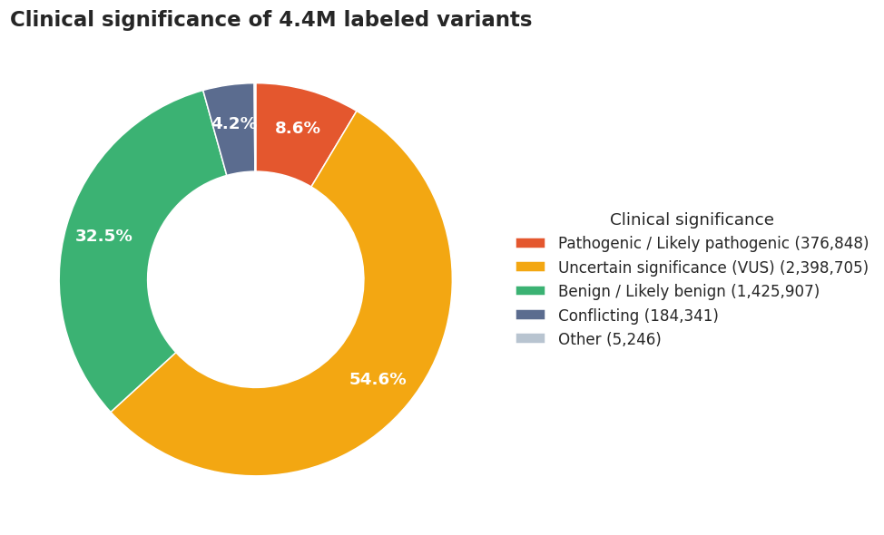
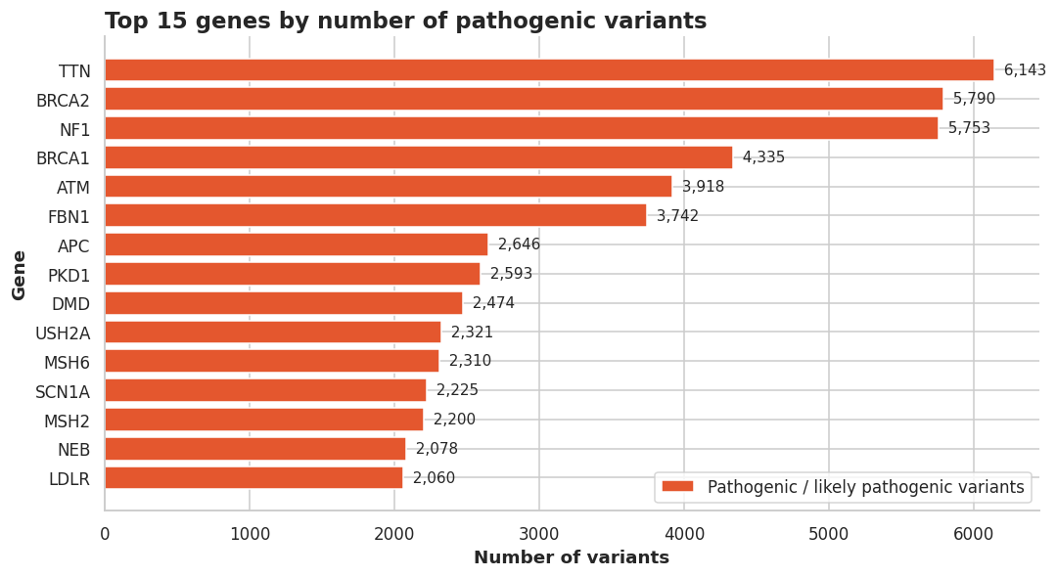
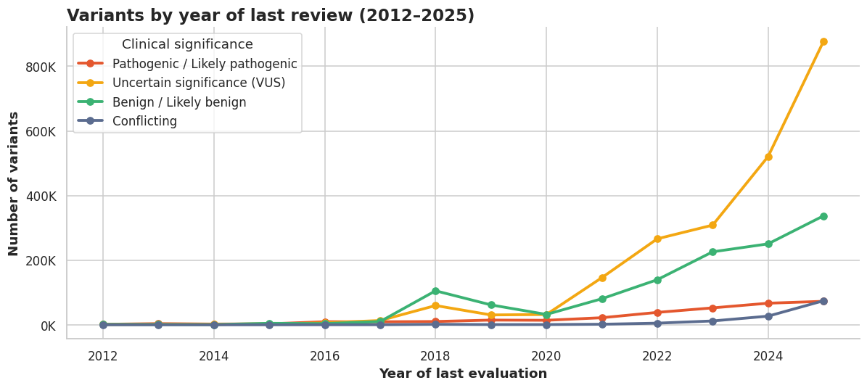
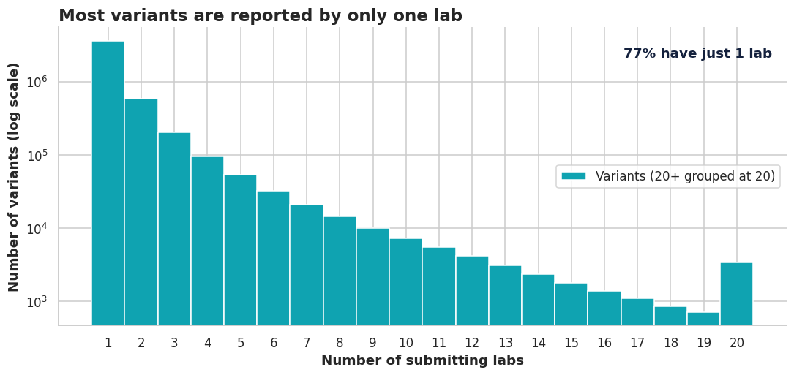
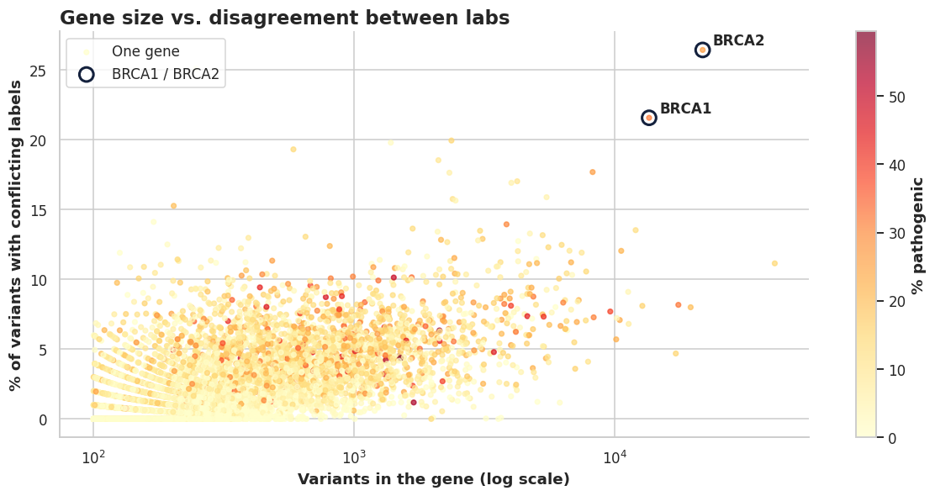
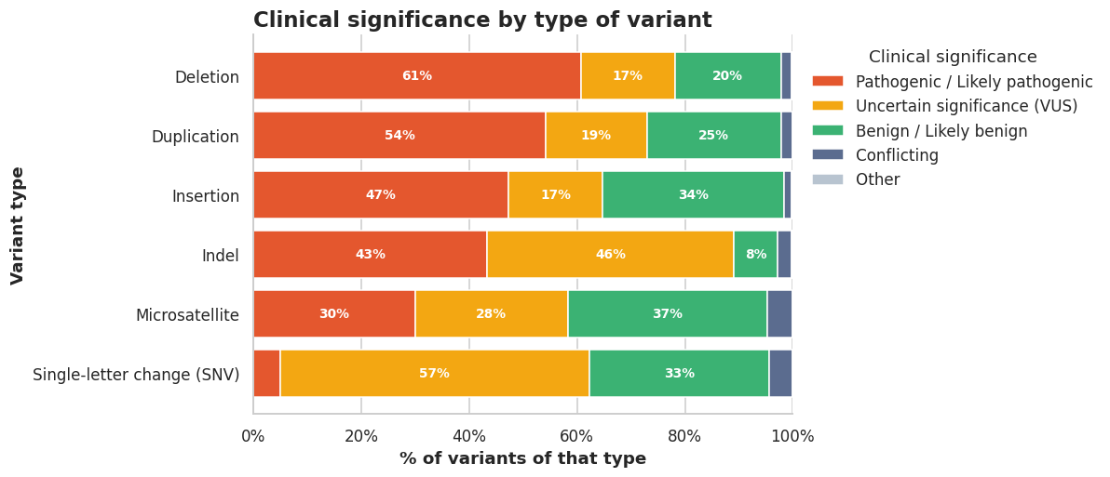
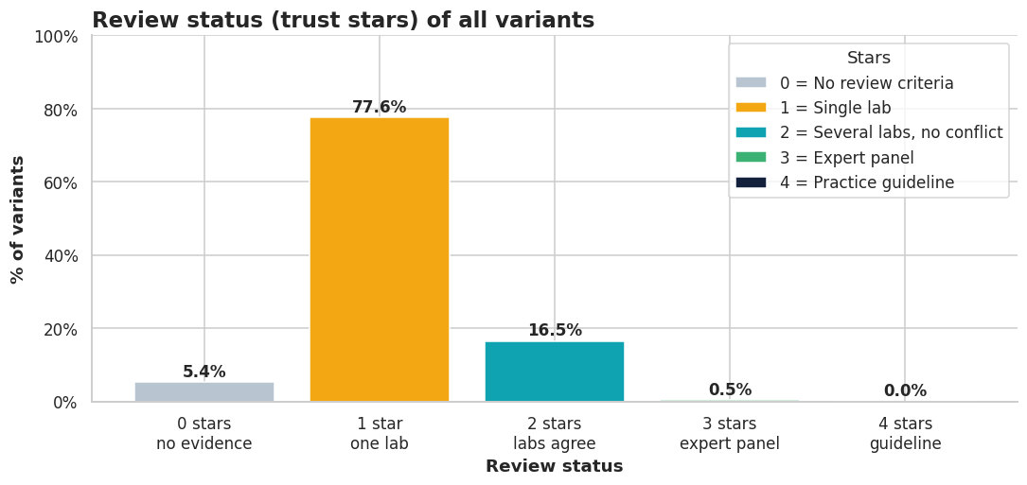
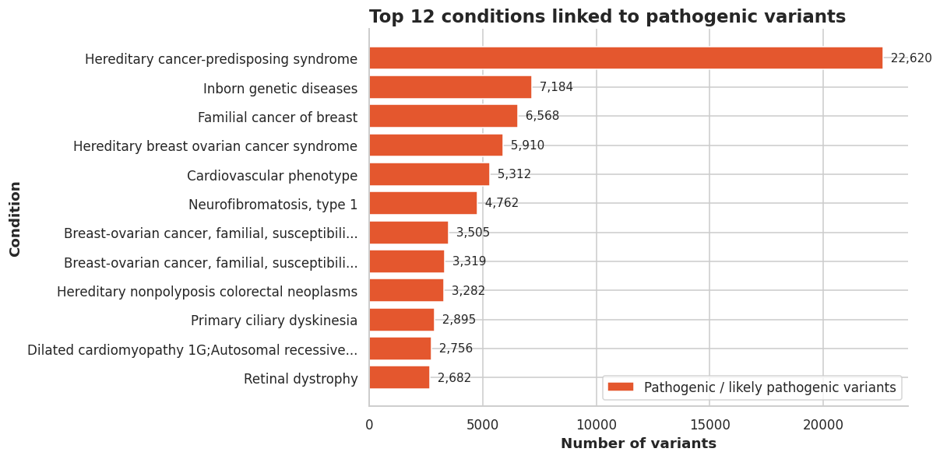
PYTHON NOTEBOOK
The eight charts from the notebook
1 · Label mix
2 · Top pathogenic genes
3 · Reviews per year
4 · Labs per variant
5 · Gene size vs. conflict
6 · Type of DNA change
7 · Trust stars
8 · Linked conditions
20

Slide 21

PART 3
THE POWER BI VERSION
The same cleaning in Power Query, and one interactive dashboard

Slide 22
POWER BI
Loading 4.6 million rows into Power BI
1
2
3
4
5
Get Data
Parse
Headers
Combine
Choose columns
Folder → 21 .txt parts
Tab-separated, QuoteStyle.None
First row → headers, once per file
Stack into one table
Keep 12 of 43
Every step is recorded in Power Query’s Applied Steps, so the whole cleaning re-runs on Refresh.
22

Slide 23
POWER BI
Same cleaning, two tools
Step | Python (pandas) | Power BI (Power Query + DAX)
Load | read_csv in chunks of 500K rows | Get Data → Folder, 21 parts
Duplicates | drop_duplicates(VariationID) | Remove Duplicates
Missing codes | replace(codes, NaN) | One replace step, whole cells only
Data types | to_numeric · to_datetime | Change Type (dates read as English, US)
Outliers | Dates < 1990 · IQR · 99.9th pct | DatePlaceholder flag · DAX measures
Label groups | sig_group() and stars() functions | Custom columns Group and Stars
Output | 8 static charts (matplotlib) | 1 interactive dashboard + slicers
23

Slide 24
POWER BI
Live demo: the dashboard reacts
1
Tick “P/LP”
2
Pick chromosome 17
Clinical significance slicer: only harmful variants remain
BRCA1 climbs in the Top 10 genes chart
3
Year range 2023–2025
4
Click the Deletion bar
KPIs and charts show recent reviews only
Every other visual filters to deletions
Clear all slicers (eraser icon) before and after the demo, so the numbers match the slides.
24

Slide 25

PART 4
ANALYSIS & INSIGHTS
What the clean data shows

Slide 26
INSIGHTS
More than half is still “we don’t know”
4.39M labeled variants (circle area = share)
54.6%
54.6%
32.5%
are uncertain (VUS)
8.6%
8.6%
4.2%
are known to cause disease
Uncertain (VUS)
Benign (B/LB)
Pathogenic (P/LP)
Conflicting
26

Slide 27
INSIGHTS
Unknowns are growing faster than answers
1.36M
reviews in 2025 (only 33K in 2017)
877K
uncertain results in 2025 alone
27

Slide 28
INSIGHTS
Most labels rest on one lab’s opinion
77.4%
reported by only one lab
0.5%
checked by an expert panel
28

Slide 29
INSIGHTS
Experts disagree most on breast-cancer genes
BRCA2: 1 in 4 variants has conflicting labels
BRCA1/2 are the most-tested genes in the world
More labs testing = more chances to disagree
29

Slide 30
INSIGHTS
Big DNA changes are easier to judge
61%
of deletions are pathogenic
57%
of single-letter changes are uncertain
30

Slide 31
INSIGHTS
Which genes and diseases come up most
31

Slide 32
INSIGHTS
Key takeaways
55% unknown
Little double-checking
Most variants are still uncertain, and that pile grows every year.
77% come from one lab; only 0.5% were expert-reviewed.
Disagreement where it matters
Cleaning was essential
BRCA1/2, the most-tested genes, have the most conflicts.
Without it, every number would be doubled or wrong.
Why it matters: clearer data means clearer test results for patients, better-aimed research, and knowing which labels to trust.
32

Slide 33
THANK YOU! QUESTIONS?
Data: NCBI ClinVar, November 2026 release · Notebook: ClinVar_Final_Project.ipynb · Dashboard: Power BI
Patterns in a public database, not medical advice.

