Slide 1
ClinVar
What 9 Million Genetic Records Tell Us
From raw dataset to cleaning to insights
PTF10 · INTRO TO DATA SCIENCE · FINAL PROJECT
Notes:
[Presenter 1 · 0:25]
Good morning everyone. We are [group name]. We took ClinVar, a huge public database of human genetic variants, and treated it like any messy real-world dataset: clean it, analyze it, model it. First in a Python notebook, then in Power BI. [Presenter 2] and I cover the notebook; [Presenter 3] and [Presenter 4] cover Power BI.

Slide 2
OVERVIEW
Our project in four parts
1
2
3
4
The Dataset
Python Notebook
Power BI
Insights
What ClinVar is, key terms, the columns we kept
Cleaning with pandas, then comparing four machine-learning models
The same cleaning in Power Query, one interactive dashboard
What the data shows, and what it means
2
Notes:
[Presenter 1 · 0:20]
Four parts: the dataset; the Python notebook, where we clean nine million rows with pandas and compare machine-learning models; the same project in Power BI as an interactive dashboard; and the insights both tools gave us.

Slide 3
PART 1
THE DATASET
What ClinVar is and what is inside it
Notes:
[Presenter 1 · 0:05]
Let's start with the dataset.

Slide 4
THE DATASET
Four terms you need first
D
DNA
G
Gene
The instruction manual in every cell, written in 4 letters: A, C, G, T.
One section of DNA that tells the body how to make one part.
V
Variant
B
Genome build
A change in the DNA letters, like a typo in a book. Some are harmless, some cause disease.
A standard “map” of human DNA. GRCh37 is the old map, GRCh38 the new one.
4
Notes:
[Presenter 1 · 0:35]
Four terms. Think of DNA as source code: a very long string over a four-letter alphabet, A, C, G, T. A gene is one function in that code. A variant is a change in the string, like a diff: some are harmless, some break the program. A genome build is a versioned reference map, GRCh37 or GRCh38. ClinVar lists every variant once per version, which matters for cleaning.

Slide 5
THE DATASET
ClinVar: the world’s public variant archive
Run by NCBI, part of the U.S. National Institutes of Health
Labs and experts share what each variant does to health
Free download: variant_summary.txt.gz (tab-separated)
We used the November 2026 release
9.35M
43
rows in the raw file
columns
440 MB
30K+
compressed file size
genes covered
5
Notes:
[Presenter 1 · 0:20]
The data comes from NCBI, part of the U.S. National Institutes of Health, where labs and experts submit what they think each variant does to health. It is a free tab-separated file, about 440 megabytes compressed: 9.35 million rows, 43 columns, November 2026 release.

Slide 6
THE DATASET
How ClinVar labels a variant
Clinical significance: the experts’ verdict
P / LP
VUS
B / LB
Conflicting
Pathogenic · causes disease
Uncertain · not enough evidence
Benign · harmless
Labs disagree · different verdicts
Review status: how much to trust the label (0–4 stars)
0
1
2
3
4
No evidence
One lab
Labs agree
Expert panel
Guideline
6
Notes:
[Presenter 1 · 0:30]
Two columns matter most. The label is the verdict: pathogenic means it causes disease, benign means harmless, uncertain means not enough evidence, and conflicting means labs submitted different verdicts, like a merge conflict. The second is review status, turned into zero to four stars, a confidence score: one star is one lab's opinion, three or four an expert panel.

Slide 7
THE DATASET
The 11 columns we used (of 43)
Column | What it holds | Example
VariationID | Unique ID of the variant | 12375
GeneSymbol | Gene the variant is in | BRCA1
Type | Kind of DNA change | single nucleotide variant
ClinicalSignificance | The label | Likely pathogenic
ReviewStatus | How it was reviewed | reviewed by expert panel
NumberSubmitters | How many labs reported it | 3
PhenotypeList | Linked condition(s) | Familial cancer of breast
Assembly / Chromosome / Start / Stop | Where it is on the DNA map | GRCh38 / 17 / 43045712
LastEvaluated | Date of the latest review | Mar 05, 2019
7
Notes:
[Presenter 1 · 0:20]
We kept 11 of the 43 columns: ID, gene, type, label, review status, number of labs, condition, position and review date. The rest were ID codes or cancer-only columns over 99 percent empty. Dropping them let the file fit in memory.

Slide 8
OVERVIEW
Our questions, and what we don’t do
1
How much do we actually know about variants?
We study the data, we don’t diagnose
2
How much can we trust the labels?
No patients, no medical advice. Doctors decide what a variant means; we check how well that knowledge is recorded.
3
Where do experts disagree?
4
Which genes and changes matter most?
8
Notes:
[Presenter 1 · 0:20]
Our four questions: how much do we know, how much can we trust it, where do experts disagree, and which genes matter most. One boundary: we analyze data. We don't diagnose anyone, and we never change an expert's label.

Slide 9
PART 2
DATA CLEANING
Turning 9.35 million messy rows into data we can trust
Notes:
[Presenter 1 · 0:05]
Now [Presenter 2] takes you through the cleaning, in the order we did it.

Slide 10
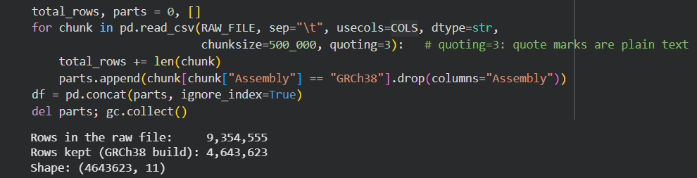
DATA CLEANING
Loading a file too big to open
1
Download
2
Peek
3
Read in chunks
4
Filter
wget from NCBI into Colab
Read 5 rows: 43 columns
500,000 rows at a time; peak memory 3.7 of 12 GB
Keep only the newer map (GRCh38)
10
Notes:
[Presenter 2 · 0:25]
Thank you. The file is too big to open at once: nine million rows can crash Colab. So we streamed it, 500 thousand rows at a time, only our columns, everything as plain text. Each chunk kept the GRCh38 rows. Result: 9.35 million rows read, 4.64 million kept, peak memory 3.7 gigabytes.

Slide 11
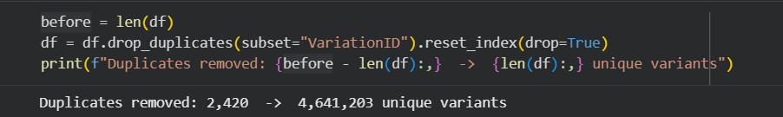
DATA CLEANING
Cleaning cut the data in half
Every variant appeared twice: once per DNA map
2,420 more exact duplicates removed
250K tumor-only records have no germline label
11
Notes:
[Presenter 2 · 0:20]
Why did half the rows disappear? Each variant appears once per genome version, so keeping one version removes the copy. Then dropping duplicates on the variation ID, our primary key, removed 2,420 more. Without this, every count we report would be doubled.

Slide 12
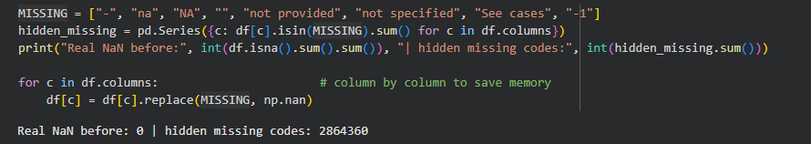
DATA CLEANING
Missing data hides behind codes
pandas found 0 missing values, but 2.86 million cells held codes like “-” or “not provided”
Replaced them with real empty values (NaN) and kept the rows
12
Notes:
[Presenter 2 · 0:25]
Pandas reported zero missing values, because ClinVar writes missing as sentinel codes: a dash, 'na', 'not provided'. We found 2.86 million and replaced them with real NaN. Forty-five percent of rows have no condition; we kept them and skip the blanks only in charts that need that column.

Slide 13
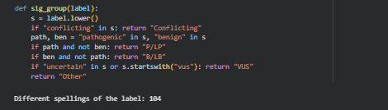
DATA CLEANING
104 label spellings, grouped into 5
These all become one group (P/LP):
“Pathogenic”
“Pathogenic/Likely pathogenic”
“Pathogenic, low penetrance”
Review-status text became a 0–4 star score the same way.
13
Notes:
[Presenter 2 · 0:25]
The label column had 104 spellings of five categories. Our function checks keywords in a fixed order: conflicting first, then pathogenic without benign, benign without pathogenic, then uncertain. Order matters, because 'conflicting classifications of pathogenicity' contains the word pathogenic. Review status became the star score the same way.

Slide 14
DATA CLEANING
Outliers and data types
1
2
3
Fake dates
Many submitters
Huge variants
111 review dates before 1990 (oldest: 1965). ClinVar began in 2013.
The IQR rule flags 22.5% of rows, but popular variants really do get many labs.
A few span up to 159 million DNA letters and squash the charts.
Set to missing
Kept: real data
Top 0.1% left out of length chart
Data types: all text at load → numbers (positions, submitters), real dates (review date), categories (type, label) to save memory.
14
Notes:
[Presenter 2 · 0:30]
Outliers. 111 review dates were before 1990, but ClinVar started in 2013, so we set them to empty. The IQR rule flags 22 percent of rows for having more than one lab, but those are real, popular variants, so we kept them. The top 0.1 percent of variant lengths are left out of the length charts only.

Slide 15
PYTHON NOTEBOOK
Machine learning: how we trained and tested the models
1
Pick the answer
2
Take a sample
3
Build the inputs
4
Split the data
Keep variants labeled pathogenic (1) or benign (0). Uncertain ones are left out: their true answer is unknown.
200,000 variants, with the same 21% pathogenic share as the full data.
38 numbers per variant: type, chromosome, length, labs, stars and year.
160,000 to train. 40,000 stay hidden for the final test.
5
Choose the models
6
Cross-check
7
Final exam
8
Apply
Baseline (always benign), Logistic Regression and Random Forest, on the same data.
5-fold cross-validation on the training data: a score and its spread for each model.
Fit on all training data, then score once on the 40,000 unseen variants.
The winner scores the 2.4M uncertain (VUS) variants.
Fair-test rules: same inputs · same split · a baseline to beat · no input that already contains the answer
15
Notes:
[Presenter 2 · 1:15]
Now the machine learning, and first our goal. More than half of ClinVar is labeled uncertain, so: can a model learn what a harmful variant looks like from the facts we recorded, and help decide which uncertain variants experts should review first? That is supervised classification with a yes-or-no answer: pathogenic or benign. Our setup: we keep only variants with a known label, because a model learns from answers and the uncertain ones have none. We sample 200 thousand, keeping the 21 percent pathogenic share, because a random forest on 1.8 million rows is too slow in Colab. Each variant becomes 38 numbers, such as type, length, labs and stars. We train on 160 thousand and lock away 40 thousand for a final exam. Three models get identical data: a baseline that always says benign, logistic regression and a random forest, compared with five-fold cross-validation. No input may contain the answer.

Slide 16
PYTHON NOTEBOOK
Machine learning: which model spots harmful variants?
Winner
Random Forest
AUC 0.812 vs. 0.779 for logistic regression; better in cross-validation too.
60,497
uncertain variants (2.5%) score ≥ 0.8: candidates for expert review, not a diagnosis.
16
Notes:
[Presenter 2 · 0:40]
Results, measured only on the 40 thousand variants the models never saw. A baseline that always says benign is already 79 percent accurate, yet it catches zero pathogenic variants, so accuracy alone would fool us. Our goal is finding harmful variants, so we use AUC, how well a model ranks pathogenic above benign, and recall, the share of truly pathogenic variants it catches. The random forest wins both: AUC 0.81 against 0.78, recall about 60 percent against 56.

Slide 17
PYTHON NOTEBOOK
Machine learning: why the random forest wins
Random Forest · confusion matrix
Predicted benign
Predicted pathogenic
True benign
28,929
2,709
True pathogenic
3,380
4,982
Green: Random Forest (AUC 0.812) · Blue: Logistic Regression (AUC 0.779) · Grey: random guess
Finds 4,982 of 8,362 pathogenic variants (60%). Logistic Regression finds 4,687 (56%).
Both models learn the same story: the type and length of the DNA change matter most.
17
Notes:
[Presenter 2 · 0:30]
Why does the forest win? On the ROC curve, closer to the top-left corner is better, and the forest stays above logistic regression. In the confusion matrix it finds 4,982 of 8,362 pathogenic variants, about 60 percent, with 2,709 false alarms. It leans on the type and length of the change: single-letter changes lean benign, deletions lean pathogenic.

Slide 18
PYTHON NOTEBOOK
Machine learning: scoring the uncertain variants
≈ 60K
uncertain variants (2.5%) score ≥ 0.8: they look like known pathogenic ones, so expert review could start there.
Limits
Still misses ~40% of pathogenic variants (3,380 of 8,362)
Inputs say what kind of change it is, not what it does to the protein
A way to prioritise, not a diagnosis
18
Notes:
[Presenter 2 · 0:35]
The real job is the uncertain variants, so we scored all 2.4 million. Most score around 0.3. About 60 thousand, 2.5 percent, score 0.8 or higher: they resemble known pathogenic variants, so experts could review them first. The limits: the model misses about 40 percent of pathogenic variants, and it sees the kind of change, not what it does. It helps prioritize work; it does not diagnose.

Slide 19
PYTHON NOTEBOOK
Machine learning: predicting disagreement per gene
A tie, so pick the simpler model
+6.6
points of conflict per extra lab
+0.6
points for a gene with 10× more variants
19
Notes:
[Presenter 2 · 0:45]
Our second goal: what predicts how often labs disagree on a gene? One row per gene, for the 7,288 genes with at least 100 variants, predicting the share of conflicting labels from gene size, average labs per variant and the share of single-letter changes. Review stars are left out, because they would leak the answer. Linear regression and the random forest tie at R squared 0.72, so we choose the simpler one: each extra lab per variant adds about 6.6 points of conflict, a gene ten times bigger only 0.6.

Slide 20
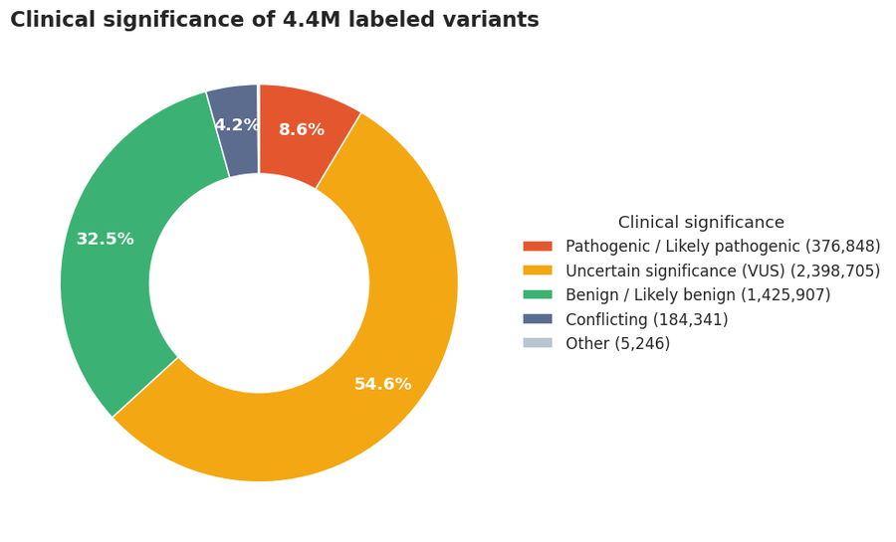
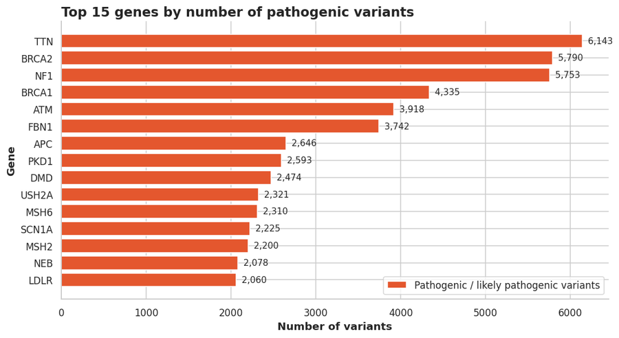
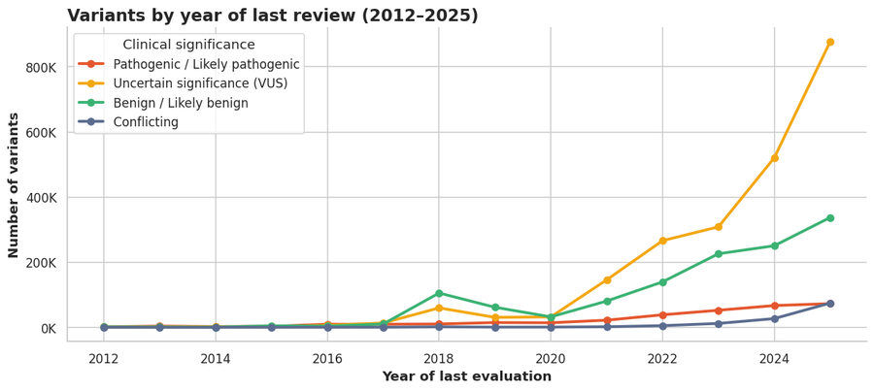
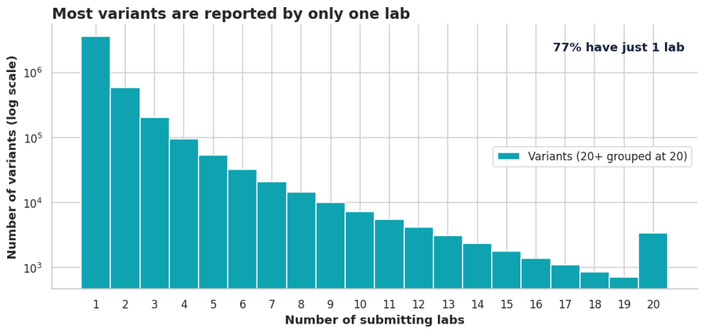
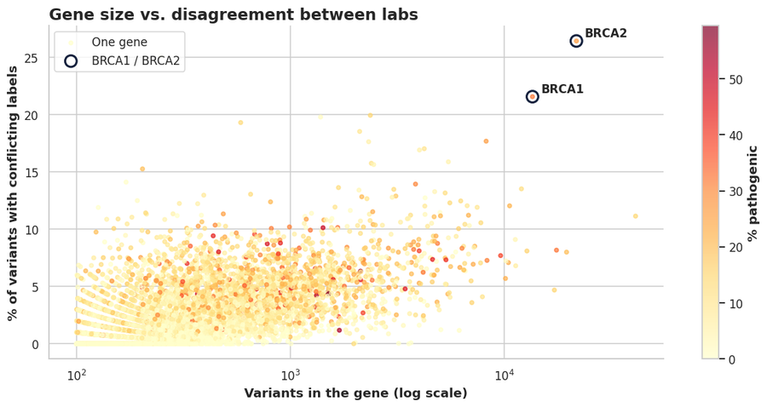
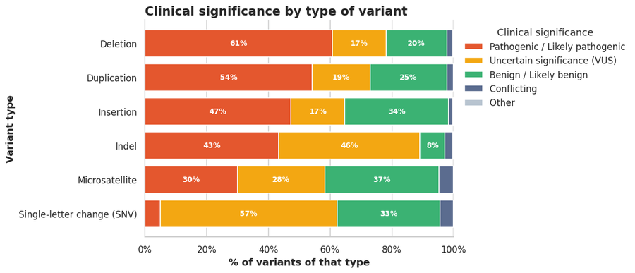
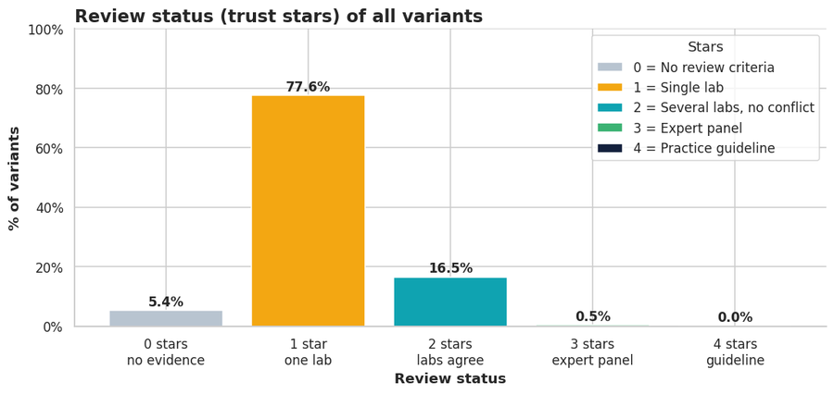
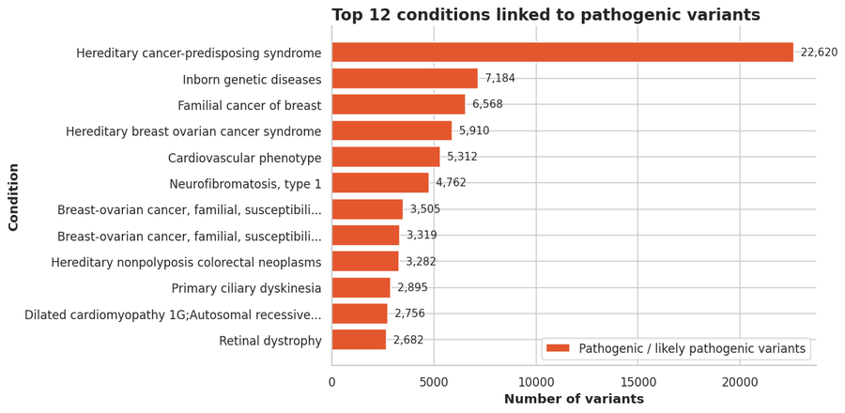
PYTHON NOTEBOOK
The eight charts from the notebook
1 · Label mix
2 · Top pathogenic genes
3 · Reviews per year
4 · Labs per variant
5 · Gene size vs. conflict
6 · Type of DNA change
7 · Trust stars
8 · Linked conditions
20
Notes:
[Presenter 2 · 0:15]
Here are the eight charts we built in the notebook. [Presenter 3] now shows the same project in Power BI, where we can explore them interactively.

Slide 21
PART 3
THE POWER BI VERSION
The same cleaning in Power Query, and one interactive dashboard
Notes:
[Presenter 3 · 0:10]
Thank you. We rebuilt the same project in Power BI, to make the results interactive.

Slide 22
POWER BI
Loading 4.6 million rows into Power BI
1
2
3
4
5
Get Data
Parse
Headers
Combine
Choose columns
Folder → 21 .txt parts
Tab-separated, QuoteStyle.None
First row → headers, once per file
Stack into one table
Keep 12 of 43
Every step is recorded in Power Query’s Applied Steps, so the whole cleaning re-runs on Refresh.
22
Notes:
[Presenter 3 · 0:35]
For Power BI we kept only the GRCh38 rows, because Power BI loaded extremely slowly with 9 million rows on some of our devices, and we would have filtered to GRCh38 anyway. The result is 21 tab-separated files. Get Data, Folder reads them and stacks them into one table, like a UNION in SQL. Two settings matter: QuoteStyle None, and promoting the first row to headers once per file.

Slide 23
POWER BI
Same cleaning, two tools
Step | Python (pandas) | Power BI (Power Query + DAX)
Load | read_csv in chunks of 500K rows | Get Data → Folder, 21 parts
Duplicates | drop_duplicates(VariationID) | Remove Duplicates
Missing codes | replace(codes, NaN) | One replace step, whole cells only
Data types | to_numeric · to_datetime | Change Type (dates read as English, US)
Outliers | Dates < 1990 · IQR · 99.9th pct | DatePlaceholder flag · DAX measures
Label groups | sig_group() and stars() functions | Custom columns Group and Stars
Output | 8 static charts (matplotlib) | 1 interactive dashboard + slicers
23
Notes:
[Presenter 3 · 0:25]
Every cleaning step has a Power BI twin: Remove Duplicates, one replace step for the missing codes, Change Type, DAX measures for the outlier checks, and custom columns for label groups and stars. The big difference is the output: eight static charts in Python, one interactive dashboard in Power BI.

Slide 24
POWER BI
Live demo: the dashboard reacts
1
Tick “P/LP”
2
Pick chromosome 17
Clinical significance slicer: only harmful variants remain
BRCA1 climbs in the Top 10 genes chart
3
Year range 2023–2025
4
Click the Deletion bar
KPIs and charts show recent reviews only
Every other visual filters to deletions
Clear all slicers (eraser icon) before and after the demo, so the numbers match the slides.
24
Notes:
[Presenter 3 · 0:30 + ~45s]
Let me show it live. [Clear all slicers first.] One: tick P/LP in the slicer, which is a filter widget, and the cards and charts show only harmful variants. Two: pick chromosome 17, where BRCA1 sits, and BRCA1 climbs in the gene chart. Three: drag the year range to 2023 to 2025. Four: click the Deletion bar, and every other visual filters to deletions. [Clear everything with the eraser icon, then return to the slides.]

Slide 25
PART 4
ANALYSIS & INSIGHTS
What the clean data shows
Notes:
[Presenter 3 · 0:10]
Both tools found the same patterns. Now [Presenter 4] takes you through what the data shows.

Slide 26
INSIGHTS
More than half is still “we don’t know”
4.39M labeled variants (circle area = share)
54.6%
54.6%
32.5%
are uncertain (VUS)
8.6%
8.6%
4.2%
are known to cause disease
Uncertain (VUS)
Benign (B/LB)
Pathogenic (P/LP)
Conflicting
26
Notes:
[Presenter 4 · 0:25]
Thank you. First: more than half of all labeled variants, 54.6 percent, are uncertain, and only 8.6 percent are known to cause disease. In data terms, the biggest class in this dataset is "unknown". So a genetic test is more likely to say "we don't know" than anything else.

Slide 27
INSIGHTS
Unknowns are growing faster than answers
1.36M
reviews in 2025 (only 33K in 2017)
877K
uncertain results in 2025 alone
27
Notes:
[Presenter 4 · 0:20]
The unknowns are growing faster than the answers. Reviews jumped from about 33 thousand variants in 2017 to 1.36 million in 2025, and 877 thousand of the 2025 reviews were uncertain. Data is being collected faster than it can be labeled.

Slide 28
INSIGHTS
Most labels rest on one lab’s opinion
77.4%
reported by only one lab
0.5%
checked by an expert panel
28
Notes:
[Presenter 4 · 0:20]
Most labels rest on one source: 77 percent of variants come from a single lab, and only half a percent were checked by an expert panel. Like code with no code review, check the stars before trusting a label.

Slide 29
INSIGHTS
Experts disagree most on breast-cancer genes
BRCA2: 1 in 4 variants has conflicting labels
BRCA1/2 are the most-tested genes in the world
More labs testing = more chances to disagree
29
Notes:
[Presenter 4 · 0:20]
Experts disagree most on well-known breast cancer genes. In BRCA2, one in four variants has conflicting labels. These are the most tested genes in the world, so more labs means more chances to disagree. That is exactly what our regression found.

Slide 30
INSIGHTS
Big DNA changes are easier to judge
61%
of deletions are pathogenic
57%
of single-letter changes are uncertain
30
Notes:
[Presenter 4 · 0:15]
Big DNA changes are easier to judge: 61 percent of deletions are pathogenic, while 57 percent of single-letter changes are uncertain. Our classifier agreed: the type of change was its most important feature.

Slide 31
INSIGHTS
Which genes and diseases come up most
31
Notes:
[Presenter 4 · 0:20]
Which genes and conditions come up most? TTN, BRCA2 and NF1 lead the genes, and hereditary cancer leads the conditions by far. TTN is simply the largest human gene, so it has the most places to change.

Slide 32
INSIGHTS
Key takeaways
55% unknown
Little double-checking
Most variants are still uncertain, and that pile grows every year.
77% come from one lab; only 0.5% were expert-reviewed.
Disagreement where it matters
Cleaning was essential
BRCA1/2, the most-tested genes, have the most conflicts.
Without it, every number would be doubled or wrong.
Why it matters: clearer data means clearer test results for patients, better-aimed research, and knowing which labels to trust.
32
Notes:
[Presenter 4 · 0:25]
To sum up. Fifty-five percent of variants are still unknown, and that pile grows every year. Most labels come from one lab and are rarely expert-checked. Disagreement is highest where testing is highest. And none of this was visible until we cleaned the data. Garbage in, garbage out.

Slide 33
THANK YOU! QUESTIONS?
Data: NCBI ClinVar, November 2026 release · Notebook: ClinVar_Final_Project.ipynb · Dashboard: Power BI
Patterns in a public database, not medical advice.
Notes:
[Presenter 4 · 0:15]
Thank you for listening. We're happy to take your questions, and we can open the notebook or the dashboard if you'd like to see either.

