Slide 1
Input:
Body temperature
Respiratory rate
Heart rate
High blood pressure
Low blood pressure
Weight
Outut:
Good
Bad

Slide 2
Health Nursing
COMP308 Project
Professor: Ilia Nika
Liping WU
Analysis and Test
Yanbo Wng
Register and login
Zhaobin BU
Others

Slide 3
Work Flow of a Patient
Register
Login as a patient
Get accepted by a Nurse
Create a report, get predict from reporting history
Read instruction after nurse reply
Read history of report and Diagrams of every factor

Slide 4
Work Flow of a Nurse
Register
Login as a nurse
Accept or Drop patients
Read reports and give instructions
Manage post system
Read history of report and Diagrams of every factor

Slide 5
Patient:
Read posts Create a report
Read reply
List report
Show AI predict to report
Nurse:
CRUD posts Accept patients Drop patients
Reply patient’s report
Read report history
Administrator
Grand nurse role to a normal user
Change a nurse role to a normal user
Delete user

Slide 6
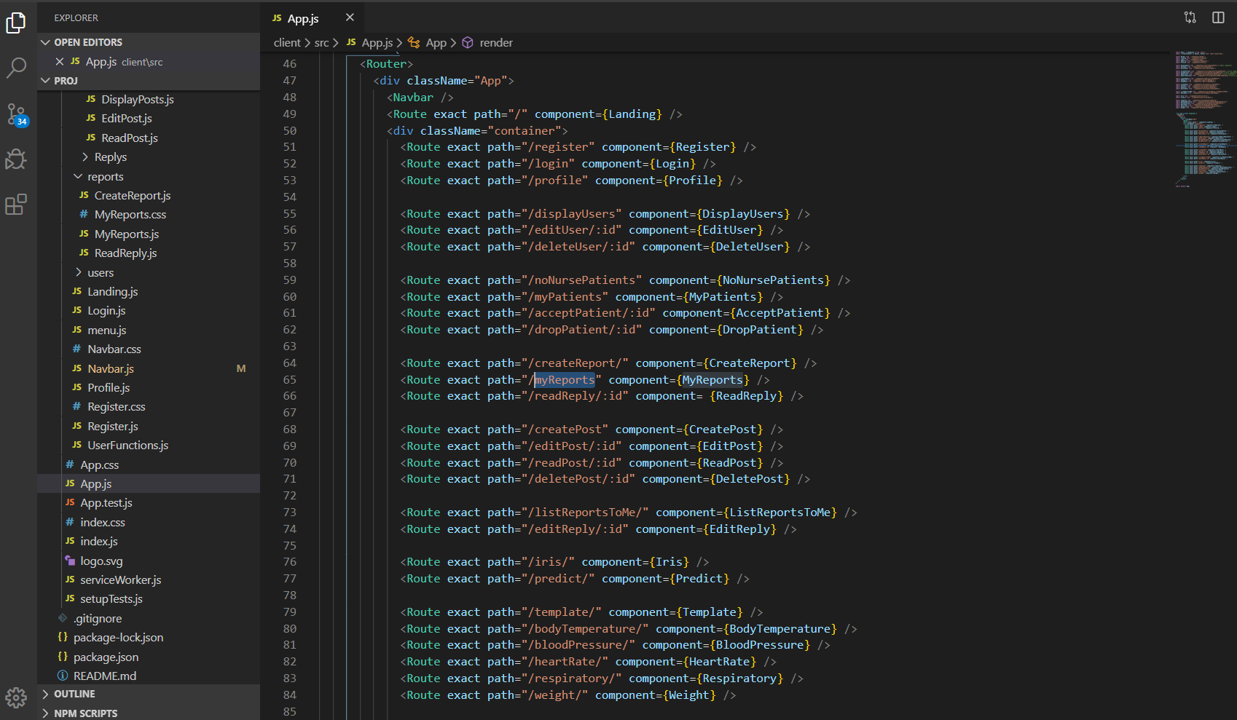

Slide 7
Thank you

