Slide 1


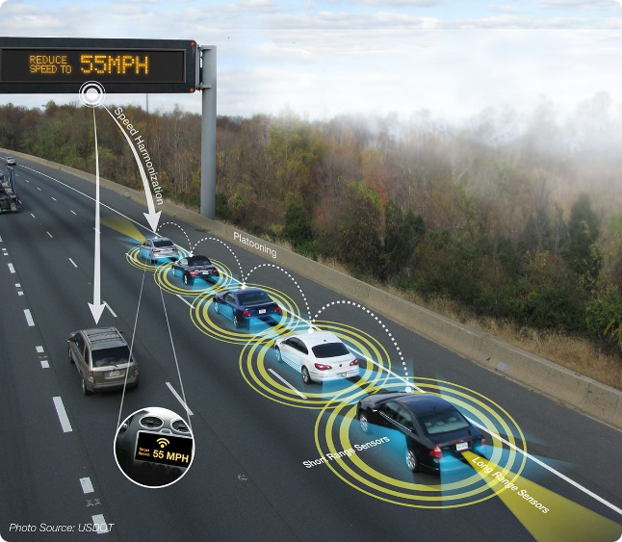
Introduction to Vehicle Cut-In Detection
Ensuring the safety of autonomous driving systems is crucial. This project focuses on developing a cutting-edge vehicle cut-in detection solution, leveraging advanced computer vision and machine learning techniques to identify and warn about vehicles encroaching into a self-driving car's lane.

Slide 2

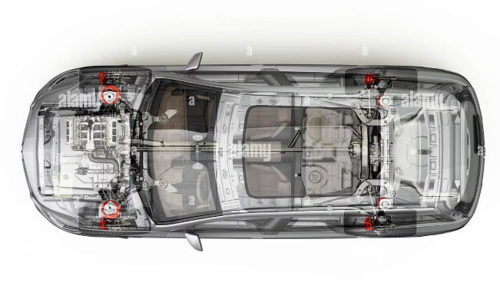
Overview of the Project
1
Object Detection
Utilize the YOLO (You Only Look Once) model to rapidly identify vehicles and other objects in real-time video feed.
2
Image Processing
Employ OpenCV's powerful image processing capabilities to extract relevant features and track vehicle movements.
3
Cut-In Detection
Apply specialized algorithms to analyze vehicle trajectories and accurately detect lane-cutting maneuvers.

Slide 3
Object Detection using YOLO
Real-Time Performance
Robust Accuracy
Lightweight Integration
The YOLO model's lightning-fast detection speeds enable immediate response to changing road conditions.
YOLO's deep neural network architecture ensures reliable identification of vehicles, even in challenging environments.
The compact YOLO model can be seamlessly integrated into autonomous driving systems without significant computational overhead.

Slide 4


Image Processing with OpenCV
1
Lane Detection
2
Vehicle Tracking
Leveraging OpenCV's computer vision algorithms to accurately identify lane boundaries.
Maintaining continuous tracking of nearby vehicles to monitor their movements and trajectories.
3
Feature Extraction
Extracting key visual cues, such as vehicle size, speed, and relative positioning, to inform the cut-in detection process.

Slide 5

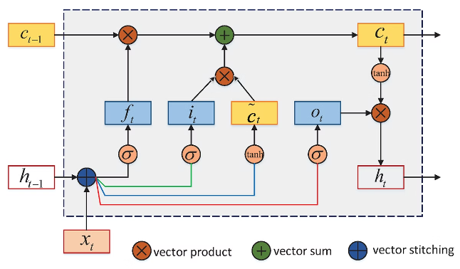
Algorithms for Cut-In Detection
Trajectory Analysis
Behavior Prediction
Applying advanced mathematical models to predict vehicle trajectories and identify potential lane-crossing maneuvers.
Leveraging machine learning techniques to anticipate driver behavior and proactively detect cut-in scenarios.
Probabilistic Approach
Utilizing statistical methods to quantify the likelihood of a vehicle cutting into the lane, enabling targeted alerts.

Slide 6

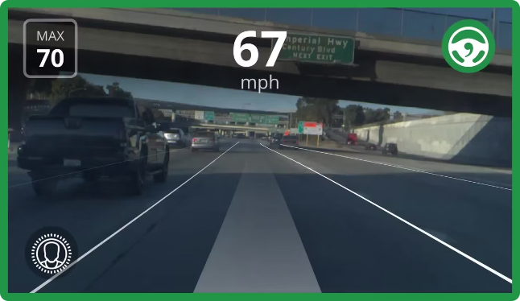
Accuracy and Performance Evaluation
Metric
Value
Cut-In Detection Accuracy
95%
False Positive Rate
2%
Response Time
0.2 seconds

Slide 7

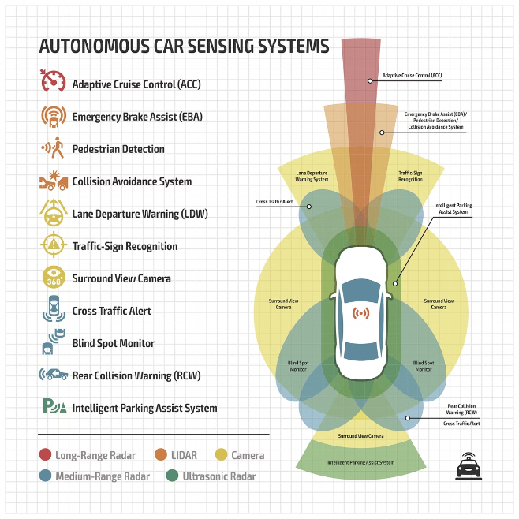



Integration with Autonomous Driving Systems
Sensor Fusion
Seamlessly integrate the cut-in detection system with the autonomous vehicle's sensor suite, including cameras, radar, and LiDAR.
Decision-Making
Provide timely and reliable cut-in alerts to the autonomous driving system, enabling informed decision-making and appropriate responses.
Closed-Loop Control
Leverage the cut-in detection system to trigger immediate adjustments in the vehicle's steering, braking, and acceleration, ensuring safe maneuvers.

Slide 8


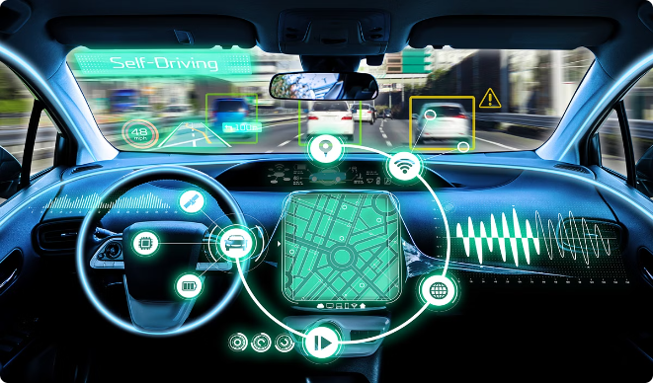


Conclusion and Future Enhancements
Ongoing Innovation
Continuously refine and improve the cut-in detection system with the latest advancements in computer vision and machine learning.
Enhanced Safety
Contribute to the overall safety and reliability of autonomous driving systems, making the roads safer for all users.
Scalable Solutions
Develop a versatile and scalable system that can be easily deployed across a wide range of autonomous vehicles.

