Slide 1
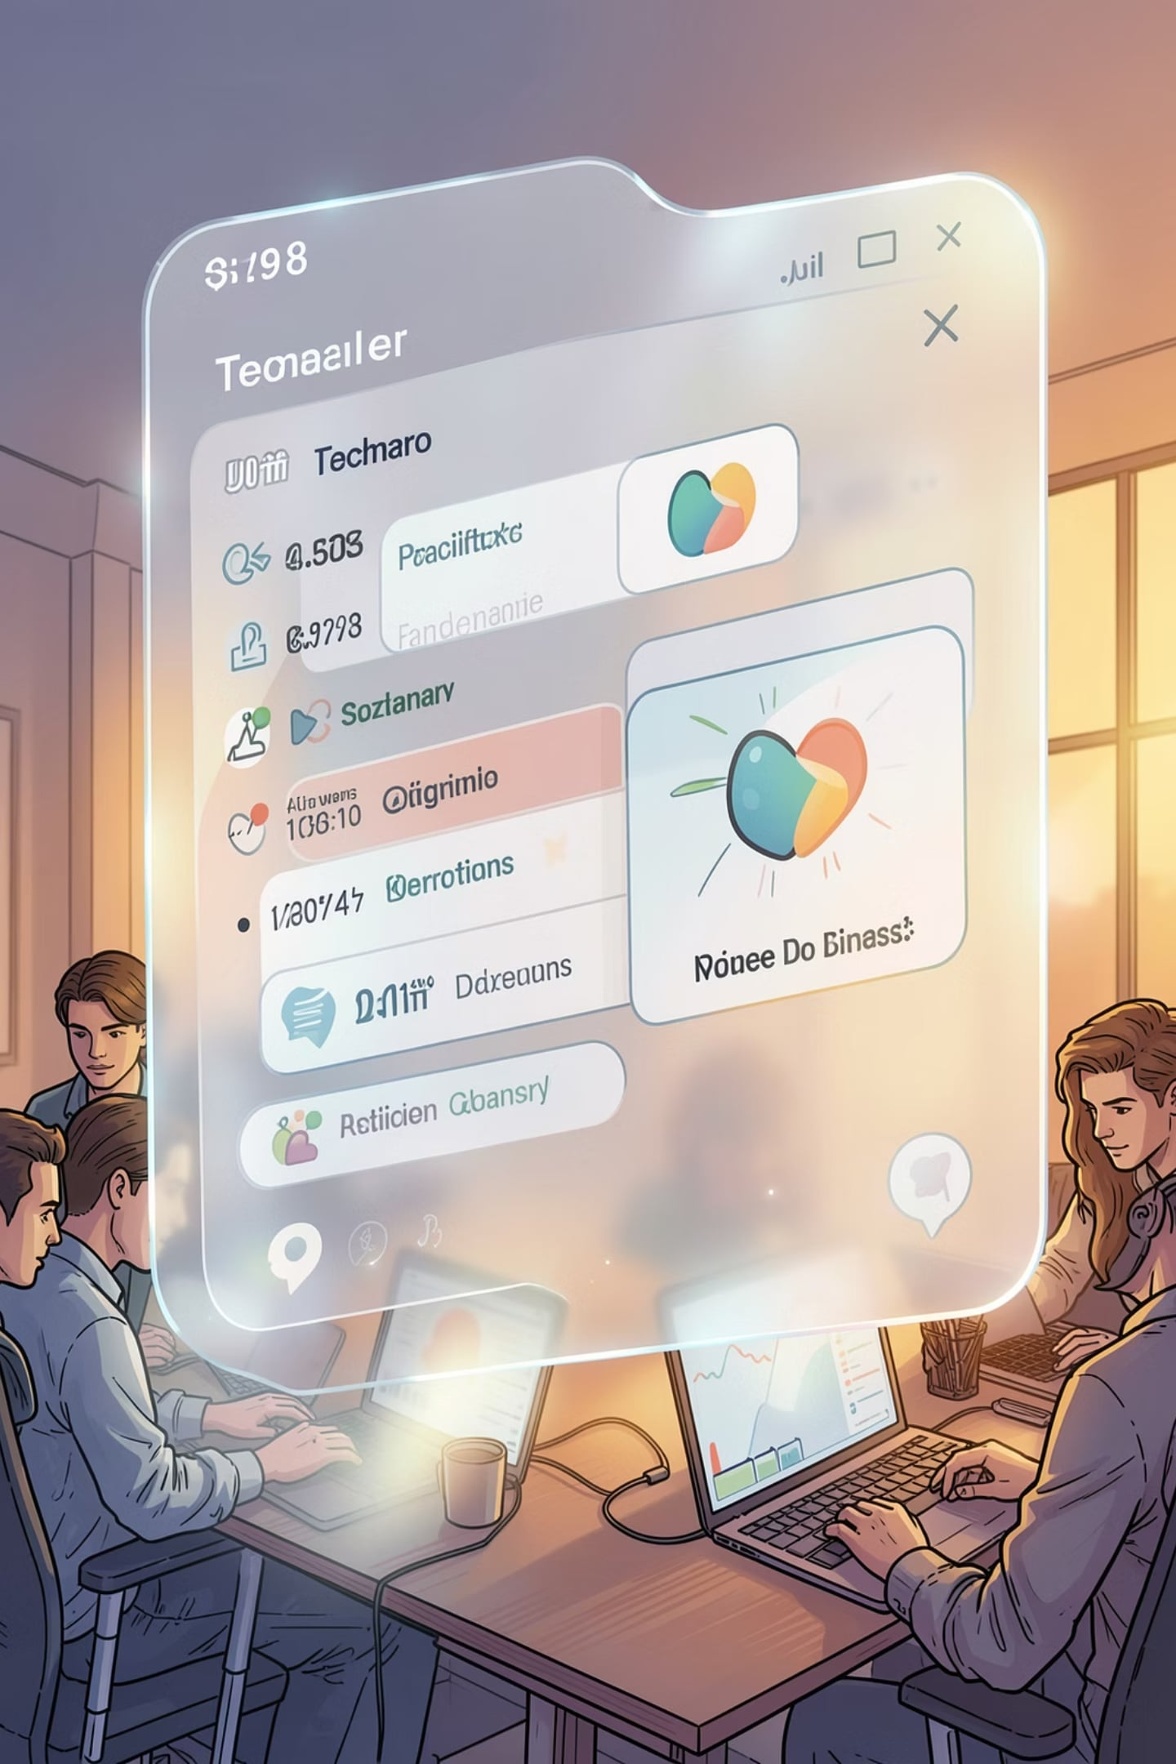

InternsHub — Next‑Gen Internship Management
Streamlining connections between Students, Companies, and Admins with a modern, light glassmorphic design system built for speed and clarity.

Slide 2


The Problem
Fragmented Communication
Manual Tracking
Spreadsheets and manual status updates create delays and mistakes in application flows.
Messages split across email, spreadsheets, and portals — candidates and partners lose context.
Legacy Mobile UX
Outdated mobile interfaces frustrate students and reduce engagement on the go.
These gaps slow hiring cycles and increase dropout rates for internships.

Slide 3
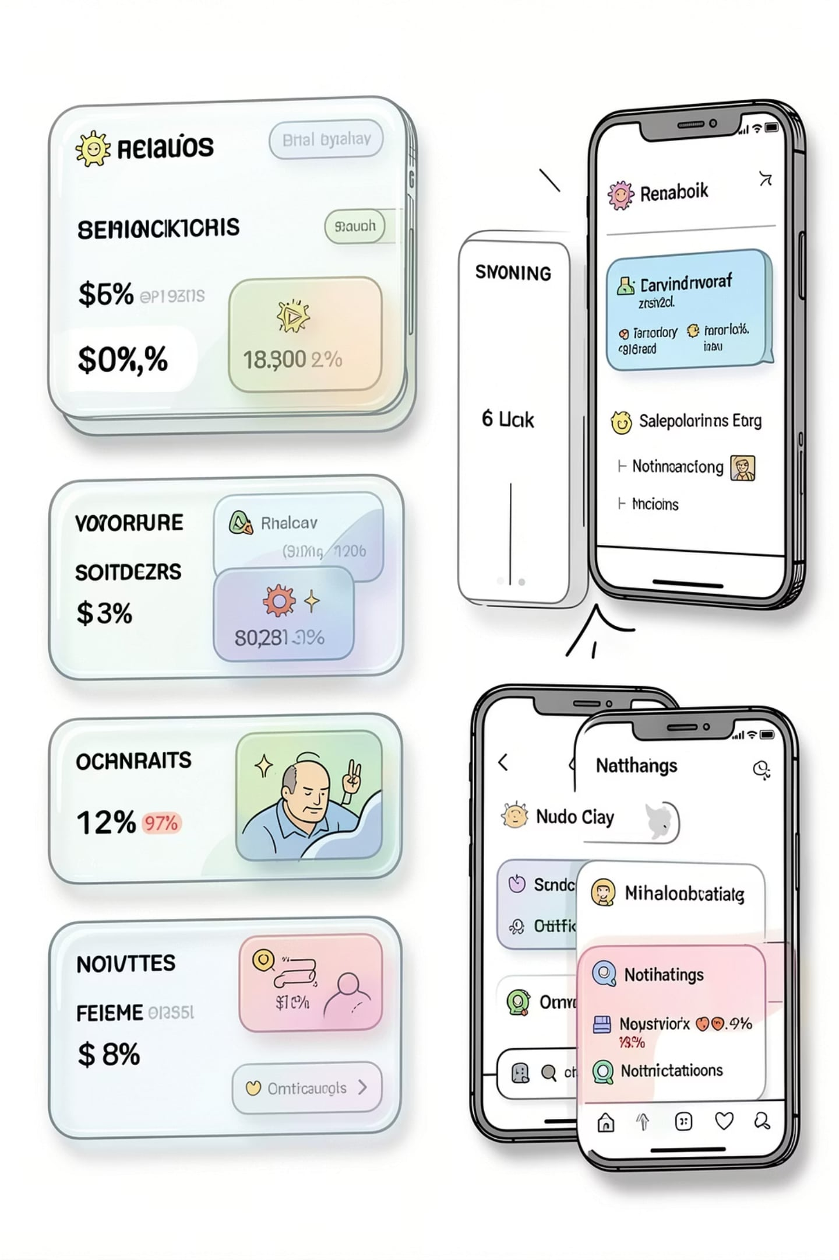
The Solution
A unified Internship Management System combining cross‑platform web & mobile portals, light glassmorphic widgets for clear information hierarchy, secure PDF matching, and automated email updates to keep every stakeholder aligned.
Unified Workflows
Single source of truth for vacancies, applications, and scheduling.
Automated Communication
Event-driven emails and PDF attachments for interview confirmations and offer letters.
Polished UX
Glassmorphic UI components optimized for accessibility and mobile responsiveness.

Slide 4

Key Tech Stack
Node.js + Express
Lightweight REST API, authentication, role-based access, PDF generation endpoints.
MongoDB Atlas
Cloud-hosted document DB for schemaless candidate profiles, audit logs, and analytics.
React (Vite)
Fast web client with modular glassmorphic component library and SSR-ready pages.
Flutter
Cross-platform mobile app delivering native performance on iOS & Android.

Slide 5
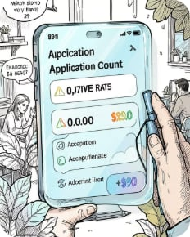
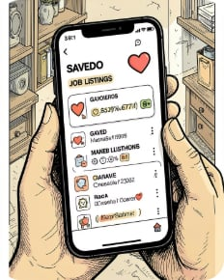
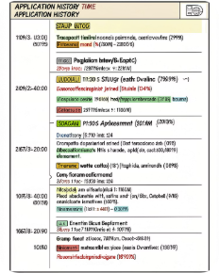
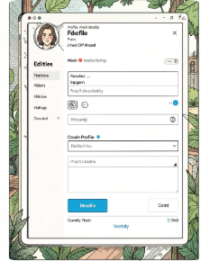
Student Experience
A concise, mobile-first experience that lets students discover, apply, and manage internships without friction.
Glassmorphic Metrics
Saved Vacancies
Application History
Web‑Redirect Profile Editor
At-a-glance KPIs: applications, interviews, offers — clear, tactile cards for quick decisions.
Bookmark roles for later, sync across web and mobile, get targeted notifications.
Immutable timeline with status, recruiter notes, and downloadable PDFs for records.
Edit rich profiles on web and push updates to mobile — maintaining polished resumes and portfolios.

Slide 6
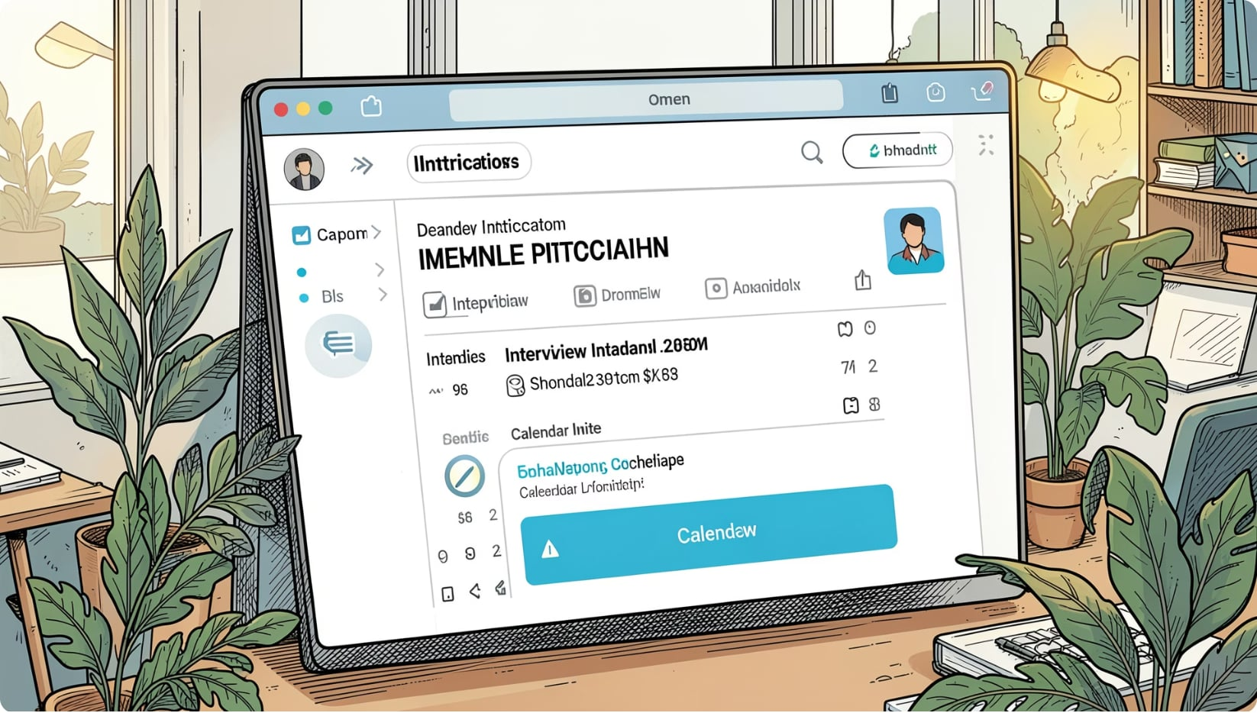
Hiring Partner Portal
Tools designed to accelerate screening, scheduling, and communication for recruiters and hiring teams.
Interactive Vacancy Creator
Create roles with structured criteria, auto-suggested tags, and templated interview flows.
Resume Reviewer
Preview parsed resumes, mark favorites, add private notes, and export shortlisted PDFs.
Automated Notifications
Nodemailer-driven emails with interview coordinates, calendar invites, and follow-up reminders.

Slide 7
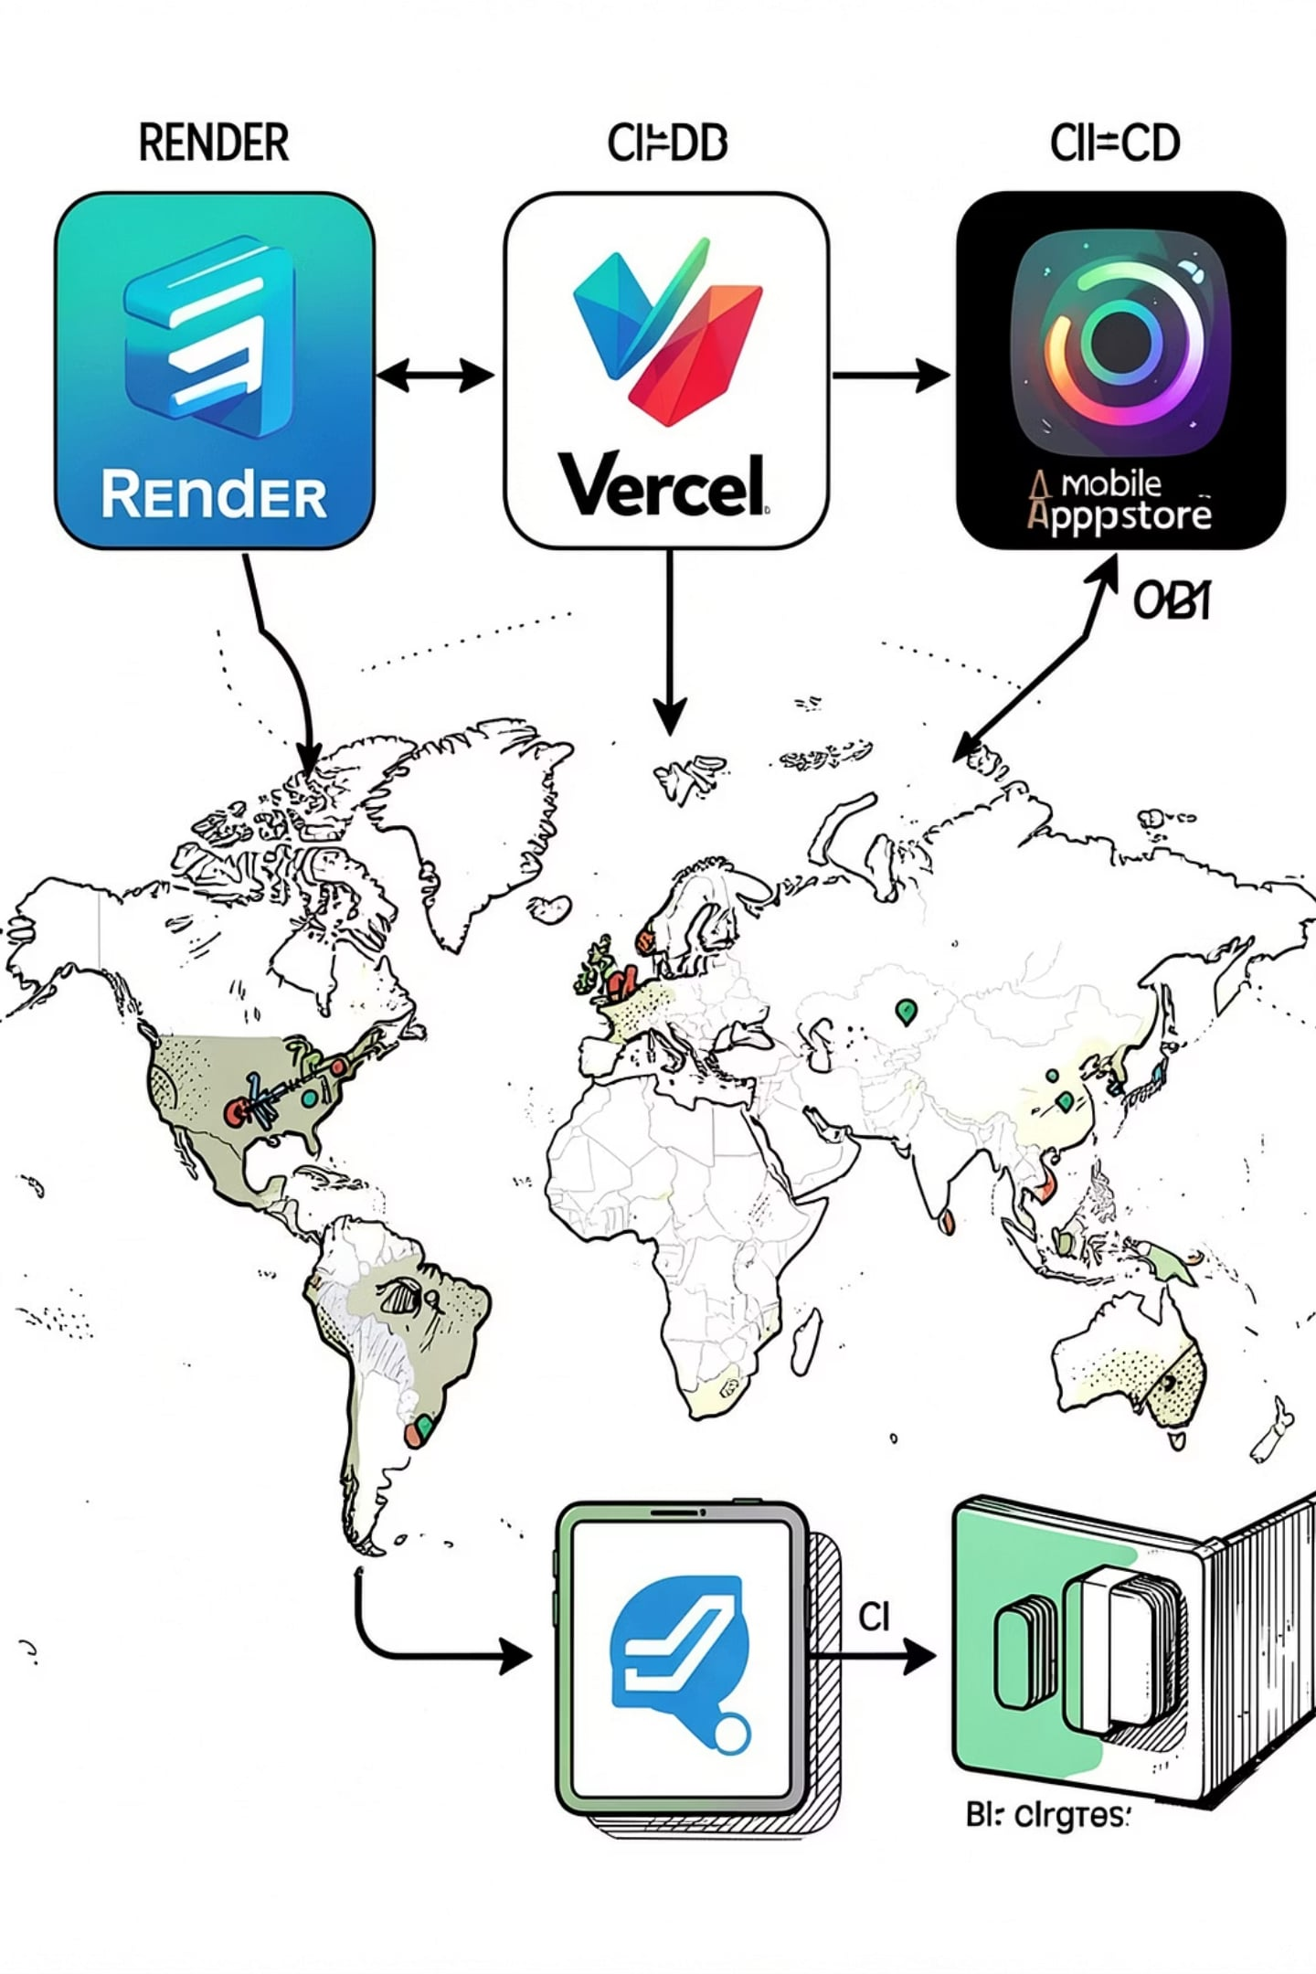

Future & Deployment
A pragmatic rollout and scaling strategy to reach students and partners globally.
Hosting
Mobile Distribution
Monitoring & Ops
Render for backend services, Vercel for web front end — auto-scaling and zero‑downtime deployments.
Signed iOS and Android builds, staged rollouts via TestFlight and Play Store for rapid feedback.
Cloud logs, alerts, and scheduled backups; analytics to track funnel conversion and engagement.
Next Steps
Beta partner program, accessibility audit, and phased internationalization for additional regions.
Theme accent: #5E4CE6 — use for CTAs and key highlights across the product.

Slide 8
Thank You!
We appreciate your time and interest in InternsHub. We're excited about the future of internship management and welcome any questions or further discussion.
Learn more at www.internshub.com or contact us a myselfadmin123@gmail.com.

