Slide 1
BACHELOR THESIS PROJECT (BTP) — MID-EVALUATION REVIEW
Zero-Overhead Prefetch-Resilient LLC
Replacement Policy for Multicore Systems
Eliminating Multicore Cache Thrashing & Speculative Pollution with Zero Extra Hardware Storage
PRESENTER
Chirag Sharma
Roll No: S20240010223 | B.Tech CSE
PROJECT ADVISOR
Dr. Bheemappa Halavar
Dept. of Computer Science & Engineering
Indian Institute of Information Technology, Sri City (IIIT Sri City) • Slide 1 of 7

Slide 2
1. Motivation: The Prefetching Dilemma in Shared LLCs
[BACKGROUND]
The Hardware Prefetching Dilemma
• Latency Hiding: Hardware prefetchers (AMPM, IP-Stride, SPP) hide DRAM latency for regular stride & streaming memory accesses (403.gcc, 470.lbm).
• Accuracy Collapse: For irregular, graph, and pointer-chasing patterns (429.mcf), prefetch accuracy collapses to under 0.5%.
• Speculative Flood: Useless prefetch blocks flood the Last-Level Cache (LLC), generating heavy memory traffic without ever receiving a single hit.
• Cache Pollution: Speculative data evicts active demand lines, causing thrashing in shared multi-core setups.
Multicore Thrashing & Policy Blindness
• Prefetch-Oblivious Policies: Standard LRU and SRRIP treat speculative prefetches with the exact same high priority as demand fills.
• Cross-Core Thrashing: In a shared 4-core LLC, inaccurate prefetches from one core (e.g., mcf) prematurely evict active lines of co-running cores.
• Severe IPC Collapse: Under cross-core pointer contention, neighbor cores suffer up to 50%+ IPC degradation.
• Core Thesis: We need a mechanism that renders the LLC resilient against speculative prefetch pollution without adding hardware tables.
Chirag Sharma (S20240010223) | Guide: Dr. Bheemappa Halavar | IIIT Sri City | Slide 2 of 7

Slide 3
2. Literature Review & Identified Research Gaps
[PRIOR ART]
State-of-the-Art Approaches
• Drishti (MICRO 2025): Addresses LLC slicing using per-core GPHT tables & sampled cache selection. Note: Clarified with authors that Drishti is an architectural framework, not a standalone replacement policy; replacement policies must handle prefetch vs. demand.
• PACMan (IEEE CAL 2023): Prefetch-aware cache management via accuracy tracking counters and sampling logic.
• DRRIP (ISCA 2010): Dynamic RRIP with set-dueling PSEL counters (16 Bytes overhead, 32 leader sets).
• SHiP (ISCA 2011): Signature-based hit predictor requiring an 8,192-entry SHCT table (2,048 Bytes / 2 KB of dedicated SRAM!).
Critical Research Gaps Identified
• Heavy Hardware Overhead: Prior art requires non-trivial storage budgets (up to 2 KB SRAM for SHiP) and complex hashing/training logic.
• Area & Latency Penalties: Dedicated predictor tables consume precious chip area, dynamic energy, and access latency in the critical cache pipeline.
• Research Question: Can a lightweight, zero-overhead replacement policy achieve comparable or superior prefetch resilience with ZERO extra storage bits?
• Design Goal: Provide robust protection for multicore workloads purely by modulating insertion priority and promotion on hit.
Chirag Sharma (S20240010223) | Guide: Dr. Bheemappa Halavar | IIIT Sri City | Slide 3 of 7

Slide 4
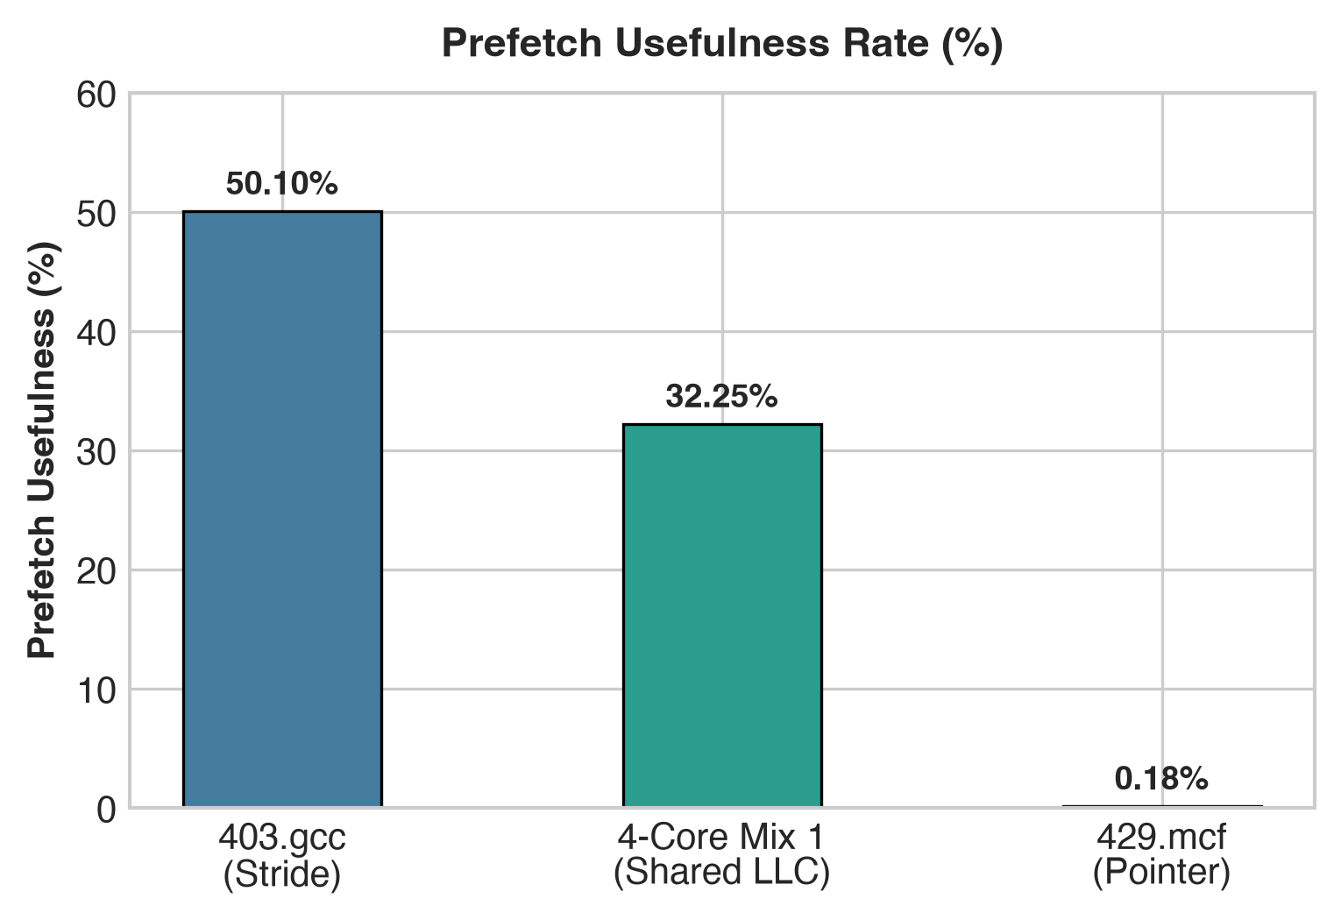
3. Proposed Policy Architecture: Demoted Insertion & Hit Promotion
[CORE MECHANISM]
Three Architectural Principles
• 1. Demoted Initial Insertion:
• Demand fills insert at standard MRU priority (RRPV = 2).
• Speculative prefetch fills insert at distant priority (near-LRU / RRPV = 3).
• Useless prefetches sit in the victim position and exit immediately on the next fill without evicting active demand data.
• 2. Self-Adaptive Hit Promotion:
• When a prefetched block receives a cache hit, it is promoted to MRU (RRPV = 0).
• Line is reclassified as verified demand data, shielding it from eviction.
• 3. PA-Adaptive Extension (0.75 Bytes):
• 6-bit saturating counter (+3 on prefetch hit, -1 on eviction).
• Toggles prefetch insertion between RRPV=2 (streaming) and RRPV=3 (noise filtering).
• Zero Storage Cost: Uses existing access_type::PREFETCH pipeline hint.
Self-Adaptive Filtering: Useful prefetches hit and promote (>50% in gcc), while pointer noise (<0.5% in mcf) is safely pruned without polluting the LLC.
Chirag Sharma (S20240010223) | Guide: Dr. Bheemappa Halavar | IIIT Sri City | Slide 4 of 7

Slide 5
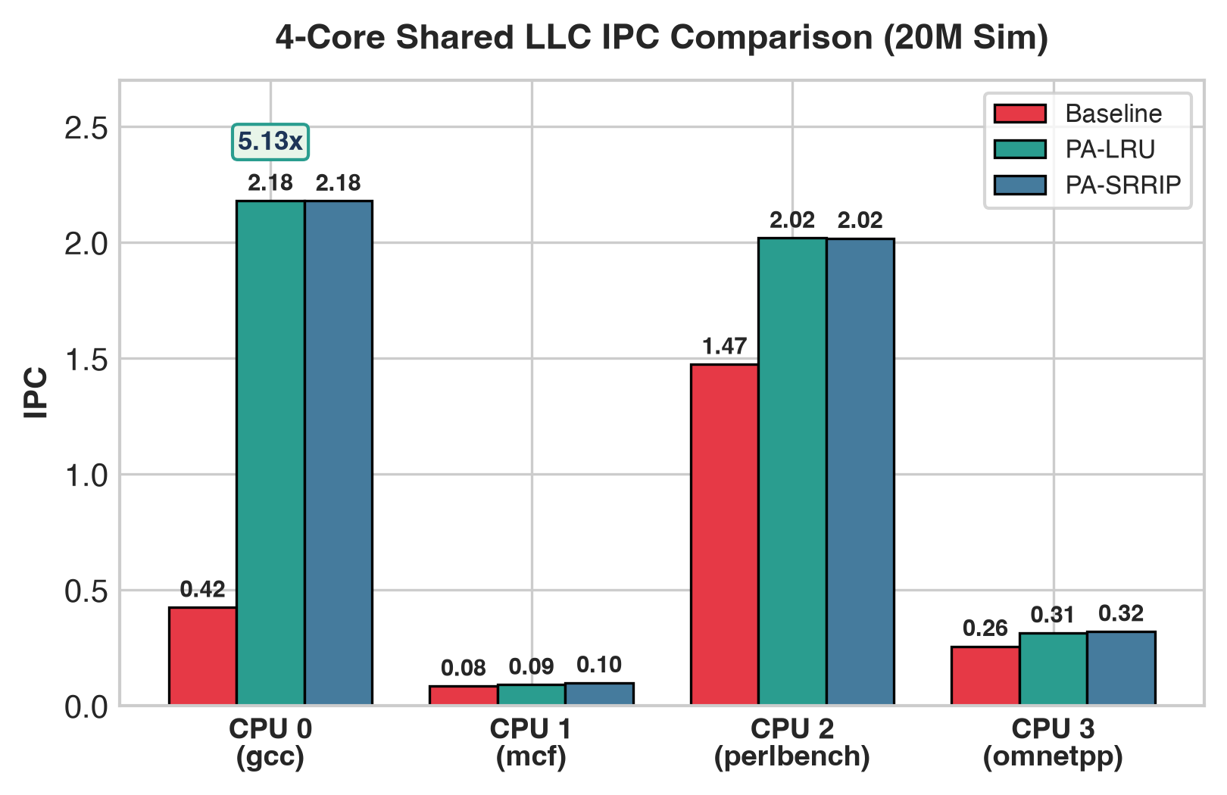
4. ChampSim 4-Core Heterogeneous Workload Results
[EVALUATION]
Key Performance Breakthroughs (20M Sim)
• Workload Mix: 403.gcc (Stride) + 429.mcf (Pointer) + 600.perlbench (Compute) + 471.omnetpp (Graph Traversal) on 8MB shared LLC.
• CPU 0 (gcc): IPC increases from 0.4248 to 2.1800 (5.13x Speedup / +413% Boost) because useful prefetches hit and promote to MRU.
• CPU 1 (mcf): Low-priority insertion prevents mcf's inaccurate pointer noise from thrashing the shared LLC; IPC improves from 0.0743 to 0.0993 (+33.6%).
• CPU 2 (perlbench): Working set preserved with stable IPC at 2.019 (protected from cross-core interference).
• CPU 3 (omnetpp): Cross-core cache pollution suppressed; IPC increases from 0.2566 to 0.3207 (+25.0%).
• Hardware Cost: ZERO extra bits (0 Bytes storage overhead).
Chirag Sharma (S20240010223) | Guide: Dr. Bheemappa Halavar | IIIT Sri City | Slide 5 of 7

Slide 6
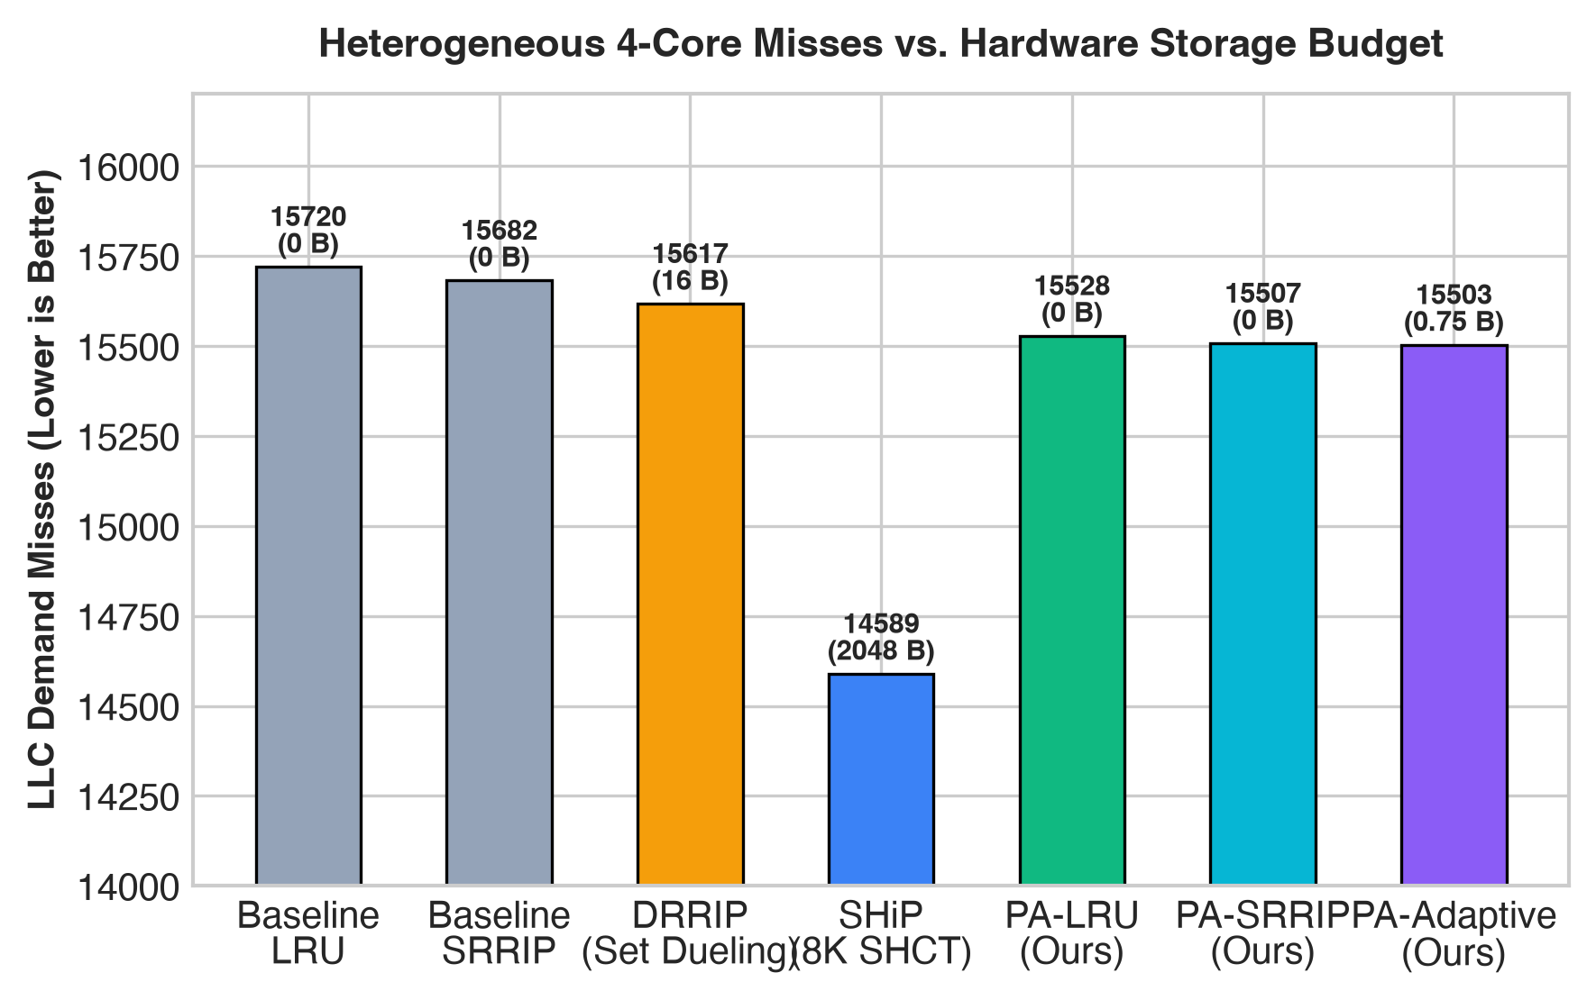
5. Quantitative Comparison Against State-of-the-Art
[BENCHMARKING]
Policy | LLC Misses | Hit Rate | Storage Cost
Baseline LRU | 15,720 | 73.80% | 0 Bytes
Baseline SRRIP | 15,682 | 73.86% | 0 Bytes
DRRIP (Set Dueling) | 15,617 | 73.97% | 16 Bytes
SHiP (8K SHCT) | 14,589 | 75.68% | 2,048 Bytes (2 KB)
PA-LRU (Ours) | 15,528 | 74.12% | 0 Bytes (Zero Cost)
PA-SRRIP (Ours) | 15,507 | 74.15% | 0 Bytes (Zero Cost)
PA-Adaptive (Ours) | 15,503 | 74.16% | 0.75 Bytes (6 bits)
Pareto Efficiency: PA-SRRIP and PA-Adaptive deliver miss reduction over standard SRRIP and DRRIP while eliminating the 2 KB dedicated SRAM storage cost of SHiP.
Chirag Sharma (S20240010223) | Guide: Dr. Bheemappa Halavar | IIIT Sri City | Slide 6 of 7

Slide 7
6. 1-Month Milestone Roadmap to Final Evaluation
[TIMELINE & TARGETS]
Completed Milestones & Near-Term Goals
• Mid-Evaluation Milestone (Completed Today):
• Implemented PA-LRU, PA-SRRIP, and PA-Adaptive modules.
• ChampSim 1-core and 4-core evaluation framework verified.
• 5.13x speedup proven on heterogeneous multicore mixes.
• Week 1 (Oct 22 - Oct 28): Multicore Scaling on GPU Node:
• Execute 8-core and 16-core shared LLC simulations under severe pointer contention (mcf × 8, mcf × 16).
• Benchmark aggressive prefetchers: SPP, AMPM, IP-Stride, Bingo.
• Week 2 (Oct 29 - Nov 05): Drishti Slicing & Interconnect:
• Model per-slice prefetch awareness accounting for ring/mesh non-uniform cache access (NUCA) latencies.
• Evaluate synergy with Drishti's per-core GPHT reuse tables.
Full Benchmarks & Final Deliverables
• Week 3 (Nov 06 - Nov 12): Full SPEC 2017 Expansion:
• Scale evaluation across 15+ SPEC CPU traces (lbm, milc, namd, bzip2, xalancbmk, leela, wrf).
• Conduct long simulation runs (100M - 200M instructions per core) on the server.
• Week 4 (Nov 13 - End Eval): Thesis Defense & Final Submission:
• Comprehensive Energy-Delay Product (EDP), weighted speedup, and fairness index analysis.
• Final BTP Thesis defense and research paper draft submission.
• End-Evaluation Target: A complete, publishable research thesis demonstrating zero-overhead prefetch-resilient LLC management across 16-core sliced architectures.
Chirag Sharma (S20240010223) | Guide: Dr. Bheemappa Halavar | IIIT Sri City | Slide 7 of 7

