Slide 1
Penetration Testing on a WEP-Encrypted Network
Matt Oswalt

Slide 2
About Me
UC – B.S. in IT
Track: Networking/Software
Employer - Kroger
Information Technology Student Association

Slide 3

Information Technology Student Association
ITSA is geared towards IT and non-IT students
Learn about technology
Reach out to the community
Increase professional skills
Have fun!

Slide 4
Purpose
To raise awareness about the inherently insecure nature of wireless technologies
To spark interest in penetration testing
To briefly overview WEP network cracking and how its done on a very basic level

Slide 5
Wireless Basics
Wireless Technologies are inherently insecure
Wireless networks broadcast ALL information EVERYWHERE
Encrypted networks are more difficult to read
WEP, WPA, WPA2 are different methods of encryption
Wireless security is an ongoing process
There is no “holy grail” of network security

Slide 6

Why do it?
Better understanding of how wireless technologies work
Better understanding of how to defend against such attacks
Network Security ==

Slide 7
Terminology
SSID – The name of the wireless network
MAC Address – a unique hexadecimal ID for network hardware
Wireless Access Point (WAP) – The device that broadcasts wireless signals
BSSID – The MAC Address of the WAP
Backtrack – a Linux-based operating system that comes with preinstalled hacking tools

Slide 8
Terminology (cont.)
Interface – The hardware card in your PC that communicates with a network (wlan0, eth0)
Channel – Like a walkie-talkie, changing the channel allows reduction of interference
IV Packets – packets used in WEP that contain the information necessary for cracking

Slide 9
Getting Started
Computer
Backtrack Live CD (or VMWare)
Wireless card in monitor mode with packet injection
Most drivers for wireless cards do not support either, so custom drivers have to be used.
Test for this with: aireplay-ng --test [interface]

Slide 10
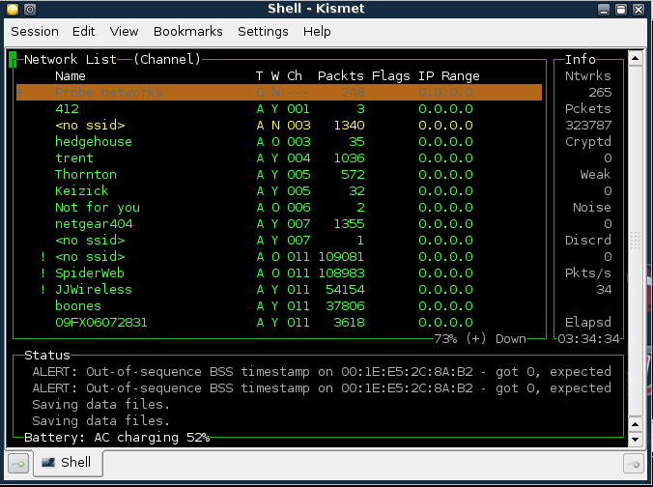
Kismet

Slide 11
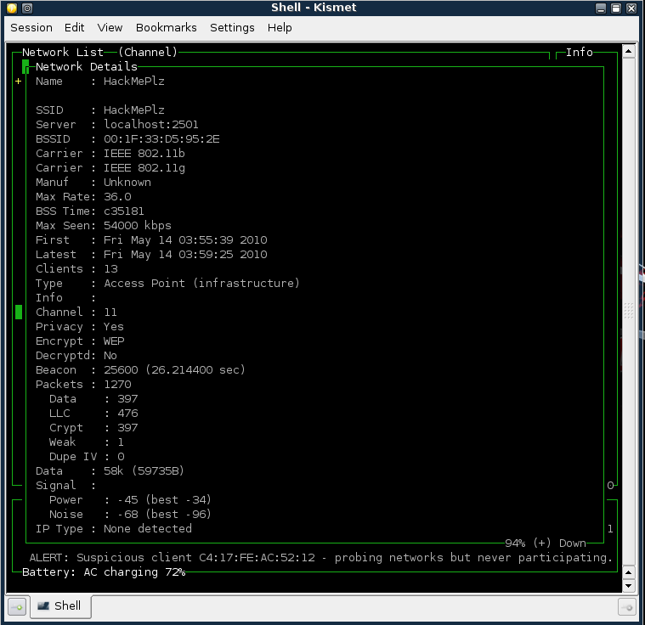
Kismet (cont.)

Slide 12
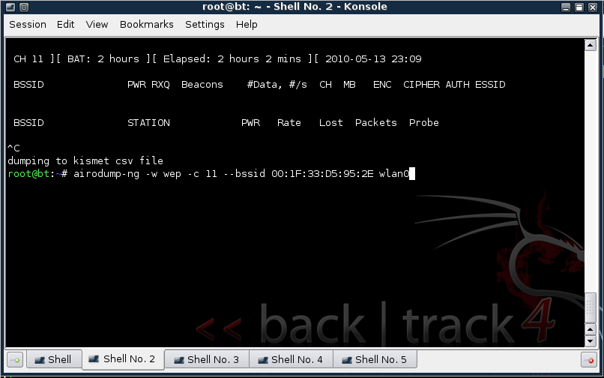
Airodump

Slide 13
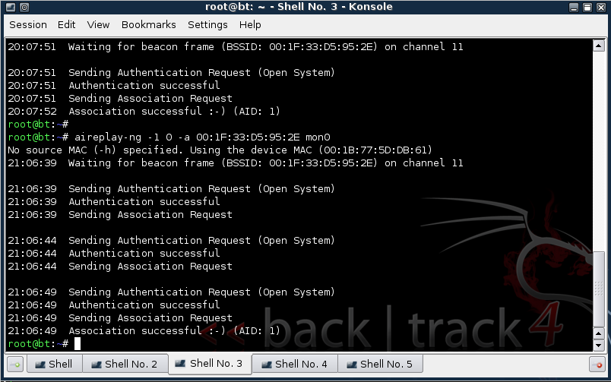
WAP Association with aireplay-ng

Slide 14
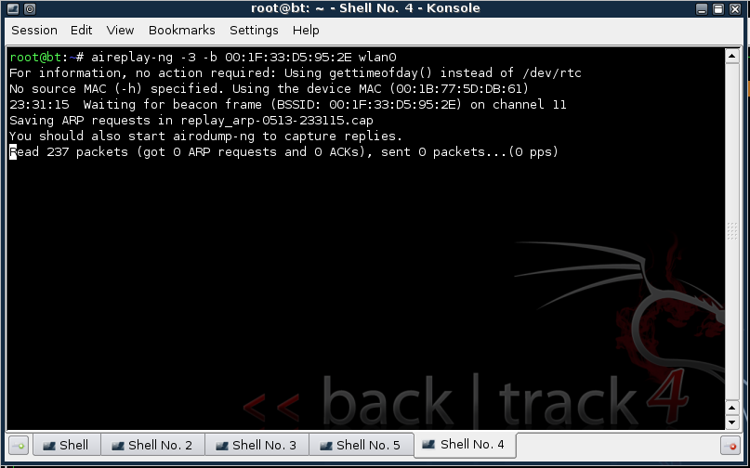
Packet Capturing with aireplay-ng

Slide 15
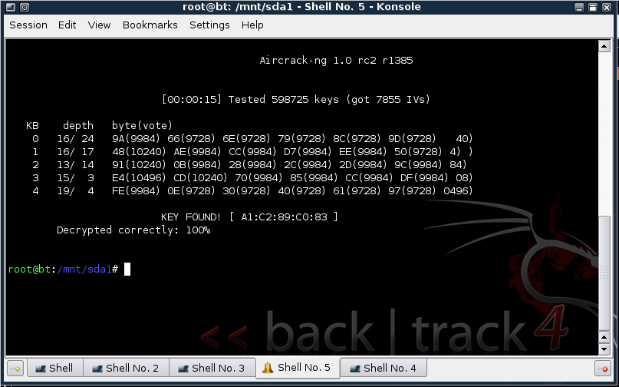
Cracking the Key with aircrack-ng

Slide 16


Conclusion
Learn more about ITSA!
http://uc-itsa.org/
http://twitter.com/ucitsa/
Learn more about me!
http://mierdin.com/blog/
http://www.linkedin.com/in/oswaltmatt
oswaltma@mail.uc.edu
Learn more about Backtrack!
http://www.backtrack-linux.org/

