Slide 1
Voxceleb-sound recognition -
UTTERANCE-LEVEL AGGREGATION FOR SPEAKER RECOGNITION IN THE WILD
By : Visual Geometry Group, Department of Engineering Science, University of Oxford, UK 2Naver Corporation, South Korea
Deep Learning course – Assaf B. Spanier
Sagi Marciano - 201074390

Slide 2
Abstract:
Speakers recognition on Dataset that calls ‘VoxCeleb’ (1,2).
The VoxCeleb include a .wav files from youtube. Its contains 7,000+ celebs Speakers.
VoxCeleb contains speech from speakers spanning a wide range of differrent ethnicities, accents, professions and ages.

Slide 3
Abstract:
The writers propose a speaker recognition deep network that call’s: ‘thin-ResNet’
‘thin-ResNet’ based on NetVLAD (GhostVLAD) layer to aggregate features across time, that can be trained end-to-end.
Extra target : investigate the effect of talk length on performance, and conclude that for ‘in the wild’ data, a longer length is beneficial

Slide 4
‘in the wild’ data :
Speaker recognition ‘in the wild’ it’s a free large-scale datasets, that have an easy accessibility of deep learning frameworks.

Slide 5
Introduction
The Goal: To recognize a specific speaker into a single utterance-level representation.

Slide 6
Introduction
How to reach the Goal:
1. Drop irrelevant parts of the signal must be filtered out.
2. Investigate how to effectively aggregate frame-level characteristics into utterance-level speaker representations.
3. Allowing back-propagation, the aggregation is not content dependent.
4. Out put an i-vector for aggregation.
5. The writers propose to marry the best of both Convolutional Neural Networks and a dictionary-based NetVLAD.

Slide 7
Introduction
The steps:
1.Create a powerful speaker recognition deep network, based on a NetVLAD layer that is used to aggregate ‘thin-ResNet’ architecture frame features.
2.The entire network is trained end-to-end using a large margin softmax loss.
3.Analyse the effect of input segment length on performance, and conclude that for ‘in the wild’ sequences having longer utterances.

Slide 8
Methods
The ideal model should have the following properties:
1. Can get an arbitrary time lengths as input and produce a fixed-length utterance-level descriptor.
2. The output descriptor should be as low- dimensional, requiring little memory, to facilitate efficient storage and retrieval.
3. The output descriptor should also be discriminative, such that the distance between descriptors of different speakers is larger than those of the same speaker.

Slide 9
Methods
For satisfy we use a modified ResNet in a fully convolutional way to encode input 2D spectrograms, followed by a NetVLAD layer for feature aggregation. To fixing the length problems.
the VLAD layer can be thought of as trainable discriminative clustering: Every frame-level descriptor will be softly as- signed to different clusters, and residuals are encoded as the output features.
To allow efficient verification need to further add a fully connected layer for dimensionality reduction.

Slide 10
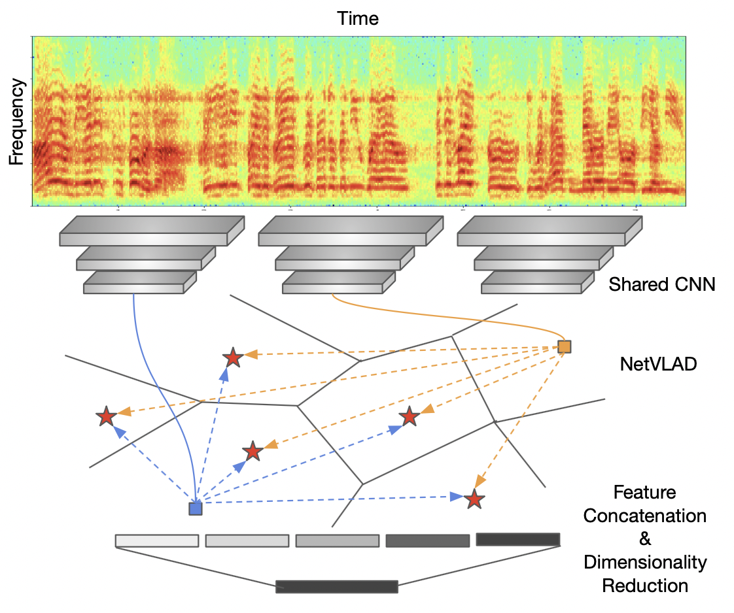
Methods
Description about the net work:
Network architecture. It consists of two parts: 1.Feature extraction, where a shared CNN is used to encode the spectrogram. 2.Extract frame-level features, and aggregation – that aggregates all the local descriptors into a single compact representation of arbitrary length.

Slide 11
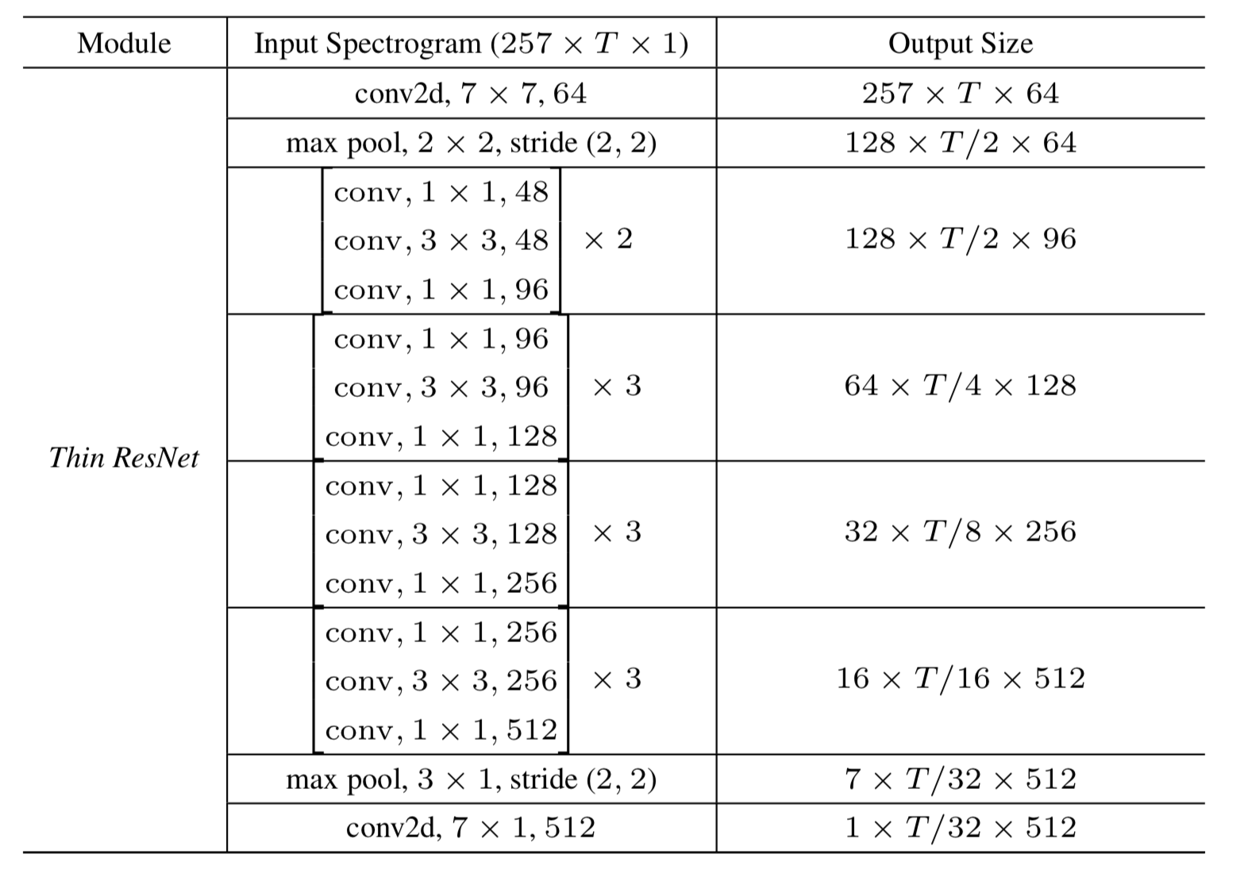
Methods - thin-ResNet
The thin-ResNet used for frame level feature extraction(ReLU and batchnorm layers are not shown).
Each row specifies the # of convolutional filters, their sizes, and the # filters. This architecture has only 3 million parameters compared to the standard ResNet-34 (22 million) that way its call thin-ResNet .

Slide 12
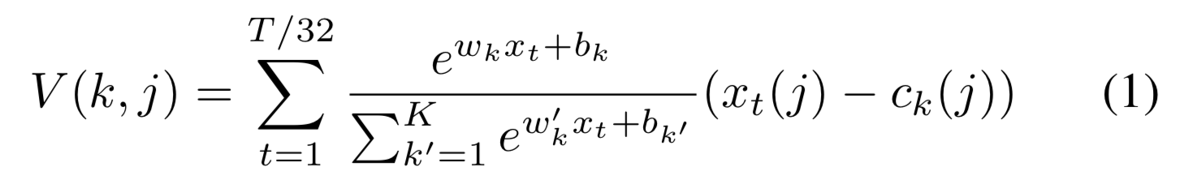
Methods - Feature Extraction - thinResNet
Feature Extraction:
1. any network can be used in our learning framework by cuting down the number of channels in each residual block
2. uses NetVLAD [16] to aggregate frame-level descriptors into a single a vector
3. The thin-ResNet maps the input spectrogram (R257×T ×1 ) to frame-level descriptors with size R1×T /32×512 . The NetVLAD layer then takes dense descriptors as input and produces a single K × D matrix V , where K refers to the number of chosen cluster, and D refers to the dimensionality of each cluster. Concretely, the matrix of descriptors V is computed using the following equation:
where {wk},{bk} and {ck} are trainable parameters, with k ∈ [1, 2, ..., K]. The first term corresponds to the soft- assignment weight of the input vector xi for cluster k, while the second term computes the residual between the vector and the cluster center. The final output is obtained by performing L2 normalisation and concatenation

Slide 13
Experiments – Datasets
Using VoxCeleb2 to train the the model (the dev partition) – 5994 speakers.
Using VoxCeleb1 to test the system, the VoxCeleb1 and 2 dont have a common data or celebs.

Slide 14
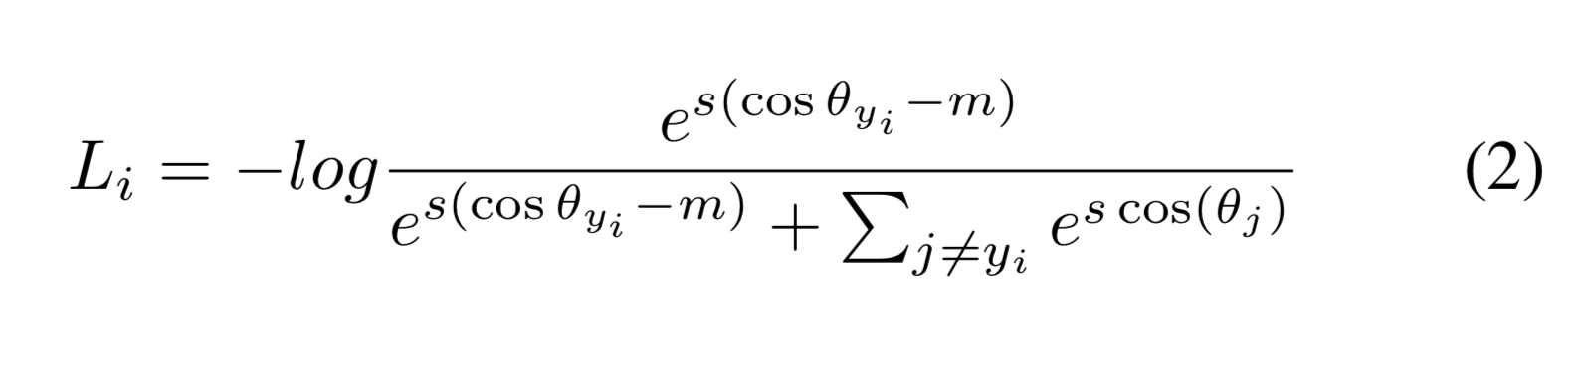
Experiments – Training Loss
Using the Softmax classification loss during the training.
The loss is given by the following equation:
used the default values m = 0.4 and s = 30.
*where Li refers to cost of assigning the sample to the correct class, θy = arccos(wT x) refers to the angle between sample features (x) and the decision hyperplane (w), as both vectors have been L2 normalised. The goal is therefore to minimise this angle by making cos(θyi ) − m as large as possible, where m refers to the angular margin. The hyper-parameter s con- trols the “temperature” of the softmax loss.

Slide 15
Experiments – Training Details
Using a fixed size spectrogram corresponding to a 2.5 second temporal segment.
Using a 512 point FFT, giving us 256 frequency components, which together with the DC component of each frame gives a short-time Fourier transform (STFT) of size 257 × 250 (frequency × temporal) out of every 2.5 second crop.

Slide 16
Results
In the results we compare the performance of our NetVLAD and GhostVLAD architectures trained using different losses to the state of the art, and then investigate how performance varies with utterance length.

Slide 17
Results Verification on VoxCeleb1
The work on VoxCeleb1 includes a evaluated on three different test lists :
1. The original VoxCeleb1 test list with 40 speakers.
2. The extended VoxCeleb1-E list that uses the entire VoxCeleb1 for evaluation.
3. The challenging VoxCeleb1-H list where the test pairs are drawn from identities with the same gender and nationality.
*Was a small number of errors in the VoxCeleb1-E and VoxCeleb1-H lists, the writers evaluate on a cleaned up version of both lists as well, which release publicly.
*The network is tested on the full length of the test segment.

Slide 18
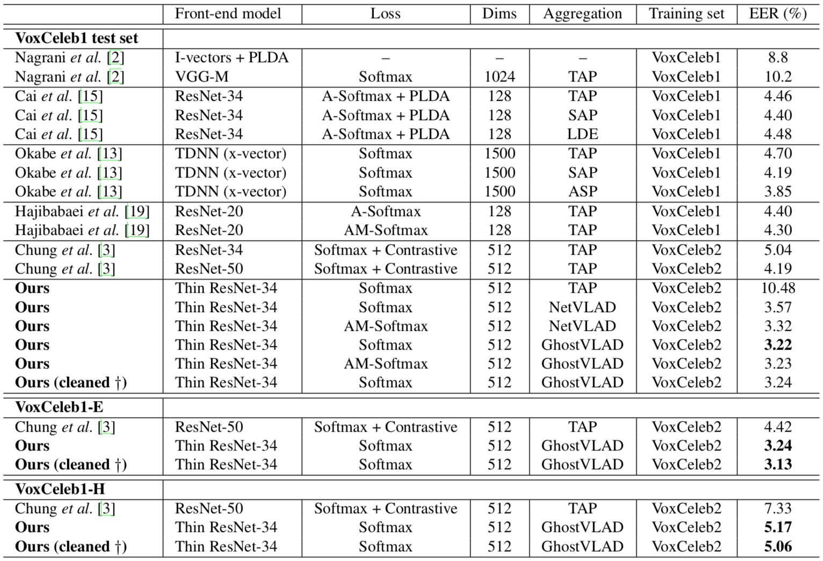
Results Verification on VoxCeleb1
Results for verification on the original VoxCeleb1 test set and the extended and hard test sets (VoxCeleb-E and VoxCeleb-H)
TAP: Temporal Average Pooling.
SAP: Self attentive Pooling Layer
Cleaned up versions of the test lists have been released publicly.

Slide 19
Results Verification on VoxCeleb1
Table 2 compares the performance of the models to the current ‘state of the art’ on the original VoxCeleb1 test set.
The model outperforms all previous methods.
Showing the softmax loss and a NetVLAD aggregation layer.

Slide 20
Results Verification on VoxCeleb1
Compering between ResNet and by a significant margin (EER of 3.57% vs 4.19%) whilst requiring far fewer parameters (10 vs 26 million).
By replacing the standard softmax with the additive margin softmax (AMSoftmax), a further performance gain is achieved (3.32% EER). But The GhostVLAD layer makes a modest contribution to performance (3.22% EER).

Slide 21
Results Verification on VoxCeleb1
When We test the NetVlad (thin-ResNet) we get -EER of 5.17% vs 7.33% by compering with ResNet-based.

Slide 22
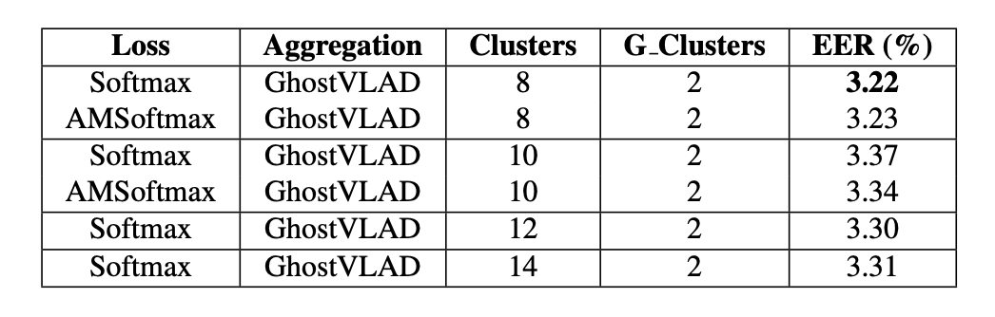
Results Additional experiment on GhostVLAD
Effect of the number of clusters in the GhostVLAD layer compare the NetVlad.
We can see a small differences in performance, we show that VLAD aggregation is robust to the number of clusters and to two different loss functions.
Results for verification on the original VoxCeleb1 test set.

Slide 23
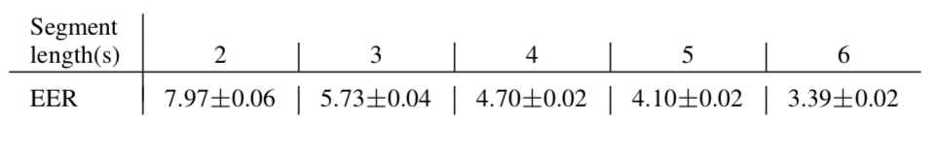
Results - Probing verification based on length
Tests the Effect of the record time between 2 to 6 sec.
Testing Voxceleb1 data set with 87,010 segments or 56.7% of the total dataset.
randomly sample 100 positive pairs and 100 negative pairs, resulting in 25,020 verification pairs.
During testing, segments of length 2s, 3s, 4s, 5s and 6s are randomly cropped from each verifi- cation pair

Slide 24
Results - Probing verification based on length
We can see there is indeed a strong correlation between verification performance and sequence length.
some of the data may be noise, silence, or speech from other speakers, and a single short. But they didn’t fixed it.
As the temporal length increases, there is a higher chance of capturing relevant speech signals from the actual speaker.

Slide 25
Results - Conclusion
The article proposed a powerful speaker recognition network.
The writers used ‘thin-ResNet’ trunk architecture, and a dictionary-based NetVLAD and GhostVLAD layers to aggregate features across time that can be trained end-to-end and show that its works better then ResNet .
The network achieves ‘state-of-the-art’ performance on the popular VoxCeleb1 test set for speaker recognition.
Shown the effect of utterance length on performance, and concluded that for ‘in the wild’ data, and we get that a longer length is beneficial.

Slide 26
Code – Git and result pics:
I take a small part from the wav file and I created a train & test groups.
I put the Epoch to be 50 (I found that the loss a little).
I got a loss of 0.6549 as the best loss.
I created an result file that show the results:

Slide 27
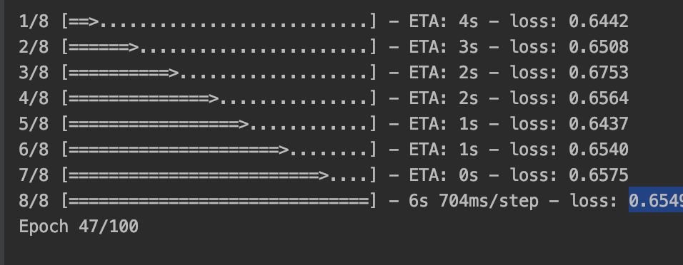
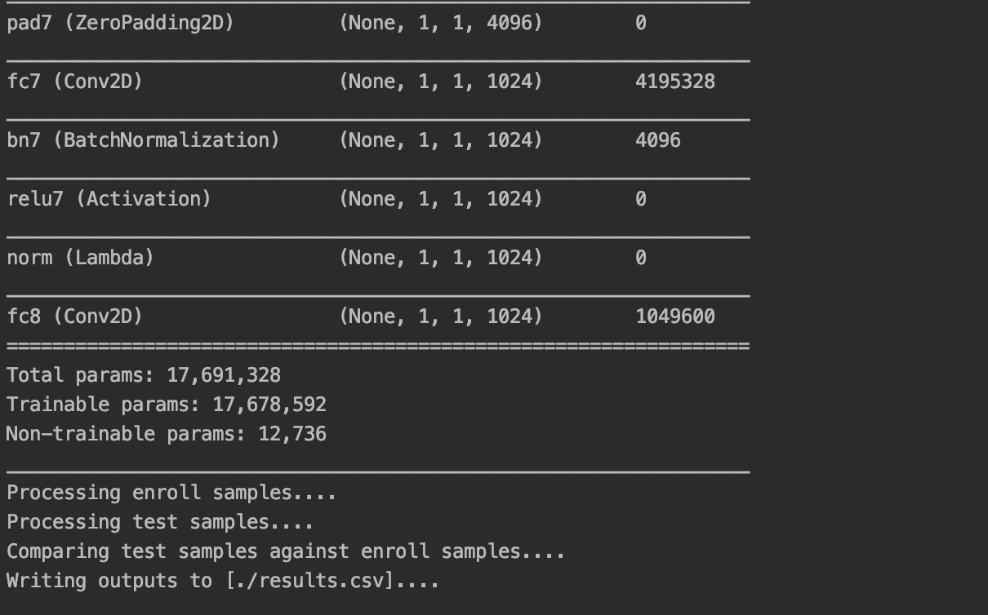
Results – Screen shots from the code
In the first pic we can see the loss at 47 epoch, After Epoch 47 the loss stay.
In the Second pic we can see a part from the training steps and the Total params, trainable params and Non-trainable params.

Slide 28
Results – Screen shots from the code
You can find all the project at the next link in GitHub:
https://github.com/yeseg11/VoxCeleb
Please read the README.md for installation
The original Article - https://arxiv.org/pdf/1902.10107.pdf
The Git code with a running program -
Thanks – Sagi Marciano

Slide 29
Results - References

