Slide 1
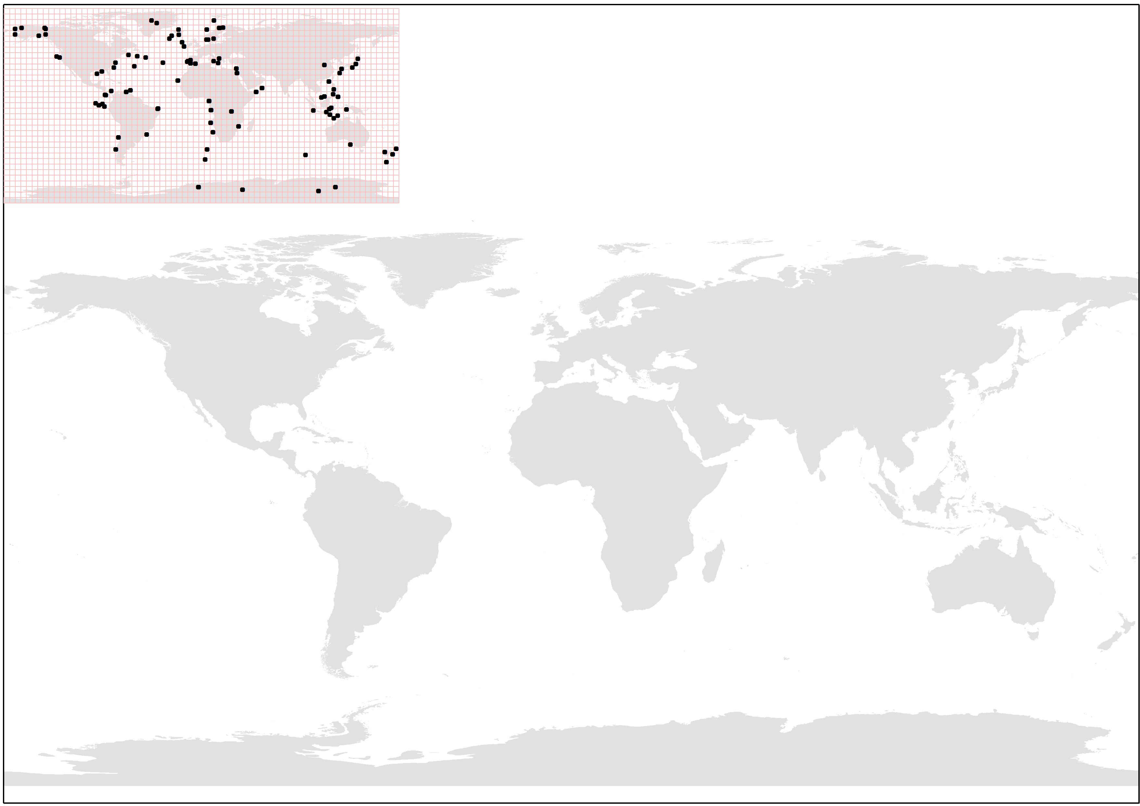
Greenland
Scandinavia and Svalbard
Alaska
Iceland – British Isles
N. Atlantic Ocean
Japan and E. China Sea
Offshore Oregon
North-Central China
Mediterranean Sea
Caribbean Sea
Gulf of Mexico
Arabian Sea
S. China Sea
Philippines
Tropical E. Pacific
Tropical SW Coast Africa
South-Central Africa
Indonesia
W. Coast of South America
New Zealand
S. Australia
Global Average
S. Atlantic Ocean
Antarctica

