Slide 1
Sentiment Analysis using deep learning models on Company Reviews
Social Network Mining
-Yesha Patel
-000790164

Slide 2
Topics
Objective
Dataset
Data Cleaning and Pre-processing
Methodology
Implementation
Compare Results
Future works

Slide 3
Sentiment Analysis
Sentiment analysis is a Natural Language Processing (NLP) technique, which is used to analyze the sentiment or emotional tone of text.
Objective : The primary goal of this project is to build a deep learning-based sentiment analysis model to accurately classify sentiment in text data. By using natural language processing (NLP) techniques, the model aims to identify and predict the sentiment of user-generated content, such as reviews as either positive, neutral, or negative.

Slide 4
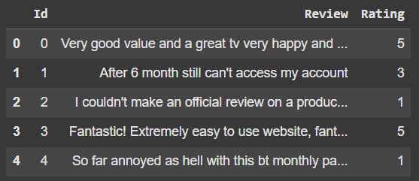
Dataset
My dataset is Sentiment Analysis - Company Reviews, which collected from Kaggle.
This dataset is collection of different company reviews which is human generated as opinion or review.
This dataset have main 5 labels which are ratings from 1 to 5.
1 : Very negative, 2 : negative, 3 : neutral, 4 : positive, 5 : very positive

Slide 5
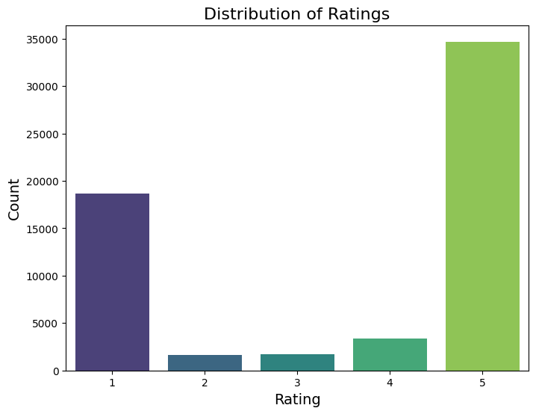
Continued..
In this dataset, data is not distributed equally, rating 1 and 5 many data as compared to rating 2, 3, and 4.

Slide 6
Data Cleaning and Pre-processing
Data Cleaning Steps:
First, checked missing values.
Handled missing values
Text Cleaning ( e.g., remove html tags, punctuations, single character, double spaces)
Data Pre-processing Steps:
Converted rating into numeric values and then into categorical text form.
Tokenize data
Added embedding vector file for words.

Slide 7
Methodology
Data Collection: Dataset Collected from the Kaggle.
Preprocessing: Data cleaning, Tokenization, and vector file for words
Experimental Design: Trained Simple Neural Network, LSTM, GRU, RNN models.
Evaluation Metrics: Accuracy, Precision, Recall, and F1-Score and confusion metrics were used to measure model performance.
Tools: Google Colab for implementation, Python libraries (NumPy, pandas, scikit-learn, TensorFlow).
Justification: Used different neural network models to compare results and get know that which model works good for sentiment analysis.

Slide 8
Implementation
In this project, I used 4 models which are simple Neural Network, Long Short Term Memory (LSTM), Gated Recurrent Unit (GRU), and Recurrent Neural Network (RNN).
Load data
Inspect Data
Data cleaning and Pre-processing
Train Models
- Simple NN
-LSTM
-GRU
-RNN
Evaluate models and Results / Insights
Split Data

Slide 9
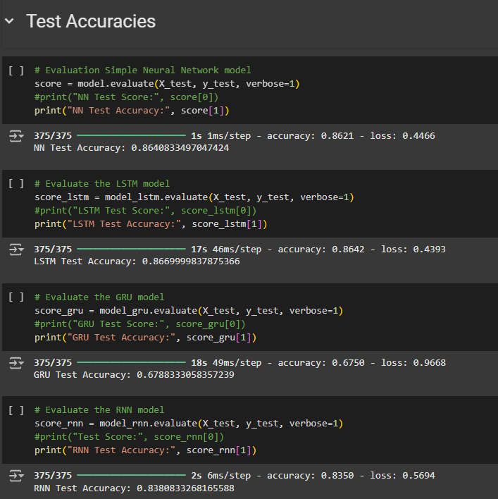
Results
From the results we can analyse that GRU model is not working well in this sentiment analysis
Simple neural network overall working well.

Slide 10
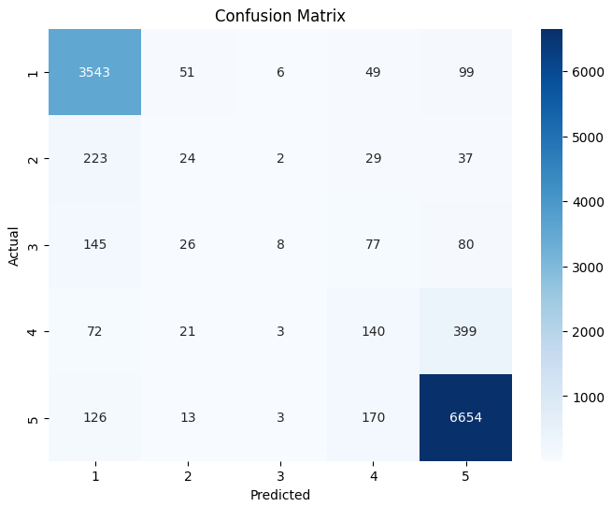
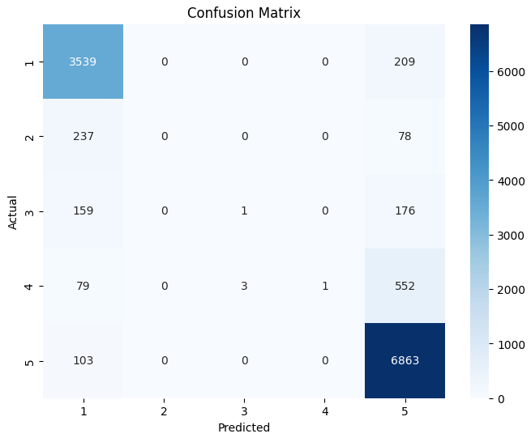
Evaluation through confusion matrix
Simple neural network (86%)
LSTM (86%)

Slide 11
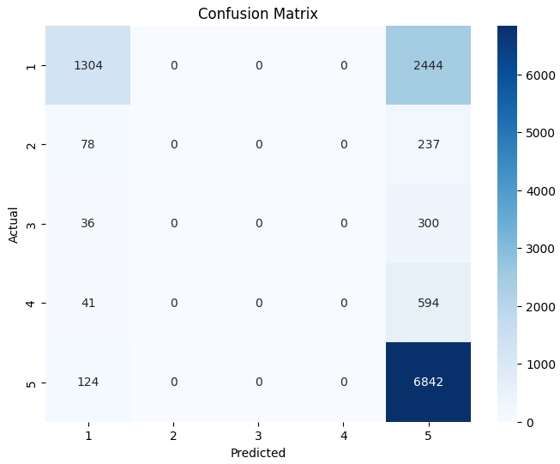
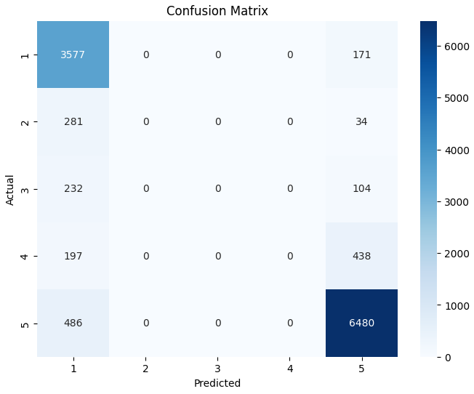
Evaluation through confusion matrix
GRU (67%)
RNN (83%)

Slide 12
Future works
Dataset is not balanced so will balance dataset by using GPT2 model and add synthetic data into dataset.
Will use more advance model models like BERT.
Will try to deploy model.

Slide 13
Thank You ☺

