Slide 1
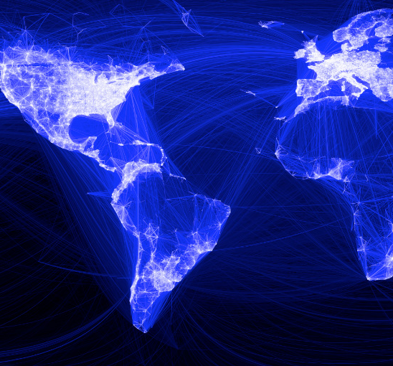
Targeting Algorithms for
Online Social Advertising Markets
CS 255 | Project | Yeshwanth Bashyam

Slide 2
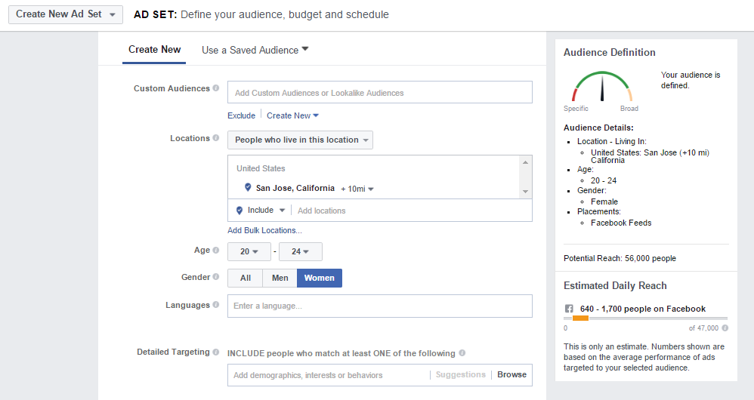
Targeted Advertisement in OSN^{[1]}

Slide 3
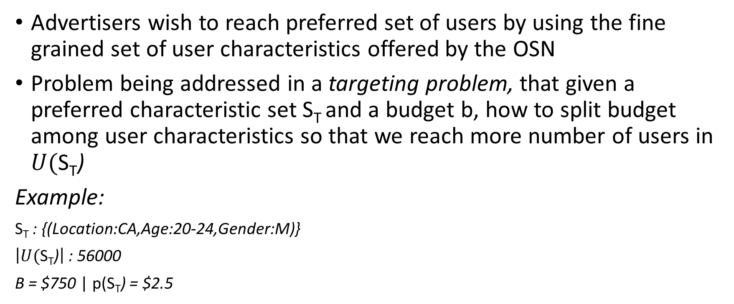
Problem Statement^{[1]}
Advertisers wish to reach preferred set of users by using the fine grained set of user characteristics offered by the OSN
Problem being addressed in a targeting problem, that given a preferred characteristic set S_{T} and a budget b, how to split budget among user characteristics so that we reach more number of users in $U(\text{S}\text{T}$)
Example:
$\text{S}\text{T}$ : {(Location:CA,Age:20-24,Gender:M)}
$\left|U(\text{S}\text{T}\text{)}\right|$ : 56000
B = $750 | p($\text{S}\text{T}$) = $2.5
Users Covered:300
Can we increase the number?

Slide 4
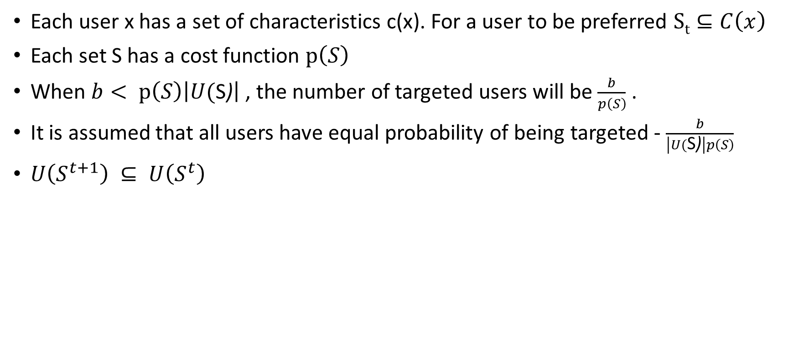
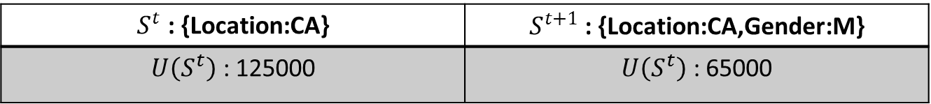
Understanding More^{[1]}
Each user x has a set of characteristics c(x). For a user to be preferred $St⊆C\left(x\right)$
Each set S has a cost function $p\left(S\right)$
When $b< p\left(S\right)\left|U(\text{S}\text{)}\right|$, the number of targeted users will be $\frac{b}{p\left(S\right)}$ .
It is assumed that all users have equal probability of being targeted - $\frac{b}{\left|U(\text{S}\text{)}\right|p\left(S\right)}$
$U\left(S^{t+1}\right) ⊆ U\left(S^{t}\right)$
$S^{t}$ : {Location:CA} | $S^{t+1}$ : {Location:CA,Gender:M}
$U\left(S^{t}\right)$ : 125000 | $U\left(S^{t}\right)$ : 65000

Slide 5
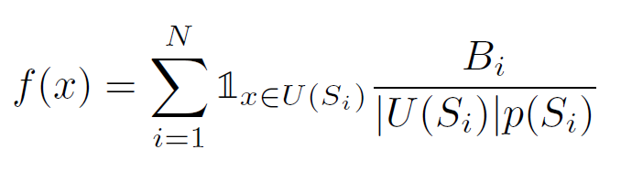
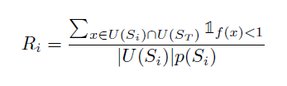
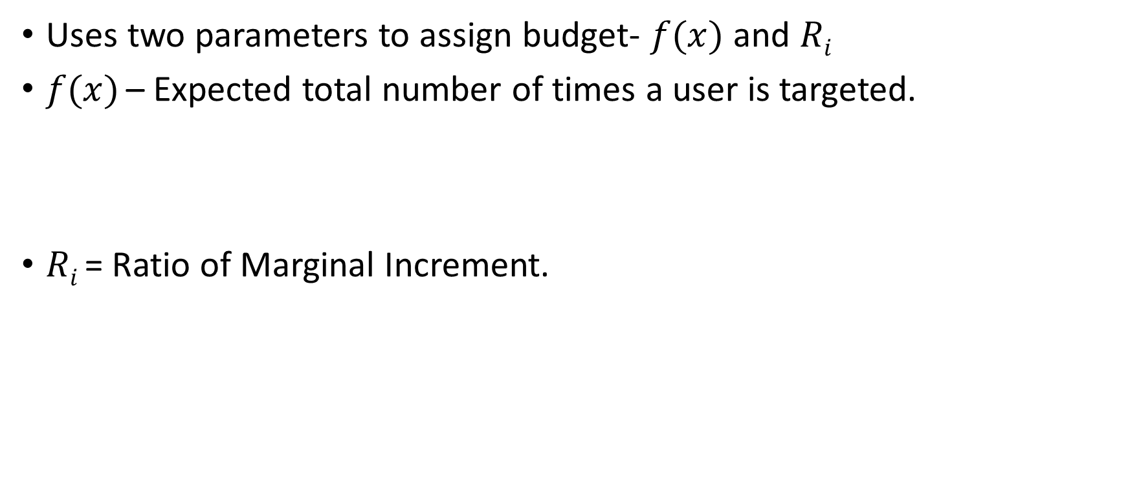
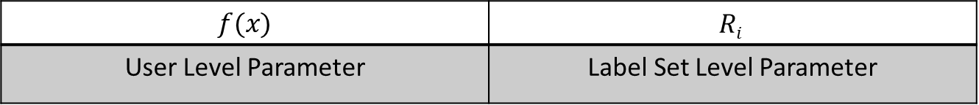
Existing Solution^{[1]}
Uses two parameters to assign budget- $f(x)$and $Ri$
$f(x)$ – Expected total number of times a user is targeted.
$Ri$= Ratio of Marginal Increment.
$f(x)$ | $$Ri$$
User Level Parameter | Label Set Level Parameter

Slide 6
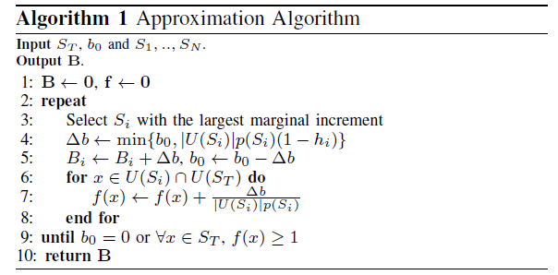
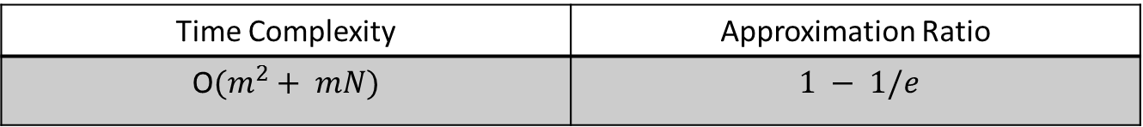
Existing Algorithm^{[1]}
Time Complexity | Approximation Ratio
O$(m^{2}+ mN)$ | $1 − 1/e$

Slide 7
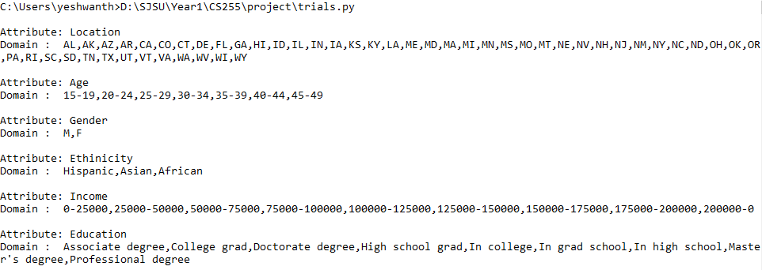
Implementation Considerations
 | Up to 1 Million user base created. Each user can have a minimum of 1 characteristic to a maximum of 6. Assignment of labels is randomized.
 | Cost of label sets has been randomized between ranges. Label set with less number of attributes, likely to be expensive than a label set with more number of attributes.
Attribute Domains
Users
Cost

Slide 8
Drawbacks
Huge search space
The total number of distinct label sets possible is very high.
For the attributes and domains under consideration, the number of distinct label sets are 489599 which makes it
This coupled with the number of users, makes the algorithm impractical for the real time labels and attributes.

Slide 9
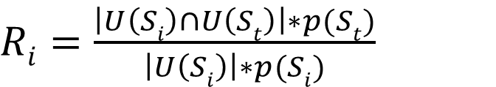
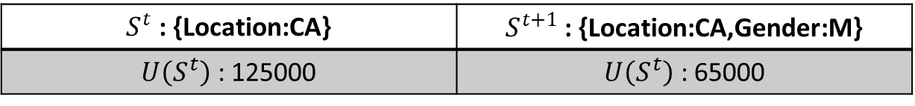
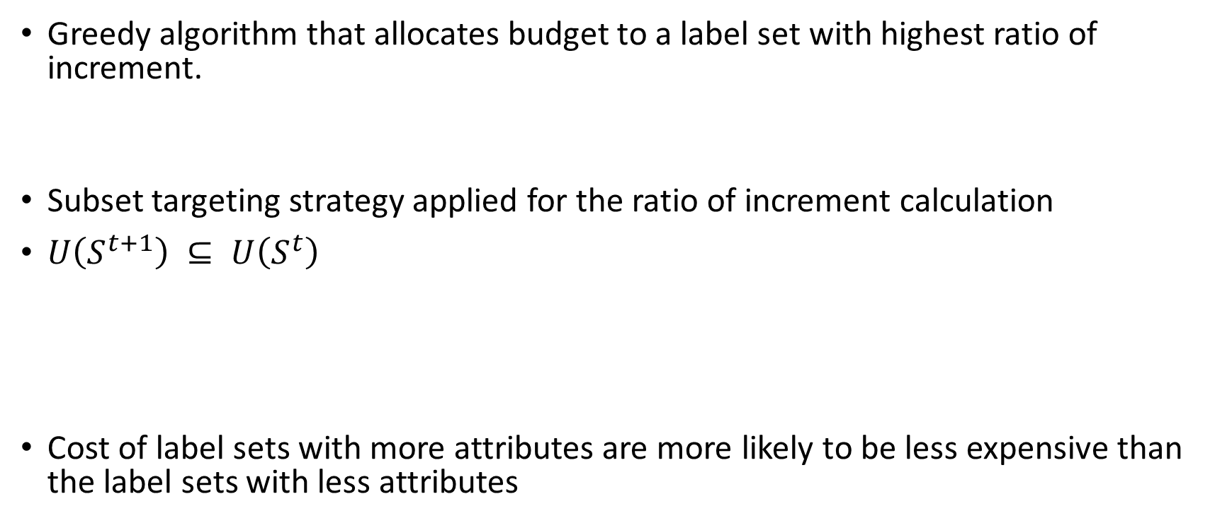
Proposed Solution
Greedy algorithm that allocates budget to a label set with highest ratio of increment.
Subset targeting strategy applied for the ratio of increment calculation
$U\left(S^{t+1}\right) ⊆ U\left(S^{t}\right)$
Cost of label sets with more attributes are more likely to be less expensive than the label sets with less attributes
$Ri=\frac{\left|U\left(Si\right)∩U\left(St\right)\right|∗p(St)}{\left|U\left(Si\right)\right|∗p(Si)}$
$S^{t}$ : {Location:CA} | $S^{t+1}$ : {Location:CA,Gender:M}
$U\left(S^{t}\right)$ : 125000 | $U\left(S^{t}\right)$ : 65000

Slide 10
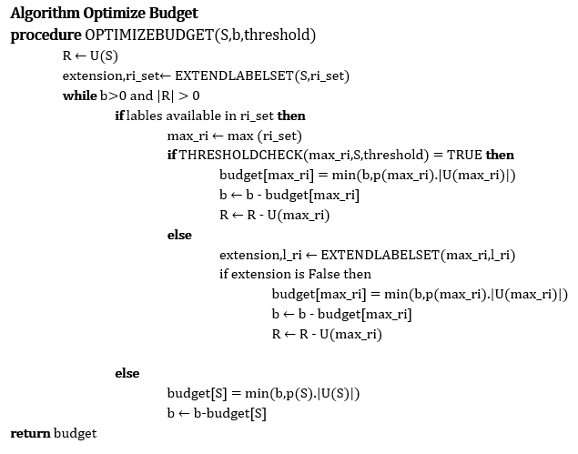
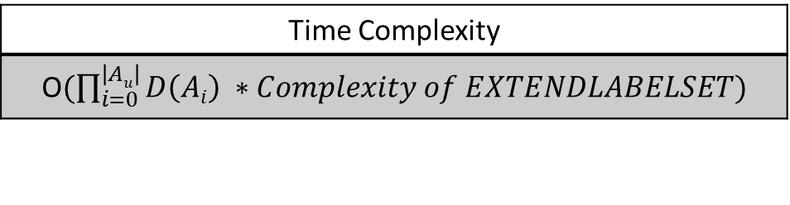
Optimized Algorithm – Module 1
When Max RI Label meet threshold
When Max RI Label doesn’t meet threshold
When extension not possible on current max RI label
When extension not possible on initial set / Excess Budget Available
Time Complexity
O$(\prod_{i=0}^{\left|Au\right|}{D\left(Ai\right)} ∗Complexity of EXTENDLABELSET)$

Slide 11
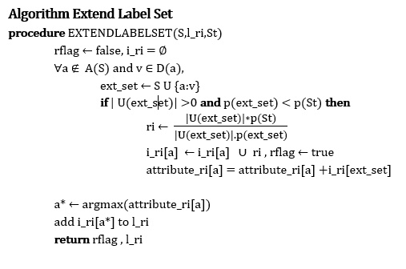
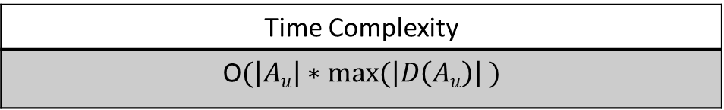
Optimized Algorithm – Module 2
List of eligible RI values for an attribute
Cumulative RI values for an attribute
Attribute with highest cumulative RI
Include RI values for attribute a* to RI set
Time Complexity
O$(\left|Au\right|∗max⁡(\left|D\left(Au\right)\right| )$

Slide 12
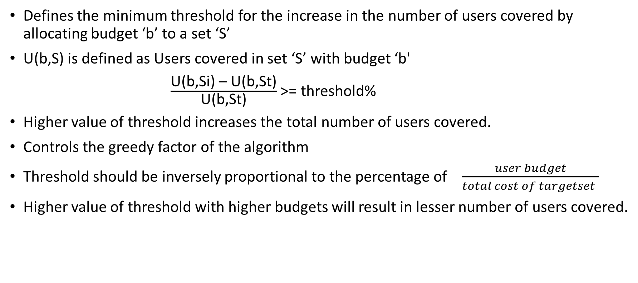
Threshold
Defines the minimum threshold for the increase in the number of users covered by allocating budget ‘b’ to a set ‘S’
U(b,S) is defined as Users covered in set ‘S’ with budget ‘b'
$\frac{\text{U}\text{(}\text{b}\text{,}\text{Si}\text{) – }\text{U}\text{(}\text{b}\text{,}\text{St}\text{)}}{\text{U}\text{(}\text{b}\text{,}\text{St}\text{)}}$ >= threshold%
Higher value of threshold increases the total number of users covered.
Controls the greedy factor of the algorithm
Threshold should be inversely proportional to the percentage of $\frac{user budget}{total cost of targetset }$
Higher value of threshold with higher budgets will result in lesser number of users covered.

Slide 13
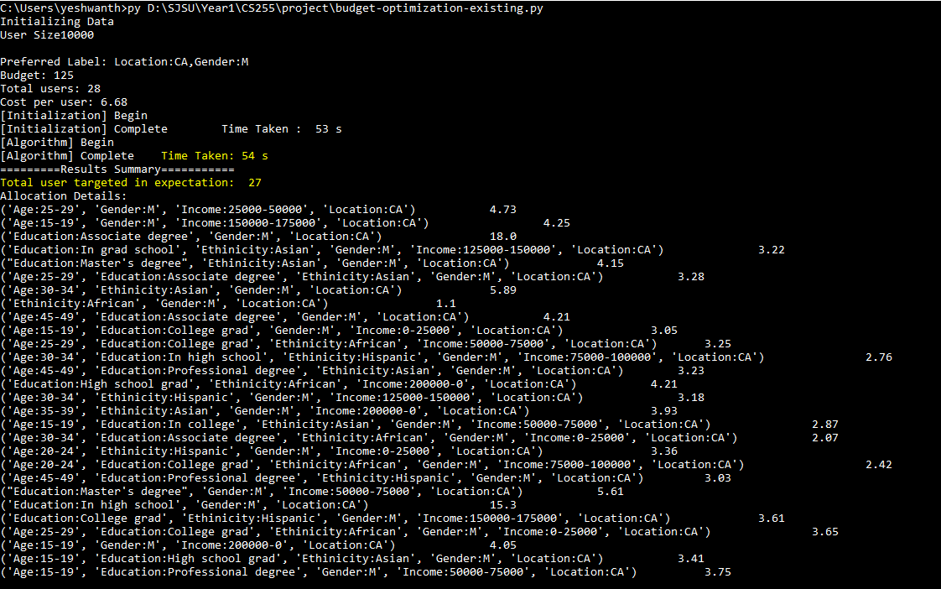
Existing Algorithm Output
User Size : 10000
Budget : 125
Run Time : 54s
Total Users Covered: 27
Additional Users Covered : 8

Slide 14
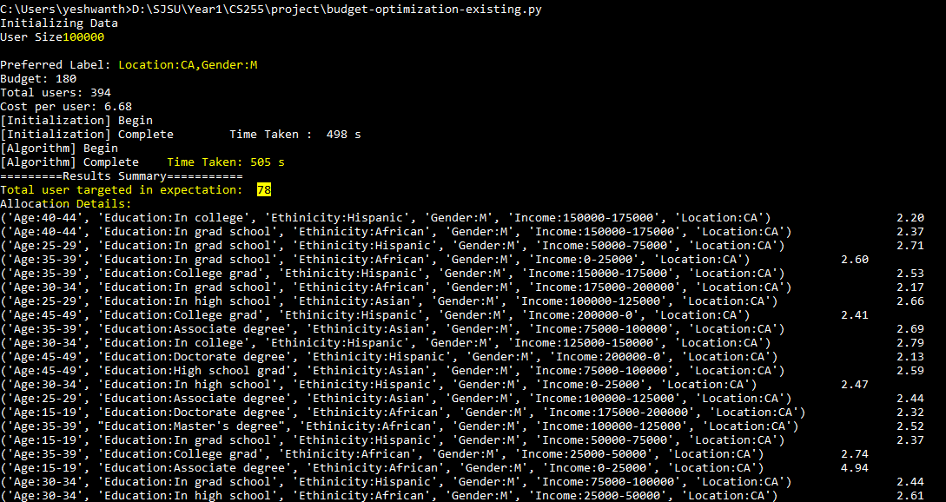
Existing Algorithm Output
User Size : 100000
Budget : 180
Run Time : 505s
Total Users Covered: 78
Additional Users Covered : 50

Slide 15
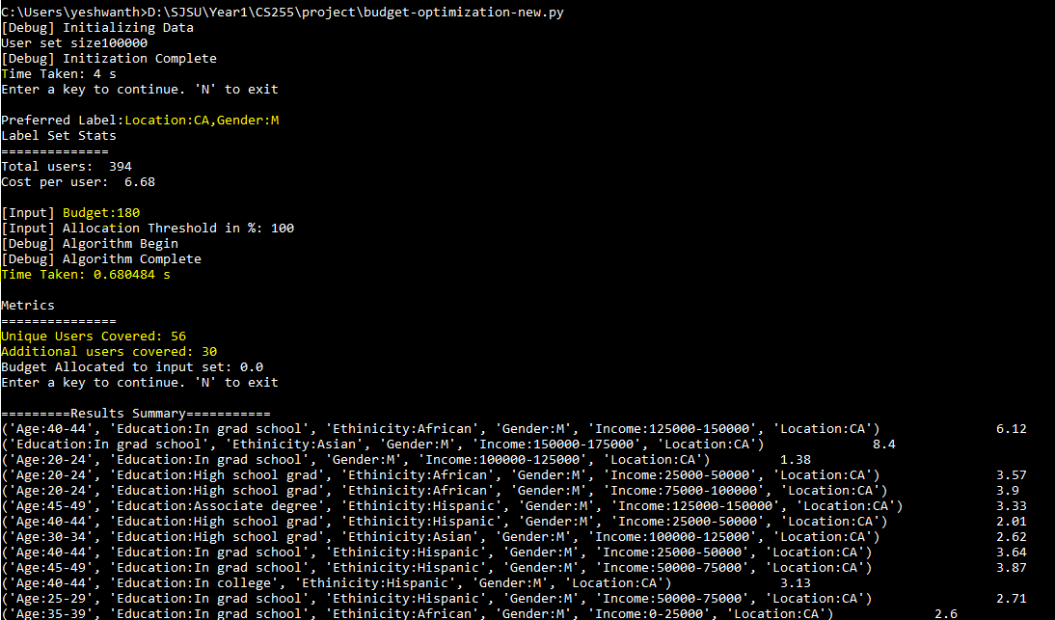
Optimized Algorithm Output
User Size : 100,000
Budget : 180
Run Time : 0.68s
Total Users Covered: 56
Additional Users Covered : 30

Slide 16
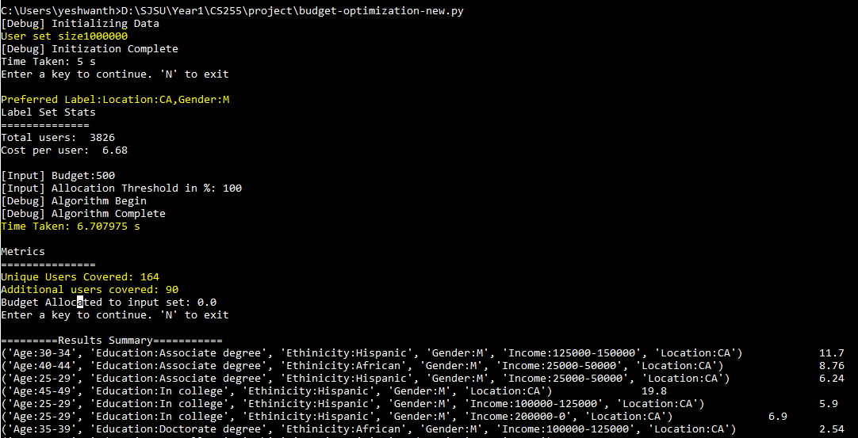
Optimized Algorithm Output
User Size : 1 Million
Budget : 500
Run Time : 6.78s
Total Users Covered: 164
Additional Users Covered : 90

Slide 17
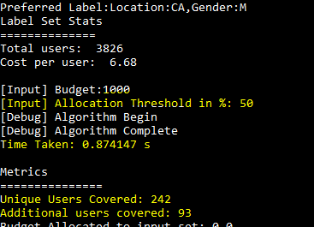
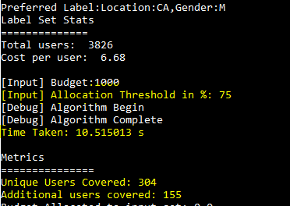
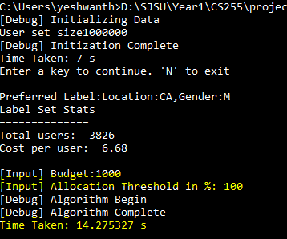
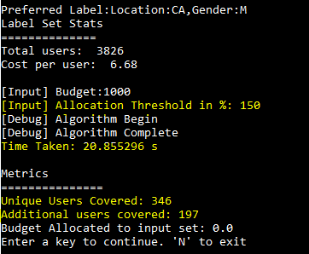
Threshold Comparison

Slide 18
Threshold Comparison

Slide 19
Tradeoffs
Proposed Solution is optimized in terms of runtime.
Benefits of runtime is traded off with the number of additional user’s covered.
Proposed algorithm runs in significantly lesser time with marginal decrease in the number of users covered.
The greedy nature of the proposed algorithm can be controlled by a Threshold factor to cover more users at the expense of time.

Slide 20
References
[1] C. Xia, S. Guha and S. Muthukrishnan. Targeting Algorithms for Online Social Advertising Markets. In 2016 IEEE/ACM International Conference on ASONAM
[2] Facebook Online Advertising System. https://www.facebook.com/advertising.
[3] M. Eftekhar, S. Thirumuruganathan, G. Das, and N. Koudas. Price trade-offs in social media advertising. In COSN, 2014.
Project Source Code : https://github.com/yeshbash/Budger-Optimization-OSN-Ads

