Slide 1
Job Recommendation
Reciprocal Recommendation Approach

Slide 2
Reciprocal Recommendation
A recommendation strategy that can be applied to people to people recommendation.
Applies well when the users and the items are autonomous in choosing their opposites. E.g. : Dating Applications, Job Recommendations
A recommendation is made only when the Object will be preferred by the User as well as the User being preferred by the object.
Job Applications : Recommendation is made only when the candidate will prefer the job and the recruiter will also prefer the candidate

Slide 3
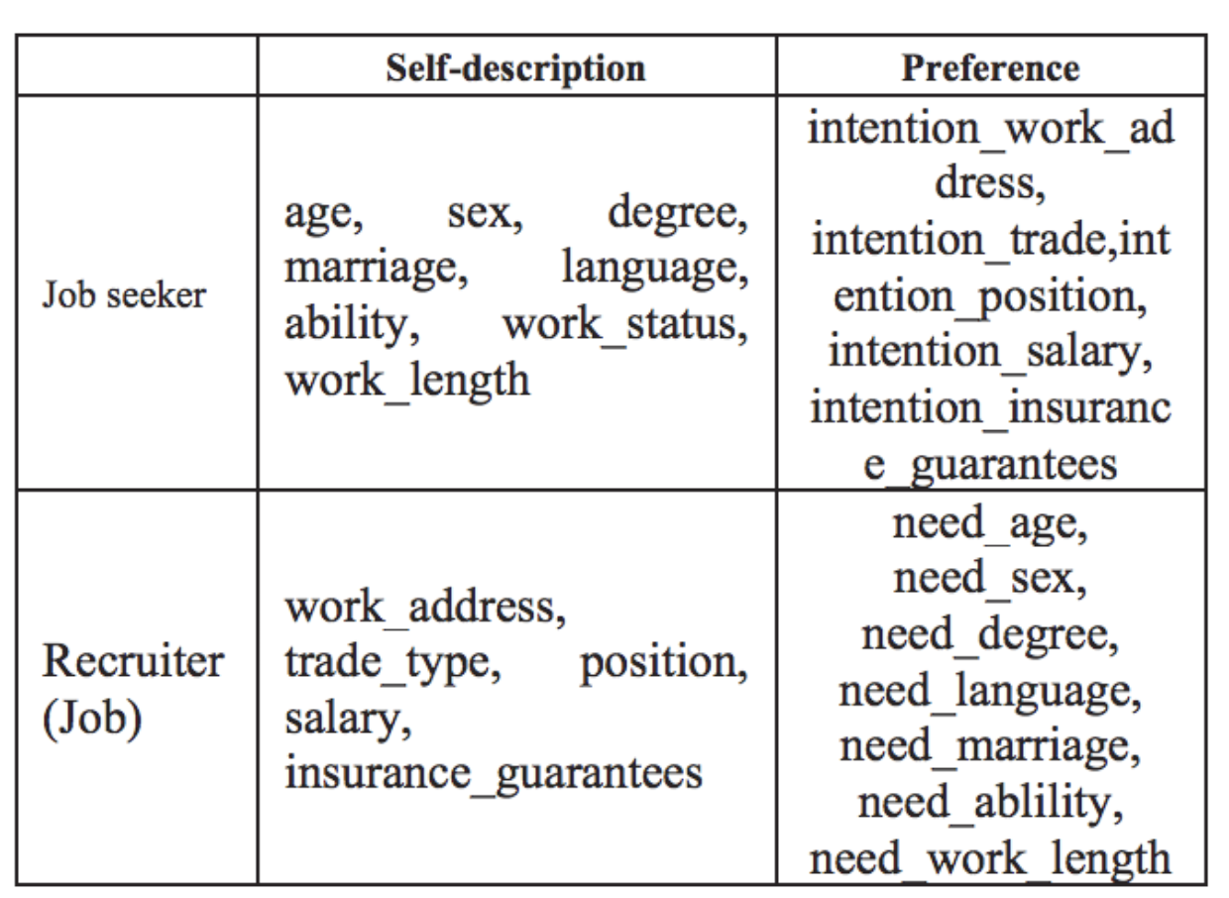
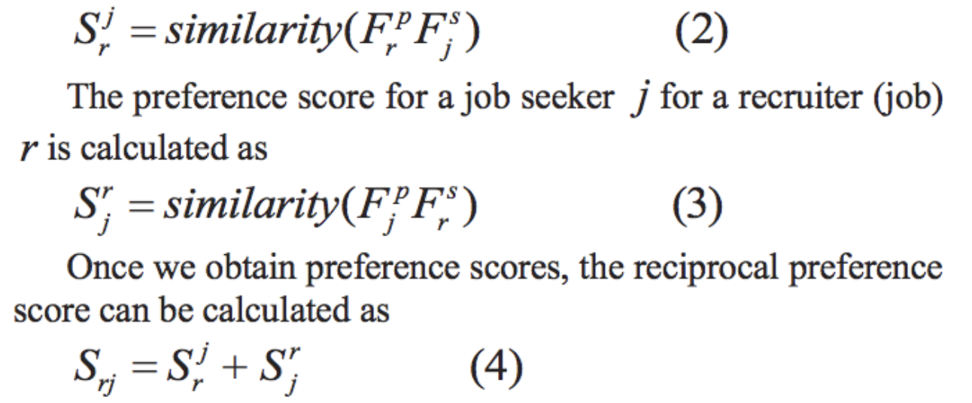
“iHR+: A Mobile Reciprocal Job Recommender System, July 2015” [2]
Follows content based reciprocal recommendation strategy.
Categorizes users as two sets C and R. Each user has a Up and Ud.
Addresses Cross Similarity as the similarity between Up(J) and Ud(C)

Slide 4
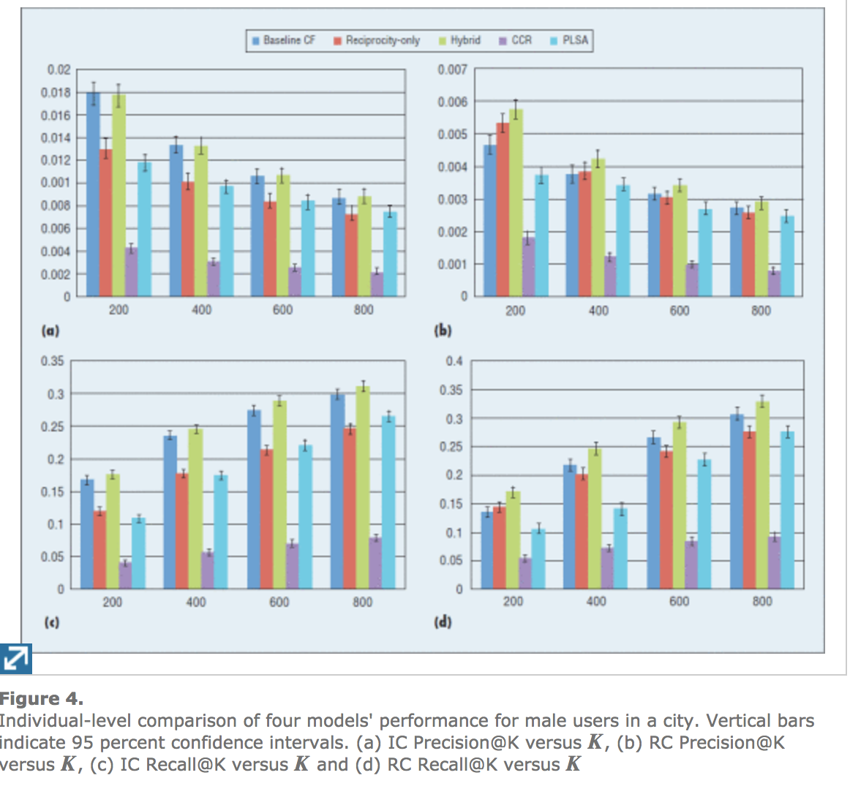
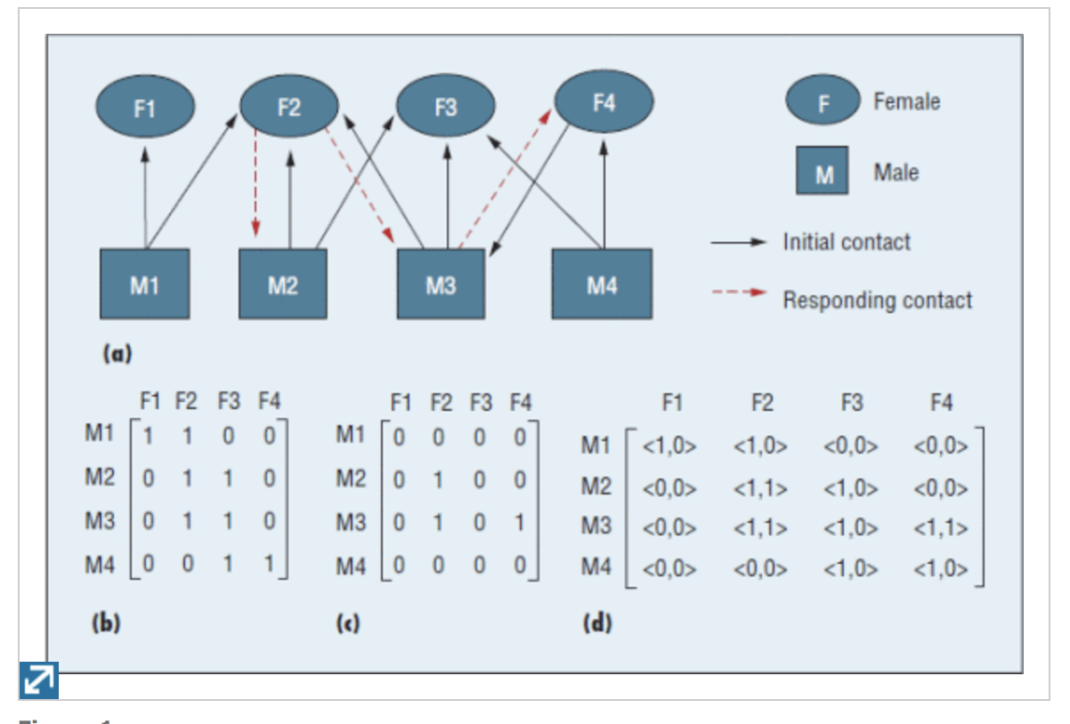
“User Recommendations in Reciprocal and Bipartite Social Networks” [1]
Follows collaborative reciprocal recommendation strategy
Represents user and interactions as a bi-partite graph
Models Used:
Baseline CF model
Reciprocity Only model
Hybrid Model

Slide 5
Pros and Cons
iHR method [2] | Dating [1]
Pro : Uses the reciprocal method which aligns well with the job recommendation industry | Pro: Applies multiple CF strategies and compares the performance of each of them Captures interaction data well and uses it in the recommendation strategies
Cons : - Very simple similarity measure is applied for all the features. Could include feature weighing Does not consider any interaction data into making recommendations Does not include performance results | Cons: Claims that it performs better than Conten-Collaborative Reciprocal systems but not necessarily for Job Recommendations

Slide 6
References
Future Work
Study the paper which is the extension of the iHR approach which includes interaction details on job applicants to generate recommendation.
Gözde Özcan, Sule Gündüz Ögüdücü, "Applying different classification techniques in reciprocal job recommender system for considering job candidate preferences", Internet Technology and Secured Transactions (ICITST) 2016 11th International Conference for, pp. 235-240, 2016.
[I] K. Zhao; X. Wang; M. Yu; B. Gao: User Recommendations in Reciprocal and Bipartite Social Networks--An Online Dating Case Study, IEEE Intelligent Systems, vo1.29, Pp. 27 - 35, March/April 20 14
[2] H. Wenxing, C. Yiwei, Q. Jianweiand H. Yin iHR+: A Mobile Reciprocal Job Recommender System. In Computer Science & Education (ICCSE), 20 15 10th International Conference on. 2015. IEEE

Slide 7
CS 297 Review Meeting
08/30

Slide 8
Proposed Approach
Reciprocal recommendation strategy for job recommendation by using domain ontology based similarity measure
Base Work : RésuMatcher: A personalized résumé-job matching system
Extension : Creating a preference profile and description profile for job seekers and job postings and calculate cross-similarity to perform reciprocal recommendation.

Slide 9
Base Approach
Information Extraction
Template Matching machine learning algorithm
Information Processing
Translating tokens to hypernyms and hyponyms
Model Building
Builds the Job model and Resume Model
Similarity Measure
Ontology based similarity measure for the various features

Slide 10
Extension
Information Extraction
Template Pattern Matching machine learning algorithm
Information Processing
Translating tokens to hypernyms and hyponyms
Model Building
Builds the Job model and Resume Model
Description Model
Descriptive features of the job/resume
Preference Model
Preference of the job seeker and employer
Reciprocal similarity
Ontology based reciprocal similarity measure between description and features.

Slide 11
Work in progress
Identify the pattern matching strategy used by the existing approach
Prepare the ontology for the job domain
Extract preference features for job seekers.
Identify dataset of job descriptions and resumes.

Slide 12
CS 297 Review Meeting
09/06

Slide 13
Ontology – DBPedia
Crowd sourced effort to extract structured information from Wikipedia
Contains information categorized as ontology classes, concepts etc.
Provides generalization and specialization relationship between concepts.

Slide 14
Database skill example
Entity : Database
Concept: Databases
Concepts
NoSQL
Relational
Online Database
Cloud Database
dbr:IBM_WebSphere_eXtreme_Scale
dbr:NoSQL
dbr:Couchbase_Server
dbr:C-treeACE
dbr:Virtuoso_Universal_Server
dbr:Clusterpoint
dbr:Aerospike_database
dbr:Wakanda_(software)
dbr:Berkeley_DB
dbr:Druid_(open-source_data_store)
dbr:MongoDB
dbr:CouchDB
dbr:Riak
dbr:Rasdaman
dbr:Stardog
dbr:DocumentDB
dbr:Cloud_database
dbr:Amazon_DynamoDB
dbr:Amazon_Relational_Database_Service
dbr:Amazon_SimpleDB
dbr:Amazon_Redshift
dbr:Aurora_database_analytics_engine
dbr:Amazon_ElastiCache
dbr:Azure_SQL_Data_Warehouse
Entities

Slide 15
Builder Approach
Seed set of generic skill categories. Eg Database, Front end development, Functional Programming.
For each category in seed set, get “broader-of” and “subject for”.
Associate entities in the “subject for” and ontology type as “software” or “Language” with the parent concept.
Recurse through the sub categories (“broader-of”)
From the resulting tree, we can deduce if a skill is a specific form of a type of skill and vice-versa.

Slide 16
CS 297 Review Meeting
09/13

Slide 17
SPARQL query – sub concepts
PREFIX broader: <http://www.w3.org/2004/02/skos/core#broader>
PREFIX category: <http://dbpedia.org/resource/Category:Software_development>
select distinct ?sub_concepts ?concept_label ?resources ?resource_label where{
?sub_concepts broader: category:.
?resources <http://purl.org/dc/terms/subject> ?sub_concepts.
?sub_concepts <http://www.w3.org/2000/01/rdf-schema#label> ?concept_label.
?resources <http://xmlns.com/foaf/0.1/name> ?resource_label .
?resources <http://www.w3.org/1999/02/22-rdf-syntax-ns#type> ?type.
FILTER(?type = <http://dbpedia.org/ontology/Software> || ?type = <http://dbpedia.org/ontology/Language>)
}
Created a base Python Implementation using SPARQLWrapper, RDFLib

Slide 18
CS 297 Review Meeting
09/20

Slide 19
Progress
Worked on the Python implementation to load a subset of the dbpedia taxonomy for certain skills.
Persisted the skill dependencies into Neo4j (a graph database)
Executed cypher queries to fetch insights relevant to the project

Slide 20
CS 297 Review Meeting
09/27

Slide 21
Big Picture
Model Building
Similarity Measurement
Resume Model
Job Posting Model
Ontology and Taxonomy of skills
Description
Preference
Description
Preference
Semantic Labelling
Similarity Metric
Pattern Matching
NLTK, Finite State Transducers (FST),

Slide 22
Resume Parsing
Several approaches available to parse resume to structured content.
This itself is an intense NLP problem area.
There are combinations of NLP, Pattern Matching, Machine Learning and Clustering methods to parse resumes.
ML Approaches : Hidden Markov Models (HMMS), Conditional Random Forests, word2vec (for detecting similar words)
Couldn’t find a credible resume parsing API with good results
Using the opensource https://github.com/antonydeepak/ResumeParser

Slide 23
Next Steps
Parsed Resume
{
"summary":
"skills":
"basics": {}
"education_and_training": []
"work_experience" : []
}
Cleaning of parsed content
Semantic Labelling of parsed content – Using nltk, wordtovec, dictionary approach

Slide 24
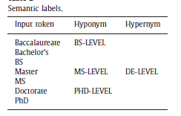
Progress – 10/18
Job description parsing to structured JSON content.
Focus on educational qualification and perform semantic labeling.
Developing python implementation to extract education features
Sample String:
“Master of Science (MS). in Computer Science, San Jose State University.”
NLP Parser Output
Observed Pattern : DEGREE(NP) CONCENTRATION(NP) UNIVERSITY(NP)
Understand all such patterns by training the various types of education string
Started extracting resumes from indeed. No APIs available from web page scrapping needed.
(ROOT (NP (NP (NNP Master)) (PP (IN of) (NP (NP (NNP Science)) (PRN (-LRB- -LRB-) (NP (NNP MS)) (-RRB- -RRB-)))) (. .)))
(ROOT (FRAG (PP (IN in) (NP (NNP Computer) (NNP Science))) (, ,) (NP (NNP San) (NNP Jose) (NNP State) (NNP University)) (. .)))

Slide 25
Progress 10/25 Named Entity Recognition for education qualifications
In the last session, attempted to extract education details through POS patterns and reg-ex
Study showed that Named Entity Recognition is the right way to extract structured information from unstructured text.
Tried Stanford NER. But supports only 7 classes like ORGANIZATION, LOCATION etc.
Tried to train a own NER. Both Stanford NLP and NLTK had provisions to train a custom NER.
Problem : Labelled Data! Decided to manually label 100 samples of education data.

Slide 26
Custom NER - Implementation
Chose the following named entities
"O", "DEGREE", "MAJOR", "UNIVERSITY", "SCHOOL", "TIMESTART", "TIMEEND“
Extracted 100 education samples from indeed.com and wrote a program to help in labelling the tags.
Implemented a custom NER using ChunkParser1 of NLTK by training with labelled data of (word, postag, iob tags)
Input Sentence:
Master of Science in Computer Science, California State University Hayward, CA, 2012
Labelled
[('Master', 'NN', 'B-DEGREE'), ('of', 'IN', 'I-DEGREE'), ('Science', 'NNP', 'I-DEGREE'), ('in', 'IN', 'O'), ('Computer', 'NNP', 'B-MAJOR'), ('Science', 'NNP', 'I-MAJOR'), ('California', 'NNP', 'B-UNIVERSITY'), ('State', 'NNP', 'I-UNIVERSITY'), ('University', 'NNP', 'I-UNIVERSITY'), ('Hayward', 'NNP', 'O'), ('CA', 'NNP', 'O'), ('2012', 'CD', 'B-TIMESTART')]

Slide 27
Custom NER - Implementation
Classifier Used – Naïve Bayes Classifier
Features includes – Current Word attributes, Previous Word Attributes and Next Word attributes
Results
Overall accuracy : 0.866028708134
Tag-wise accuracy
Accuracy of I-TIMESTART : 0.818181818182
Accuracy of I-UNIVERSITY : 0.815789473684
Accuracy of B-TIMEEND : 0.692307692308
Accuracy of I-DEGREE : 1.0
Accuracy of B-DEGREE : 1.0
Accuracy of B-TIMESTART : 0.818181818182
Accuracy of O : 0.923076923077
Accuracy of B-UNIVERSITY : 0.928571428571
Accuracy of B-MAJOR : 0.764705882353
Accuracy of I-TIMEEND : 0.875
Accuracy of I-MAJOR : 0.846153846154

Slide 28
Random Testing
M.S in Psychology Engineering, Arizona State University 08/2017 - 05/2019
[('M', 'NNP', 'B-DEGREE'), ('S', 'NNP', 'I-DEGREE'), ('in', 'IN', 'O'), ('Psychology', 'NNP', 'B-MAJOR'), ('Engineering', 'NNP', 'I-MAJOR'), ('Arizona', 'NNP', 'B-UNIVERSITY'), ('State', 'NNP', 'I-UNIVERSITY'), ('University', 'NNP', 'I-UNIVERSITY'), ('08', 'CD', 'B-TIMESTART'), ('2017', 'CD', 'I-TIMESTART'), ('05', 'CD', 'B-TIMEEND'), ('2019', 'CD', 'I-TIMEEND’)]
Master of Science (MS). in Chemical Engineering, San Jose State University.Aug 16 - May 18
[('Master', 'NN', 'B-DEGREE'), ('of', 'IN', 'I-DEGREE'), ('Science', 'NNP', 'I-DEGREE'), ('MS', 'NNP', 'I-DEGREE'), ('in', 'IN', 'O'), ('Chemical', 'NNP', 'B-MAJOR'), ('Engineering', 'NNP', 'I-MAJOR'), ('San', 'NNP', 'B-UNIVERSITY'), ('Jose', 'NNP', 'I-UNIVERSITY'), ('State', 'NNP', 'I-UNIVERSITY'), ('University', 'NNP', 'I-UNIVERSITY'), ('Aug', 'NNP', 'I-UNIVERSITY'), ('16', 'CD', 'I-TIMESTART'), ('May', 'NNP', 'B-TIMEEND'), ('18', 'CD', 'I-TIMEEND')]

Slide 29
Progress 11/01
Important to automatic content fetching for resume and job desc.
Spent some time in writing an tool to extract resume content from indeed resume website.
Explored the python package BeautifulSoup for web scripping from raw HTML content
Provides HTML parsing, navigation and content extraction
Indeed structure for resume
<div id=“resume>
<div id=“section_title”><h2>Education</h2></div>
</div>

Slide 30
Similarity Measure
Similarity based on hyponyms. Working on training and classifying tokens to hyponyms. This can be done.
[('M', 'NNP', 'B-DEGREE'), ('S', 'NNP', 'I-DEGREE’)
[('Master', 'NN', 'B-DEGREE'), ('of', 'IN', 'I-DEGREE'), ('Science', 'NNP', 'I-DEGREE’)
Same problem applies to skills.
Javascript and JS are the same.

Slide 31
Progress 11/13 Extraction and Classification of education skills
Completed the flow to perform Named Entity Recognition on education skills and classifying the degree to one of 5 categories(PhD, MS, BS, AS and Diploma)
Master of Science in Software Engineering, SAN JOSE STATE UNIVERSITY, San Jose, CA, August 2017 to August 2019
Custom NER build using NLTK/Probability based classification
[(‘Master', 'NNP', 'B-DEGREE'), (‘of’, IN', 'I-DEGREE'), (‘Science', 'NNP', 'I-DEGREE'), ('in', 'IN', 'O'), (Software', 'NNP', 'B-MAJOR'), ('Engineering', 'NNP', 'I-MAJOR’), …
Aggregate IOB tags
Degree : Master of Science
Major : Software Engineering
Degree Classifier using Naïve Bayes
MS-DEGREE

Slide 32
Sample Results
Ph. D. in Computer Science, Rutgers University-New Brunswick New Brunswick, NJ, 2003 to 2010
Degree : Ph D . Major: Computer Science
Degree type :D
Master of Science in Computer Science, California State University Hayward, CA, 2012
Degree : Master of Science . Major: Computer Science
Degree type :M
M.Tech in Computer Science and Engineering, Indian Institute of Technology, 2010
Degree : M Tech . Major: Computer Science and Engineering
Degree type :M
B.Tech in Computer Science and Engineering, Calicut University Calicut, Kerala
Degree : B Tech . Major: Computer Science and Engineering
Degree type :B

Slide 33

Skills Similarity
Base paper calculates the Jaccard similarity between two skills A, B if they satisfy the above conditions
Neo4j Query to check A is hypernym of B
MATCH p= (A:Skill)<-[:subclass*..2]-(B:Skill) WHERE A.name="Object-oriented programming languages" AND B.name = "Kotlin" return p
Neo4j Query to check common hypernym
MATCH path = ((a:Skill)-[*..2]->(common:Skill)<-[*..2]-(b:Skill)) WHERE a.name =~ "(?i)MongoDB.*" AND NOT a.uri CONTAINS "Concept“ AND b.name =~"(?i)Couchbase.*" AND NOT a.uri CONTAINS "Concept“ RETURN path

Slide 34
Challenges
Names of skills in the ontology graph is not consistent.
Current using regex matches to fetch but will not be accurate for all cases
Few common hypernyms do not make sense – Junk data fetched from dbpedia
Kind of stuck in how to solve the problem of different representations of a skill.

Slide 35
Progress 11/29 Resolving the challenges
Junk hypernyms in ontology
Modified the existing crawler algorithm to add concepts only if it has sub-concepts corresponding to technical skills.
Number of junk nodes drastically reduced from before.
Still some less relevant nodes are fetched because of the dbpedia labelling. But this should be manageable
Handling different representation/names of skills
Did some reading on handling this issue. Word2Vec (word embedding) is a common method adopted to better represent words as vectors by maintaining the semantic relationship.

Slide 36
Progress 11/29 Resolving the challenges
Cleaning dbpedia labels. Understanding the DP naming pattern, usage of correct parameters and basic text cleaning enabled in getting a consistent representation.
Object-oriented programming languages | object-oriented_programming_languages
Swift_(programming_language) | swift
C_Sharp_(programming_language) | c#
Abbreviations are still a challenge.

Slide 37
Dataset sourcing
Getting labelled data set for the system is a challenge.
The current paper uses their own dataset of 100 job descriptions and 10 user profiles and performs accuracy predictions on top
Explored other papers and most of them use their own self built dataset to perform the analysis of results
Found several new papers published in the last few months in job recommendations.
Currently referencing them for pointers on enhancements.

Slide 38
Progress 12/04
Sourcing the dataset used by the base paper.
Identified the resume’s and job description db dump from their public GitHub repo
Data includes 20 resumes and 50 job descriptions
Should contact the team to understand the exact data used for the various experiments
Job descriptions are in HTML format.
Working on scrapping and parsing them.
Calculating pairwise similarity of skills

Slide 39
Work during vacation
Main work on ontology based similarity measure
Implemented edge counting approaches described in Ontology-based semantic similarity: A new feature-based approach by D Sanchez et al.
Distance of smallest path between two skills
Distance to the least common ancestor
Above metrics divided by the depth from the root
Worked on the entire workflow of information extraction from resume and modelling the resume object.
Recommendation work flow should be complete in a week.
Job description extraction workflow is pending.

Slide 40
Progress 01/31
Reviewed literature on the various approaches on ontology based similarity measure.
Weighted approaches – Weights given to the edges either by empirical means or by labelled training set
Un Weighted approaches – No weights for edges and longer paths have less effect on the score.
Implemented an approach based on proximity. Uses all paths to calculate weights
Similarity = Sum of 1/n for all paths between two nodes. n is the number of edges in a path.

Slide 41
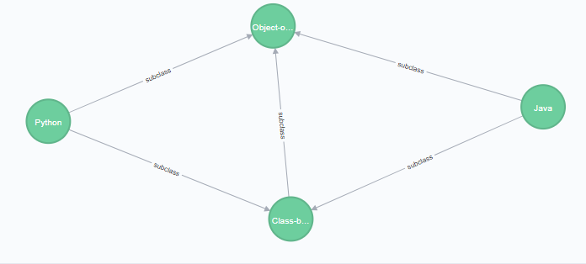
Results
 | Polymer | Javascript | CoffeeScript | Ruby | Python | Java | MySQL
Polymer | - | 1.9 |  |  |  | 0.9
Javascript | 1.9 | - | 1.6 | 0.66 | 0.58 | 0.91 | 0
CoffeeScript | 0 | 1.6 | - | 0.33 | 0.33 | 0.33 | 0
Ruby |  | 0.66 | 0.33 | - | 1.58 |  | 0
Python |  | 0.58 | 0.33 | 1.58 | - | 1.67 | 0
Java | 0.9 | 0.91 | 0.33 |  | 1.67 | -
MySQL |  | 0 | 0 | 0 | 0 | 0 | -

Slide 42
Automating the flow
In the current flow resume parsing is a manual step as it is a java program.
Tried out couple of other web-service based parsers but not much success
Need to work in this area to get the flow working end to end

Slide 43

Main Focus
Crawl and build a larger and more general ontology.
Finalize on the ontology based similarity measure
Feature based similarity measure:
Sanchez et al. – Feature based Ontology Similarity Measure
Features of an entity (skill) are all the ancestors of the entity in the ontology
Distance measure is based on the ratio of dissimilar features to the total features
Disimilarity ranges from [0 1].

Slide 44
Impelementation
Implemented the approach on the extended ontology
Comparision between Python and Perl: 0.3
Python - Perl
{'Class-based_programming_languages', 'Dutch_inventions', 'Programming_languages_created_in_1991', 'Python', 'Educational_programming_languages'}
Perl - Python
{'American_inventions', 'Unix_programming_tools', 'Dynamic_programming_languages', 'Programming_languages_created_in_1987', 'Computer_programming_tools', 'C_programming_language_family', 'Perl', 'Procedural_programming_languages', 'Free_compilers_and_interpreters'}
Perl & Python
{'Scripting_languages', 'High-level_programming_languages', 'Text-oriented_programming_languages', 'Object-oriented_programming_languages', 'Programming_languages', 'Dynamically_typed_programming_languages', 'Computer Programming'}

Slide 45

How did it do?
Number of dissimilar features over shadows the similar features resulting in smaller similarity values.
Figured out an approach that focusses on the similarity with weights to reduce the effects of dissimilar features.
Rodriguez et.al - Determining semantic similarity amongentity classes from different ontologies.
Modified the above to include the non linear log from previous approach to get a value between [0 1]

Slide 46
Results
While doing this found a bug in the ontology. Few links were missing and which also caused for the smaller values of similarity measures.
Corrected the bug and reran the ontology crawler. Loaded partial skills.
 | Without alpha | Alpha = 0.7
Java - Python | 0.26 | 0.41
TensorFlow – Keras | 0.80 | 0.89
Ruby – Python | 0.55 | 0.73
TensorFlow – NumPy | 0.26 | 0.38
IntelliJ – Eclipse | 0.25 | 0.37

Slide 47
Progress
Crawled ontology for the following root concepts
Computer Programming
Databases
Machine learning
Web Development
Loaded around 9000 skills into the ontology
Implemented the similarity and dissimilarity measure for a set of skills and set of requirements.

Slide 48
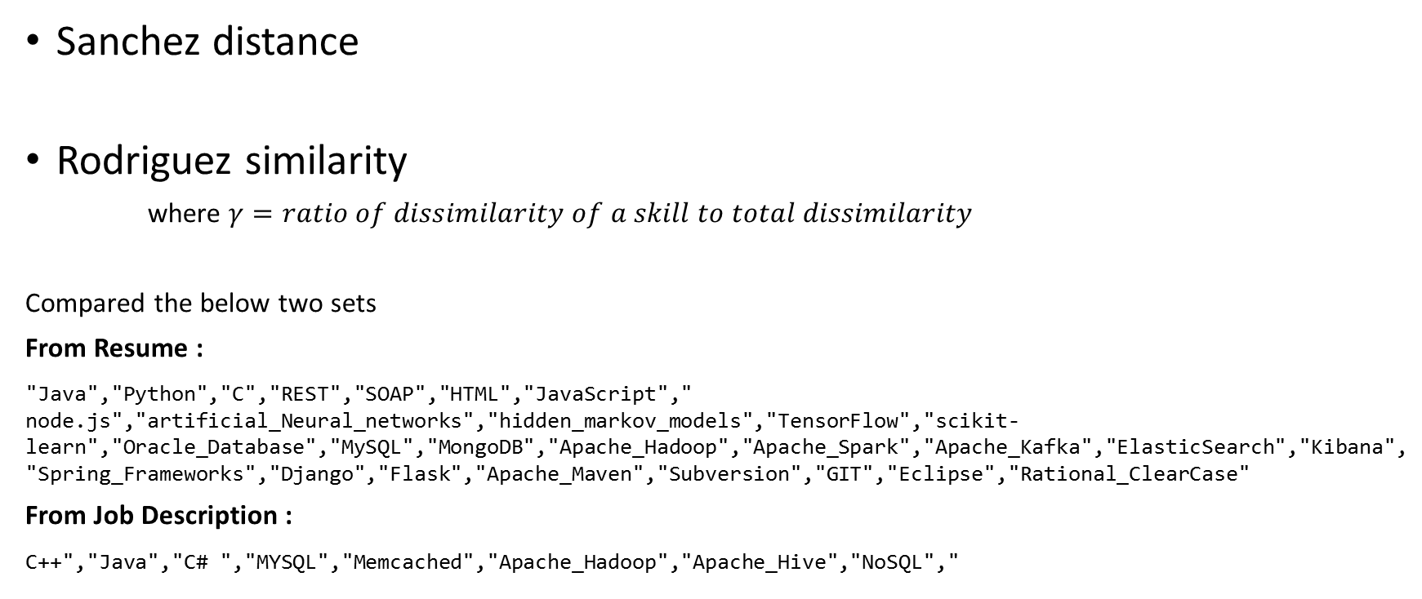
Dissimilarity measure
Sanchez distance
Rodriguez similarity
where $γ=ratio of dissimilarity of a skill to total dissimilarity$
Compared the below two sets
From Resume :
"Java","Python","C","REST","SOAP","HTML","JavaScript"," node.js","artificial_Neural_networks","hidden_markov_models","TensorFlow","scikit-learn","Oracle_Database","MySQL","MongoDB","Apache_Hadoop","Apache_Spark","Apache_Kafka","ElasticSearch","Kibana","Spring_Frameworks","Django","Flask","Apache_Maven","Subversion","GIT","Eclipse","Rational_ClearCase"
From Job Description :
C++","Java","C# ","MYSQL","Memcached","Apache_Hadoop","Apache_Hive","NoSQL","

Slide 49
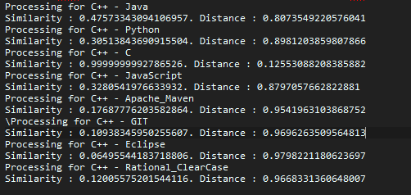
C++ and resume skills

Slide 50
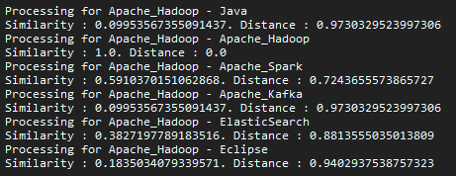
Apache Hadoop and other

Slide 51
Aggregation strategy
For each skill in the job description
Calculate Sanchez similarity and Rodrigues distance for each skills
Filter skills with distance of 1
Calculate weighted average of the similarity with weights being (1- distance) value

Slide 52
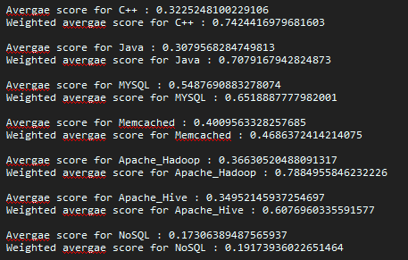
Results

Slide 53
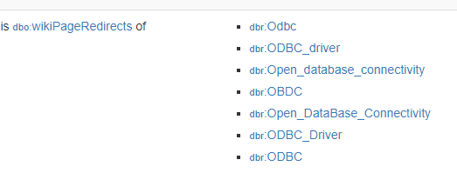
Improving skill matching
One of the current problems is to match the skill with the corresponding node in the ontology database.
Reason for it is that skills take several representations
Couchbase server is referred to as Membase or just Couchbase
ODBC can be referred to as Open database connectivity.
Improving the skill matching by utilizing the wikiredirects property for each resource

Slide 54
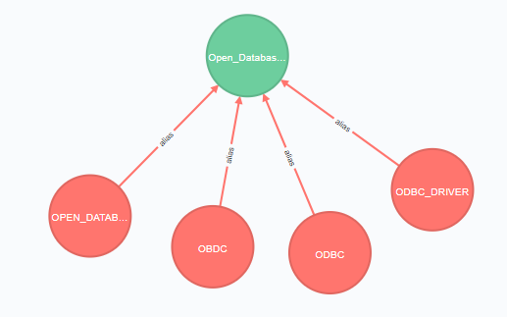
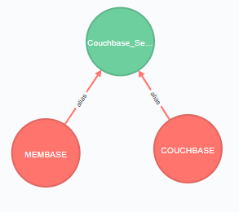
Improving skill matching
Created a new type of node and relationship in the ontology database
Modified the similarity flow to account for aliases

Slide 55
Pair-wise similarity score flow
Couchbase
BerkDB
Skill Cleaner
(CONSISTENT CLEANING)
Skill Matcher
(MATCH SKILL BY NAME OR ALIAS)
Ontology
{
“id”: URI
“name”: “Couchbase_Server”
}
{
“id”: URI
“name”: “Berkley_DB”
}
Skill Smilarity
(CALCULATE DISTANCE AND SIMILARITY)
{
“similarity”: 0.35
“distance”: 0.55
}

Slide 56
Working on . . .
Perform systematic experiments and summarize results.
Consider Including yago classes while building ontology
Yago (Yet another great ontology) is a knowledge base which is built by extracting information from Wikipedia, wordnet etc.
Dbpedia has linking to yago classes which are 800,000 classes in total.

Slide 57
Progress
Included yago classes in the ontology crawler.
Crawler fetches more useful topics now. But runs for long!
Tried to optimize by parallelizing chunk of work.
Restructured and cleaned up the code and chained the entire workflow together
Ran results for pairwise similarity measures

Slide 58
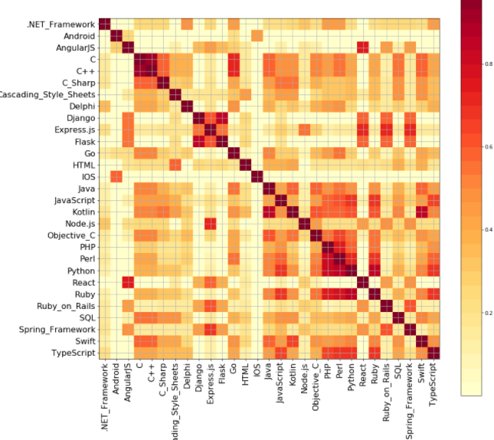
Skill Similarity – Top programming skills
Most of the similarities are expected
Few similarities are unexpected from a technology skill standpoint. Eg : Spring, Django and Express have considerable similarity from a web framework perspective. But they are very different skills from a technical perspective. Another example is Python and Javascript.
Few misses – Swift and IOS

Slide 59
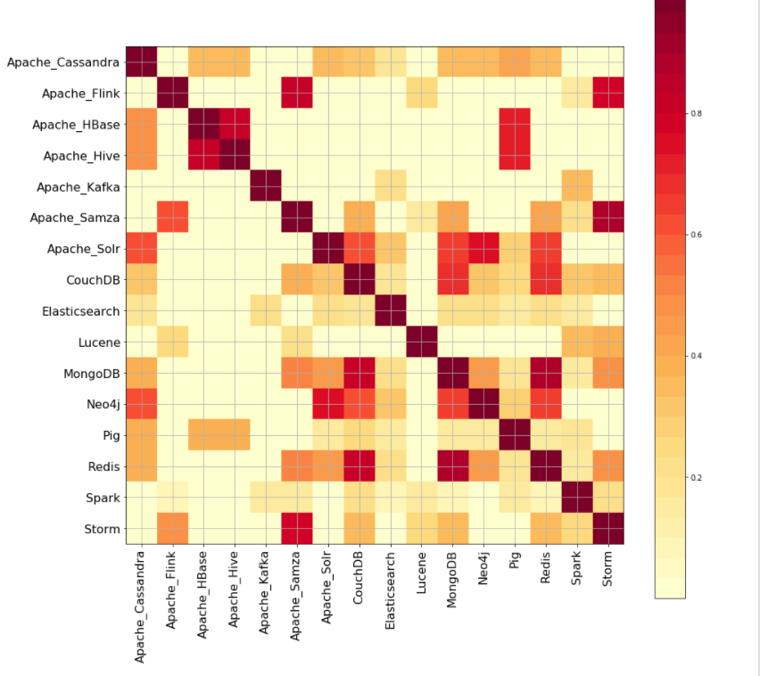
Skill Similarity – Top Big data skills
More unexpected similarities
Apache Solr – MongoDB - CouchBase
Misses – Lucene, Elasticsearch
Reason : Possibly, the ontology subgraph is not broad. Crawling was started form more specialized root nodes.

Slide 60
Problems/Confusions
How to compare and quantify the performance of the skill similarity.
Looking for similar papers to compare results
Should I embed this into a overall recommendation strategy and compare the overall recommendation score?

