Slide 1
Recommend Projects To Donors
Yeshwanthi Durairaj

Slide 2
Presentation Outline:
Objective of the project
Crisp Data Mining
Business Understanding
Data Understanding
Data Cleaning
Modelling
Evaluation/Results
Conclusion

Slide 3

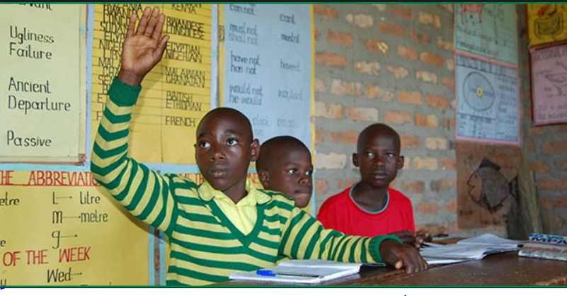

Data Science For Good !!! Donor – Project Recommendation

Slide 4

Data Source
Projects
Donations
Donors
Resources
Schools
Teachers

Slide 5
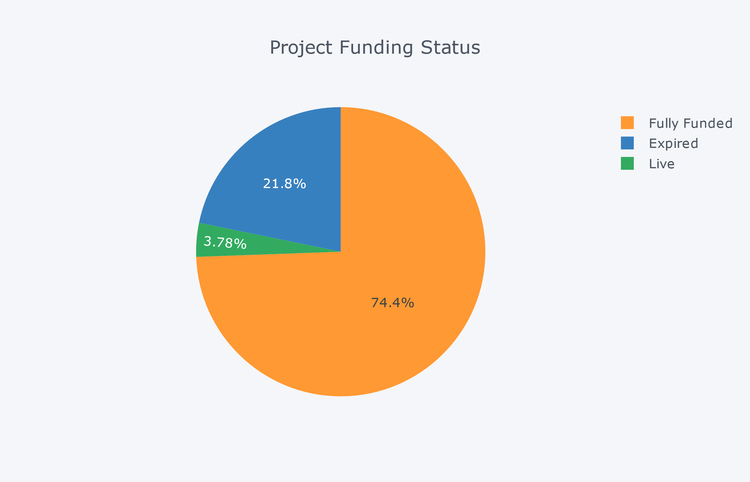
Data Understanding
Project Funding Status

Slide 6
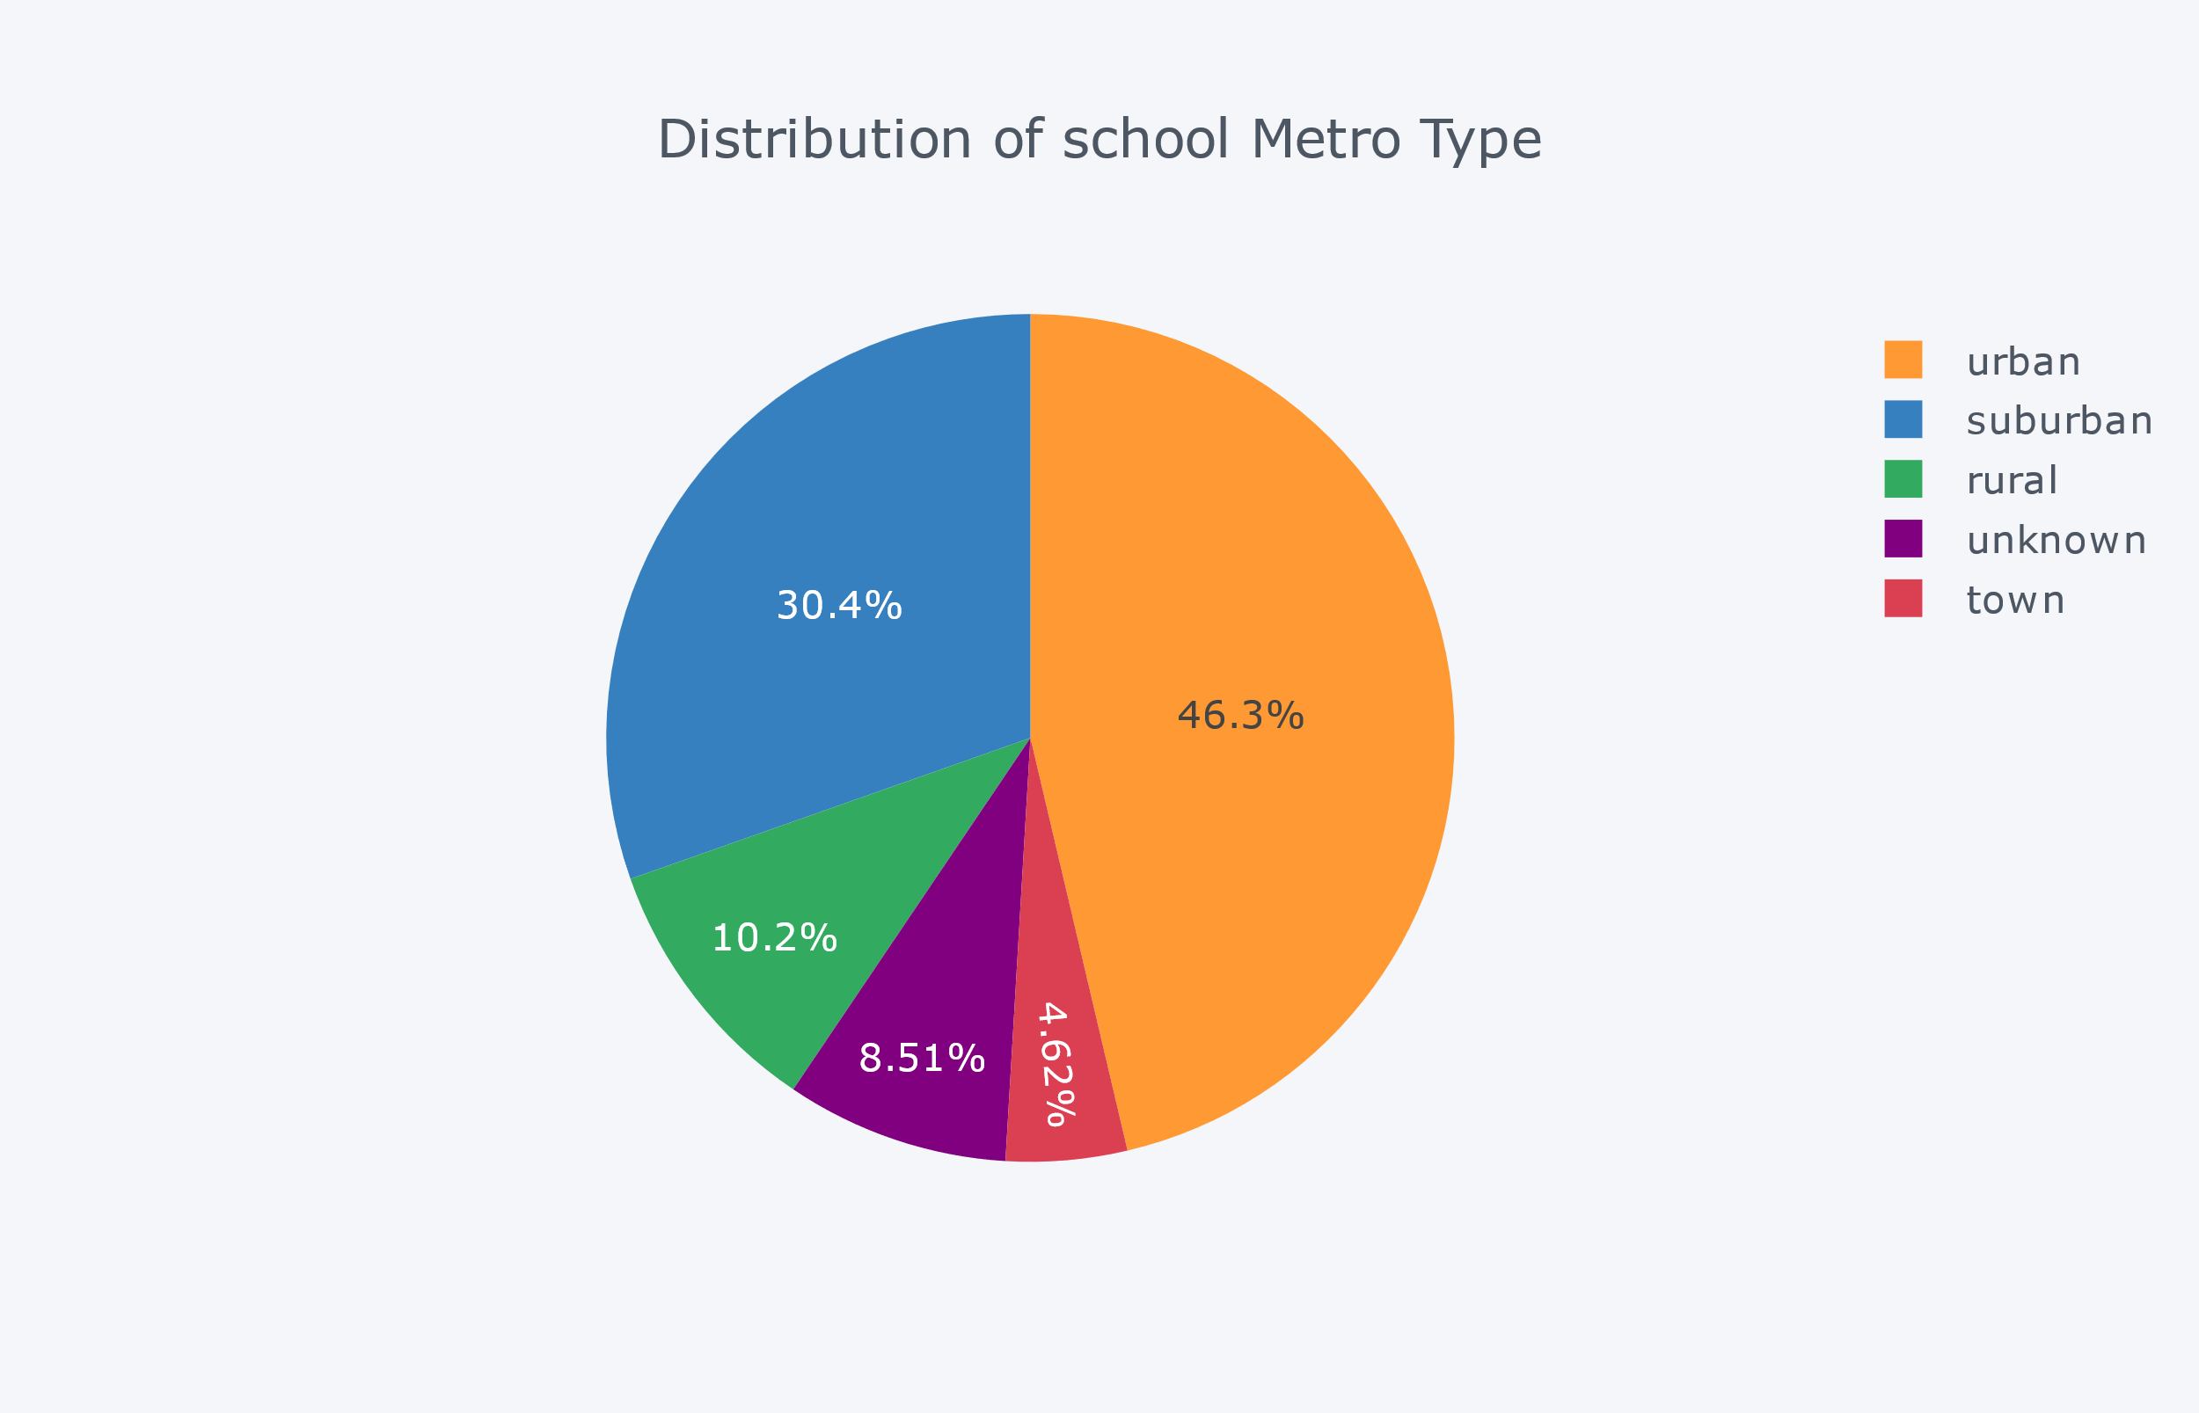
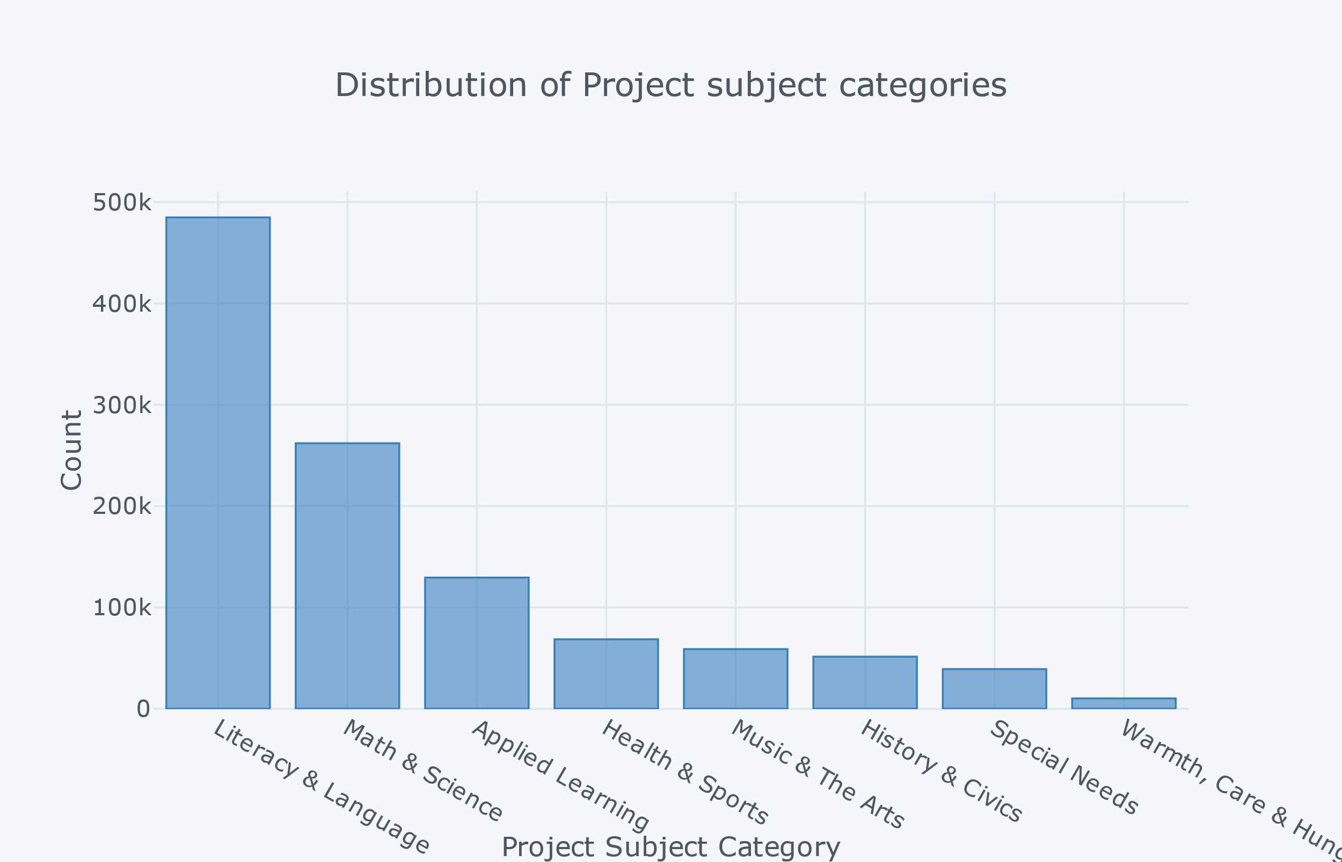
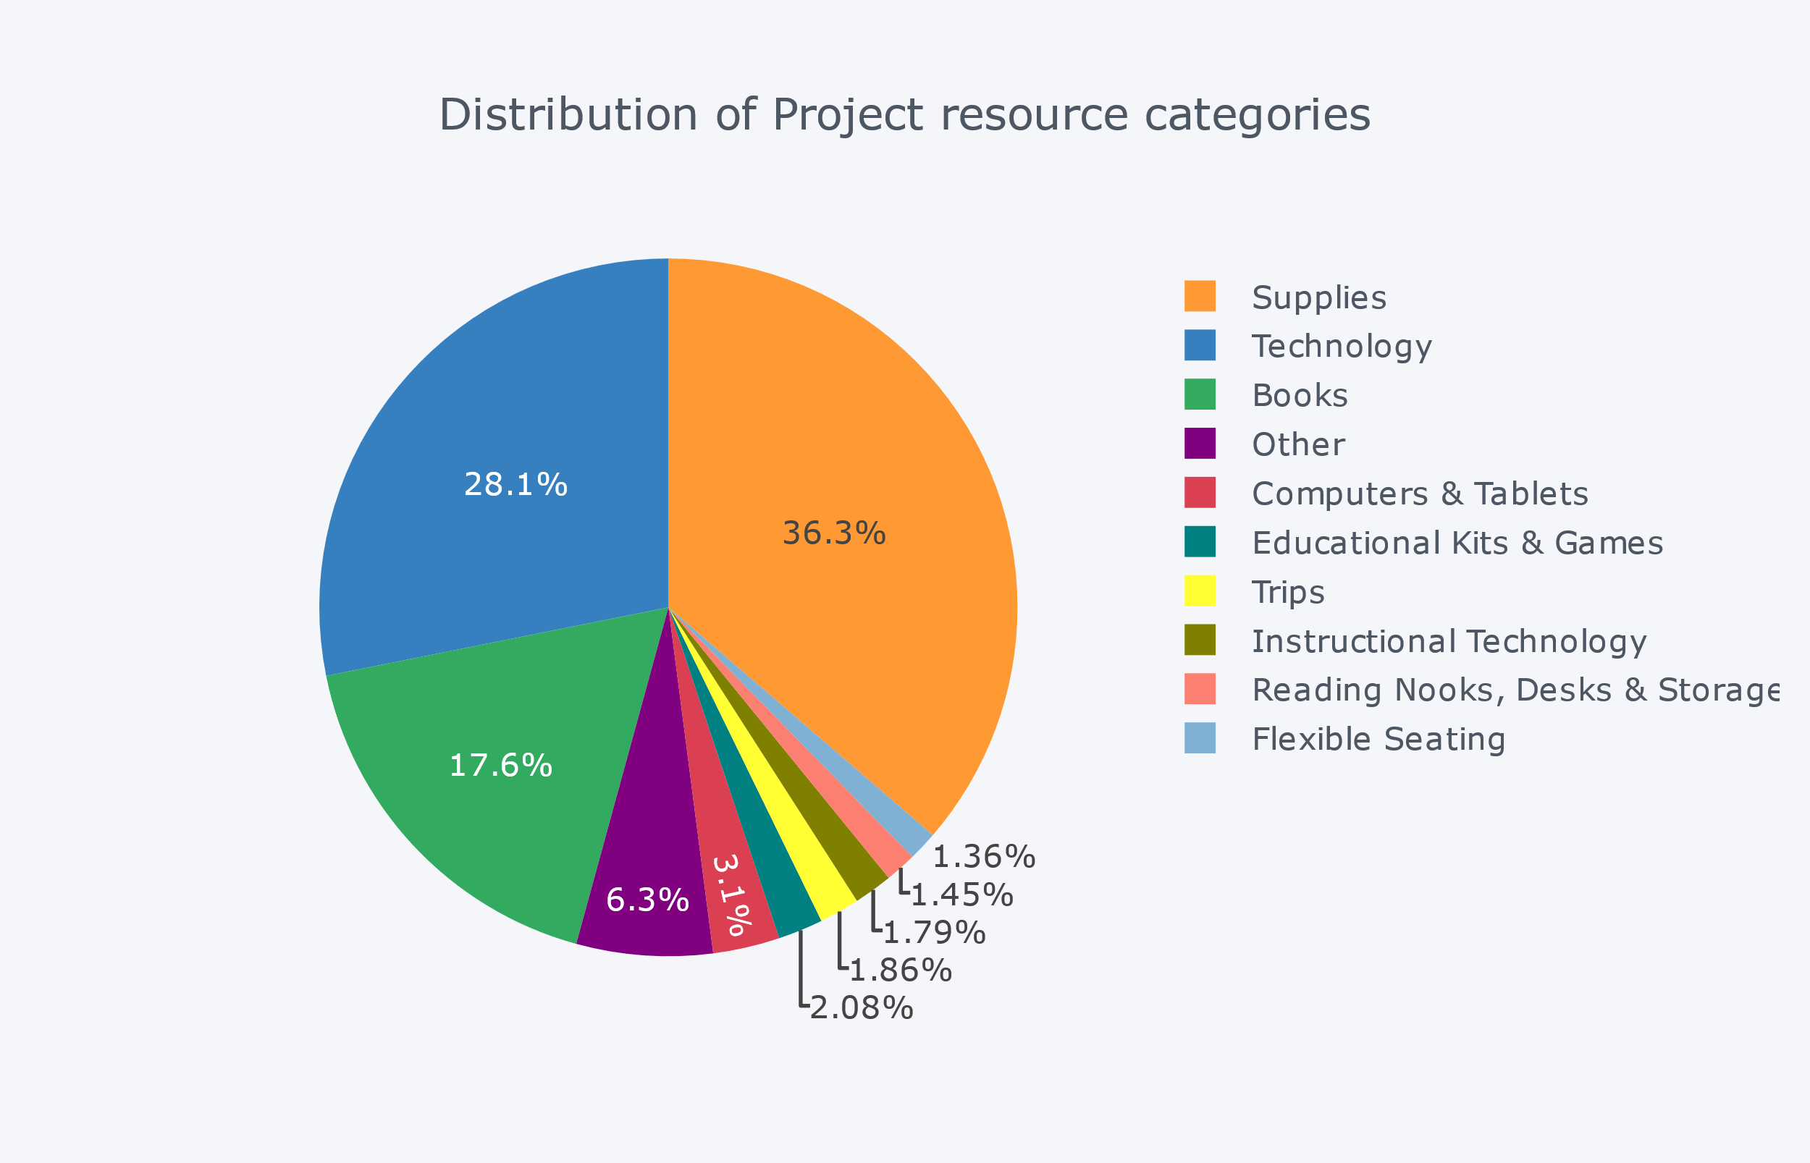
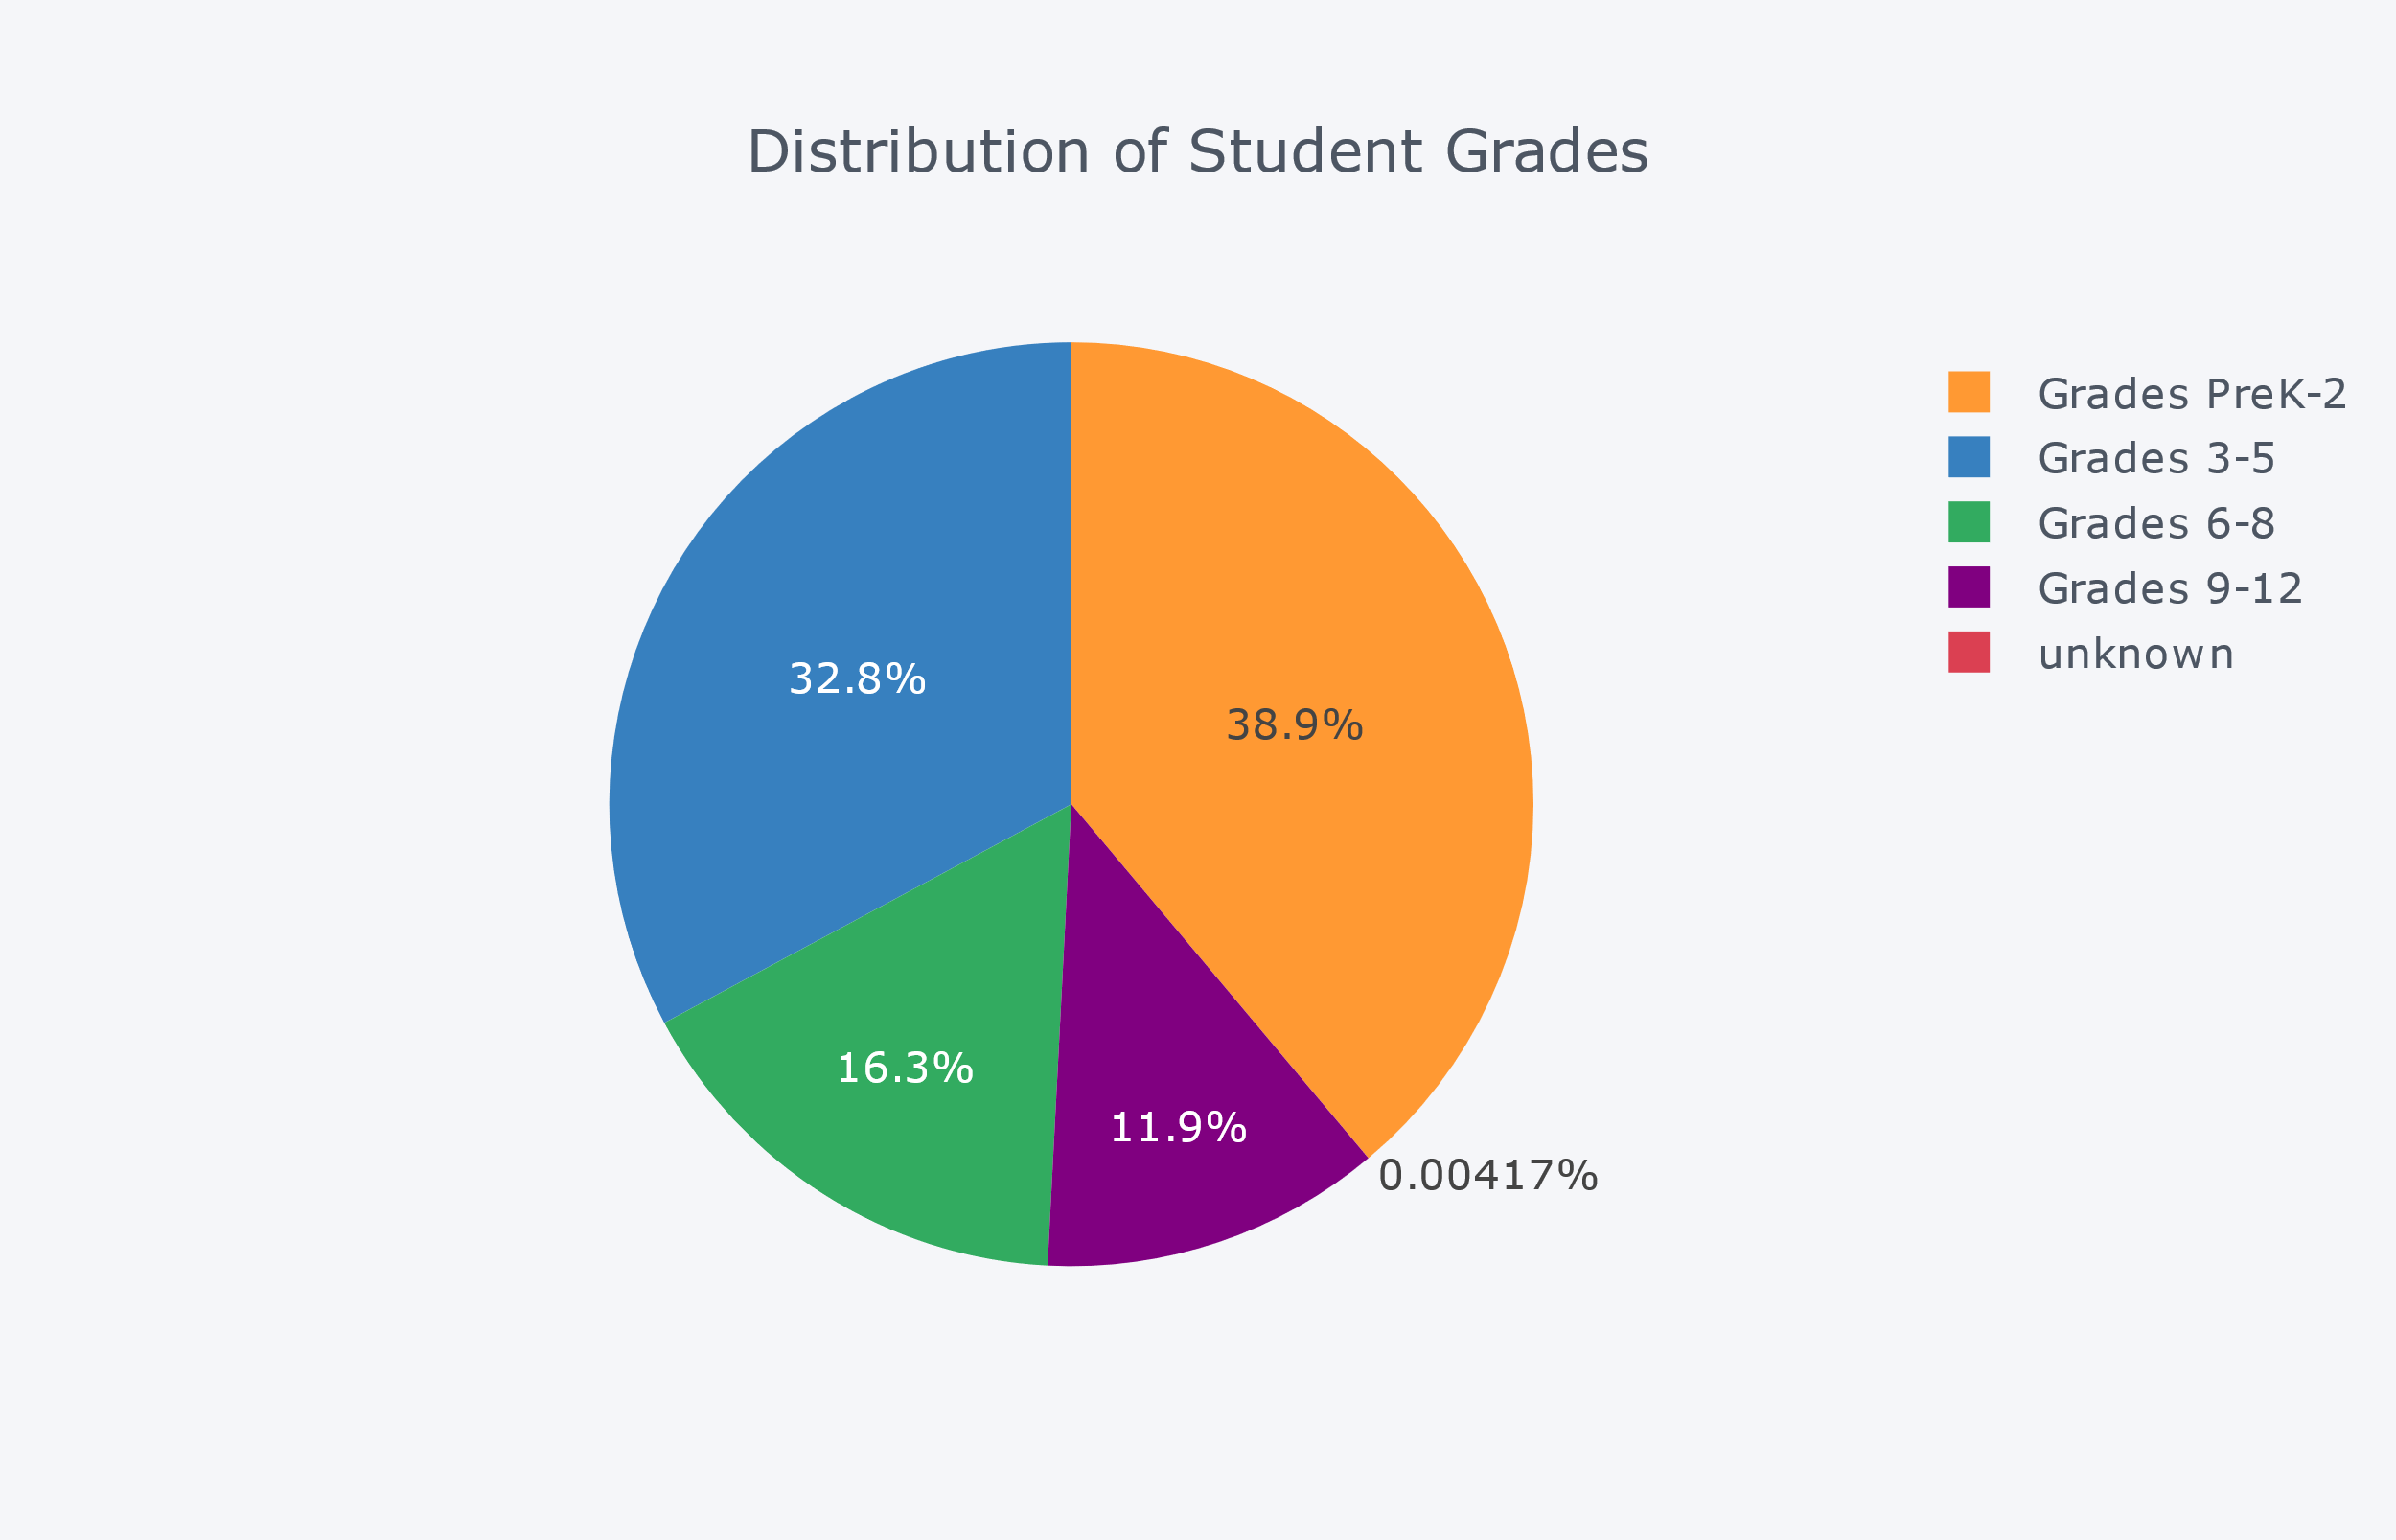
Data Merging
School
Project
Resources

Slide 7
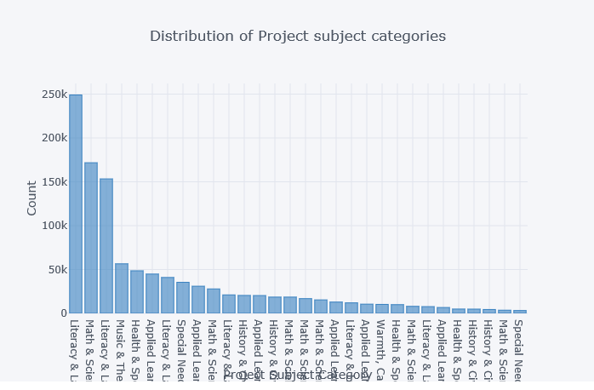
Data Cleaning and Merging
Categorical Variables - Grouping Levels

Slide 8
Data Cleaning and Merging
Categorical Variables - Grouping Levels

Slide 9
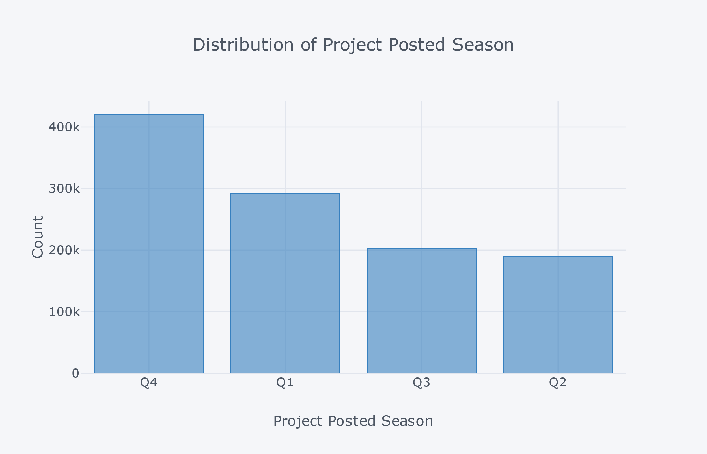
Data Cleaning and Merging
Derived Columns – Project_ Posted_Date

Slide 10
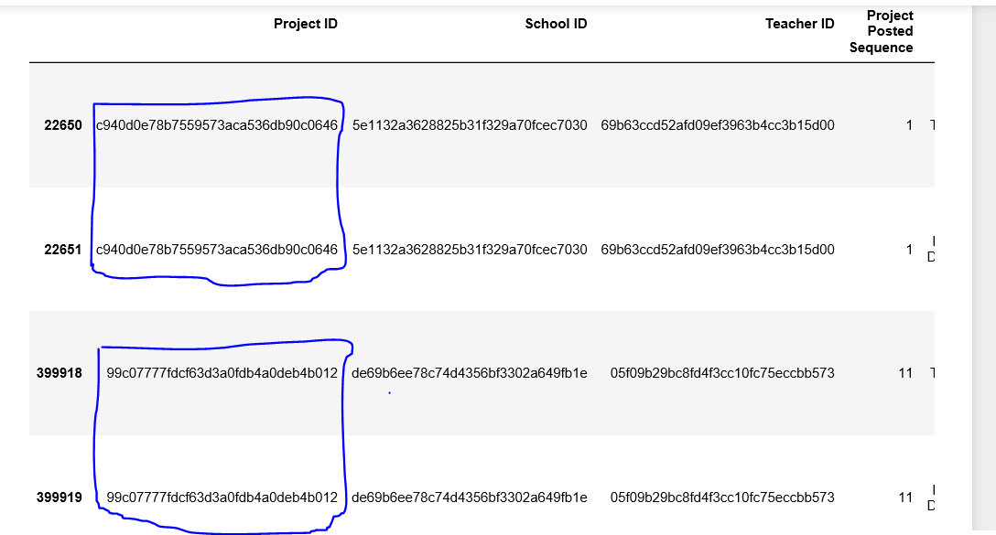
Data Cleaning and Merging
Duplicate Records, Missing Values

Slide 11
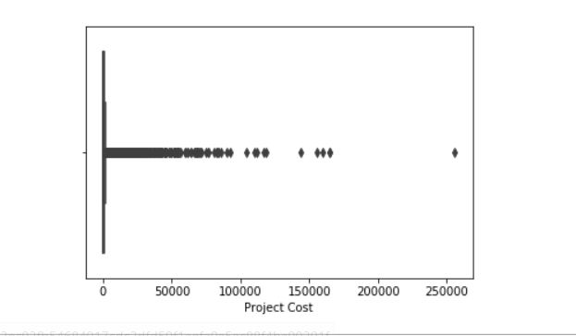
Data Cleaning and Merging
Detecting Outliers – Project Cost

Slide 12
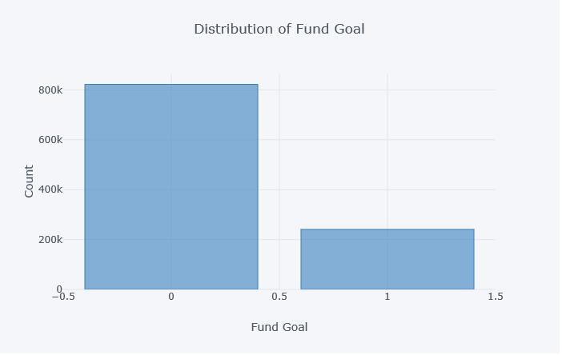
Target Variable
Target Variable – Fund Goal – (Class Imbalance Issue)
Percentage of Non Funded Projects 23%
Percentage of Funded Projects 77%

Slide 13
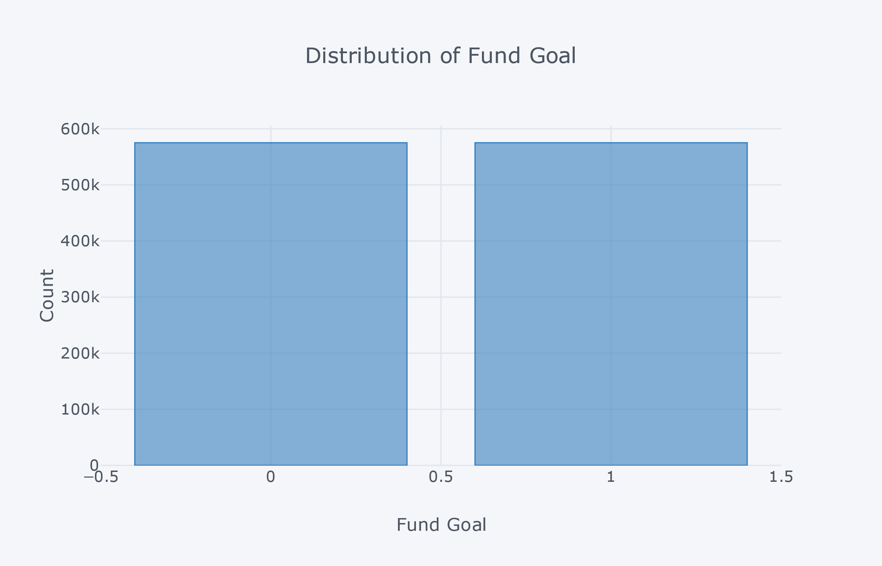
Oversampling Target
Target Variable – Fund Goal – (Class Imbalance Issue)
Length of Over Sampled data -1150214
Count of Fully Funded Projects –
Count of Un Funded Projects
Percentage of Non Funded Projects – 0.5
Percentage of Funded Projects - 0.5

Slide 14
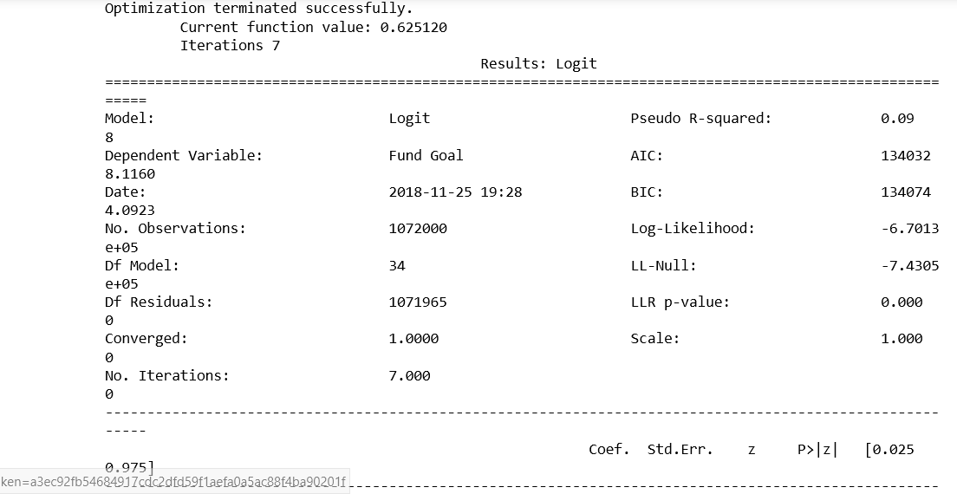
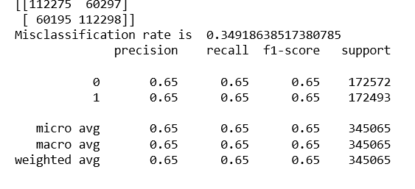
Classification Models
Model 1 - Logistic Regression Class Label – Fund Goal

Slide 15
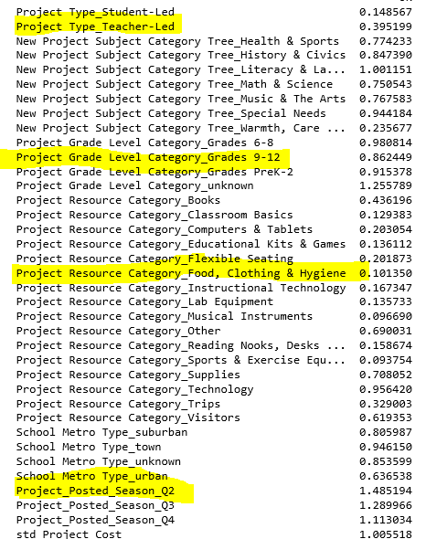
Classification Models
Model 1 - Logistic Regression Class Label – Fund Goal

Slide 16
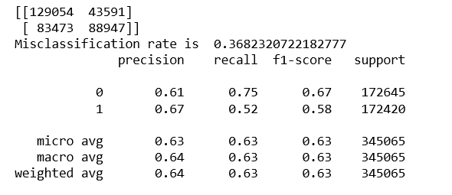
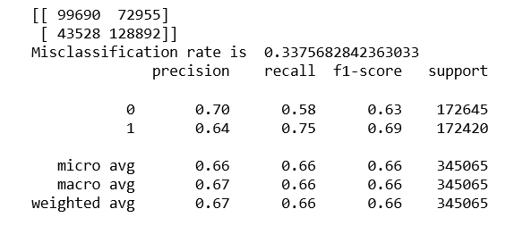
Classification Models
Model 2 – Decision Tree Class Label – Fund Goal
Model 3 – Random Forest Class Label – Fund Goal

Slide 17

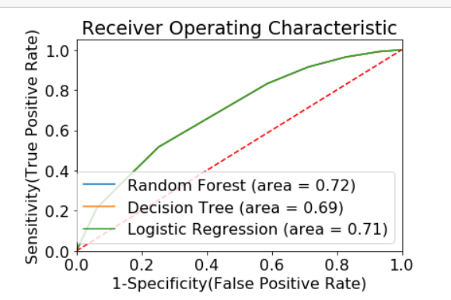
Model Evaluation

Slide 18
Next Objective - Clustering

Slide 19
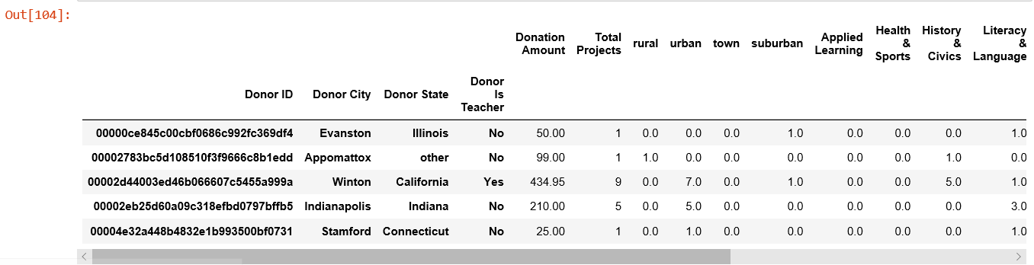
Segmenting Donors
Merge - Donor : Project : Donations

Slide 20
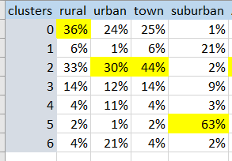
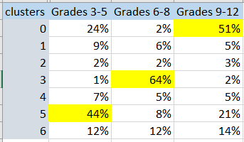
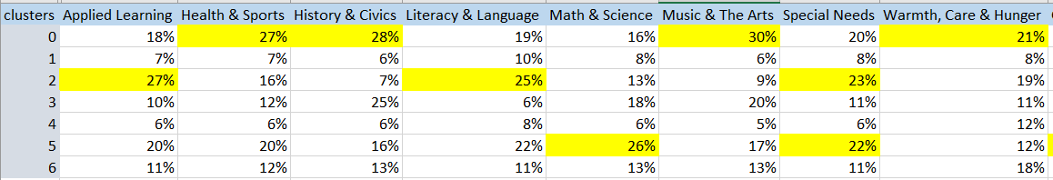
Segmenting Donors
Location
Grades
Area of Interest

Slide 21
Thank You

