Slide 1
Explain Housing Price Variability – King County
Yeshwanthi Durairaj Priyanka Agrawal

Slide 2
Presentation Outline:
Objective of the project
Data Explanation
Hypothesis Testing
Data Exploration
Methodology
Model Evaluation/ Results

Slide 3


Variables Explaining Housing Price?? Most Important Factors To Consider As Investor??

Slide 4


Data Source
Kaglle – Housing Price & House Features
Crime Count by Zip Code
Population by Zip Code
Median Income for the Zip Code
Average Distance from Amazon HQ

Slide 5

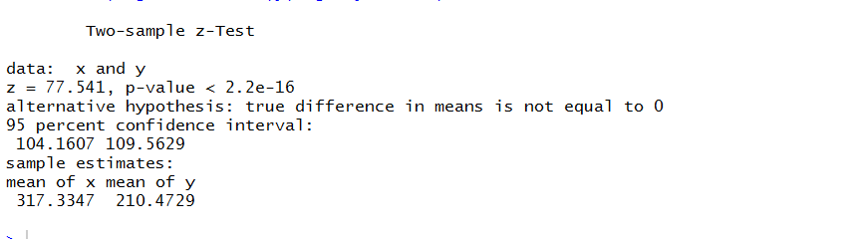
Hypothesis Test
Alexa check Amazon Hypothesis
Null Hypothesis
Amazon Distance has no effect on average price per square feet
Alternate Hypothesis
Amazon Distance is contributing on average price per square feet

Slide 6

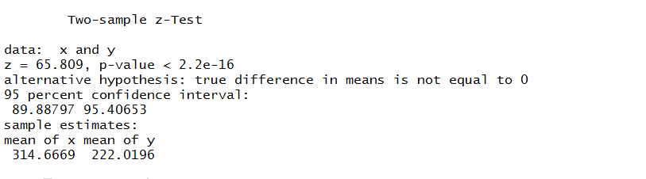
Hypothesis Test
Null Hypothesis
Crime has no effect on average price per square feet
Alternate Hypothesis
Crime is contributing on average price per square feet

Slide 7
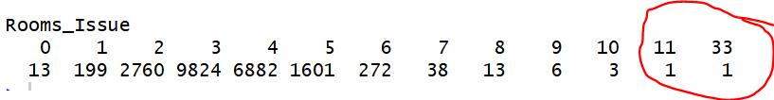
Not a data perfect world
Inspecting the SQFT & Price for this – It was no sense data
This is just example

Slide 8
Derived Columns
Price Per Square-Feet
(Price/Living SQFT)
New_SQFT_LIVING
(2014 & 2015 changes due to renovation)
New_SQFT_LOT
(2014 & 2015 changes due to renovation)
Crime rate
(Crime/Population)

Slide 9
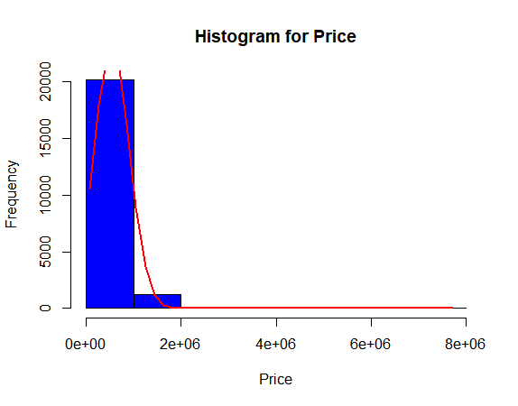
Explorative Analysis
Home Price -- Dependent Variable

Slide 10
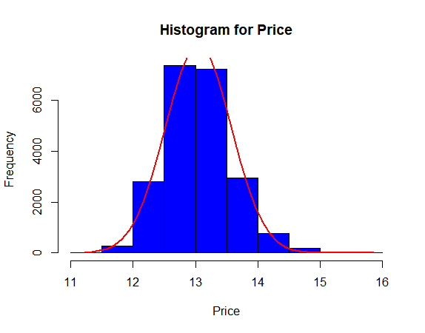
Explorative Analysis
Home Price -- After Log Transformation

Slide 11
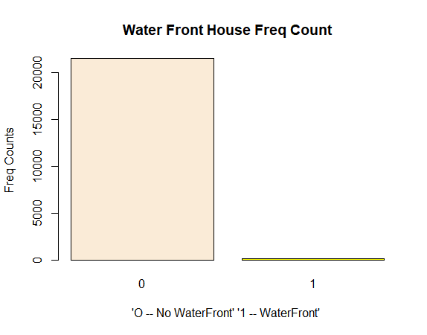
Explorative Analysis
How many Aqua homes???

Slide 12
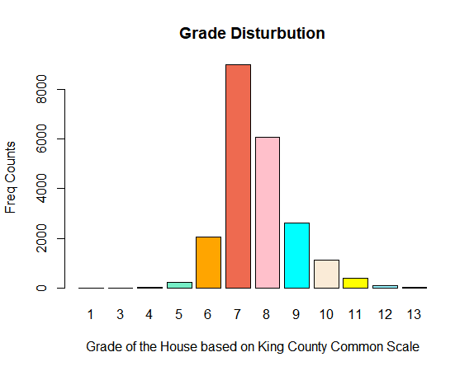
Explorative Analysis
Grade of the house (Common King County Scale)

Slide 13
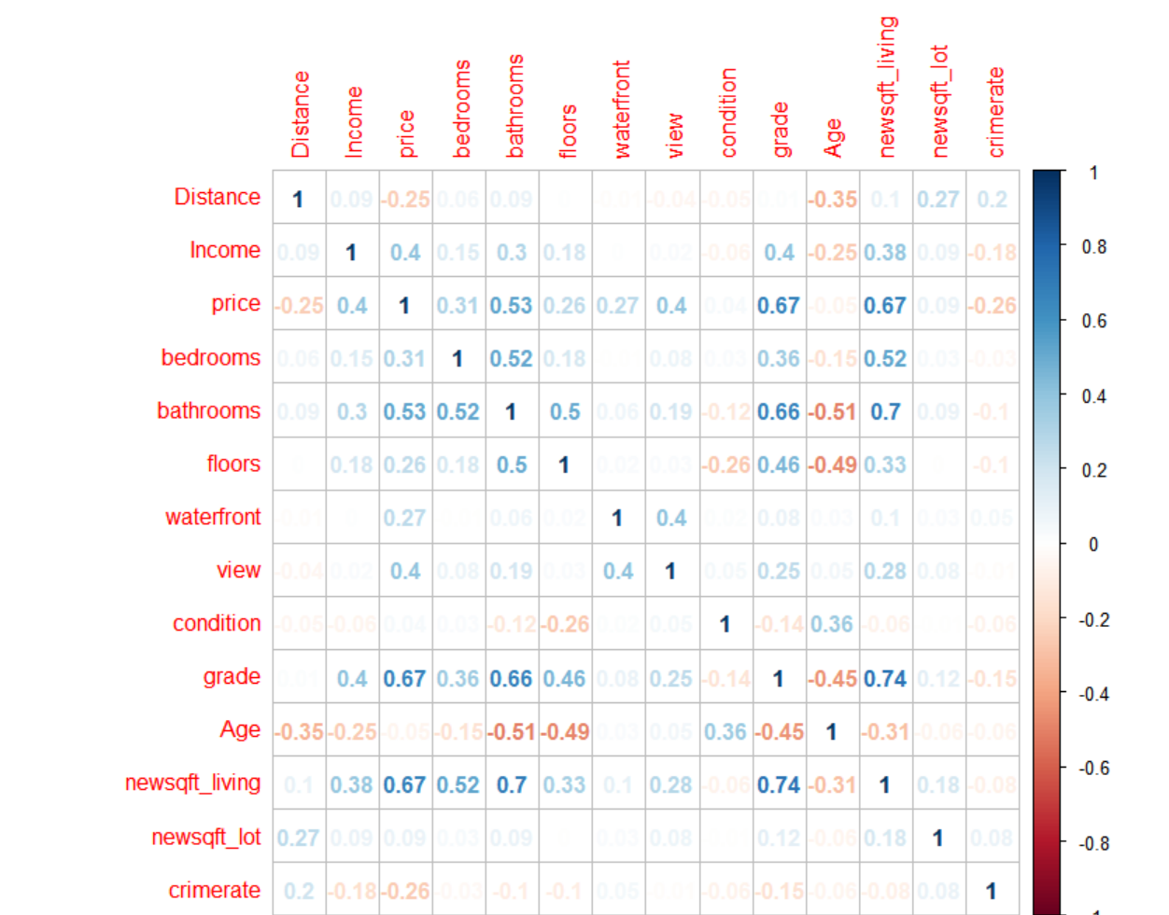
Pearson Correlation Matrix

Slide 14
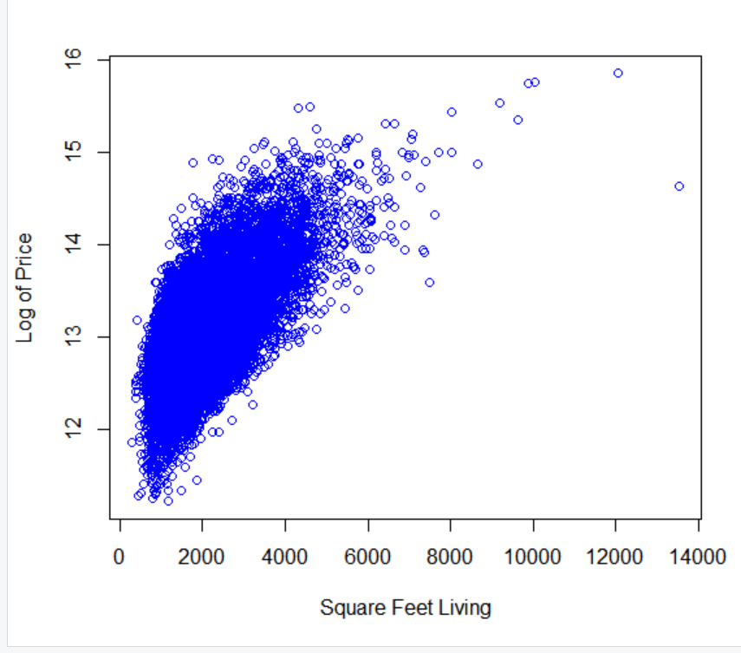
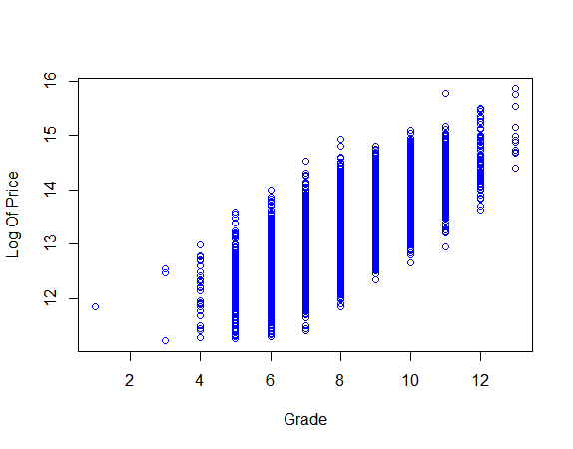
Scatter Plot Target vs Predictors

Slide 15
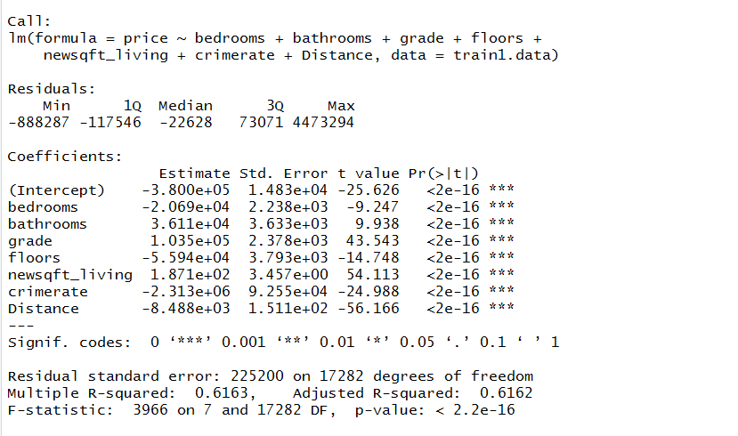
Model 1 (Without Log Transforming the Target) -- Basic Model

Slide 16
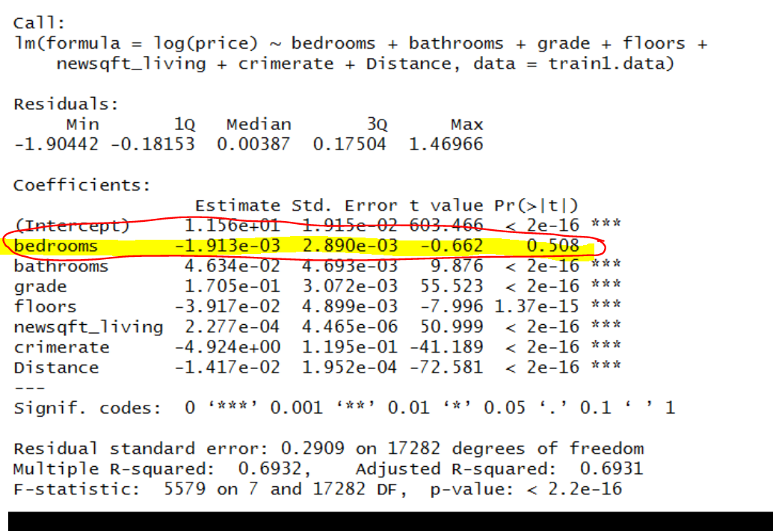
Model 2 (Log Transforming the Target) – Bedroom not significant

Slide 17
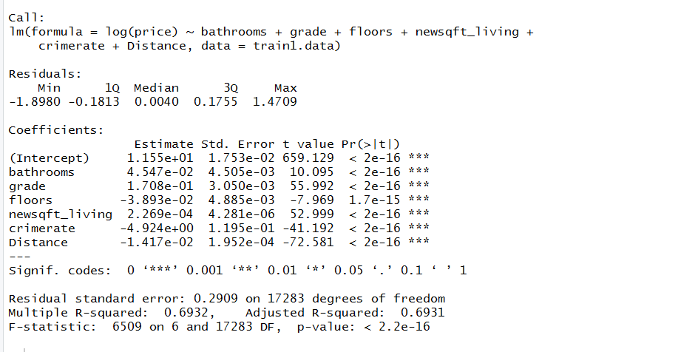
Model 3 – After Removing Bedroom

Slide 18
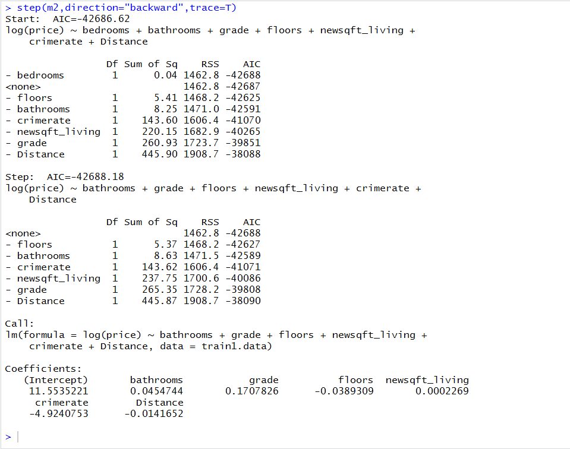
Model 4 – Stepwise Regression – Suggest To Remove Bedroom

Slide 19
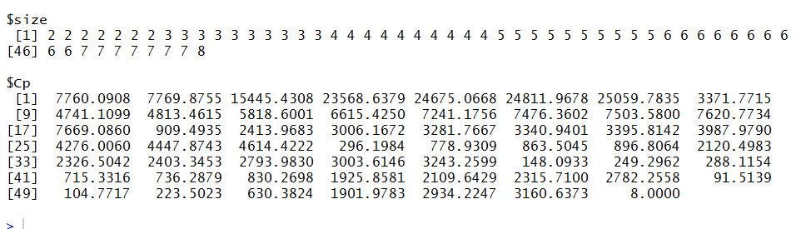
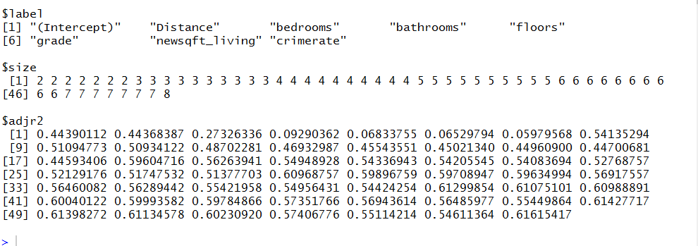
Model 5 – Best Subset Regression- Suggest To Remove Bedroom
Subset Selection by Cp
Subset Selection by Adj RSquared

Slide 20

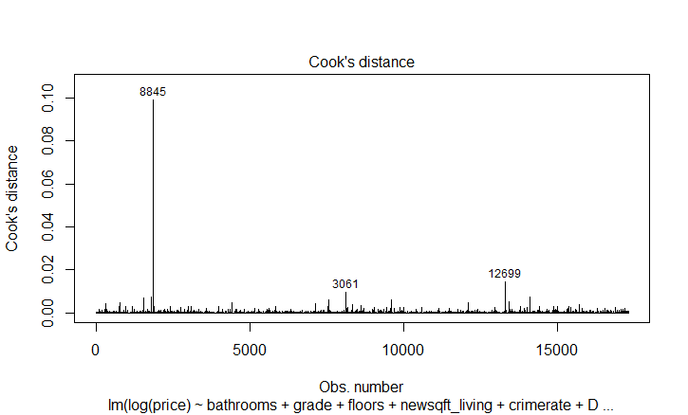
Multicollinearity???
Influential Points

Slide 21
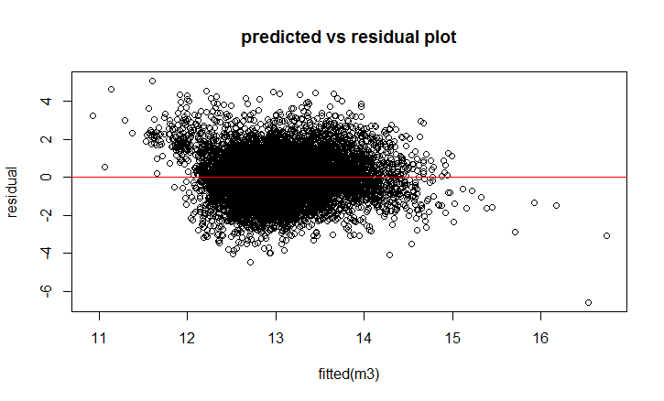
Residual Plots – Assumptions Check

Slide 22
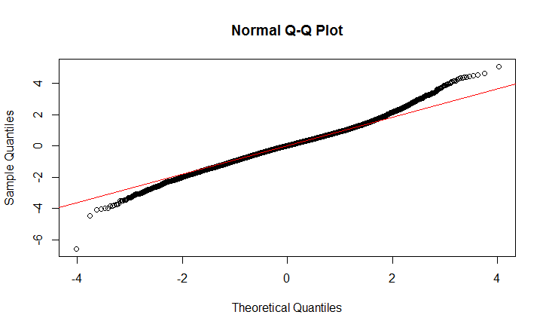
Residual Plots – Normality Check

Slide 23
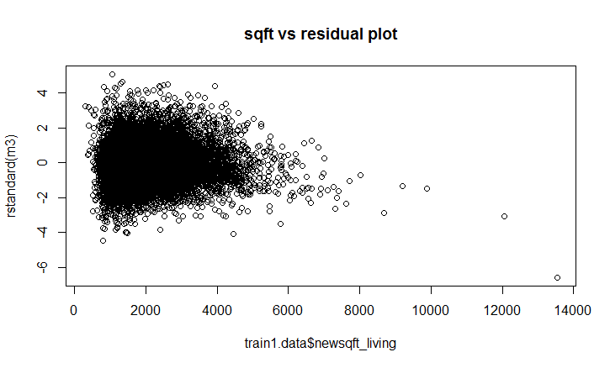
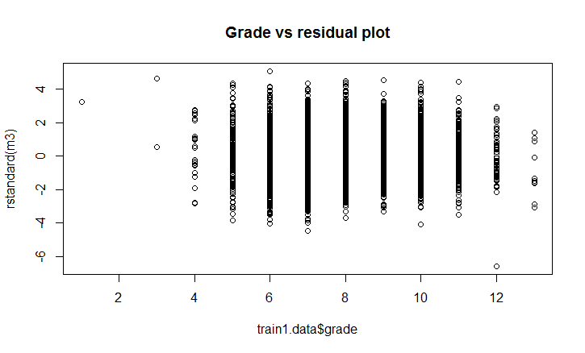
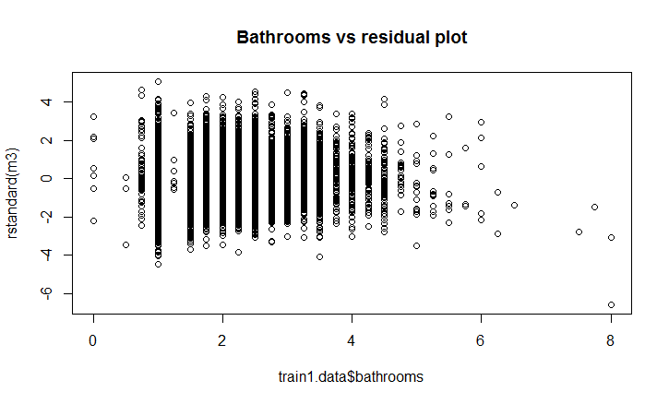
Residual Vs Independent Variable

Slide 24
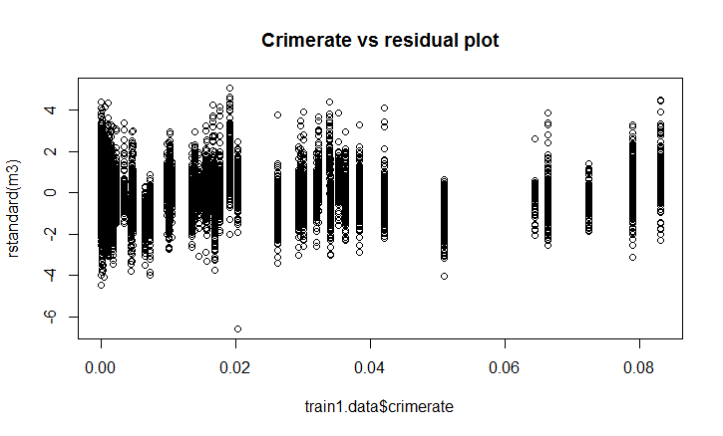
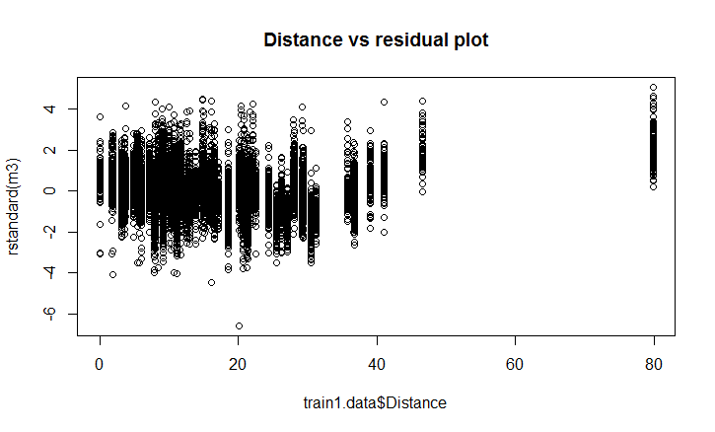
Residual Vs Independent Variable

Slide 25
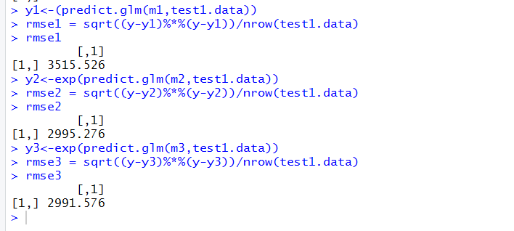

Model Evaluation -- RMSE

Slide 26
Results
Closer to Amazon – More you pay
Safer the area – less the crime rate – Higher Price tag
More number of Bathrooms – More Expensive it is
Higher the Grade – Standardized Seattle Housing Grade – Price Increases
Very Obvious More the SQFT Area Greater is the Price

Slide 27
Appendix

Slide 28

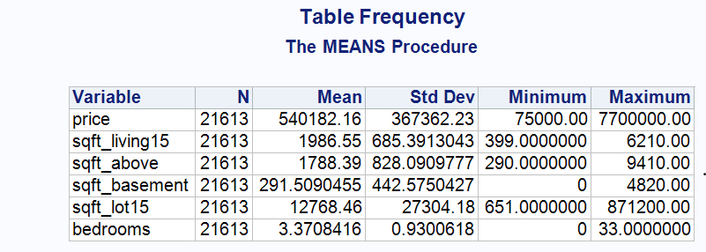
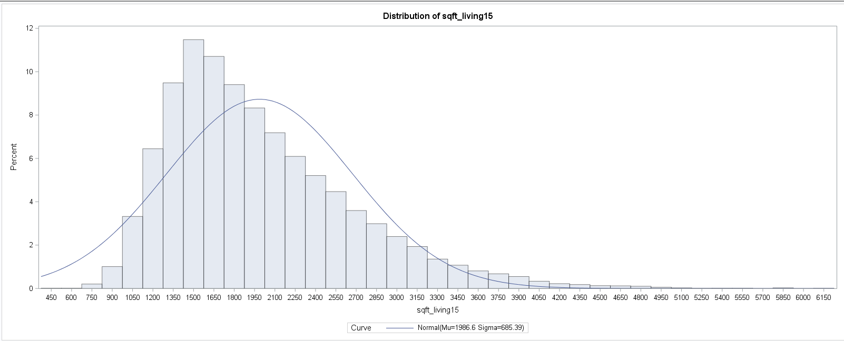

Slide 29
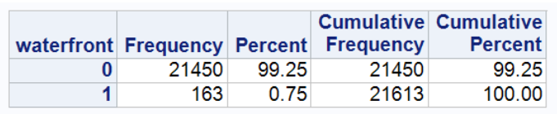
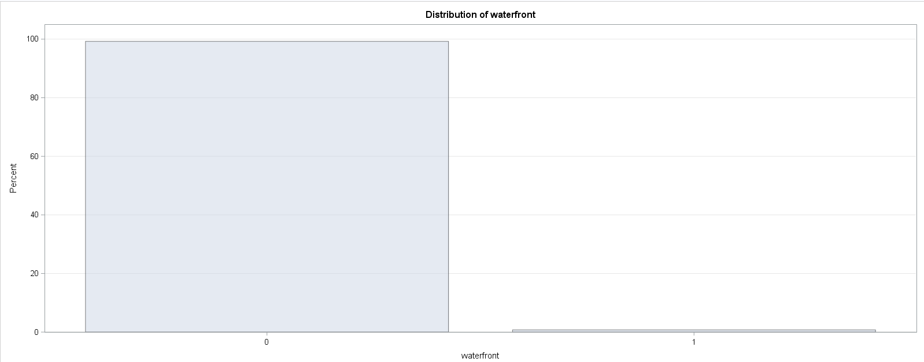

Slide 30
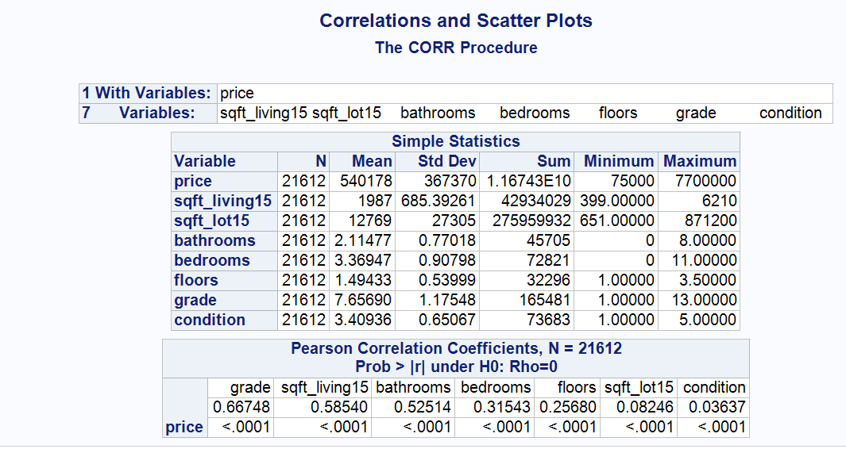

Slide 31
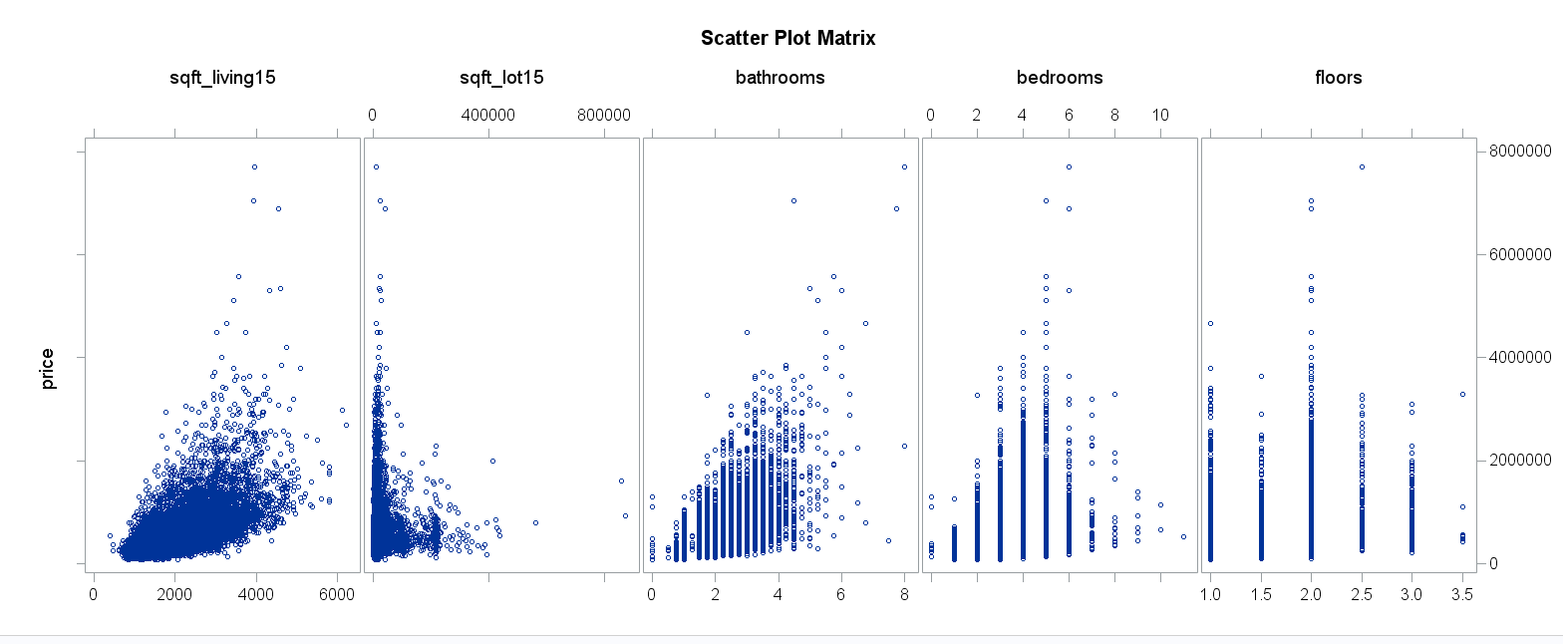

Slide 32
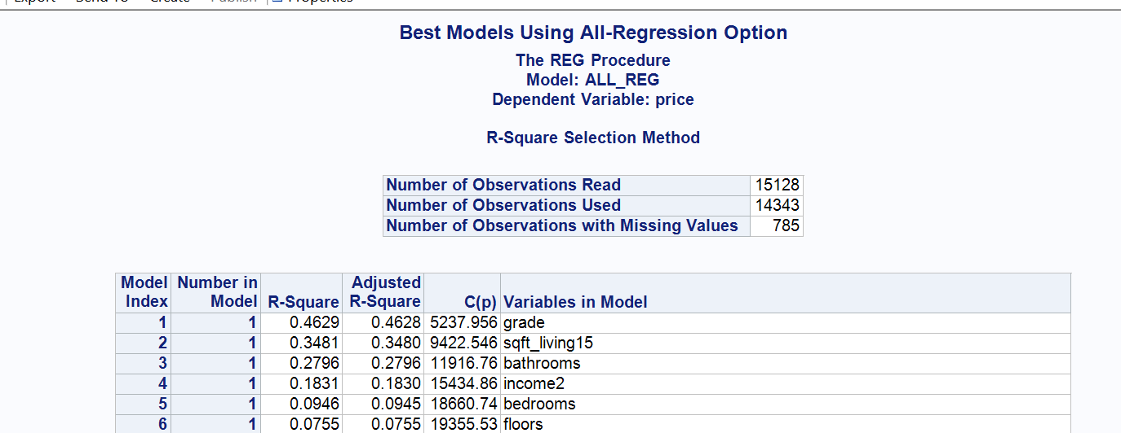
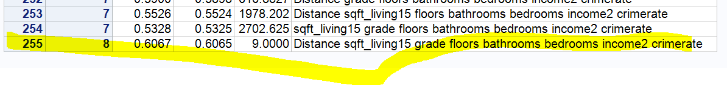

Slide 33
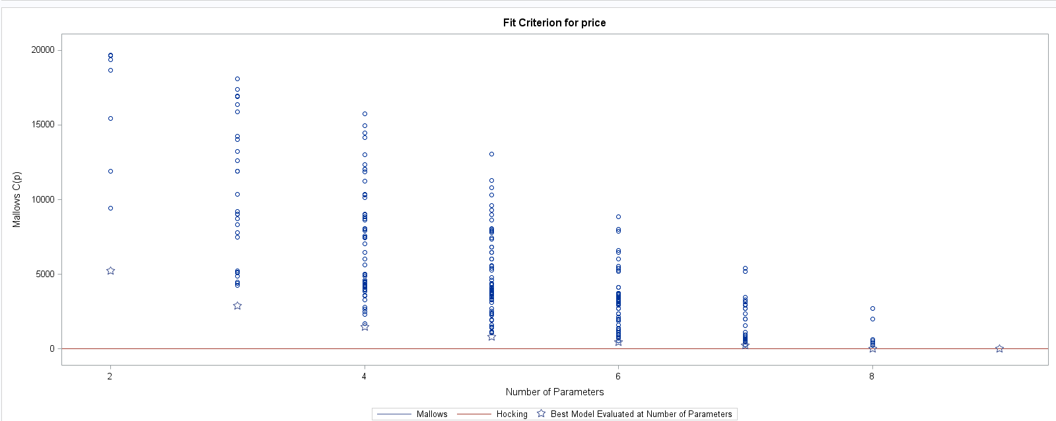

Slide 34
