Slide 1
Capstone Project
Energy consumption/Energy Load Prediction
Author:
Zhassulan Yeshmukhametov

Slide 2
The Problem Area:
The focus of my project is on energy consumption and load prediction, specifically in the context of residential electric vehicle (EV) charging in apartment buildings.

Slide 3

Dataset
Residential EV Charging Data
from

Slide 4
Description of Data:
Data have been collected from a large housing cooperative in Norway, with 1,113 apartments and 2,321 residents. A new infrastructure for EV charging was installed from December 2018. From December 2018 to January 2020, charging sessions were registered by 97 user IDs.

Slide 5
What does the Data look like:
Dataset 1: EV charging reports
Dataset 2: Hourly EV charging loads and idle capacity, for all sessions and users individually
Dataset 3 and 4: Hourly EV charging loads and idle capacity, aggregated for private or shared CPs
Dataset 5: Hourly smart meter data from garage Bl2
Dataset 6: Local traffic density
Dataset 7: Weather Data

Slide 6
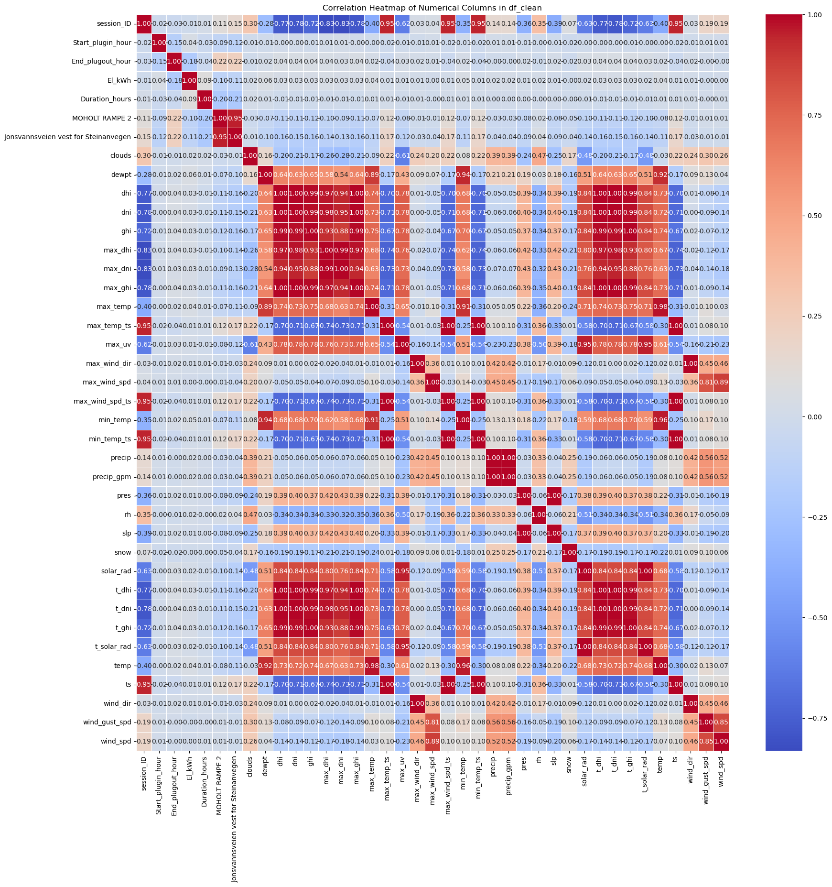

Slide 7
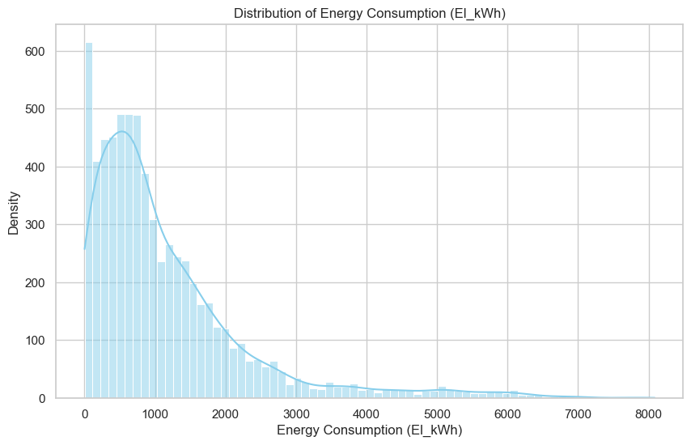

Slide 8
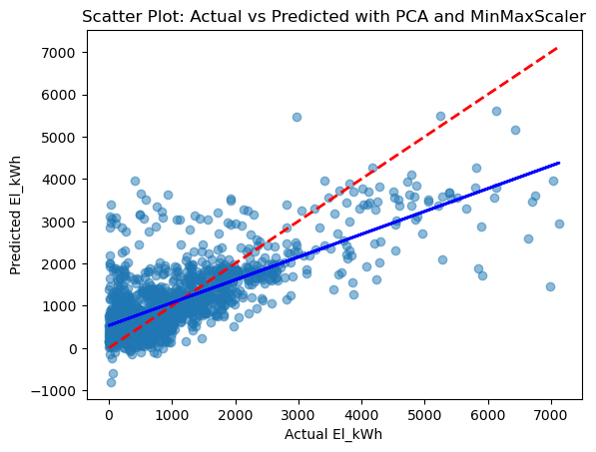

Slide 9
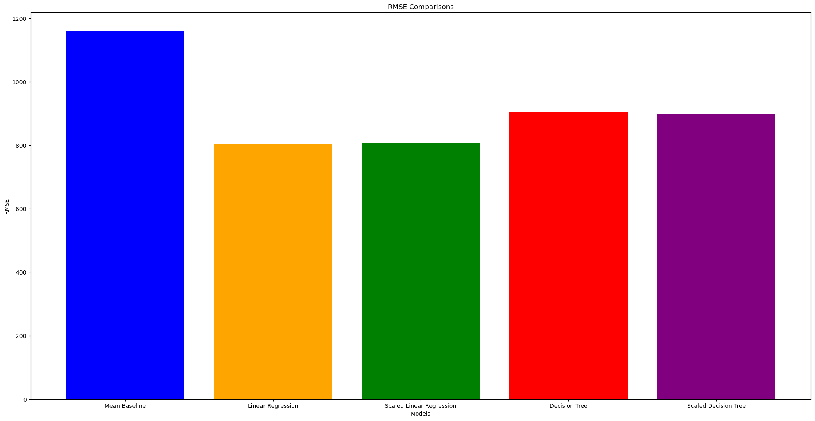

Slide 10
Future Steps:
Feature engineering
Hyperparameter tuning
Explore more advanced modeling techniques
Final Model

Slide 11
Thank you!

