Slide 1
Capstone Project
Sprint 1
Energy consumption/Energy Load Prediction
Author:
Zhassulan Yeshmukhametov

Slide 2

Dataset
Residential EV Charging Data
from

Slide 3
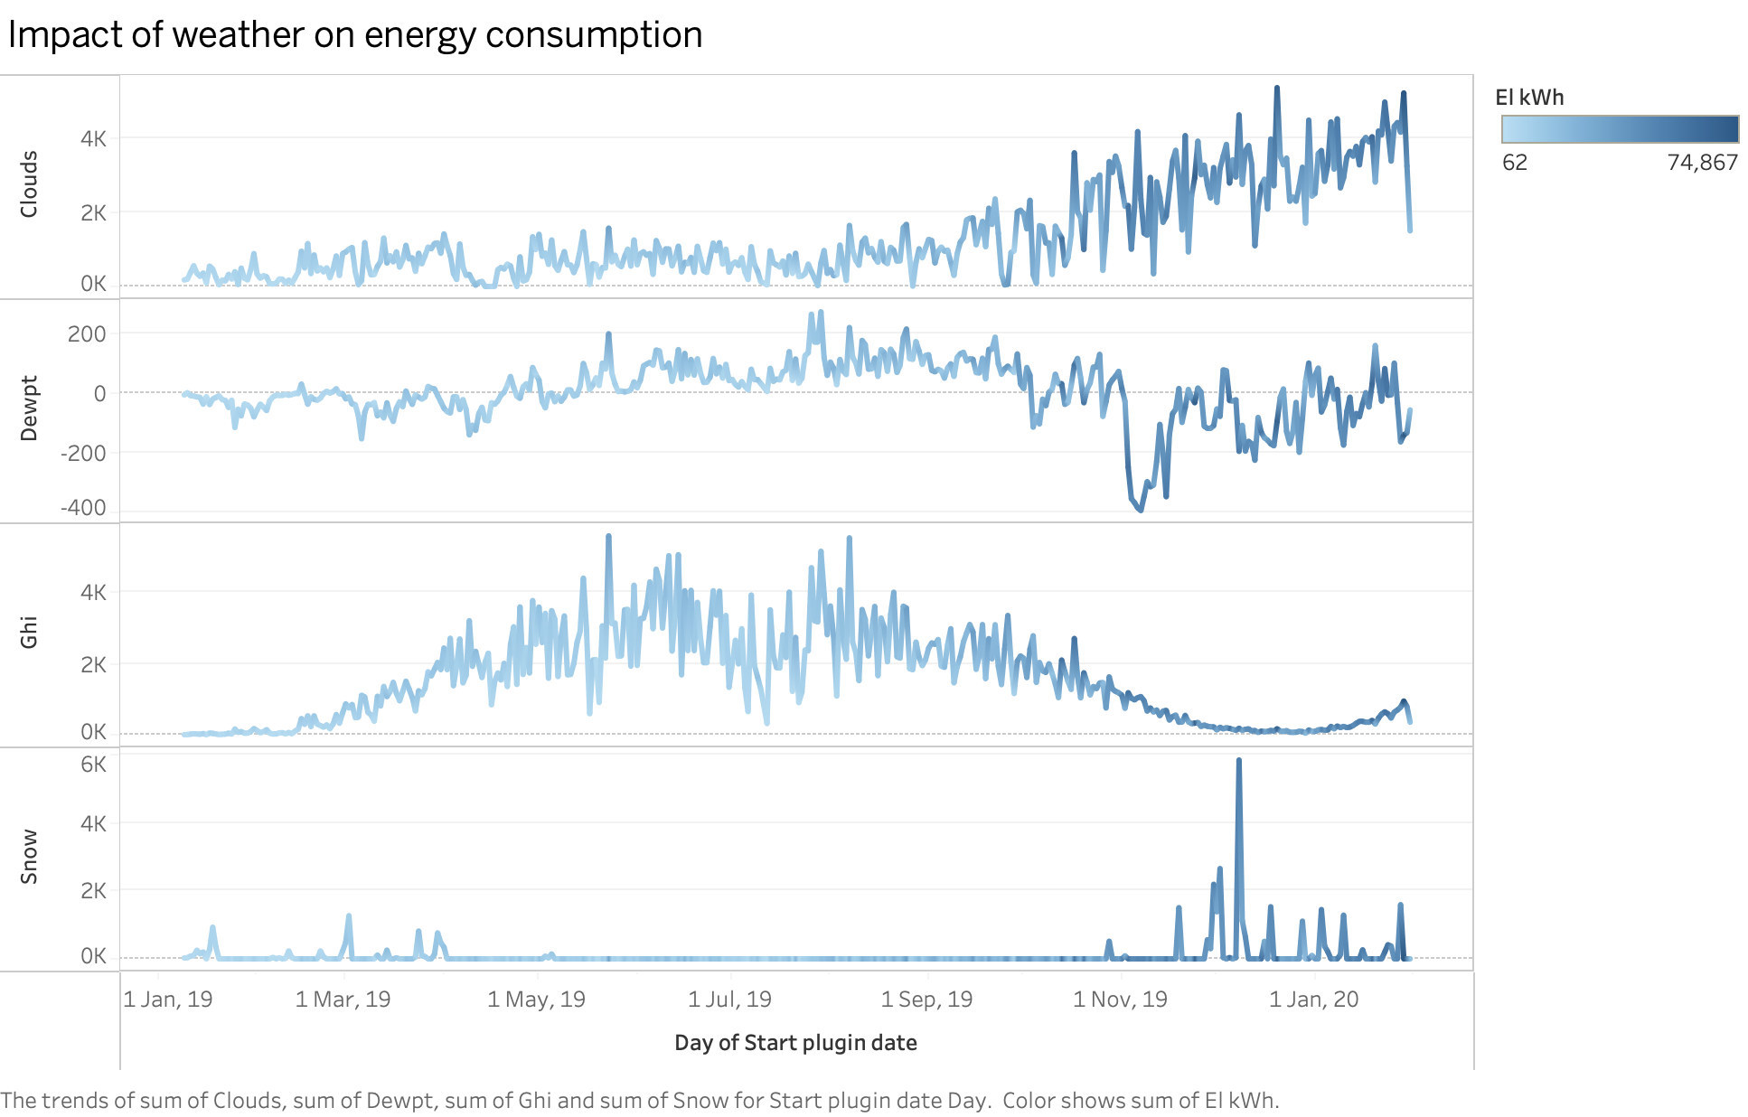

Slide 4
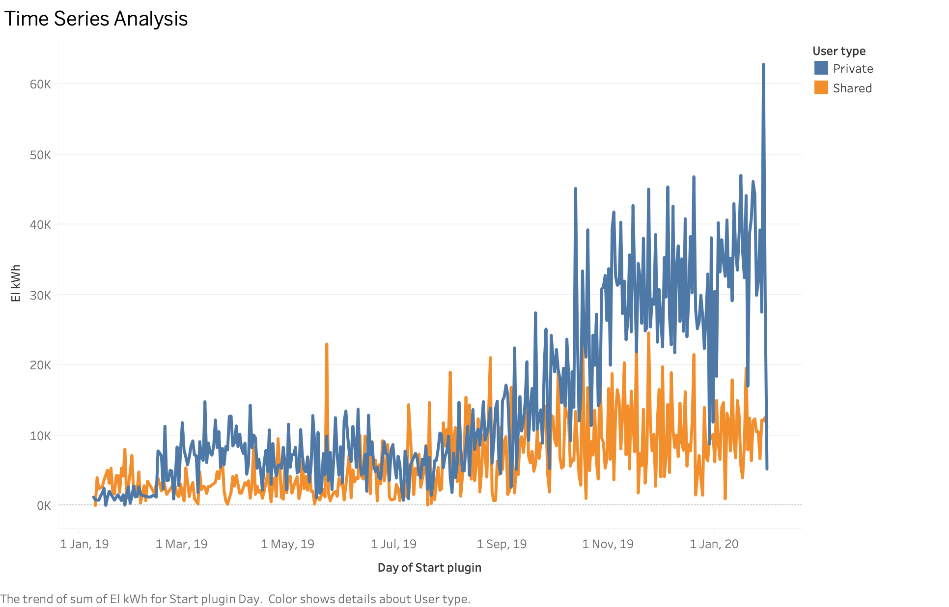

Slide 5
EDA
Dataset 1: EV charging reports
Dataset 2: Hourly EV charging loads and idle capacity, for all sessions and users individually
Dataset 3 and 4: Hourly EV charging loads and idle capacity, aggregated for private or shared CPs
Dataset 5: Hourly smart meter data from garage Bl2
Dataset 6: Local traffic density
Dataset 7: Weather Data
Final result:
Index: 6819 entries, 0 to 87572
Data columns (total 54 columns):
13 of columns are categorical

Slide 6
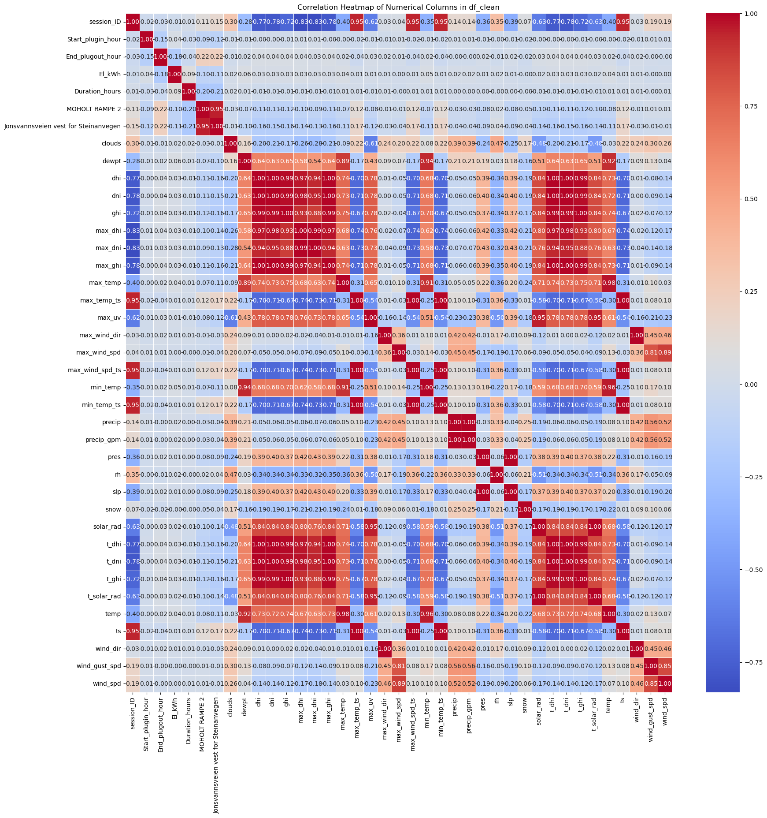

Slide 7
Thank you!

