Slide 1
📚
What's inside
Sathnur Village Library · Offline-first · EN / ಕನ್ನಡ
🔐
PIN Login
📊
Dashboard
Secure 4-digit access every session
Live stats — books, members, overdue
📚
Books
👥
Members
Add, search & manage all 13,000 titles
Register villagers & track active loans
Gyaana Grama
↗️
Issue & Return
📷
Barcode Scanner
Guided 3-step checkout / return flow
USB HID scanner for fast bulk ops
SLMS
⚙️
Settings
💾
Backup & Import
Library Management System
Loan rules, PIN security, language
Auto .db backup + Android migration
User Guide · v1.0.0 · 2025–26

Slide 2
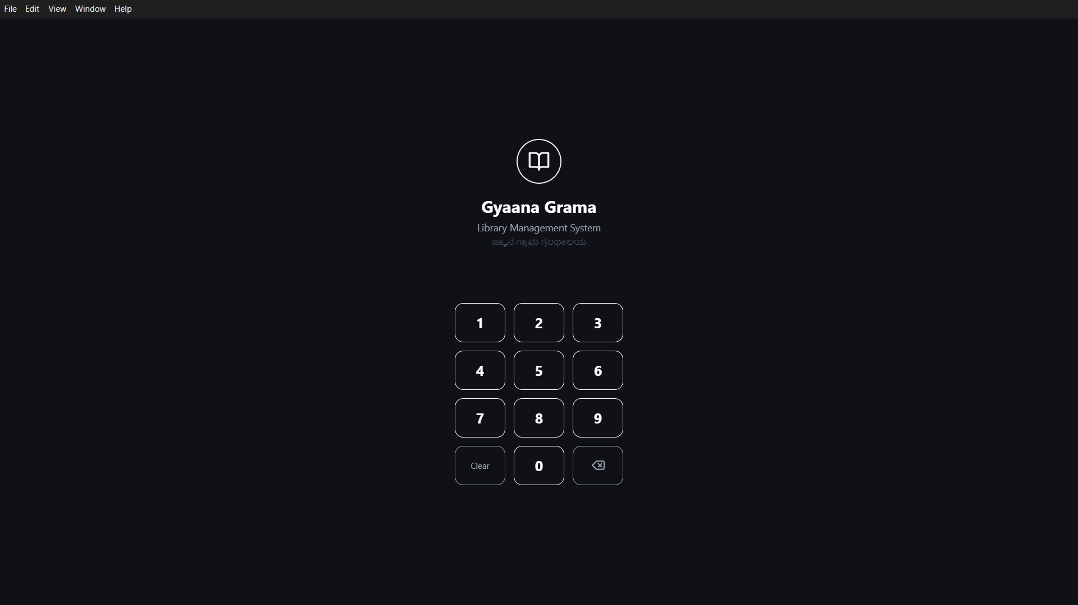
SLIDE 1 · LOGIN
Logging In with Your PIN
The app opens to this screen every time it starts. Enter your 4-digit PIN to unlock.
🔑
How to log in
App logo + name
Tap the numbered buttons to build your 4-digit PIN.
Dots appear at the top — one dot fills per digit entered.
Tap ⌫ to delete the last digit, or Clear to start fresh.
A wrong PIN shows an error message — tap Clear and retry.
On first launch the default PIN is 1234 — change it immediately.
1–9, 0 keys
🎹
Key Buttons
1 – 9, 0
Enter your PIN digits one at a time
Clear
Wipe ALL digits — restart entry from scratch
Number keypad
⌫
Delete only the last digit entered
🔒 Security tip: Change your PIN immediately via Settings → Security. Never share your PIN.
Clear
⌫ backspace

Slide 3
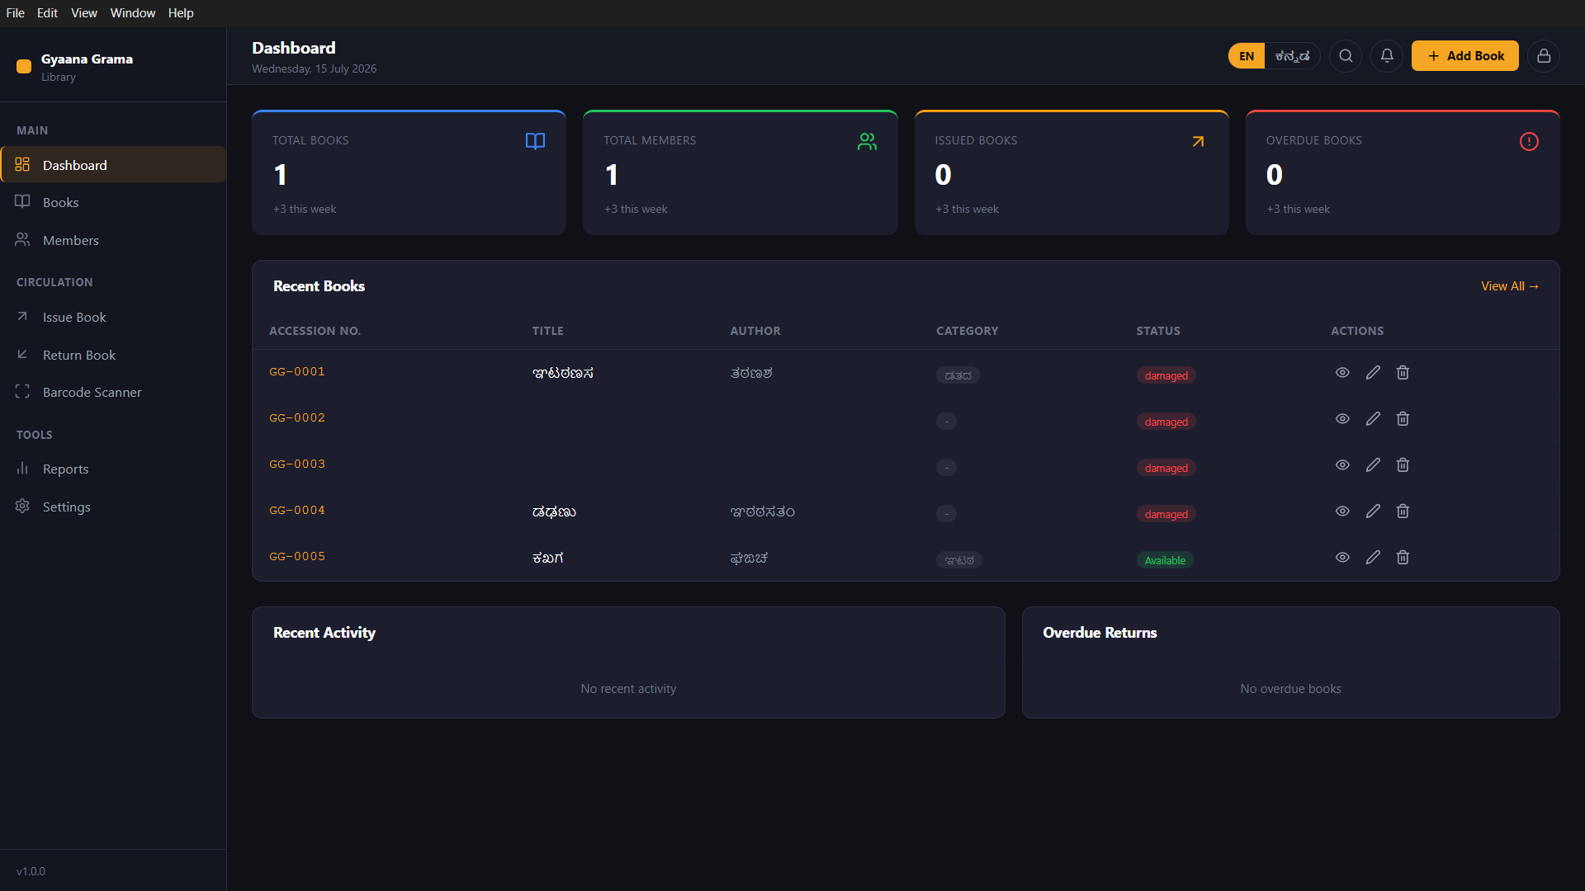
SLIDE 2 · DASHBOARD
Dashboard
Your command centre — check this every morning before the library opens.
Total
Books
📚
Every book added to the library, all formats and genres.
Total Books
Members
Issued
Overdue
Members
👥
All registered borrowers from the village.
Recent Books table
Issued
↗️
Books currently checked out — not on the shelf.
Overdue
⚠️
Books whose due date has passed — action needed.
Recent Activity
Overdue Returns

Slide 4
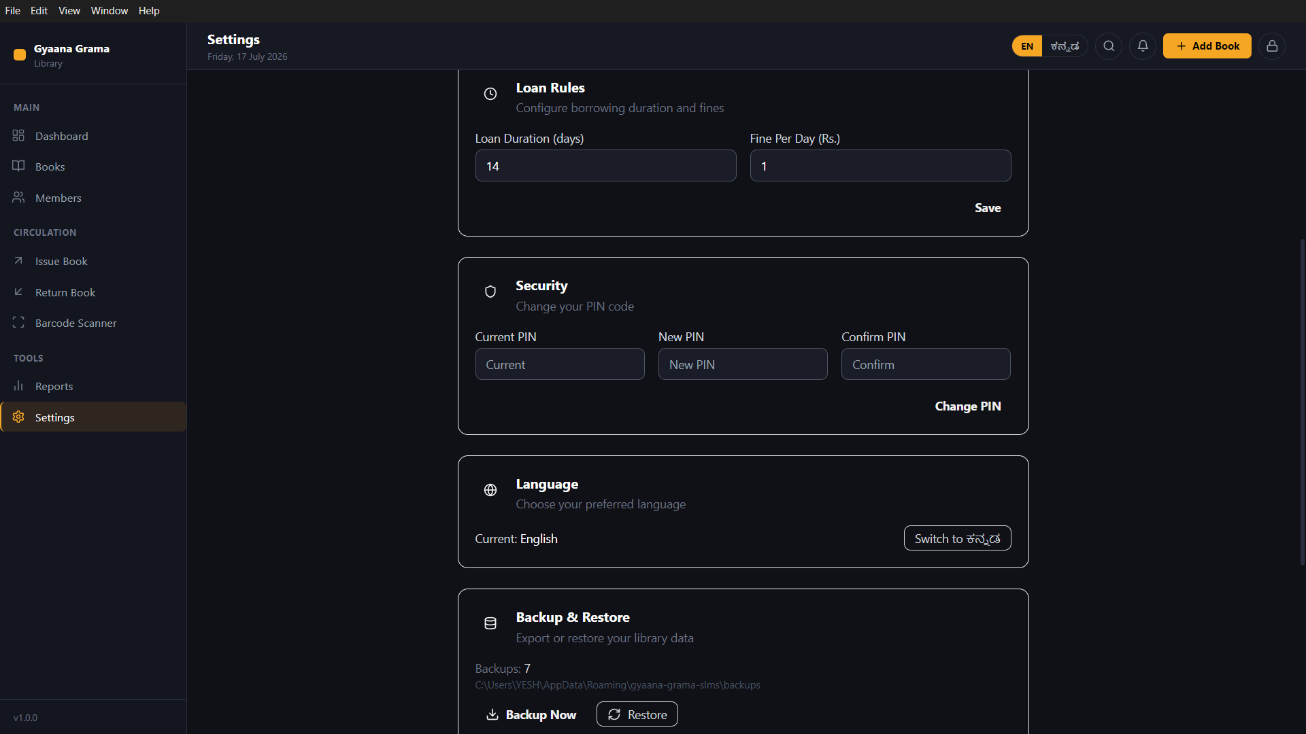
SLIDES 3 & 4 · SETTINGS
Settings — Rules, PIN & Language
Everything that controls how the library behaves — scroll down in Settings to reach all sections.
A
Loan Rules
⚖️
Loan Duration
Days a member may keep a book (default: 14)
Fine Per Day
₹ charged per overdue day (default: ₹1)
Save button
Tap Save — applies to ALL future issues immediately
A Loan Rules
B
Change PIN
🔐
Current PIN
Enter the PIN you use now
New PIN
Your chosen new 4-digit PIN
Confirm PIN
Repeat new PIN, then tap Change PIN
B Security / Change PIN
C
Language Toggle
🌐
Current: English
Tap "Switch to ಕನ್ನಡ" to switch
C Language Toggle
Instant switch
The entire app UI changes at once
Toggle back
Tap again to return to English any time
💡 Backup & Restore and Android Import are below Language — scroll down in Settings to reach them.

Slide 5
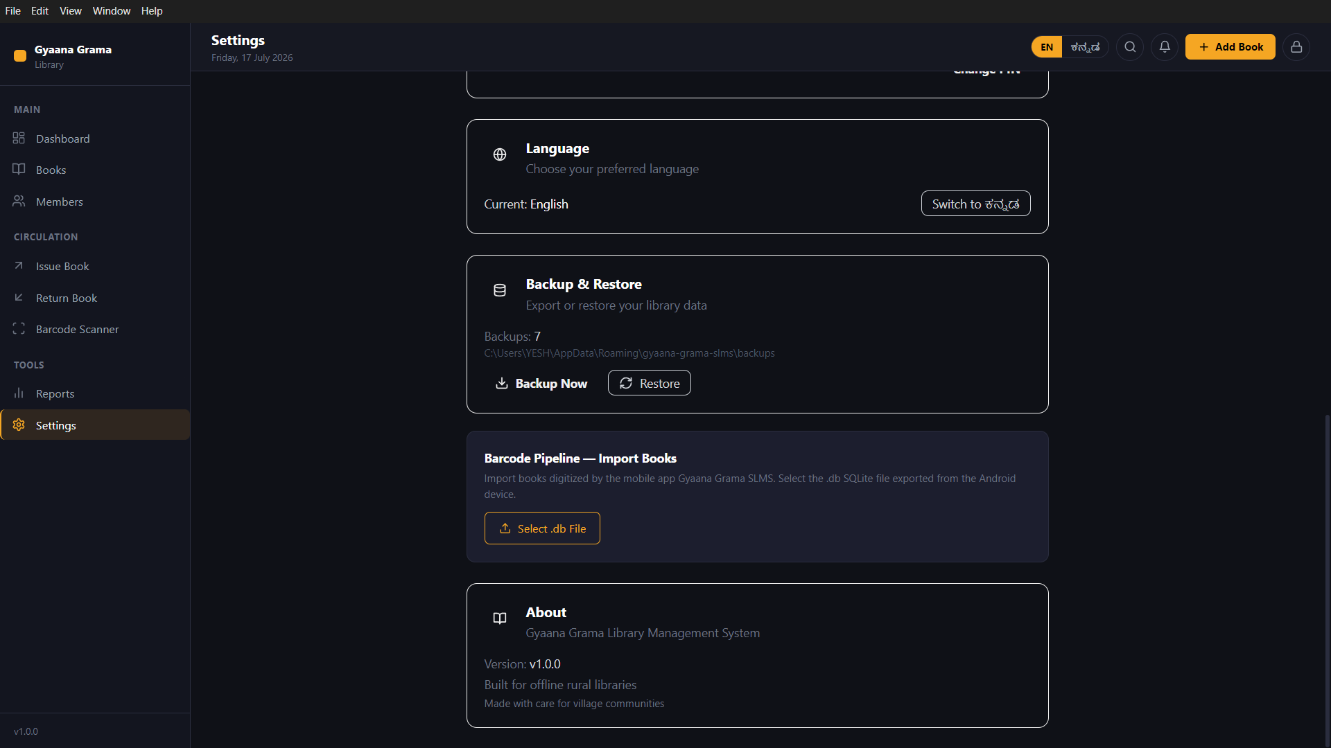
SLIDE 5 · BACKUP & IMPORT
Backup & Android Import
Protect your data weekly. Import Android books once during migration.
💾
Backup & Restore
Your safety net — run this every week.
Backup Now
Saves a timestamped .db file to AppData/backups
Backups: 7
Shows how many backups exist (7-day rolling window)
Restore
Roll back to any saved backup if data is corrupted
Backup & Restore section
📲
Android DB Import (one-time)
Migrate books from the old mobile app.
Export the .db SQLite file from the Android app to USB/Drive.
Tap "Select .db File" and choose the exported database.
Books import automatically — GG-XXXX IDs auto-assigned.
Duplicate titles (same title + author) are merged, not doubled.
Android Import section
⚡ Import is a one-time migration. After that, use Add Book form for all new books.

Slide 6
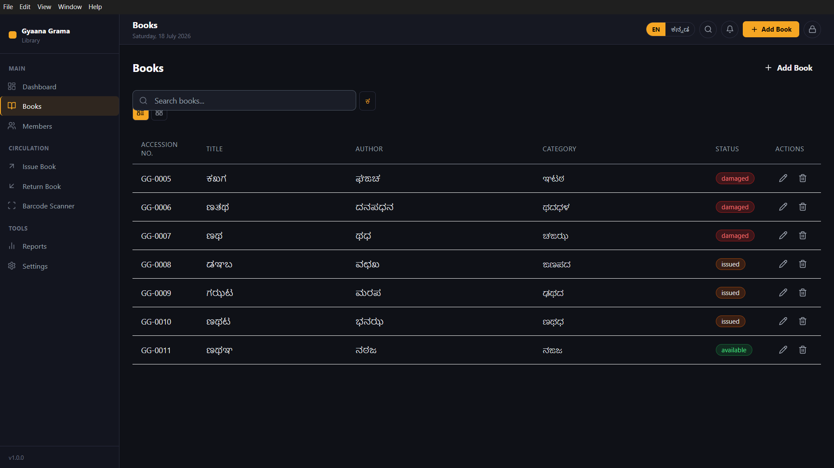
SLIDE 6 · BOOKS
Books List — All Titles
Browse, search, and manage every book in the Sathnur library collection.
Status Badges
available
On the shelf — can be issued now
Search bar
+ Add Book button
issued
Checked out to a member
damaged
Needs repair before re-circulation
damaged
Actions per Book Row
🔍 View
Full book details in a side panel
✏️ Edit
Update any field — title, author, genre…
issued
🗑️ Delete
Permanently remove (cannot undo)
Search Tips
available
Search by book title, author name, or GG-XXXX accession number.
Use the ಕ button next to the search bar to switch search to Kannada script.
Edit / Delete
GG-XXXX IDs

Slide 7
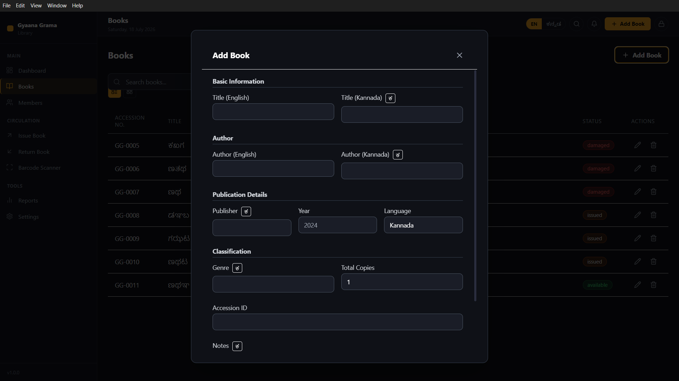
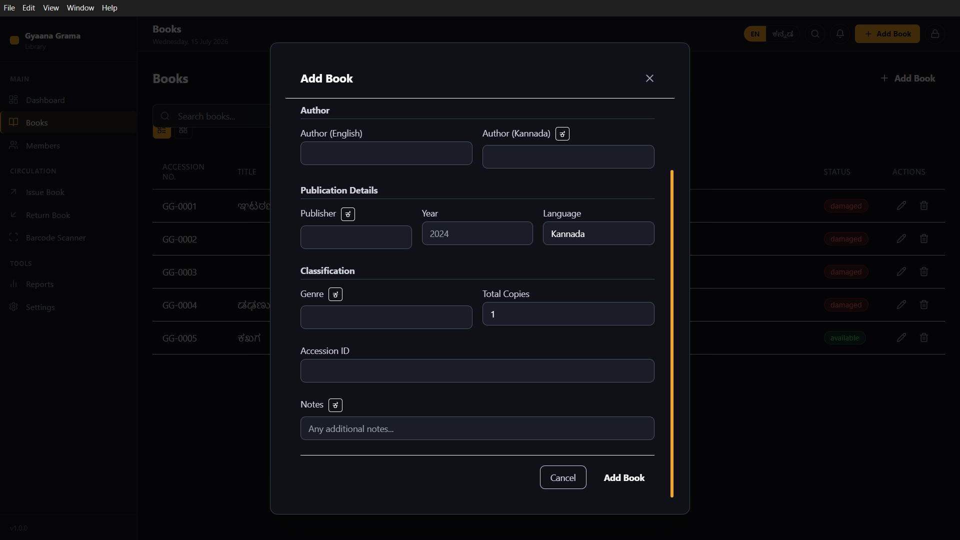
SLIDES 7 & 8 · ADD BOOK
Adding a New Book
Open via: Books (sidebar) → + Add Book (top right). Fill the form top-to-bottom.
All Fields
★
Title (EN)
Title (KN)
Title EN + KN
Author EN + KN
★
Author (EN)
Author (KN)
Author EN + KN
Publisher
Publication Details
Year
Language
Genre
Publication Details
Genre + Copies
Total Copies
Accession ID
Accession ID (auto GG-XXXX)
Notes
Genre + Copies
Accession ID
Top of form
Bottom of form
★ = Required
Notes + Add Book button

Slide 8
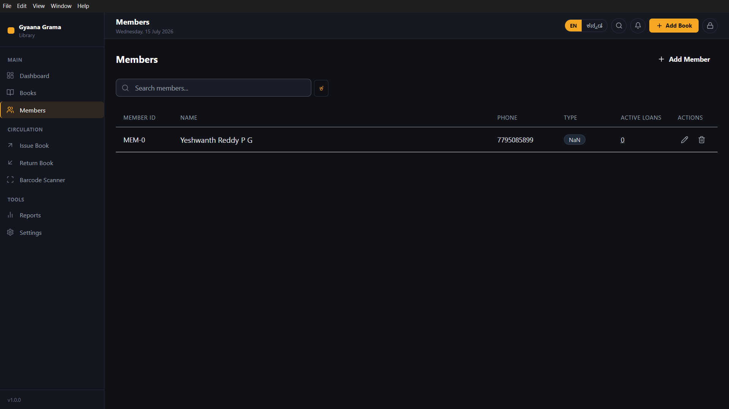
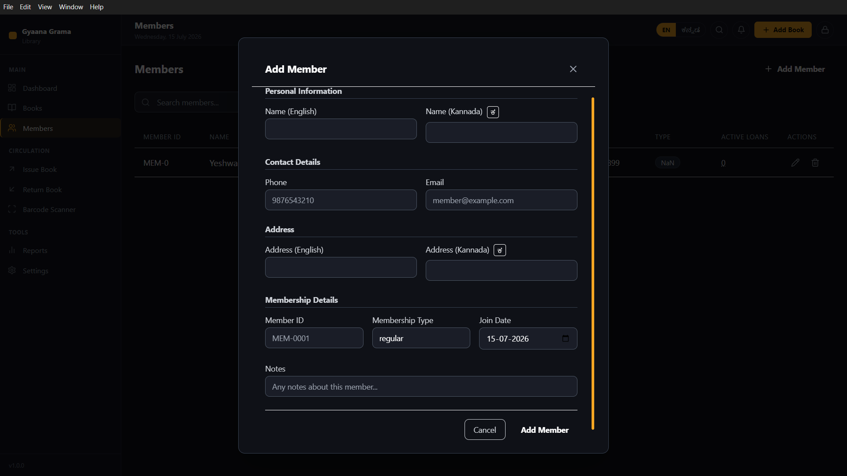
SLIDES 9 & 10 · MEMBERS
Members — List & Add New
Every borrower must be a registered member before a book can be issued to them.
Search bar
+ Add
MEM-ID
Name + Phone
Personal Info — Name EN + KN
Contact — Phone + Email
tap
+ Add Member
Address EN + KN
Member ID (auto) + Type + Date
💡 Member ID (MEM-XXXX) is auto-assigned on save. Membership Type defaults to "regular". Email and Address are optional.

Slide 9
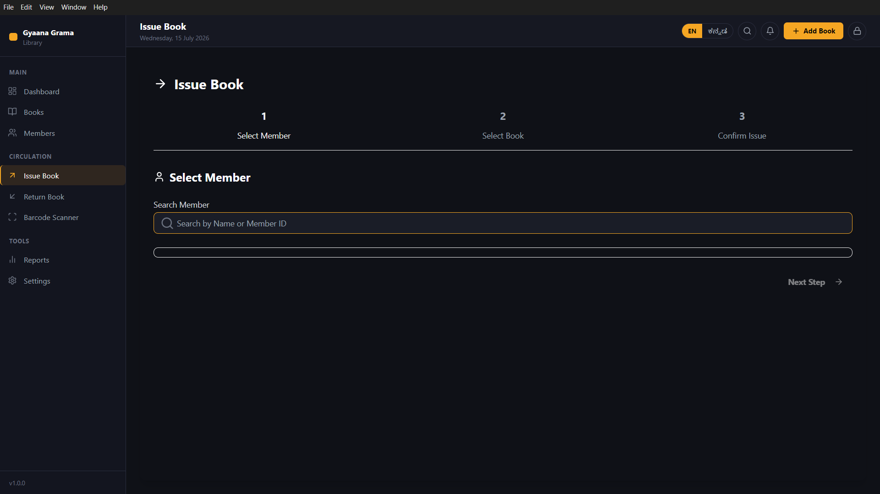
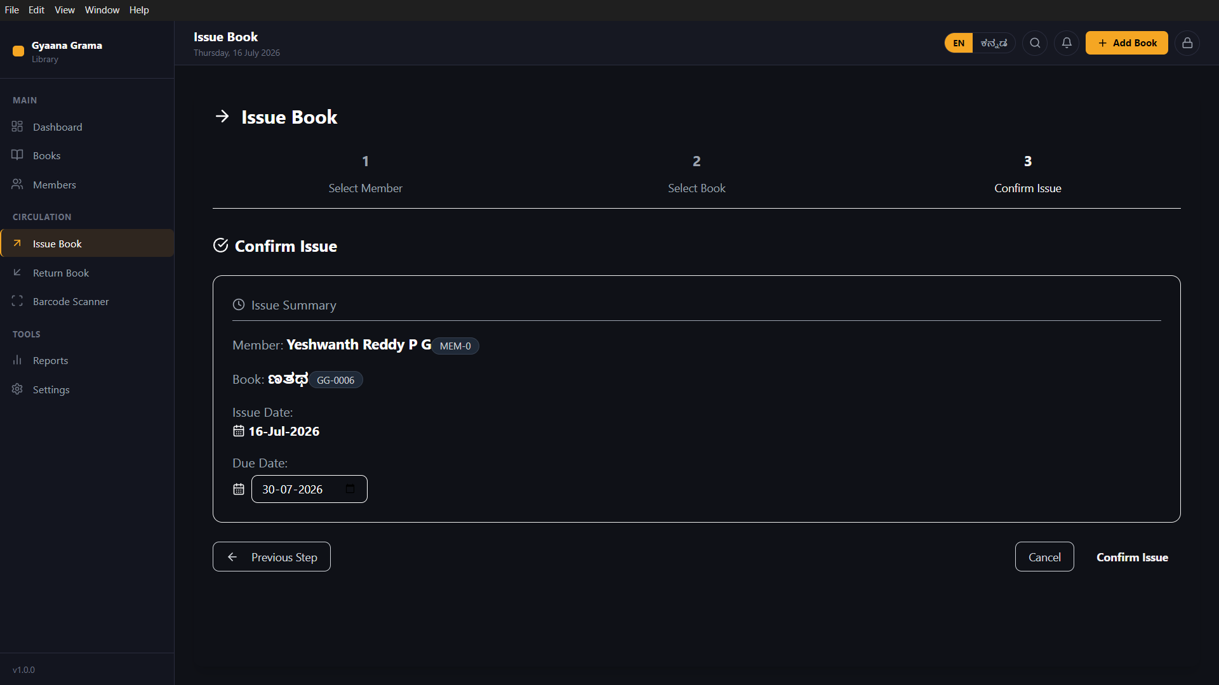
SLIDES 11 & 12 · ISSUE BOOK
Issue a Book — 3-Step Flow
1
Select Member
2
Select Book
3
Confirm Issue
S
T
E
P
2
S
e
l
e
c
t
B
o
o
k
Step indicator (Step 3 active)
Search by Name or MEM-ID
Member name + MEM-ID chip
Result row — click to select member
Book title + GG-XXXX chip
Due Date (editable before confirm)
Issue Summary card
STEP 1
Confirm Issue
STEP 3
💡 Due Date = Today + Loan Duration (from Settings). You can edit the due date in Step 3 if needed for special cases.

Slide 10
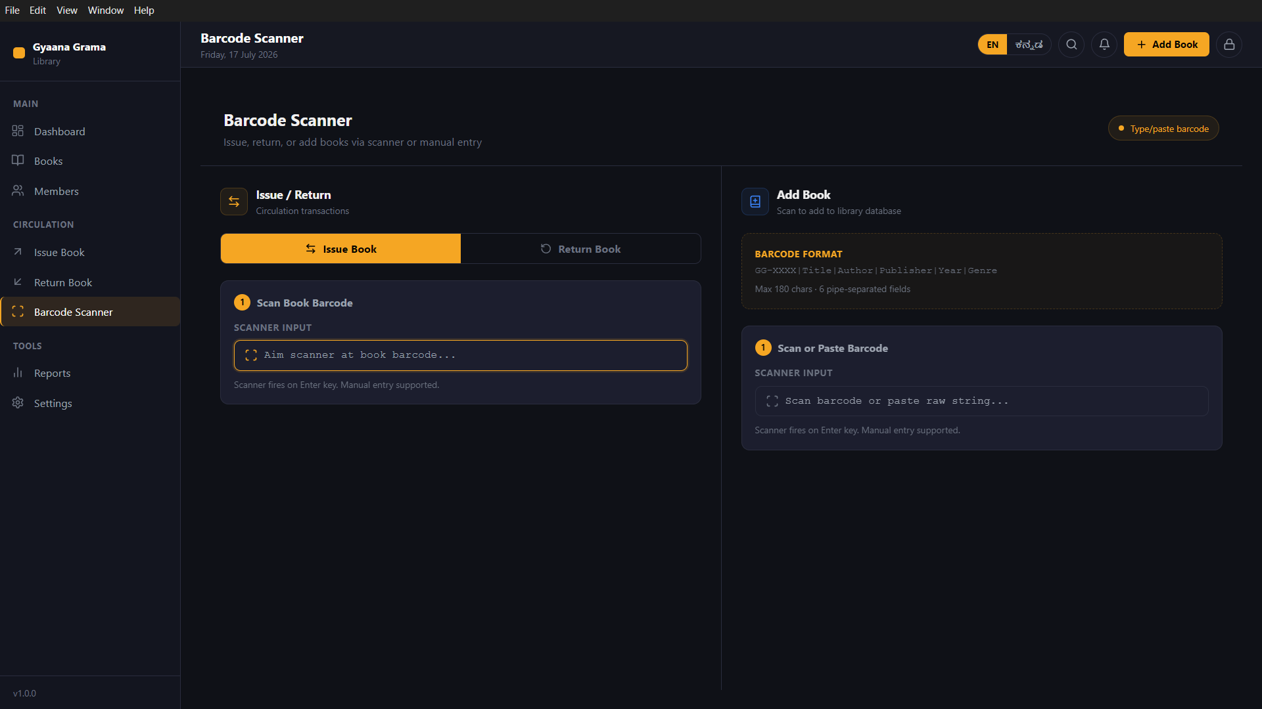
SLIDE 13 · BARCODE SCANNER
Barcode Scanner
Fastest way to issue, return, or add books. Two modes, one screen.
↗️
Issue / Return Mode
Type/paste button
Select Issue Book or Return Book tab.
Issue Book tab (active)
Return Book tab
Aim your USB/wireless scanner at the book's ISBN barcode.
Scanner triggers on Enter key — member search panel opens.
Barcode format spec
Scanner input field
Complete the standard 3-step issue or return flow.
📷
Add Book Mode — Format
Add Book panel
Pipe-delimited string (max 180 chars):
Issue / Return panel
GG-XXXX|Title|Author|Publisher|Year|Genre
6 pipe-separated fields · press Enter to import the book.
No scanner? Use "Type/paste barcode" button (top right).
⚡ Sidebar → CIRCULATION → Barcode Scanner

Slide 11
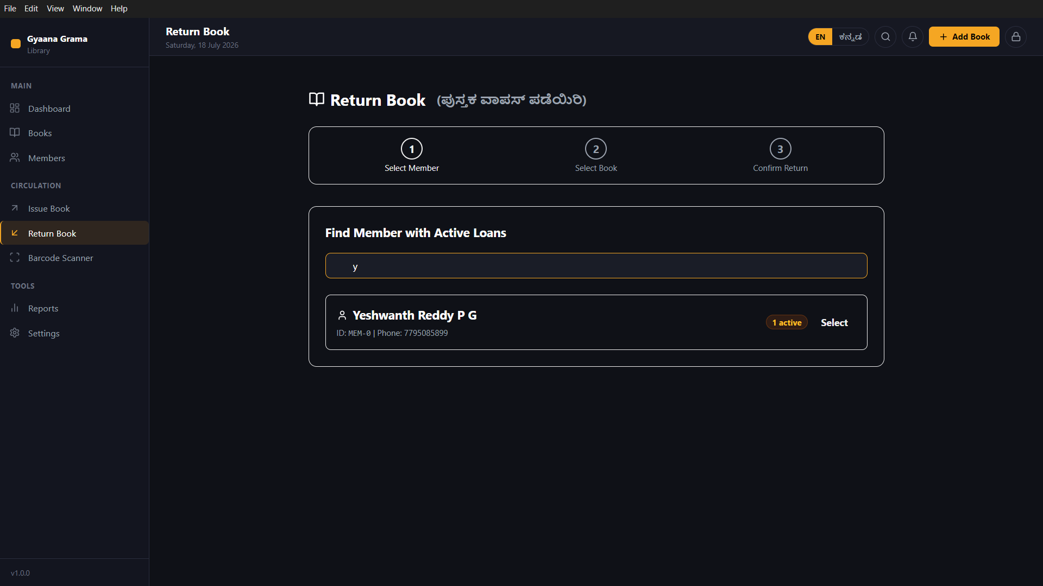
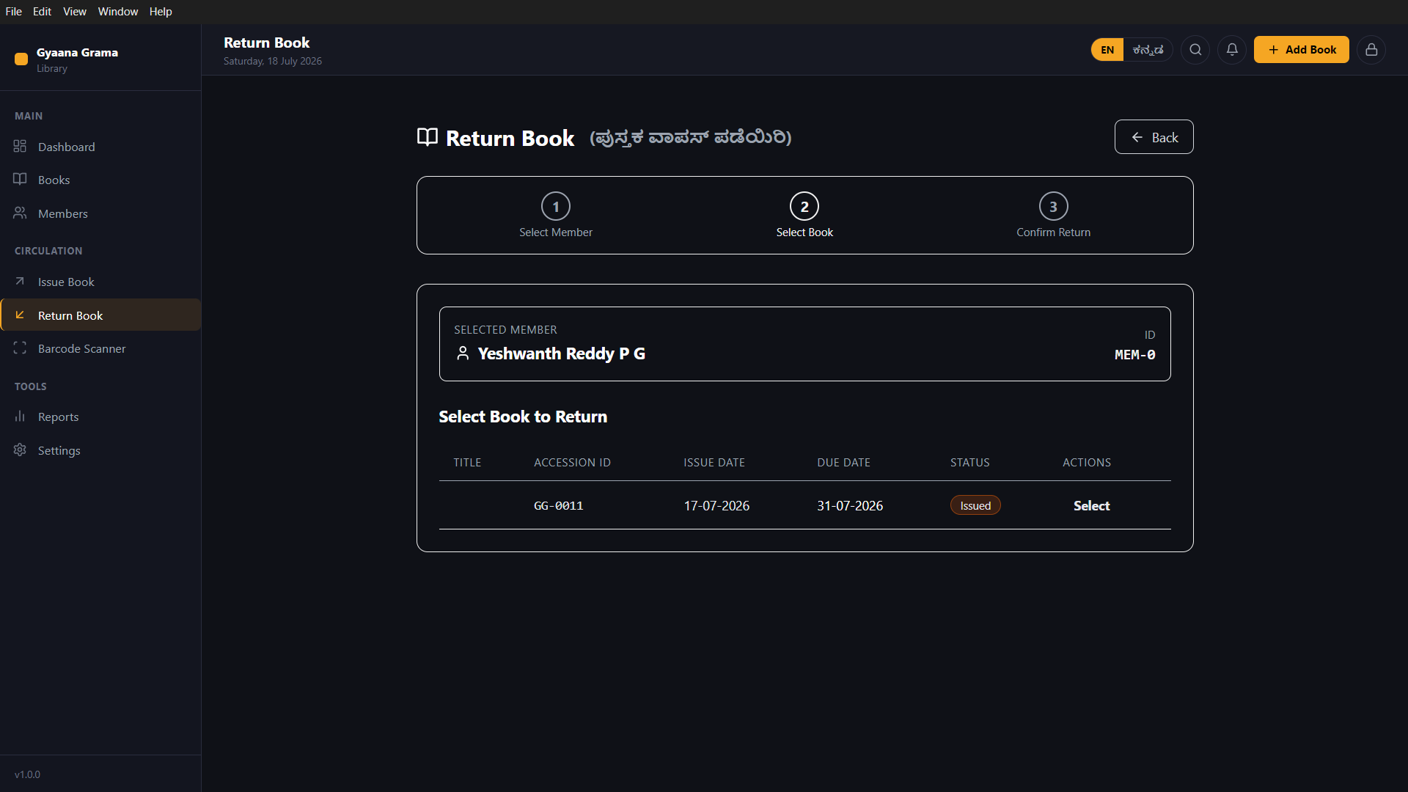
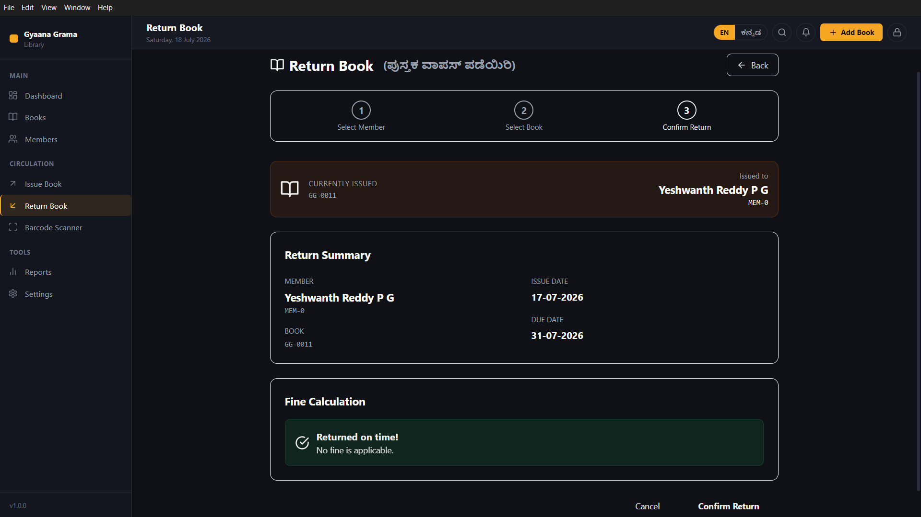
SLIDES 14–16 · RETURN BOOK
Return a Book — 3-Step Flow
1
Find Member
2
Select Book
3
Confirm & Fine
Find Member with Active Loans
Step 3 active
Step bar — Step 2 active
Search input
Currently Issued banner
Selected member banner
Select
Member result + "1 active" badge
GG-0011 · Issued · Select
Return Summary
Fine Calculation
STEP 1
STEP 2
STEP 3
💡 Fine = 0 if returned on or before due date. Fine = Days Overdue × ₹/day. This rate is set in Settings → Loan Rules.
Confirm Return

Slide 12
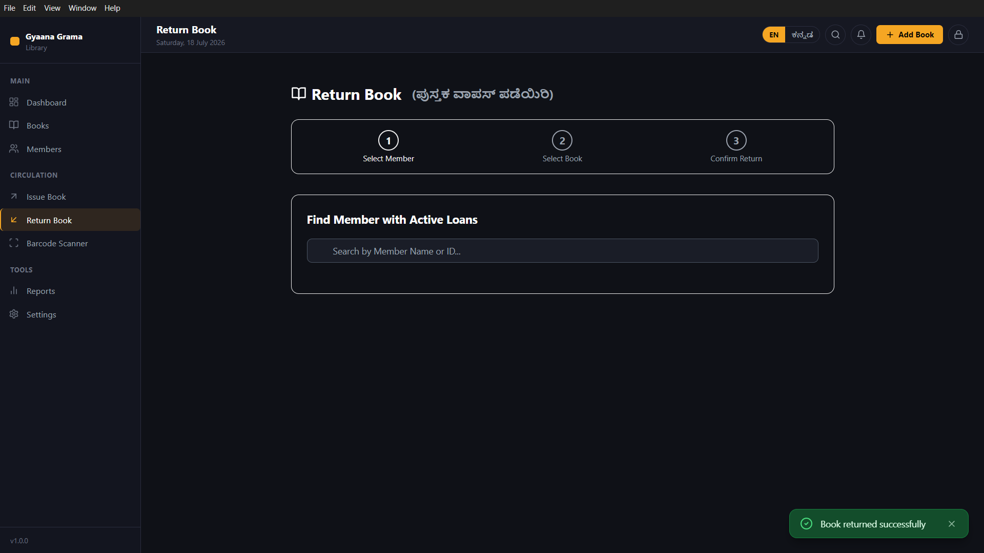
SLIDE 17 · SUCCESS
Return Success — Toast Notification
A green toast confirms the return is saved. The book is immediately available again.
✓
Book returned successfully
Toast dismisses automatically in ~3 seconds
✅
What happens after return
Book status flips to "Available" instantly.
Member's Active Loans count drops by 1.
Transaction recorded in Recent Activity.
Dashboard "Issued" count decreases by 1.
Overdue entry cleared (if applicable).
⚠️ If NO toast appears — the return did NOT save. Check the book's status in the Books list before the member leaves the library.
"Book returned successfully"

Slide 13
QUICK REFERENCE
Complete System Workflow
Every action the librarian performs — mapped in one view.
🔐 PIN LOGIN
📊 DASHBOARD
📚 Books List
↗️ Issue Book (1→2→3)
👥 Members List
➕ Add Book Form
✅ Issued · Due Date Set
➕ Add Member
✅ Saved · GG-XXXX
↩️ Return Book (1→2→3)
✅ MEM-XXXX Assigned
✅ Returned · Fine Calc.
⚡ BARCODE SCANNER — faster Issue / Return / Add Book without typing
⚙️ SETTINGS (sidebar → TOOLS): Loan Duration · Fine Per Day · Change PIN · Language · Backup · Android Import

