Slide 1


Department of CSE(AI&ML) Academic year: 2026-27
EAST WEST INSTITUTE OF TECHNOLOGY DEPARTMENT OF CSE(AI&ML)
Project Phase I (BCI685) – Presentation 1
Project Title: G-CARE
PROJECT TEAM:
Yeshrutha S - 1EW23CI063
Abhay Vadagi - 1EW23CI002
Saicharan G - 1EW23CI043
Venkat Sai Kowshik - 1EW23CI041
GUIDE:
Asst. Prof. Sreehari M
Assistant Professor
Department of CSE(AI&ML)
EWIT, Bengaluru

Slide 2
CONTENTS
Introduction
Literature review
Problem Statement
System Architecture
Conclusion

Slide 3
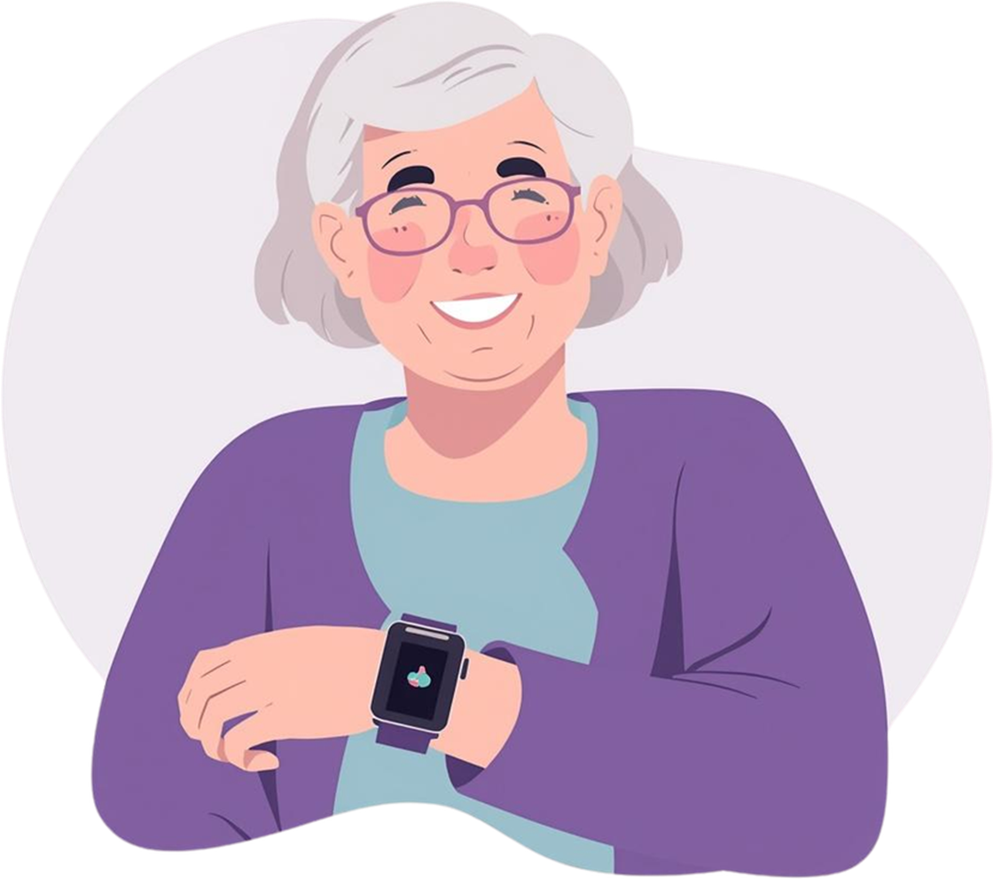

INTRODUCTION
G-Care is an AI-powered elderly care system designed to improve safety and independence
It provides real-time health monitoring and smart reminders
Helps elderly individuals manage daily activities easily
Uses wearable technology + voice interaction
Connects users with guardians for continuous support

Slide 4
LITERATURE REVIEW
PAPER AND AUTHOR DETAILS | DESCRIPTION | ADVANTAGES | RESEARCH GAPS
“Wearable IoT Enabled Real-Time Health Monitoring System” J. Wan et al., 2018 (EURASIP Journal) | Proposes WISE system using wearable sensors and cloud for real-time health monitoring | Real-time monitoring, Cloud integration, Multiple sensors | Requires continuous connectivity, Device dependency
“An IoT System for Remote Health Monitoring in Elderly Adults” L.A. Durán-Vega et al., 2019 | System for monitoring elderly health remotely and improving caregiver communication | Remote monitoring, Better patient supervision, Real-time alerts | Limited prediction capability, Infrastructure dependency
“IoT Wearable Sensors and Devices in Elderly Care” T.G. Stavropoulos et al., 2020 | Review of IoT wearable systems for elderly care and ambient assisted living | Reliable monitoring, Supports independent living, Scalable | Privacy concerns, High data handling complexity
“IoT-Based Elderly Health Monitoring System Using Firebase Cloud” A. Efendi et al., 2025 | IoT system with real-time monitoring, cloud storage, and ML-based prediction | High accuracy, Real-time alerts, Improves quality of life | Requires internet, System complexity

Slide 5

Problem Statement
Elderly individuals often forget medications and lack continuous monitoring, which increases health risks. Existing systems are complex and expensive, making them difficult to use. Hence, a simple and user-friendly solution is needed to ensure safety and support.

Slide 6
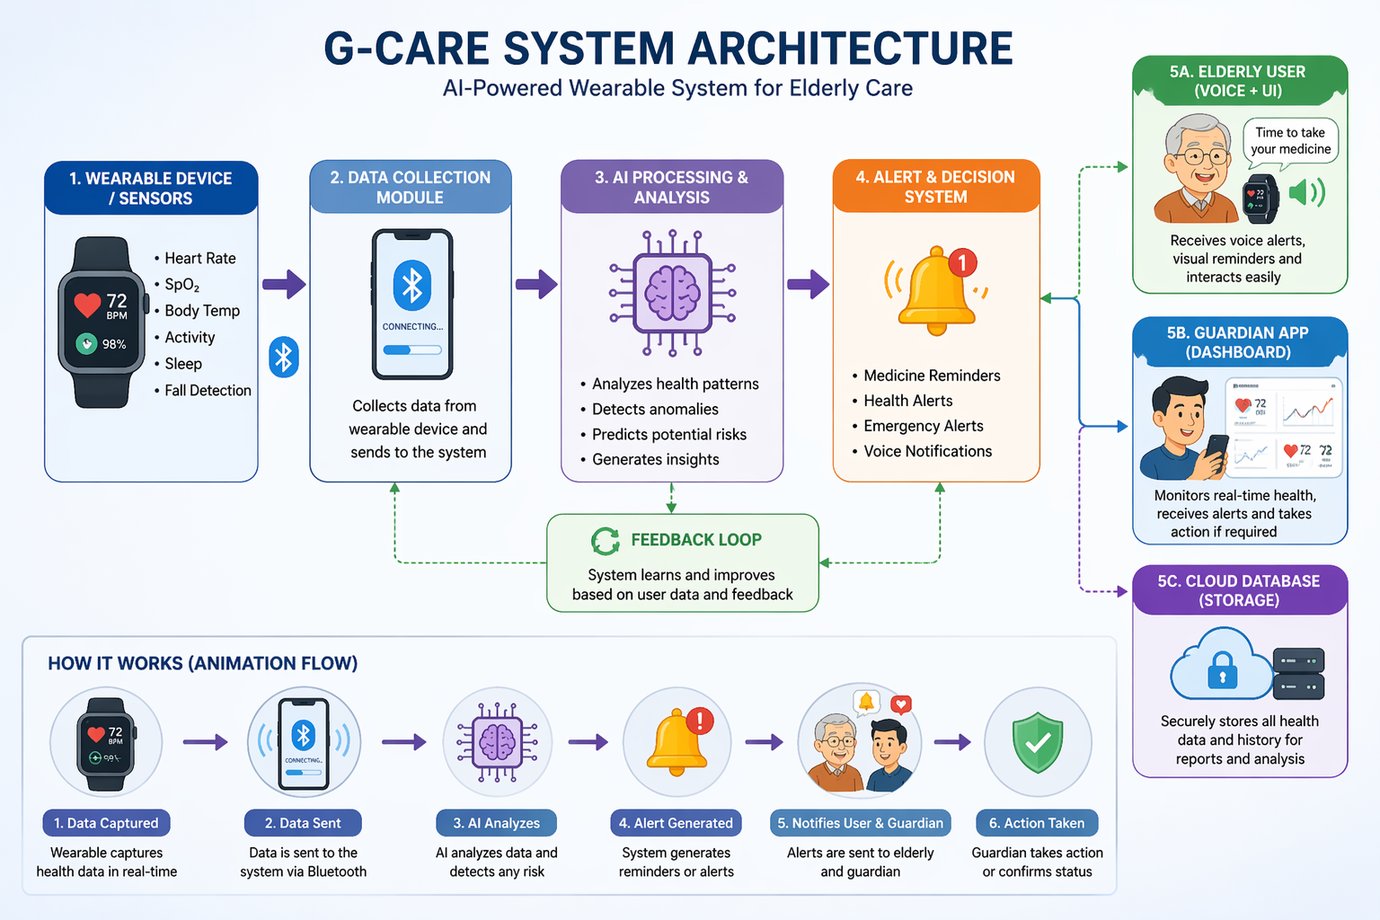
SYSTEM ARCHITECTURE

Slide 7
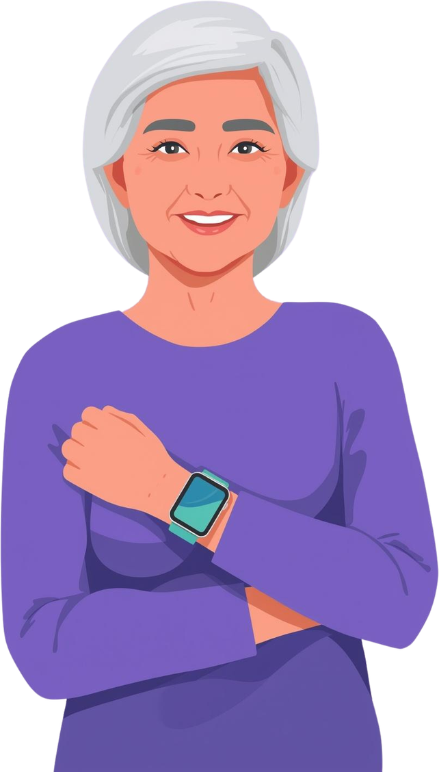
Conclusion
G-Care is a simple yet powerful system designed to support elderly people in their daily lives. It ensures they take the right medicine at the right time through guided reminders, visual cues, and easy interaction.
By combining wearable technology, voice assistance, and a guardian dashboard, the system improves safety, reduces dependency, and provides real-time monitoring.
G-Care helps elderly individuals live more independently while keeping their families connected and reassured. Because safety is not about surviving, its about living without fear.
G-care - Future of Health Care

