Slide 1


Department of CSE(AI&ML)
Academic year: 2026-27
EAST WEST INSTITUTE OF TECHNOLOGY
DEPARTMENT OF CSE(AI&ML)
Project Phase II (BCI685) – Presentation 2
Project Title: G-CARE
PROJECT TEAM:
Yeshrutha S - 1EW23CI063
Abhay Vadagi - 1EW23CI002
Saicharan G - 1EW23CI043
Venkat Sai Kowshik - 1EW23CI041
GUIDE:
Sreehari M
Assistant Professor
Department of CSE(AI&ML)
EWIT, Bengaluru

Slide 2
CONTENTS
Introduction
Background of the problem
Motivation
Problem Statement
Objectives
Phase I Summary
Phase II Summary
Implementation Progress
Results
Conclusions
References

Slide 3
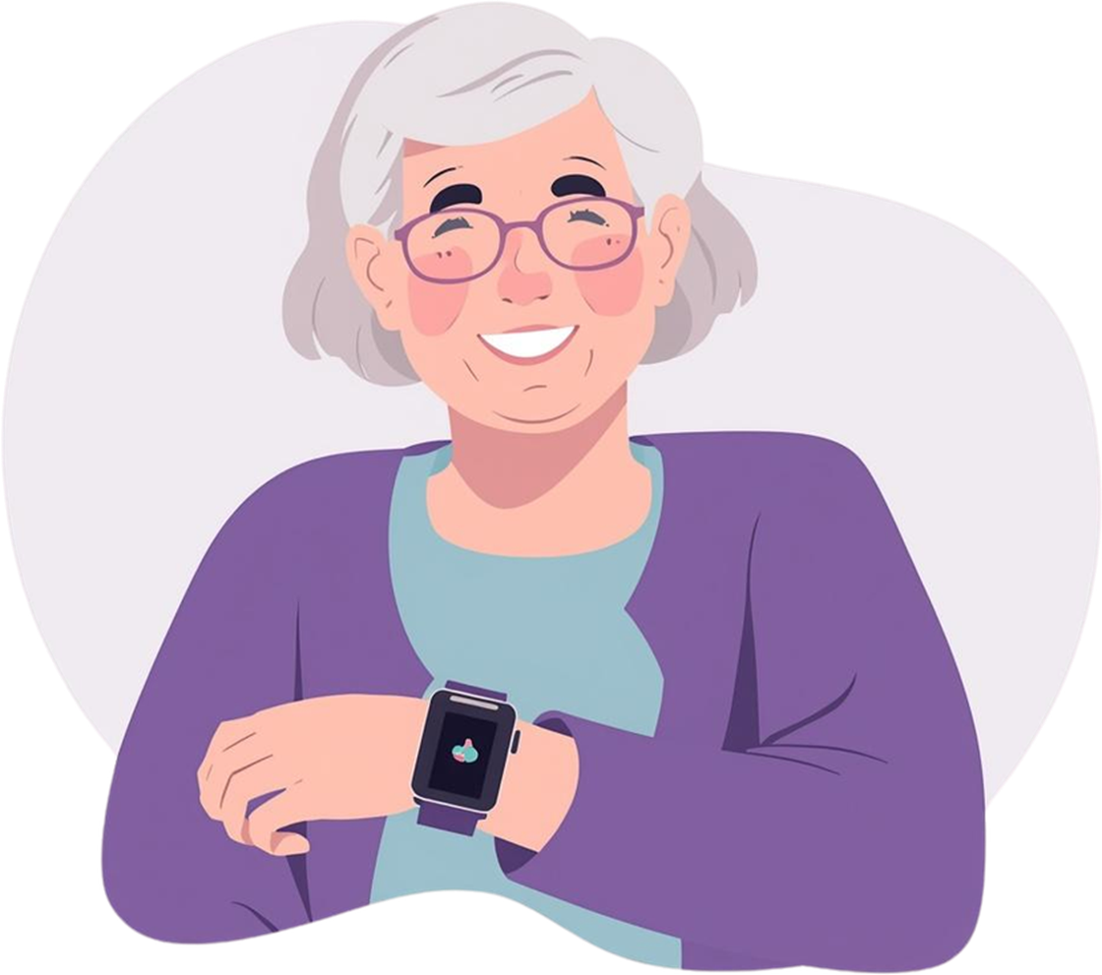

INTRODUCTION
Guardian Care is a smart elderly-care and health-monitoring system designed to improve the safety, independence, and well-being of senior citizens.
Monitors vital health parameters and daily activity
Sends instant alerts during emergencies
Helps guardians and doctors track elderly users remotely
Provides medication reminders and multilingual accessibility

Slide 4
BACKGROUND OF THE PROBLEM
Many elderly people live alone or require continuous supervision due to age-related health risks.
Delayed help during falls, abnormal vitals, or emergencies can be dangerous
Family members cannot monitor health conditions continuously
Medication schedules are often missed
Existing systems may be costly, difficult to use, or lack personalized alerts

Slide 5
MOTIVATION
The project is motivated by the need to make elderly care more proactive, accessible, and technology-driven.
Ensure timely assistance during emergencies
Reduce caregiver workload through remote monitoring
Improve medication adherence and daily routine management
Give families peace of mind through real-time alerts and updates

Slide 6

Problem Statement
To develop an integrated elderly-care system that monitors health and safety information, detects emergency situations, sends alerts to guardians, and provides an easy-to-use interface for elderly users, caregivers, and doctors.

Slide 7
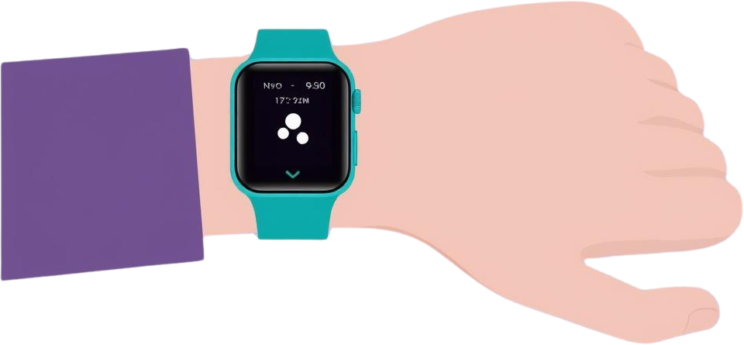
OBJECTIVES
Monitor vital signs such as heart rate, temperature, SpO₂, and blood pressure
Detect falls and emergency situations
Send SOS notifications to guardians or caregivers
Provide medicine and appointment reminders
Maintain health logs for doctors and family members
Support simple, multilingual, senior-friendly interaction

Slide 8
PHASE I SUMMARY
During Phase I, the project focused on planning, requirement analysis, and prototype design.
Identified problems faced by elderly people and caregivers
Conducted system requirement analysis
Designed the overall architecture and user flow
Created initial dashboard and interface prototypes
Planned modules for vital monitoring, emergency alerts, reminders, and guardian access

Slide 9
PHASE II SUMMARY
During Phase II, the planned features were developed and integrated into the working prototype.
ESP32-S3-WROOM-1: Main controller with Wi-Fi and Bluetooth connectivity
MAX30102: Measures heart rate and SpO₂ level
MAX30205: Monitors body temperature
MPU6050: Supports fall detection and activity monitoring
OLED Display: Shows vital signs, battery status, GPS status, and alerts
NEO-6M GPS: Tracks location and sends alerts during emergencies
SOS Button, Buzzer & Vibration Motor: Enables immediate manual emergency activation and user notifications
RTC, Li-Po Battery, Charger & Regulator: Ensures accurate event logging and reliable portable power
PCB & Enclosure: Makes the system compact, durable, and wearable
Estimated hardware cost: around ₹6,000

Slide 10
IMPLEMENTATION PROGRESS
MODULES COMPLETED
CURRENT STATUS
User authentication and role-based access
Elderly dashboard
Guardian dashboard
Vital signs monitoring
SOS emergency alert system
Medicine reminders
Health and activity logs
Doctor portal
Multilingual interface support
The web-based Guardian Care prototype is functional and demonstrates the main workflow between elderly users, guardians, and doctors. The system currently uses demo/simulated data for health monitoring and alerts. Future work can connect it to wearable sensors and cloud-based real-time databases.

Slide 11
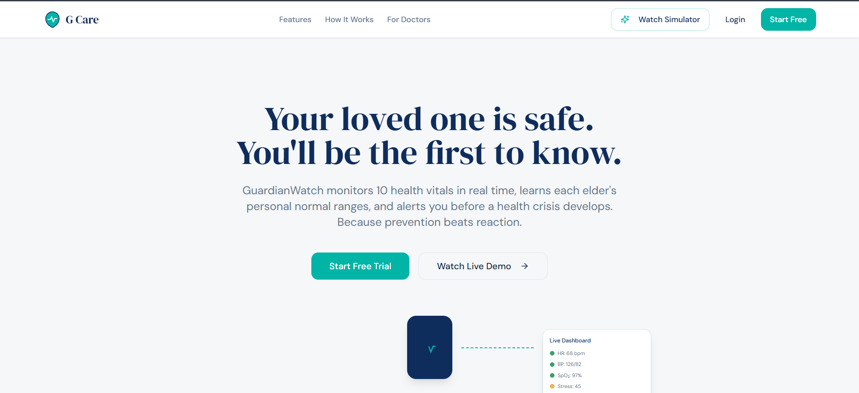
PROTOTYPE

Slide 12
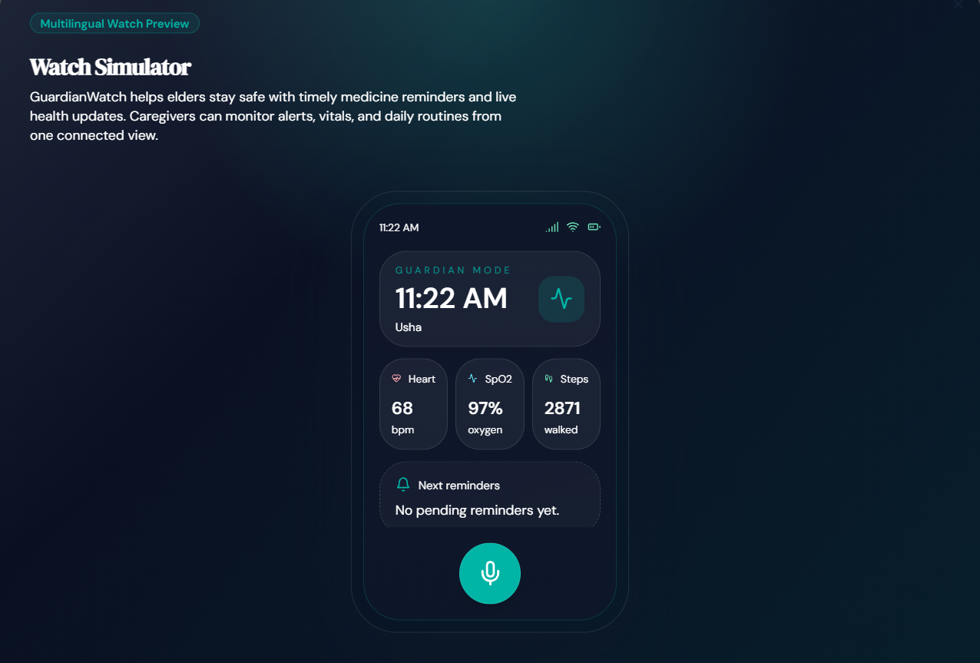

Slide 13
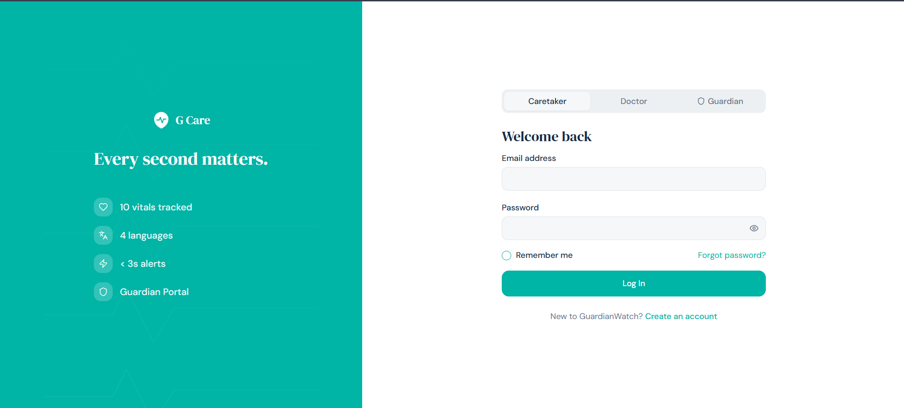

Slide 14
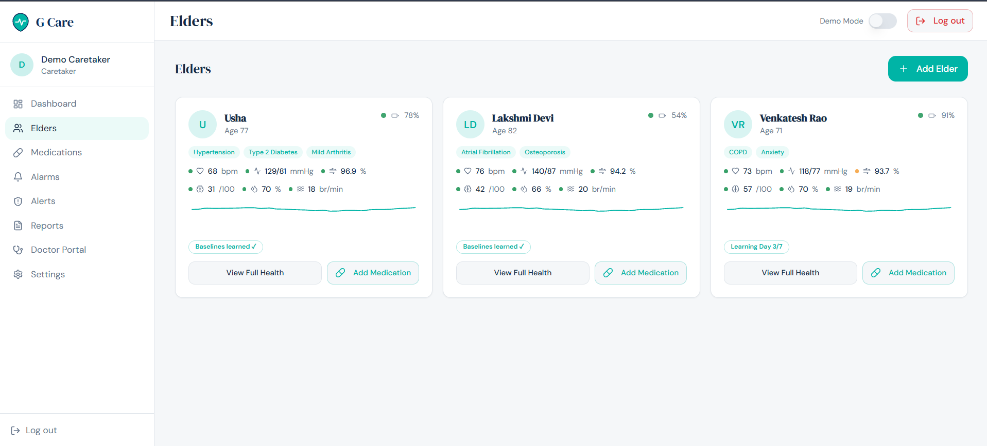

Slide 15
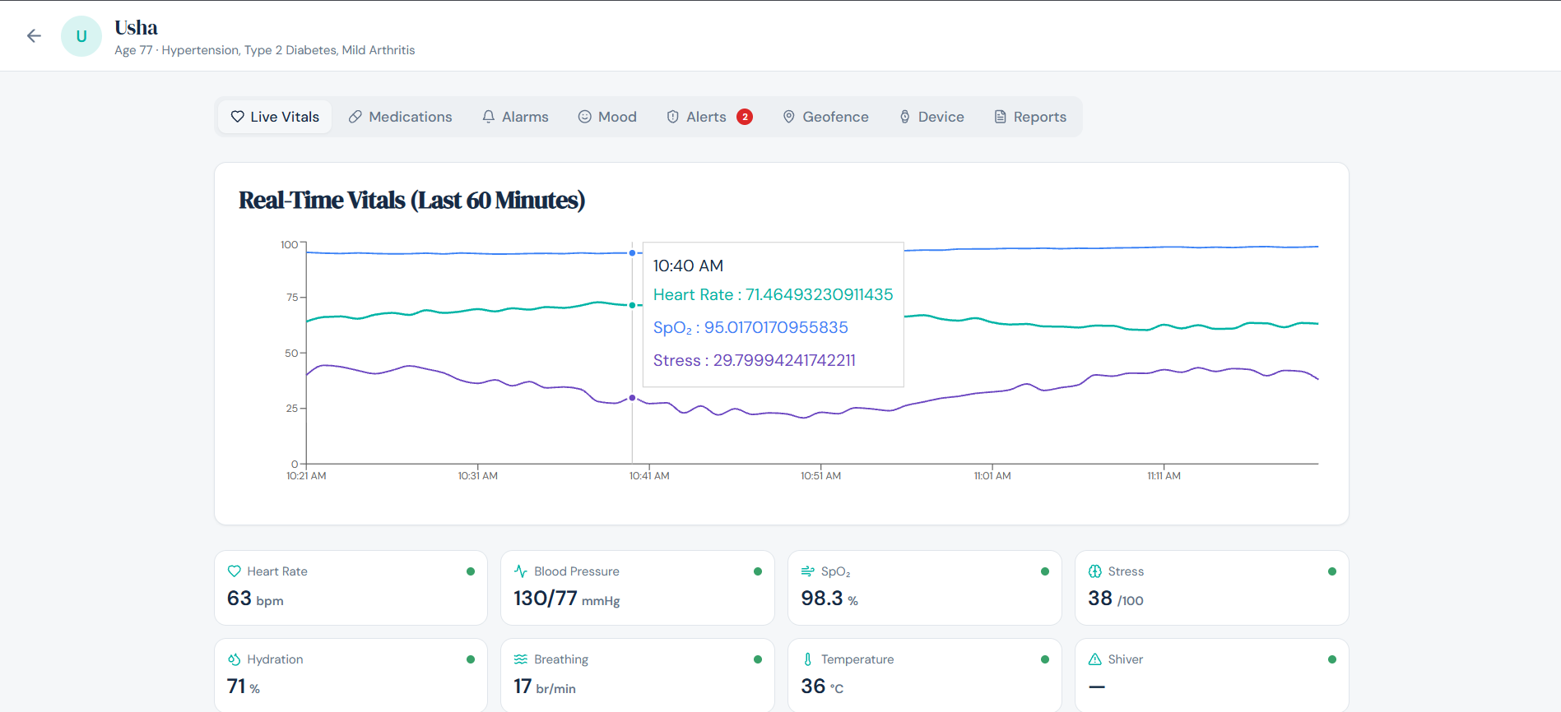

Slide 16
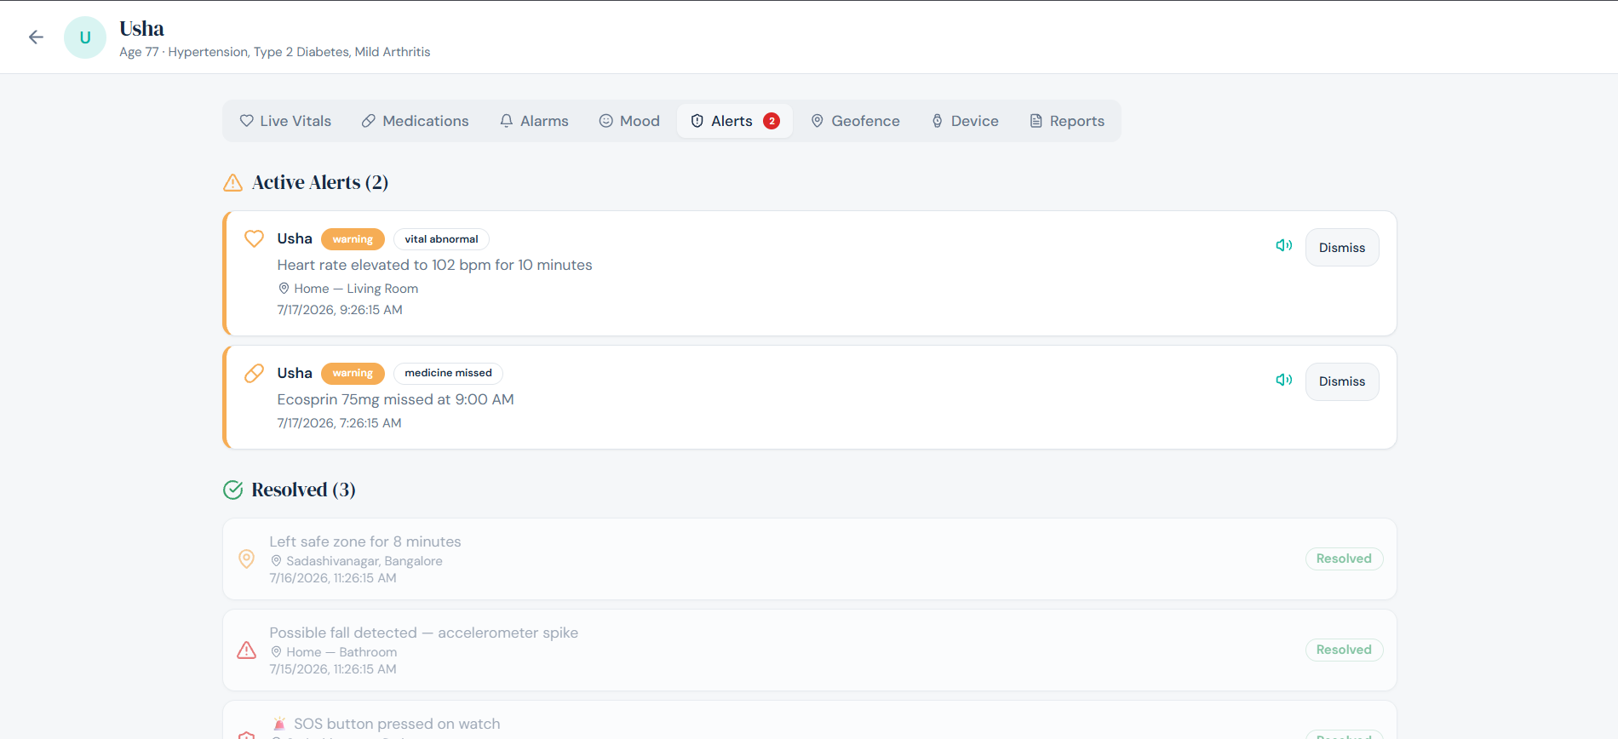

Slide 17
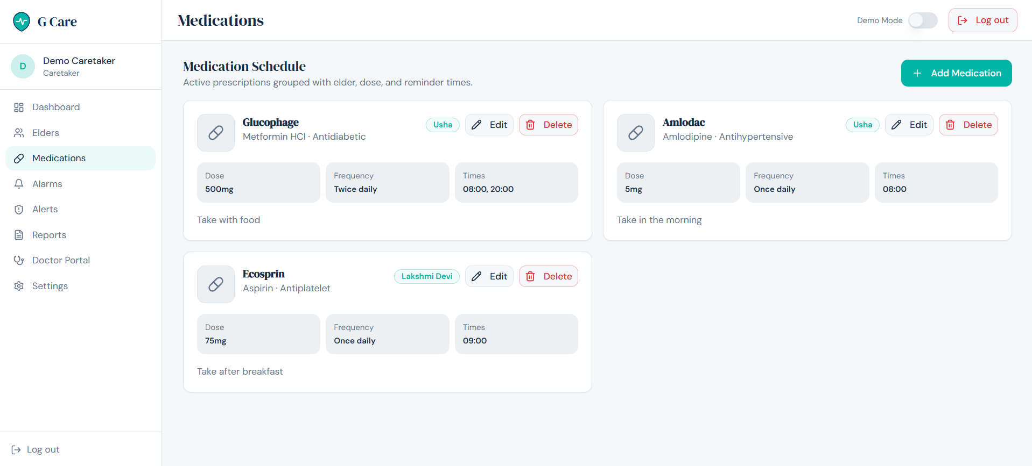

Slide 18
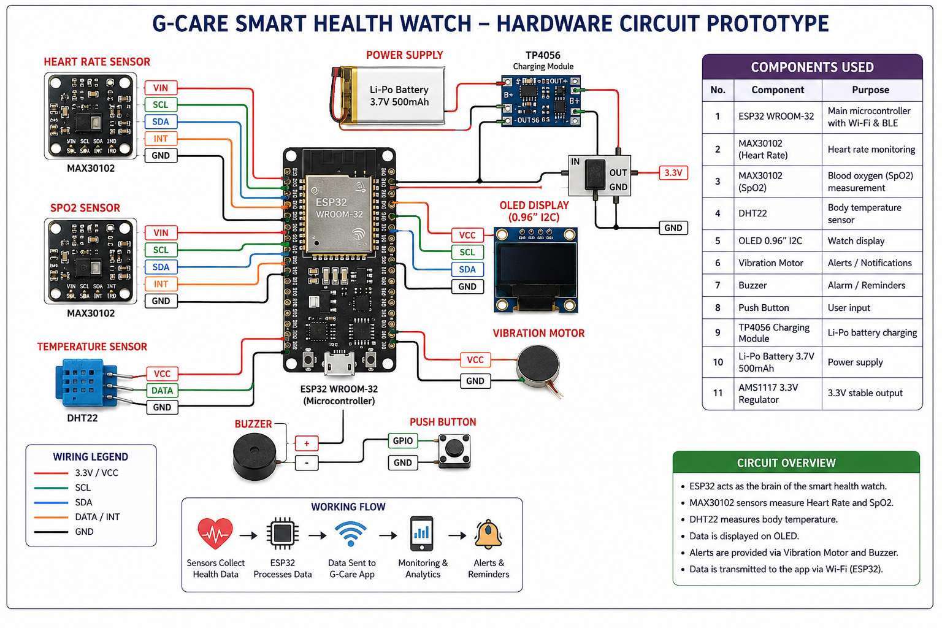

Slide 19
RESULTS
Functional G-Care healthcare monitoring system.
Real-time monitoring of vital parameters.
Doctor, caretaker, guardian, and patient modules.
Medicine reminders and health alerts.
Proposed ESP32-based hardware prototype.
Health data transmission to the G-Care application.
Improved remote healthcare monitoring and timely assistance.

Slide 20

Conclusion
Guardian Care demonstrates how digital health technology can support safer and more independent living for elderly people.
The system combines health monitoring, emergency alerts, medication reminders, and remote caregiver access in one platform. With wearable-device integration and real-time data storage, Guardian Care can become a practical solution for modern elderly healthcare.
G-care - Future of Health Care

Slide 21
REFERENCES
Wan, J. et al., “Wearable IoT Enabled Real-Time Health Monitoring System,” EURASIP Journal, 2018
Durán-Vega, L.A. et al., “IoT System for Remote Health Monitoring,” 2019
Stavropoulos, T.G.et al., “IoT Wearable Sensors in Elderly Care,” 2020
Efendi, A. et al., “IoT-Based Elderly Monitoring Using Firebase,” 2025
Fall Detection using Wearable Sensors Study

