Slide 1

Resume Analyzer using Azure AI Project Synopsis Presentation Date: 10/12/2025
Industrial Training(ECS599)
Degree : BTECH(AI-ML-DL)
Project Guide:
Mr. Nirpesh Sir
Assistant Professor
Student Name: Bairla Yeshwanth
Student ID:TCA2359055
FACULTY OF ENGINEERING & COMPUTING SCIENCES
TEERTHANKER MAHAVEER UNIVERSITY, MORADABAD

Slide 2

Team Details
Student Name | Role
Bairla Yeshwanth | Full Stack Developer
2
T011A/ Template Version 5.0

Slide 3
Project Brief
Project Brief:
The Resume Analyzer is a Flask-based web application that uses Azure AI Document Intelligence to automatically extract key information from resumes. Users upload a PDF resume, and the system identifies fields such as name, contact details, skills, education, and experience. The extracted data is then displayed in a clean, structured format. This project demonstrates cloud-based AI integration, resume parsing, and automated information extraction.
Functions / Modules
1. Resume Upload Module
Allows users to upload PDF resumes through a simple web interface.
2. Azure Document Intelligence Module
Sends the uploaded resume to Azure Form Recognizer API to extract structured data like:
Name Email Phone Skills Education, Work & Experience
3. Data Processing Module
Cleans and organizes the extracted information and formats it for output.
4. Display / Result Module
Shows the analyzed results on a webpage in a structured, readable layout.
5. Backend Module (Flask)
Handles routing, API communication, environment configuration, and result rendering.
3
T011A/ Template Version 5.0

Slide 4
Methodologies/ Technologies/ Tools to be used
Methodologies
Cloud-based AI document analysis: Uses Azure AI Document Intelligence (Form Recognizer) to extract structured data (name, contact, skills, education, experience) from resumes.
Rule-based post-processing: Cleans and validates the extracted fields (e.g., checking email/phone patterns, separating skills, etc.).
Web-based client–server architecture: Flask backend handles requests, communicates with Azure API, and serves results to the user via HTML templates.
Form-driven user interaction: Users upload resumes through a simple web form; responses are shown in a clean result page for easy screening.
Technologies
Programming Language: Python
Web Framework: Flask
AI Service: Azure AI Document Intelligence (Form Recognizer)
Frontend: HTML, CSS (Flask templates/ and static/ folders)
Deployment Platform: Render (for hosting the web app)
Tools
Code & Project Management: Git, GitHub
Environment & Config: .env for API keys and Azure endpoint configuration
Testing Data: Sample resumes stored in test_resumes/ for validating extraction
Browser & Developer Tools: Used to test UI, inspect requests, and debug responses from Azure service
4
T011A/ Template Version 5.0

Slide 5
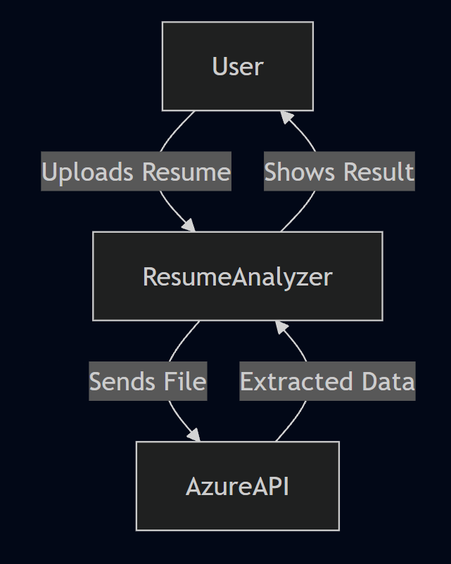
Context Diagram (Overall Project)
5
T011A/ Template Version 5.0

Slide 6
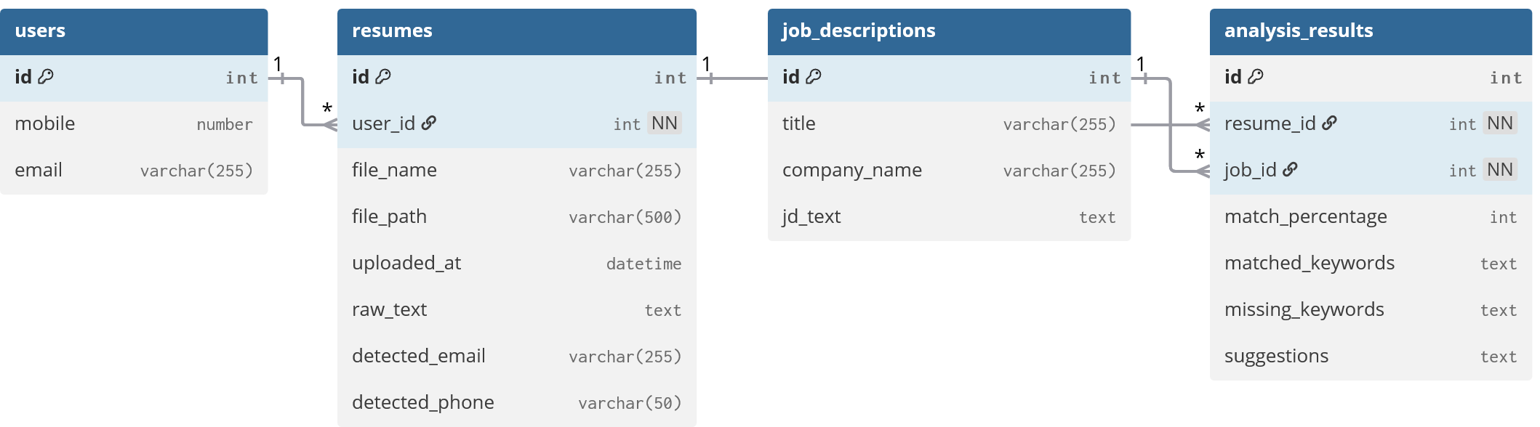
Entity Relationship Diagram (ERD)
6
T011A/ Template Version 5.0

Slide 7
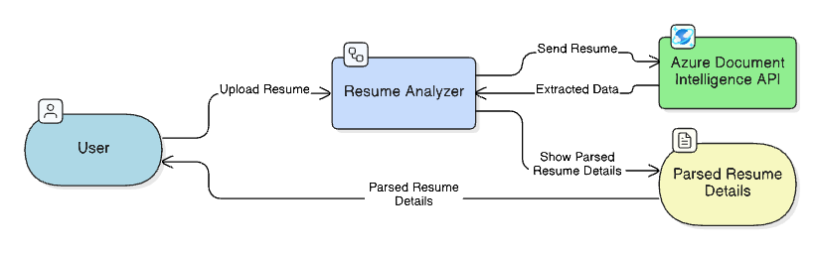
Data Flow Diagram (DFD)
7
T011A/ Template Version 5.0

Slide 8
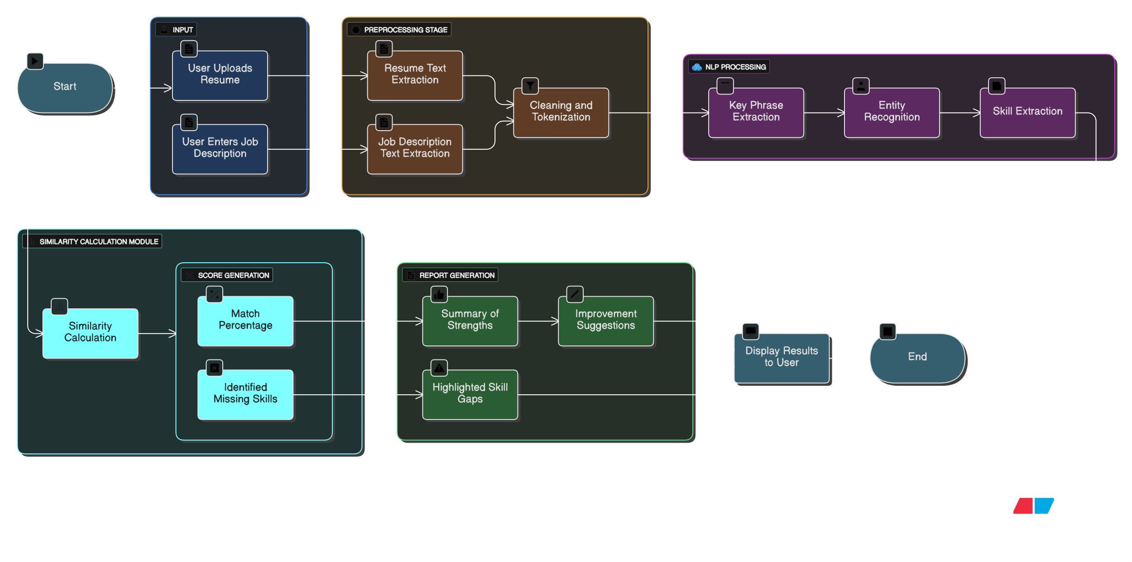

Flow Chart
8
T011A/ Template Version 5.0

Slide 9
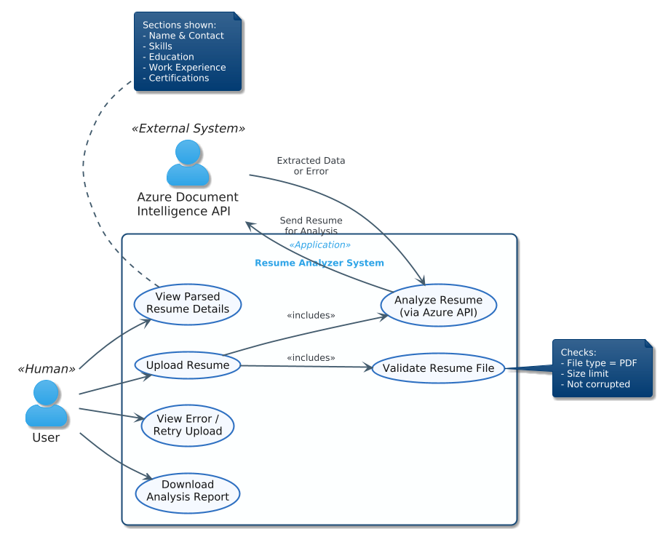
Use Case Diagram
9
T011A/ Template Version 5.0

Slide 10
\
Advantage of The Project
1. Automated Resume Processing
The system removes manual effort by automatically extracting name, skills, education, work experience, and other key sections from resumes.
2. High Accuracy With Azure AI
Leveraging Azure Document Intelligence (Form Recognizer) ensures precise extraction even from complex or differently formatted resumes.
3. Fast and Efficient Analysis
Resumes are processed in seconds, enabling faster screening compared to manual review.
4. Reduces Human Error
Automated extraction avoids mistakes or omissions that can occur when reading through multiple resumes manually.
5. Web-Based and Easy to Use
Users can upload a resume through a simple interface without needing technical knowledge.
6. Standardized Resume Interpretation
All resumes are processed uniformly, ensuring consistent evaluation regardless of their layout or style.
7. Scalable and Cloud-Backed
The system can scale easily using Azure services to handle many resumes simultaneously.
8. Helps Recruiters and HR Teams
Significantly speeds up initial shortlisting by providing structured, readable output of candidate information.
9. Extensible for Additional Features
The system can be expanded with:
ATS scoring
Job description matching
Skill ranking
PDF export
10
T011A/ Template Version 5.0

Slide 11
References, if any
Microsoft Azure Cognitive Services Documentation: https://learn.microsoft.com/en-us/azure/cognitive-services/
Flask Framework Official Documentation — https://flask.palletsprojects.com/
Python Official Documentation — https://docs.python.org/3/
Medium Articles and GitHub Repositories on Resume Parsing using NLP
11
T011A/ Template Version 5.0

Slide 12
THANKS

