Slide 1


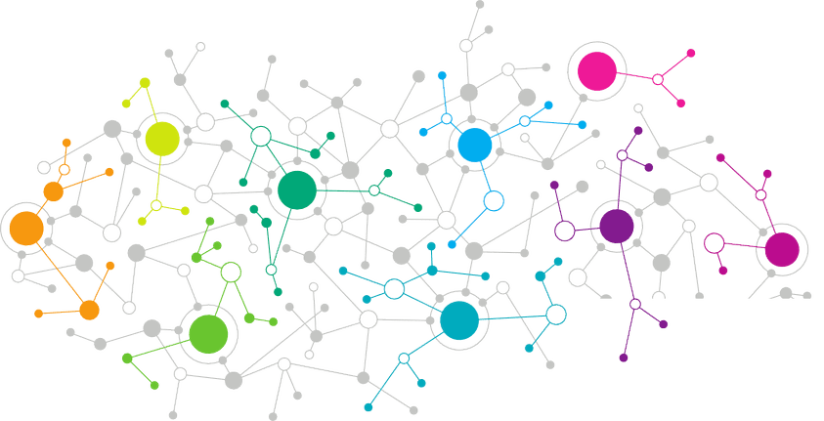

Data Science
Fraud Detection
Notes:
Welcome back to the forth module of data science.

Slide 2
Agenda
01
Introduction to Statistics
02
Statistical Terminology
03
Introduction to Sampling
04
Sampling Technique
05
Categories of Statistics
Notes:
In this module, we will be focusing on Introduction to Statistics, its basic terminologies, what is sampling and then we will discuss some if the sampling techniques and then we will be focusing on Categories of Statistics that is Descriptive and inferential statistics.
So lets begin.

Slide 3


Fraud Detection
Credit Card Fraud costs banks millions of dollars a year in reimbursement, legal fees, and mitigation. Denying fraudulent transactions before they occur would greatly reduce expenses
Notes:
The first question that arise in our mind is why Statistics?
Let me make you clear that Statistics is one of the key fundamental skills required for data science. Moving forward in the data science, if you go for any kind of algorithms then primarily knowledge in statistics is quite important. Actually, the statistics and probability are considered as the base knowledge and they are very essential for moving into any machine learning algorithms.

Slide 4
Thank You
Notes:
And this brings us to the end of this session, thanks for attending & let’s meet in the next class!

