Slide 1

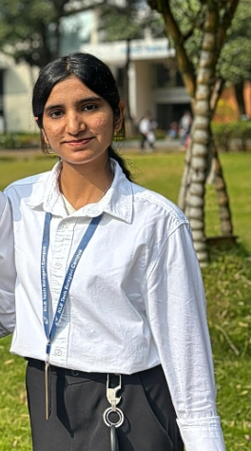
IBM University Engagement Project Submission
"Exploring the Power of Agentic AI with IBM Granite and IBM Bob"
SMART SATELLITE COMMUNICATION KNOWLEDGE ASSISTANT
Project Name
Domain
OrbitIQ
Aerospace & Satellite Communication
Student
photo
Yashaswi Bhatkande
yeshubhatkande@gmail.com
6361107596

Slide 2

Project Overview
Project Identity
Why Intelligent Assistance Matters
Title: Smart Satellite Communication Knowledge Assistant
Name: OrbitIQ
Domain: Aerospace & Satellite Communication
Specialized Complexity
Satellite communication involves highly specialized technical knowledge spanning frequency bands, modulation, link budgets, and orbital mechanics.
Fragmented Information
Engineers and students need rapid access to information distributed across textbooks, research papers, and technical documentation.
Inefficient Workflows
Traditional search and troubleshooting methods are time-consuming, slowing down learning and problem-solving cycles.
AI as the Bridge
An AI-powered assistant can close the knowledge gap and dramatically accelerate both learning and engineering problem resolution.

Slide 3


Problem Statement
SMART SATELLITE COMMUNICATION KNOWLEDGE ASSISTANT
The Challenge
The Objective
01
Conceptual Complexity
Scattered Knowledge
AI-Powered Information Retrieval
Frequency bands, modulation techniques, link budgets, and communication protocols demand deep, specialized expertise to navigate effectively.
Critical information is fragmented across textbooks, research papers, and technical documentation — with no unified access point.
Build an assistant that retrieves accurate information directly from satellite communication documents using RAG.
02
Plain-Language Explanation
Slow Retrieval
Troubleshooting Demands
Explain complex concepts in simple, accessible language suitable for both students and working engineers.
Finding relevant information quickly is difficult and time-consuming, creating bottlenecks in both learning and engineering workflows.
Diagnosing issues requires simultaneous analysis of multiple technical parameters — a task ill-suited to traditional search tools.
03
Intelligent Troubleshooting
Provide guided, step-by-step troubleshooting for real satellite communication problems.
04
Conversational Interface
Support natural multi-turn dialogue through an interactive chat interface powered by IBM Granite models.

Slide 4




Proposed Solution — OrbitIQ
OrbitIQ is an AI-powered satellite communication knowledge assistant built using IBM Bob, IBM watsonx.ai, IBM Granite, and Retrieval-Augmented Generation (RAG). It transforms fragmented technical knowledge into an intelligent, conversational engineering resource.
Knowledge Retrieval
Concept Explanation
Extracts relevant information from technical documents and knowledge bases with semantic precision using RAG pipelines.
Translates complex satellite communication concepts — frequency bands, link budgets, modulation — into simple, understandable language.
Troubleshooting Support
Conversational Interface
Provides step-by-step guidance for diagnosing and resolving satellite communication problems through structured reasoning.
Enables natural, interactive multi-turn dialogue through an intelligent chat interface that maintains context across sessions.

Slide 5
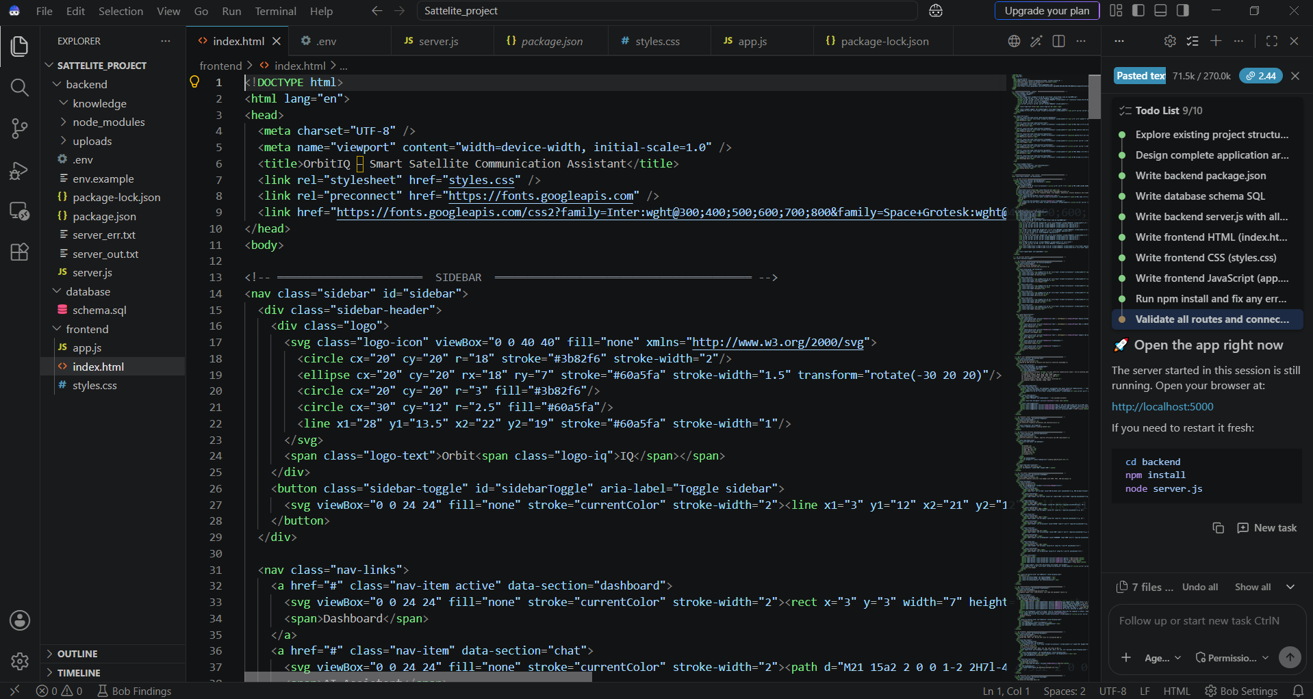
Project File Structure — Created Using IBM Bob
The complete OrbitIQ codebase was scaffolded and generated using IBM Bob, following a modular, production-ready directory structure:
satellite-project/
│
├── frontend/
│ ├── index.html
│ ├── style.css
│ ├── script.js
│ ├── chat.js
│ └── upload.js
│
├── backend/
│ ├── server.js
│ ├── config.js
│ ├── routes/
│ ├── controllers/
│ ├── services/
│ └── uploads/
│
├── files/
│ ├── documents/
│ └── processed/
│
├── database/
│ └── schema.sql
│
├── .env
├── .gitignore
└── README.md
Module Responsibilities
frontend/
backend/
Chat UI, document upload panel, and responsive interface components built with HTML, CSS, and JavaScript.
Node.js + Express.js server, REST API routes, business logic controllers, and AI service integrations.
files/ + database/
Config & DevOps
Raw document ingestion, processed knowledge embeddings, and MySQL schema for persistent data storage.
.env for environment secrets, .gitignore for version control hygiene, README.md for project documentation.

Slide 6




Technology Stack
AI & Development
Knowledge & Retrieval
Backend & Frontend
IBM Bob
RAG
Node.js + Express.js
Application development, code generation, and AI workflow implementation — the primary development environment for OrbitIQ.
Retrieval-Augmented Generation retrieves relevant technical information from the knowledge base before generating any response, ensuring accuracy.
Backend services, REST APIs, request routing, and session management for the OrbitIQ platform.
HTML + CSS + JavaScript
IBM Granite Models
LangChain
Interactive, responsive frontend interface enabling seamless user interaction with the assistant.
Natural-language understanding, multi-step reasoning, and context-aware response generation for satellite domain queries.
Orchestrates document processing, embedding pipelines, and the end-to-end RAG workflow integration.
MySQL
IBM watsonx.ai
Persistent application data storage and processed satellite communication document repository.
Enterprise-grade IBM Granite model integration, providing scalable, governed AI capabilities for the assistant.

Slide 7
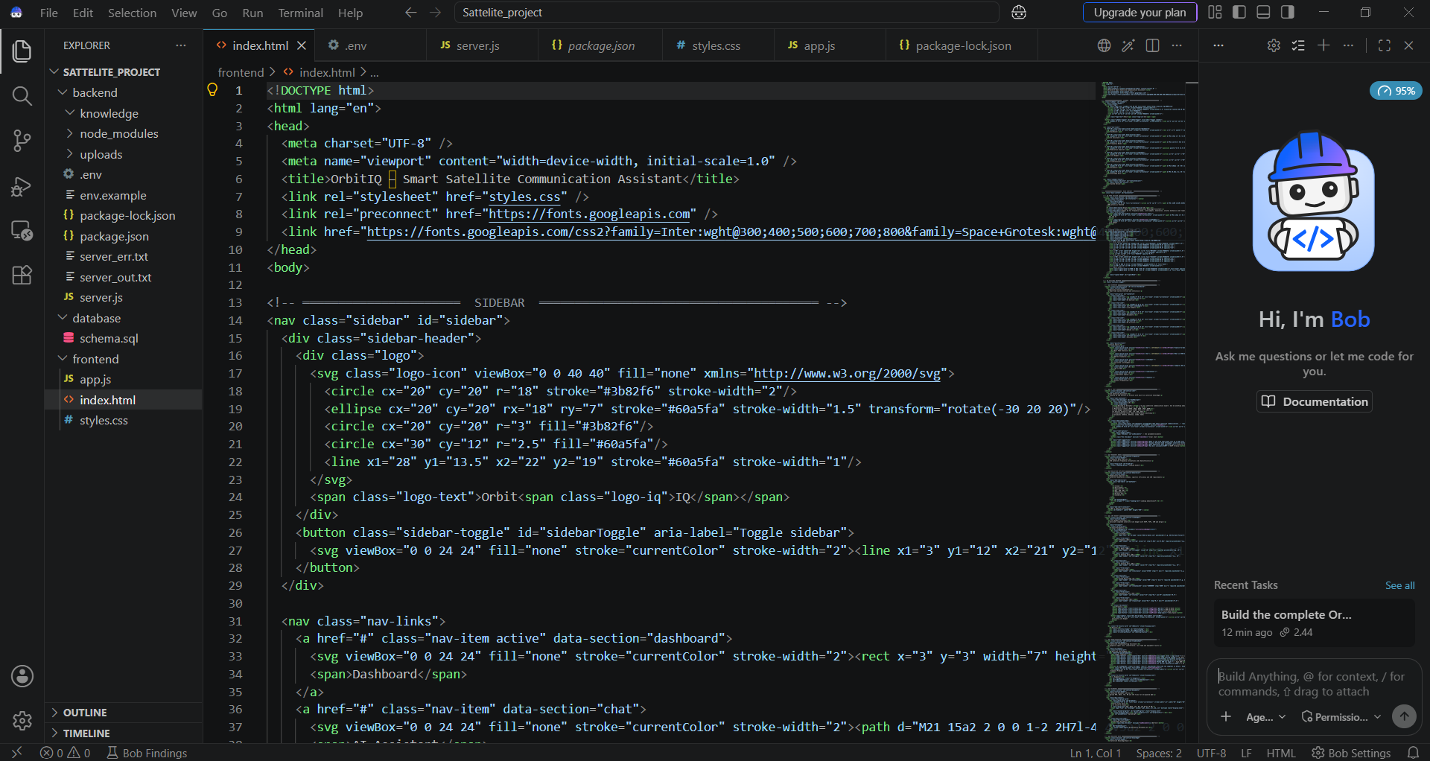
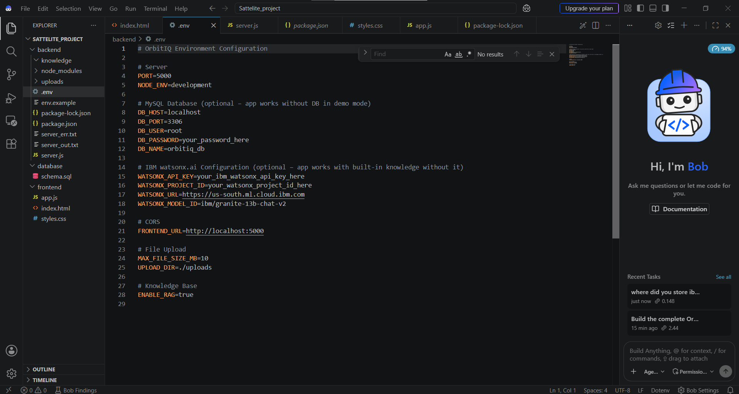

IBM Bob Screenshots
Professional screenshot showcase demonstrating IBM Bob's role in OrbitIQ development
Screenshot 1 — Application Development & Code Generation
Screenshot 2 — AI Workflow & RAG Implementation
[INSERT IBM BOB SCREENSHOT 1] — Capture showing IBM Bob generating the OrbitIQ frontend code, including chat interface layout, CSS styling, and JavaScript event handlers.
[INSERT IBM BOB SCREENSHOT 2] — Capture showing IBM Bob generating the RAG pipeline, LangChain integration, and IBM Granite model connection logic.
This screenshot highlights IBM Bob's role in generating the core intelligence layer — the RAG retrieval workflow, document embedding pipeline, and watsonx.ai API integration that powers OrbitIQ's knowledge engine.
This screenshot demonstrates IBM Bob's ability to scaffold complete, functional frontend components from a single natural-language prompt, accelerating development from ideation to working code.

Slide 8

IBM Bob Development Process
How IBM Bob was used to build OrbitIQ's core functionality through structured AI-assisted prompting
1
2
3
Frontend Development
RAG Implementation
Troubleshooting Logic
Prompt: "Generate the satellite communication assistant frontend with chat interface, document upload, and responsive design using HTML, CSS, and JavaScript."
[INSERT IBM BOB PROMPT SCREENSHOT] · [INSERT IBM BOB OUTPUT SCREENSHOT]
Prompt: "Implement RAG-based document retrieval using LangChain, IBM Granite, and IBM watsonx.ai for satellite communication knowledge base."
[INSERT IBM BOB PROMPT SCREENSHOT] · [INSERT IBM BOB OUTPUT SCREENSHOT]
Prompt: "Build conversational troubleshooting functionality that guides users through satellite communication problem diagnosis."
[INSERT IBM BOB PROMPT SCREENSHOT] · [INSERT IBM BOB OUTPUT SCREENSHOT]

Slide 9
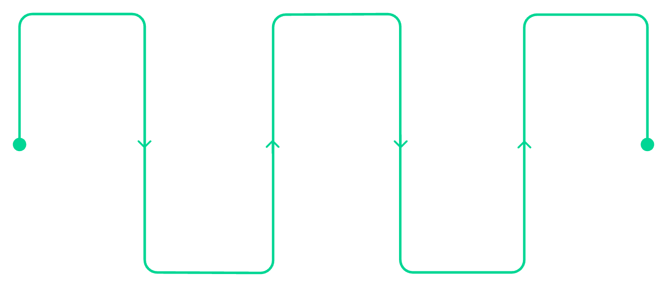
Architecture Blueprint — OrbitIQ
Key Architectural Components
User Query
Backend API
RAG Retrieval
Frontend Layer
Initiate request via chat
Node.js + Express.js APIs
LangChain retrieval and synthesis
Interactive chat interface, document upload portal, and knowledge browser built with HTML, CSS, and JavaScript.
Backend Layer
OrbitIQ Interface
Query Processing
Node.js + Express.js REST APIs handling request routing, session management, and service orchestration.
Conversational frontend layer
Intent and context understanding
RAG Engine
LangChain-based retrieval pipeline with document embedding and semantic search over the knowledge corpus.
Knowledge Store
MySQL database storing processed satellite communication documents and embedding indices.
AI Engine
IBM Granite models accessed through IBM watsonx.ai for enterprise-grade reasoning and response generation.
Development Layer
IBM Bob for code generation, workflow automation, and rapid prototyping across all layers.

Slide 10
Role of Agentic AI in OrbitIQ
Agentic AI transforms OrbitIQ from a simple chatbot into an intelligent, autonomous system that understands context, retrieves knowledge, and provides expert-level guidance — proactively, not reactively.
Agentic Workflow
System Coordination
01
OrbitIQ's agentic core orchestrates retrieval, reasoning, and response generation seamlessly — functioning not as a passive lookup tool, but as a goal-oriented engineering collaborator.
Query Understanding
Analyzes user questions to identify intent, technical domain, and contextual parameters before any retrieval occurs.
Impact Statement
02
OrbitIQ combines Agentic AI, RAG, and IBM Granite to transform scattered satellite communication knowledge into an interactive engineering assistant that is:
Knowledge Retrieval
Searches the satellite communication knowledge base semantically for the most relevant documents and concepts.
Proactive — anticipates information needs
Context-aware — tracks conversation and intent
Goal-oriented — drives toward problem resolution
03
IBM Granite Reasoning
Processes retrieved information and synthesizes contextually appropriate, technically accurate responses.
04
Technical Explanation
Breaks down complex concepts into understandable language calibrated for the user's level of expertise.
05
Troubleshooting Guidance
Provides structured, step-by-step problem diagnosis and resolution pathways for satellite communication issues.
06
Conversational Context
Maintains full dialogue history to enable coherent, multi-turn conversations without loss of context.

Slide 11

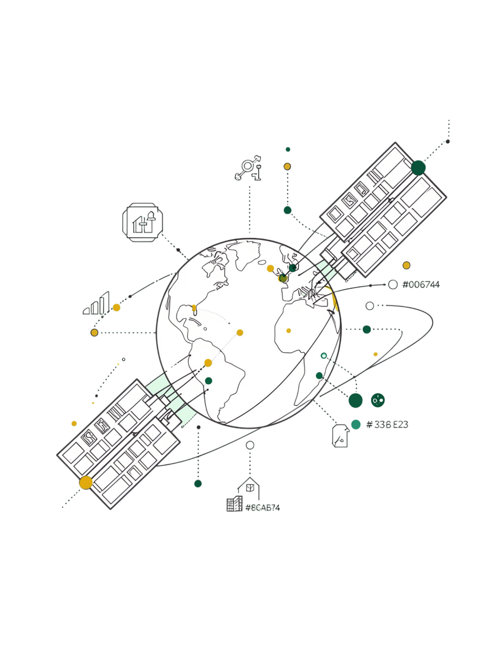
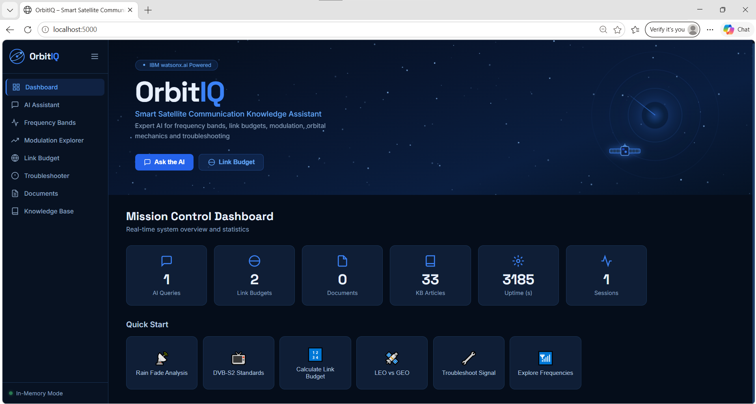

Token Usage
IBM Granite token usage summary for the OrbitIQ project
[PROMPT]
[RESPONSE]
Prompt Tokens
Response Tokens
Tokens used in prompts sent to IBM Granite
Tokens generated in model responses
[TOTAL]
Total Tokens
Combined token consumption across the full project
Placeholder: Replace [PROMPT], [RESPONSE], and [TOTAL] with actual token counts from IBM Granite usage logs.

Slide 12
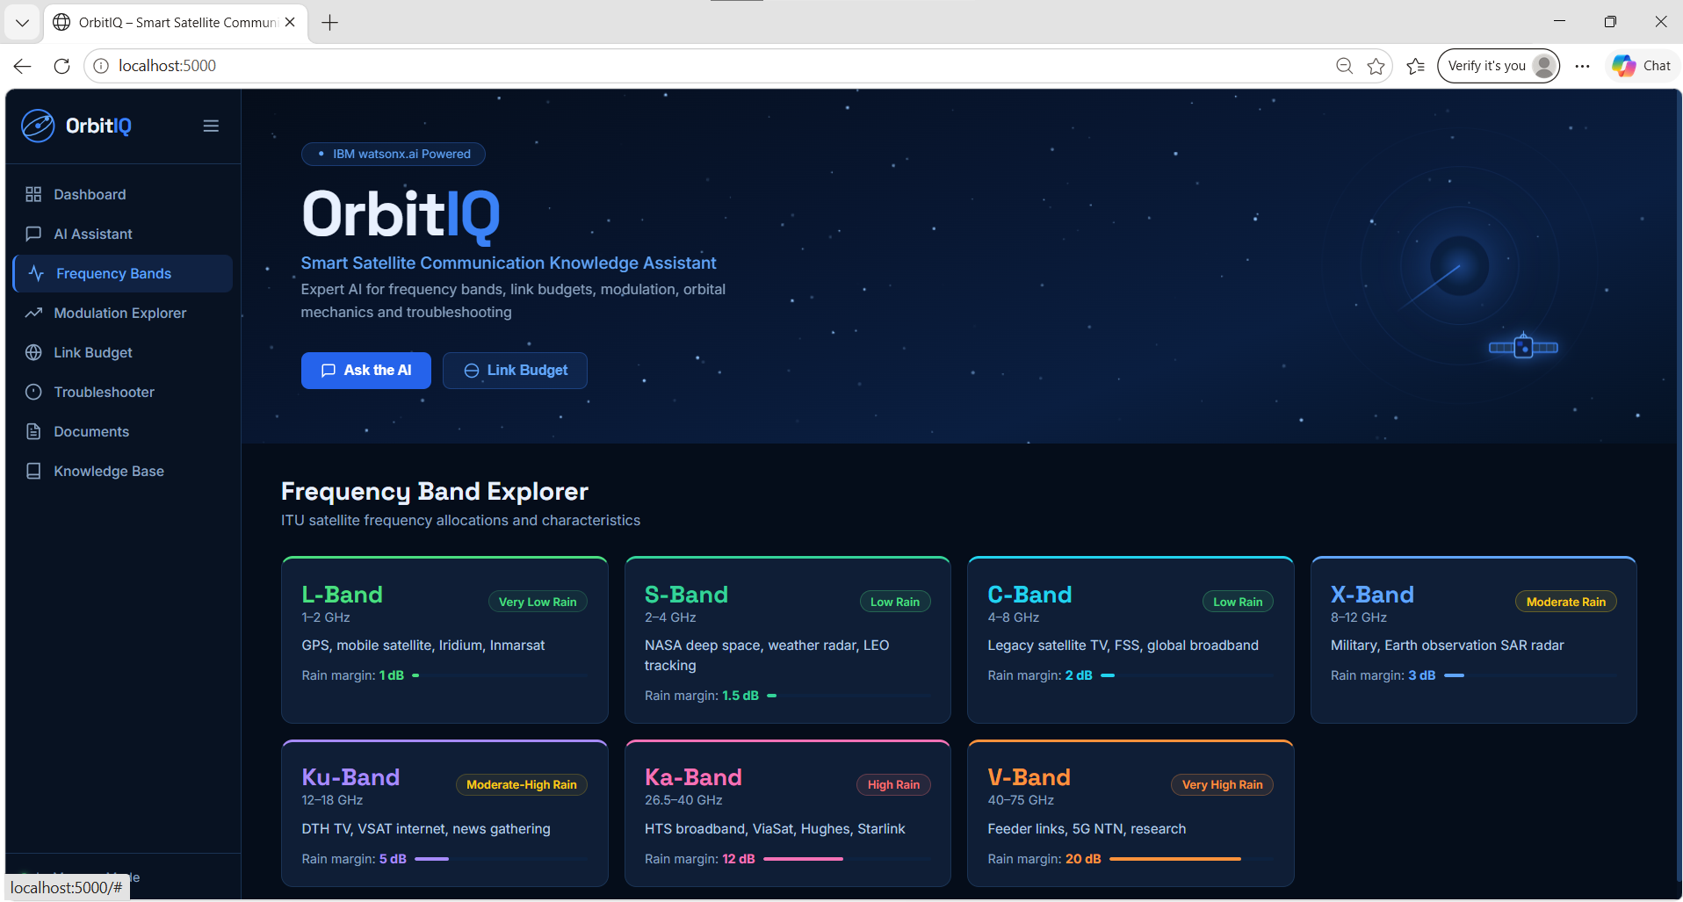
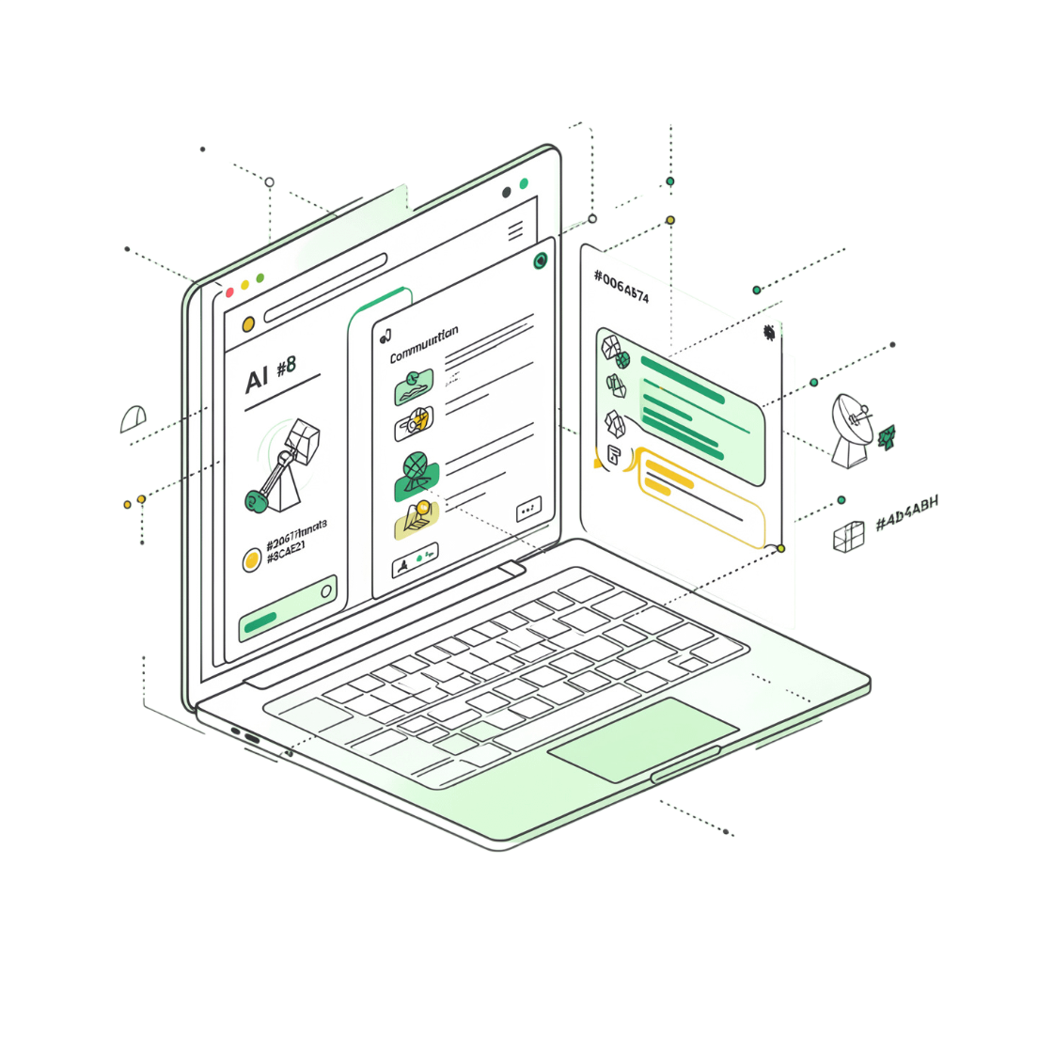

Project Output – OrbitIQ
APPLICATION SCREENSHOT 1
OrbitIQ in Action
The OrbitIQ conversational interface enables engineers and students to query satellite communication knowledge naturally — no manual document searching required.
Natural-language Q&A interface
Powered by IBM Granite reasoning
Context-aware knowledge retrieval
Placeholder: Insert OrbitIQ Application Screenshot 1 — showing the main chat or query interface.

Slide 13
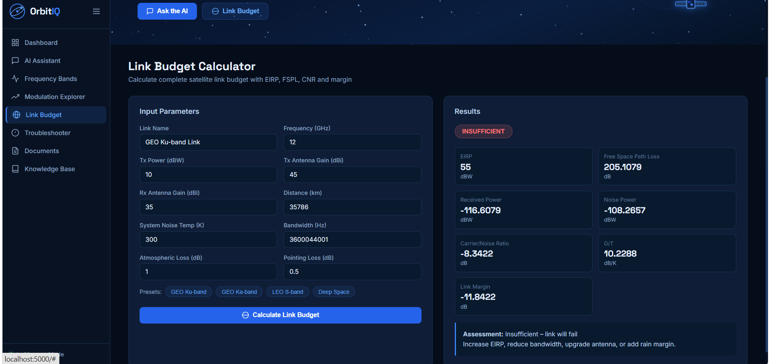
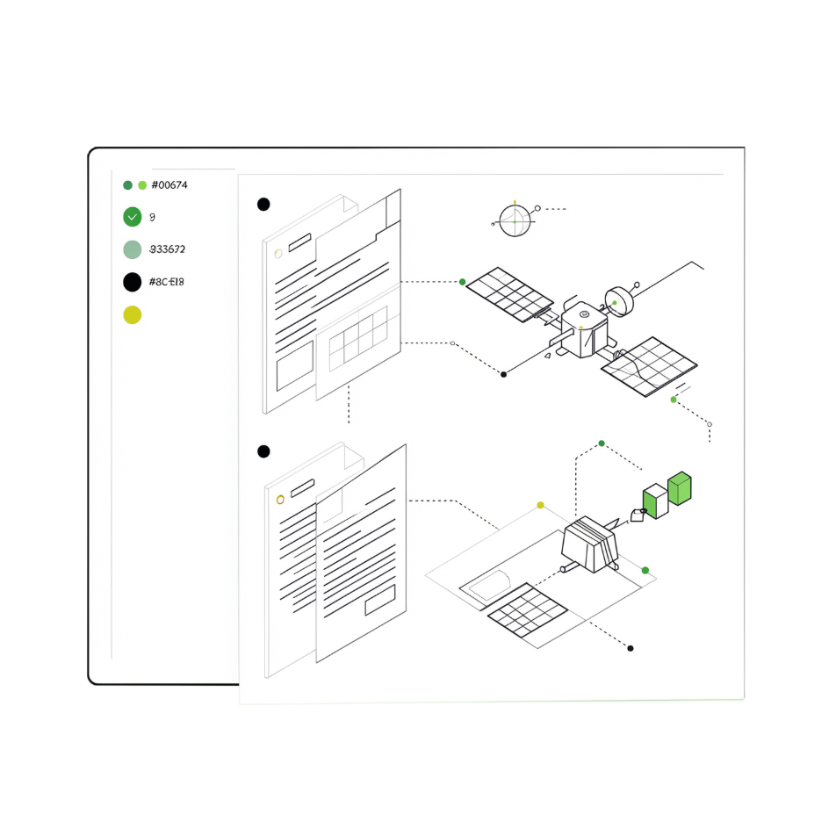
Project Output – Knowledge Retrieval
APPLICATION SCREENSHOT 2
Retrieval-Augmented Generation (RAG) surfaces precise, document-grounded answers from the OrbitIQ satellite communication knowledge base.
How RAG Works in OrbitIQ
1
Query Ingestion
2
Document Retrieval
User submits a natural-language question about satellite systems or protocols.
Relevant technical documents are retrieved from the vector knowledge base.
3
Grounded Response
IBM Granite synthesizes a precise, document-backed answer for the user.
Placeholder: Insert OrbitIQ Output Screenshot 2 — showing a knowledge retrieval result.

Slide 14
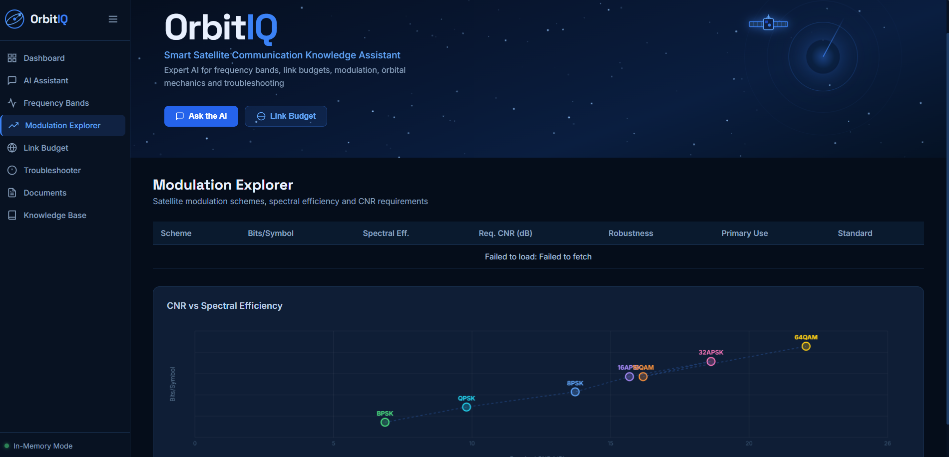
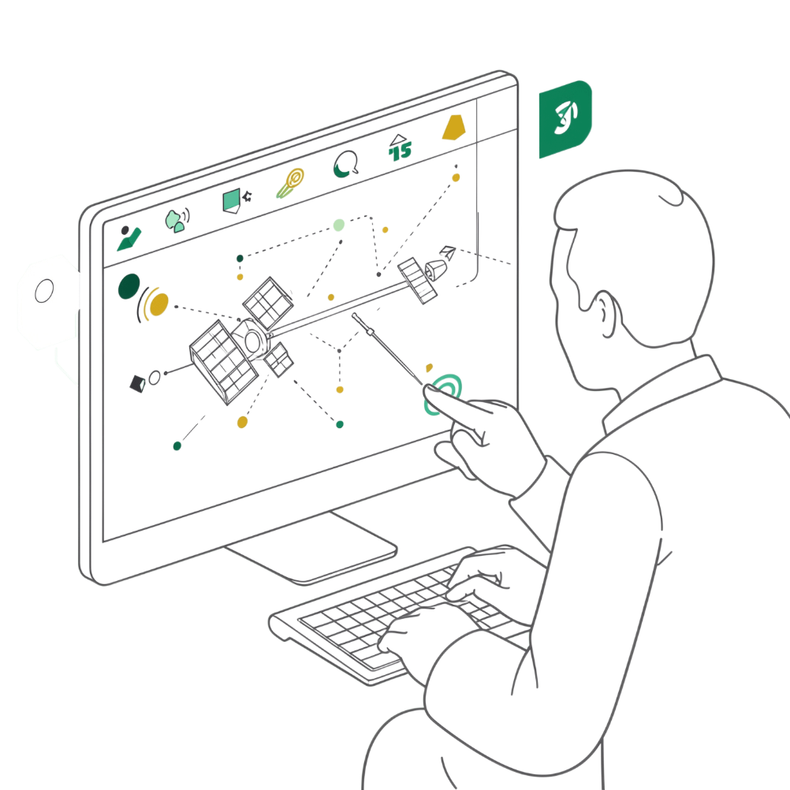

Project Output – Troubleshooting & Concept Explanation
APPLICATION SCREENSHOT 3
AI-Powered Engineering Support
OrbitIQ breaks down complex satellite communication concepts and guides users through systematic troubleshooting — transforming dense engineering knowledge into clear, actionable guidance.
Step-by-step issue diagnosis
Plain-language concept explanations
Signal analysis and link-budget guidance
Contextual follow-up question support
Placeholder: Insert OrbitIQ Output Screenshot 3 — showing a troubleshooting or concept explanation response.

Slide 15






Novelty & Uniqueness
OrbitIQ transforms fragmented satellite communication knowledge into an accessible, intelligent, and interactive engineering assistant.
Domain-Specific RAG
Simple Technical Explanations
Retrieves relevant knowledge directly from satellite communication technical documents
Converts complex engineering concepts into understandable, clear responses
AI Troubleshooting
Conversational Access
Supports systematic analysis of satellite communication faults and issues
Natural-language interaction replaces manual document searching entirely
IBM Granite Integration
Agentic Workflow
Uses IBM Granite for intelligent reasoning and high-quality response generation
Combines retrieval, reasoning, and response into one intelligent end-to-end workflow

Slide 16
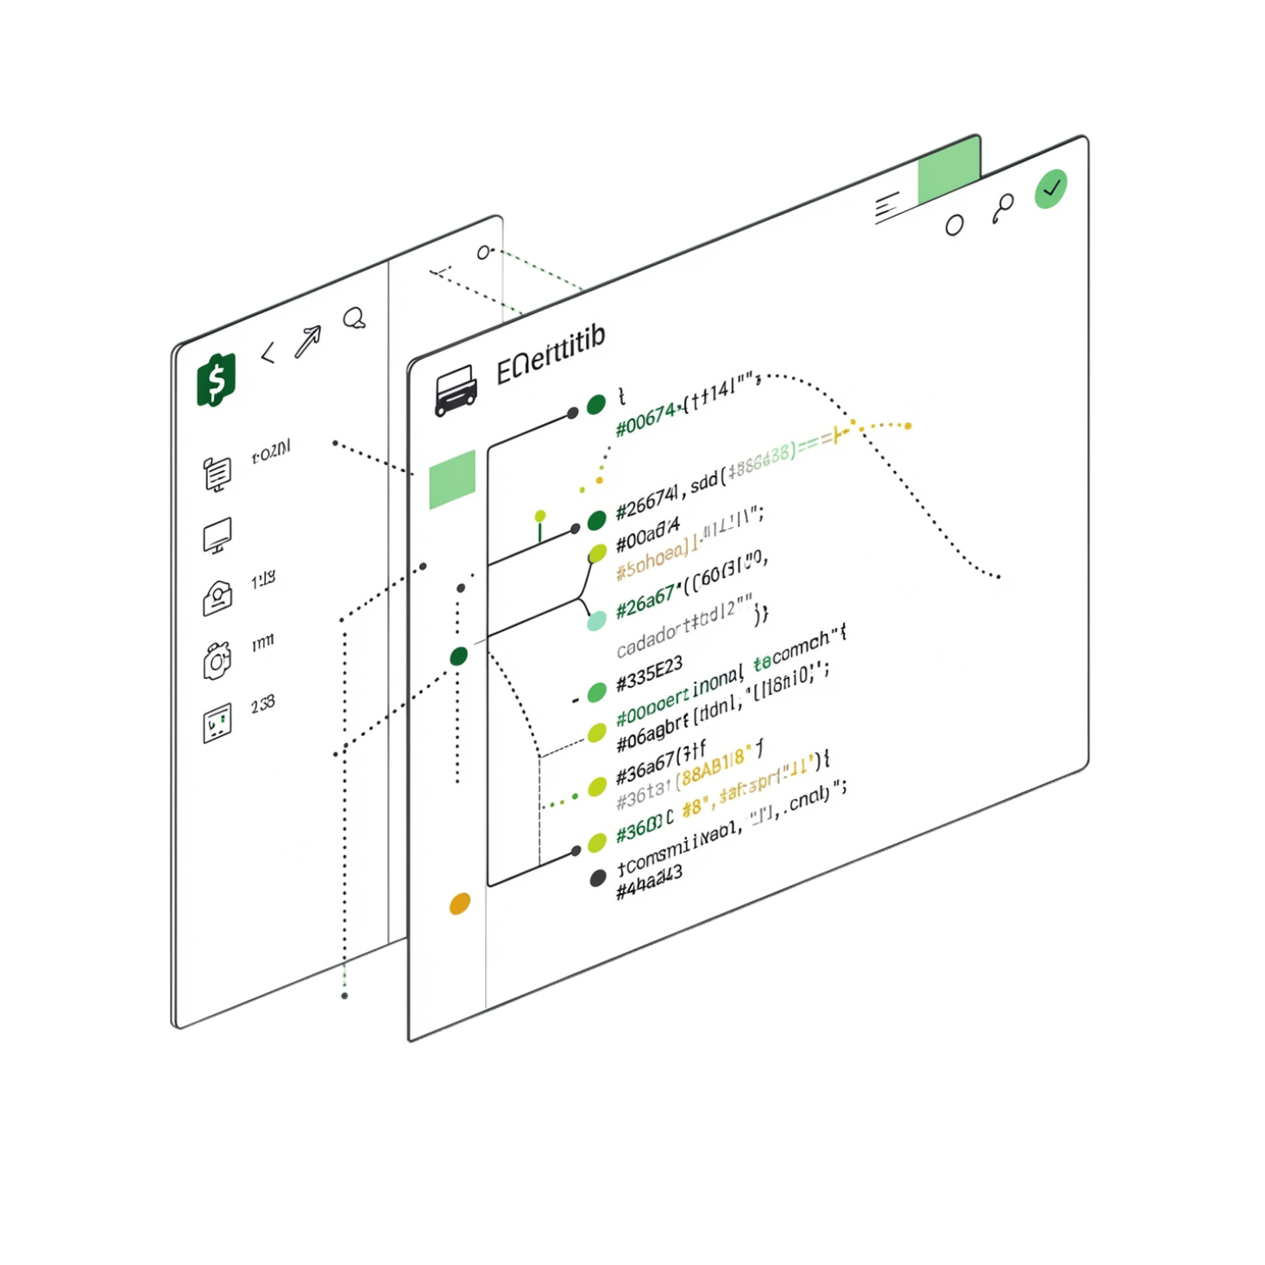

GitHub Repository
Repository URL
https://github.com/yeshubhatkande-alt/OrbitIQ-Satellite-Communication-AI
Repository Contents
All relevant IBM watsonx / IBM Cloud agent files
Problem Statement PDF (No. 24 — Aerospace & Satellite Communication)
Project Presentation PPTX
Other project files and supporting documentation

Slide 17
Future Scope
OrbitIQ is designed to grow — the roadmap below outlines key enhancements planned to extend its capabilities across real-time data, advanced analysis, and broader accessibility.
Real-Time Telemetry
Signal Analysis
Predictive Troubleshooting
Integrate live satellite telemetry and communication parameters for context-aware troubleshooting
Automated analysis of SNR, BER, signal quality, and interference parameters
Use historical data to detect and predict communication failures before they occur
1
2
3
4
5
6
Multilingual Voice
Expanded Knowledge Base
Visual Dashboard
Enable voice interaction and multi-language support for global engineering teams and students
Interactive link-budget analysis, signal metrics, and real-time communication status visualization
Add research papers, ITU standards, manufacturer manuals, and technical documentation

Slide 18
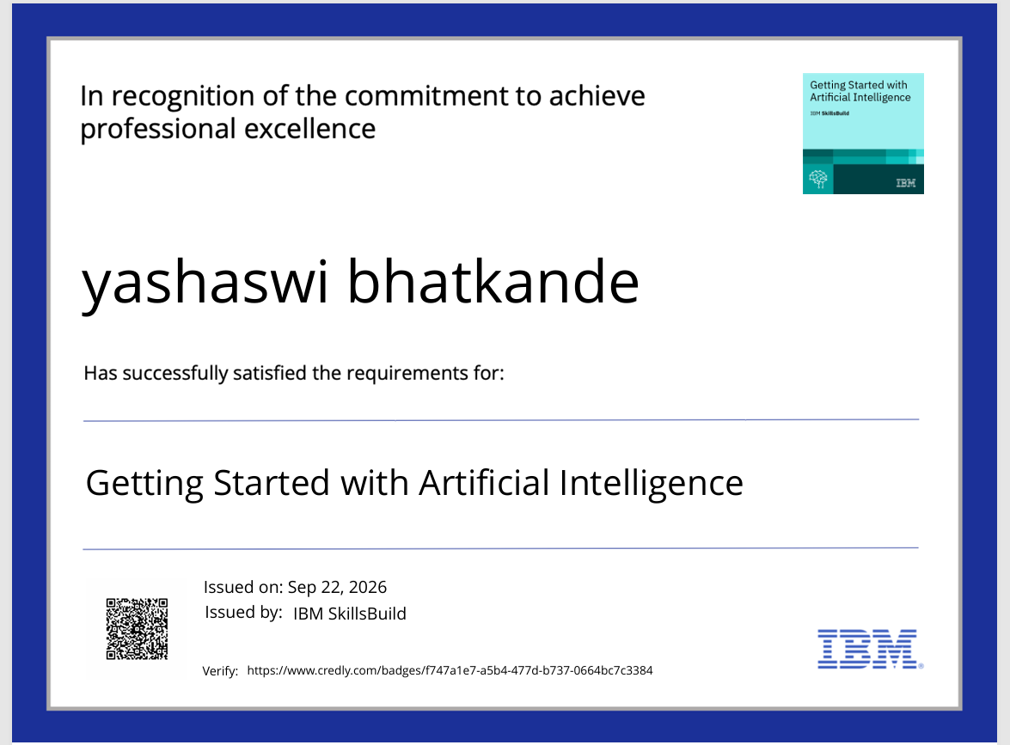

Certificates Earned
Credly Certificate
This credential recognizes successful completion of IBM-certified learning modules and skill validation relevant to the OrbitIQ project.
Issued via Credly digital badging platform
Verifiable and publicly shareable
Validates IBM AI & cloud skill competency
Placeholder: Insert Credly Certificate image or badge screenshot here before final submission.

Slide 19
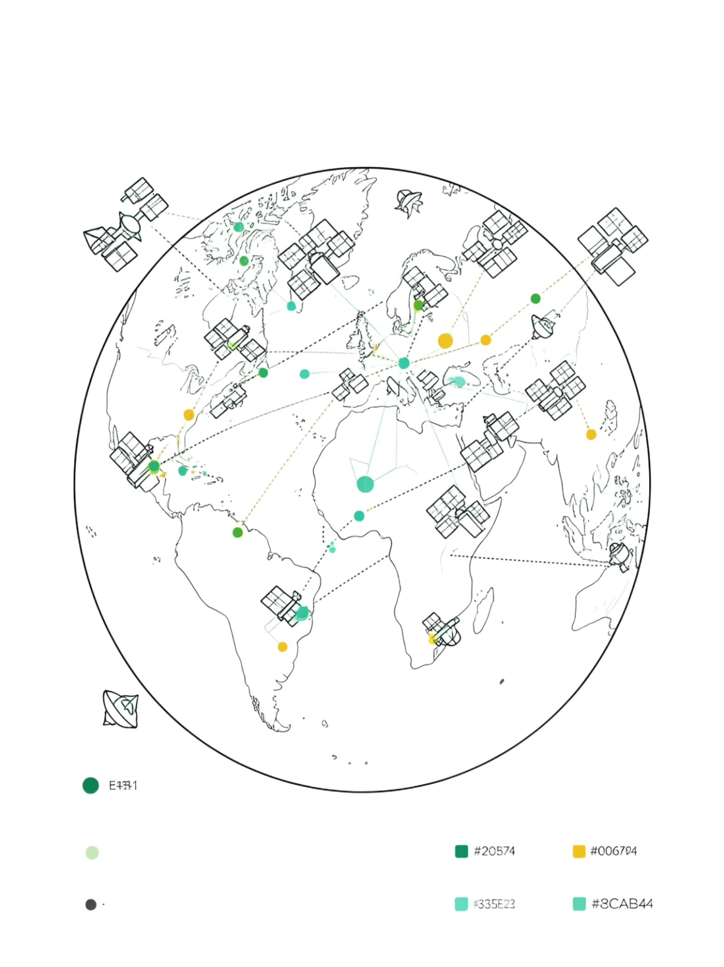
Thank You
OrbitIQ — Smart Satellite Communication Knowledge Assistant
An AI-powered assistant that combines RAG, Agentic AI, IBM Granite, and conversational interaction to make satellite communication knowledge easier to retrieve, understand, and apply.
Domain
Problem Statement
Aerospace & Satellite Communication
No. 24 — IBM University Engagement Program
Core Stack
IBM Granite · RAG · Agentic AI · watsonx

Slide 20
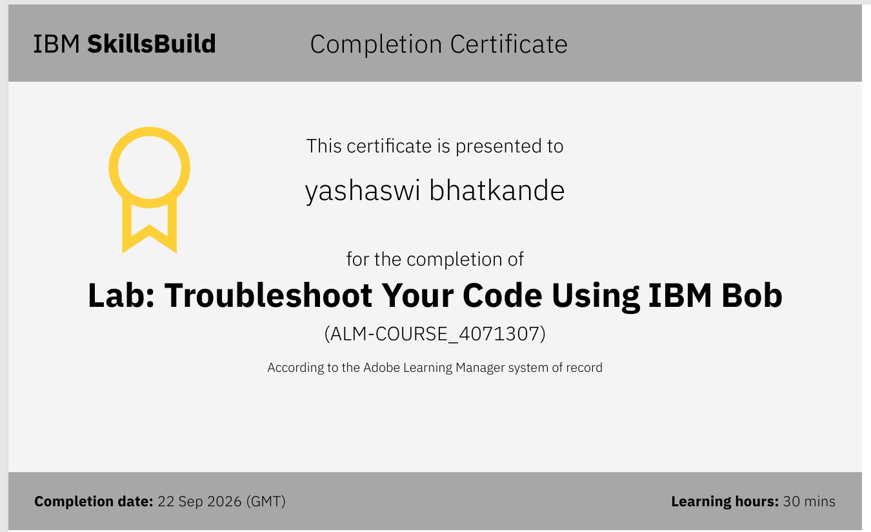
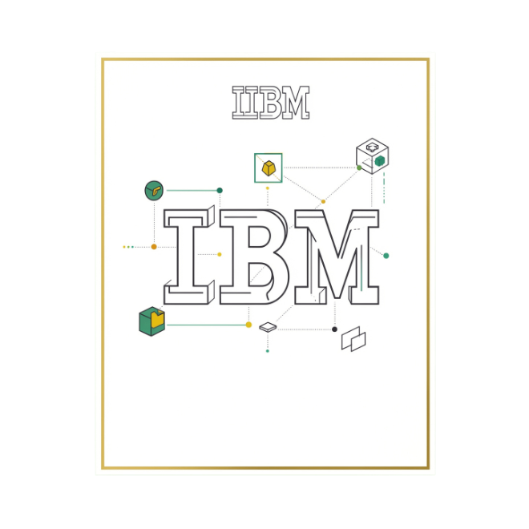

Certificates Earned
IBM watsonx Certificate
Official project completion certificate from IBM recognizing the successful development and submission of OrbitIQ under the IBM University Engagement Program.
Issued by IBM upon project completion
Acknowledges applied AI & agentic workflow skills
Problem Statement No. 24 — Aerospace & Satellite Communication
Placeholder: Insert IBM watsonx / IBM Bob Certificate i

