Slide 1


MACHINE LEARNING · MULTICLASS CLASSIFICATION
Multi-Class Customer Category Prediction
Using Multinomial Logistic Regression
Presented by : 2520030201 - Susmitha
2520030194 - Yeshvitha
Supervised By : Rani Mam
Section : 5
Notes:
1

Slide 2
Abstract
  Businesses collect large amounts of customer data, but understanding customer behavior and identifying different customer groups can be challenging.
  This project develops a machine-learning system to classify customers into multiple categories using customer-related features. Multinomial Logistic Regression is used as the primary classification algorithm, applied to 50,000 retail customer records across 14 columns.
  The workflow includes data exploration, data cleaning, feature preparation, model training, and performance evaluation. The trained model can predict the category of a new customer based on the input data.
  The project demonstrates how machine learning can support customer analysis and data-driven business decisions by classifying customers into four categories: Occasional, Regular, Loyal, and High_Value.
Notes:
26

Slide 3
Introduction
  Customer data helps businesses understand purchasing patterns and customer activity.
  Manual classification can be time-consuming when datasets are large.
  Machine learning can identify patterns in historical customer data.
  This project uses 11 customer features — age, income, spending, purchase frequency and more — to predict one of four customer categories.
  The task is a multi-class classification problem because the target contains more than two possible categories.
Notes:
26

Slide 4
Problem Statement & Objective
  Businesses need a systematic way to classify customers using available customer data. This project builds a model that predicts a customer's category — Occasional, Regular, Loyal or High_Value — from demographic, spending and behavioral features such as age, income, purchase frequency and discount usage.
OBJECTIVE
  Understand and explore the customer dataset.
  Evaluate the model using suitable classification metrics.
  Demonstrate how predictions can support customer analysis.
Notes:
26

Slide 5
End-to-End System Workflow
Customer
Dataset
→
Data
Loading
→
Data
Exploration
→
Data Quality
Check
→
Data
Cleaning
→
Feature/Target
Separation
↓
Preprocessing
→
Train-Test
Split
→
Logistic
Regression
→
Prediction
→
Model
Evaluation
→
Customer
Category
Notes:
26

Slide 6
INTRODUCTION
Understanding Customer Classification
1
Customer classification is the process of assigning customers to predefined groups.
CUSTOMER CATEGORIES
2
Demographic, spending and purchase-behavior data can be used for classification.
Occasional
Lowest engagement tier
3
Machine Learning can identify patterns hidden in existing customer data.
Regular
4
This project applies Multinomial Logistic Regression to predict customer categories.
Consistent, moderate activity
5
The model performs four-class classification across the full customer base.
Loyal
Strong repeat engagement
High_Value
Top-tier spenders
Notes:
2

Slide 7
PROBLEM STATEMENT
From Raw Customer Data to Actionable Categories
Retail businesses hold large volumes of customer information but often struggle to categorize customers manually. The goal is to develop a Machine Learning model that automatically predicts a customer's category from their demographic, spending and behavioral information.
INPUT
OUTPUT
• Age
• Annual Income
• Monthly Spending
• Purchase Frequency
• Avg. Order Value
• Discount Usage
• Return Rate
• Browsing Time
• Support Interactions
• Payment Method / Region
Predicted
Customer Category
Occasional · Regular · Loyal · High_Value
Notes:
3

Slide 8
OBJECTIVES
What This Project Sets Out to Do
1
2
3
Load and understand the customer dataset
Clean and preprocess the dataset
Predict customer categories for unseen data
Perform Exploratory Data Analysis (EDA)
Separate features and target variable
Evaluate the model with classification metrics
Identify missing values and duplicate records
Train a Multinomial Logistic Regression model
Analyze the confusion matrix and coefficients
Notes:
4

Slide 9
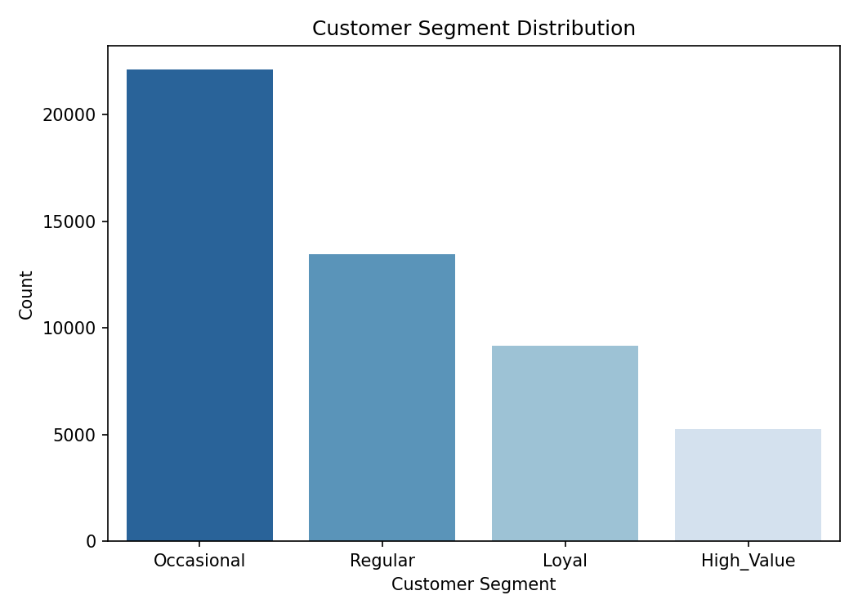
DATASET DESCRIPTION
50,000 Customers · 14 Columns · 4 Segments
50,000
14
4
0
Records
Columns
Classes
Duplicates
TARGET CLASS DISTRIBUTION
Customer Segment | Records
Occasional | 22,109
Regular | 13,455
Loyal | 9,163
High_Value | 5,273
Notes:
5

Slide 10
SETUP
Importing Required Libraries
PURPOSE
import pandas as pd
import numpy as np
import matplotlib.pyplot as plt
import seaborn as sns
from sklearn.model_selection import (
train_test_split
)
from sklearn.preprocessing import (
StandardScaler, OneHotEncoder
)
from sklearn.impute import SimpleImputer
from sklearn.compose import ColumnTransformer
from sklearn.pipeline import Pipeline
from sklearn.linear_model import (
LogisticRegression
)
from sklearn.metrics import (
accuracy_score, precision_score,
recall_score, f1_score,
classification_report, confusion_matrix
)
Pandas — data handling
NumPy — numerical operations
Matplotlib / Seaborn — visualization
Scikit-learn — machine learning
LogisticRegression — classification model
Metrics — model evaluation
Notes:
6

Slide 11
DATA LOADING
Loading the Dataset
EXPLANATION
from google.colab import files
uploaded = files.upload()
filename = list(uploaded.keys())[0]
df = pd.read_csv(filename)
df.head()
Dataset is uploaded via Google Colab
pd.read_csv() loads the CSV file
Data is stored in the DataFrame df
df.head() previews the first 5 records
Result: 50,000 rows × 14 columns loaded
Notes:
7

Slide 12
EXPLORATION
Basic Dataset Exploration
WHAT THIS REVEALS
COMMANDS USED
1
Dataset size (rows × columns)
df.shape
df.columns
df.dtypes
df.info()
df.describe(include="all").T
df.nunique(dropna=False)
2
Column names and structure
3
Data types of every feature
4
Presence of missing values
5
Descriptive statistics
6
Number of unique values per column
Notes:
8

Slide 13
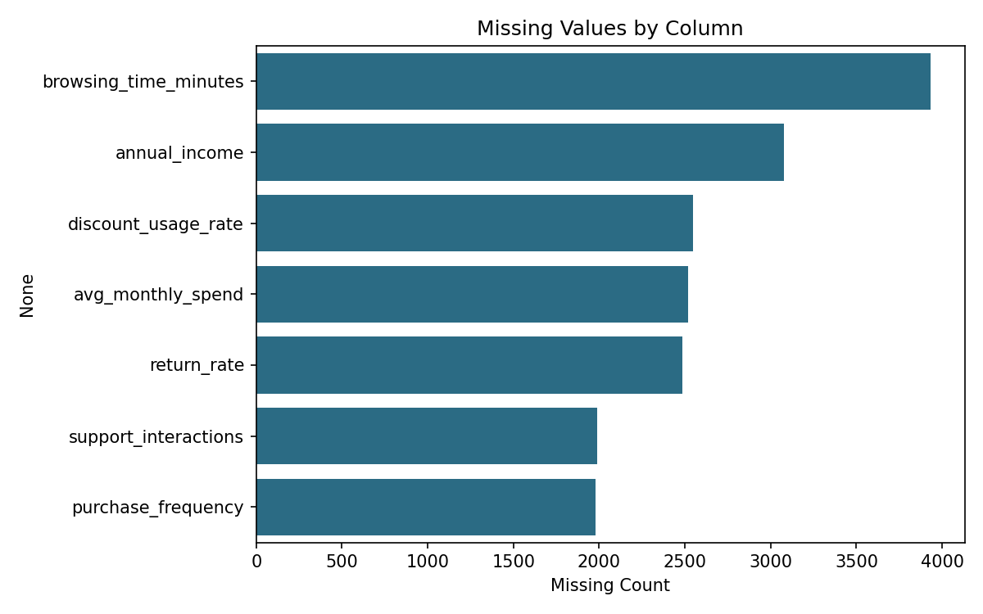
DATA QUALITY
Missing Value & Duplicate Analysis
df.isna().sum()
Missing values appear across seven numerical columns, ranging from ~2,000 to ~3,900 records each.
DUPLICATE CHECK
df.duplicated().sum()
0
No exact duplicate rows found in the supplied dataset.
Notes:
9

Slide 14
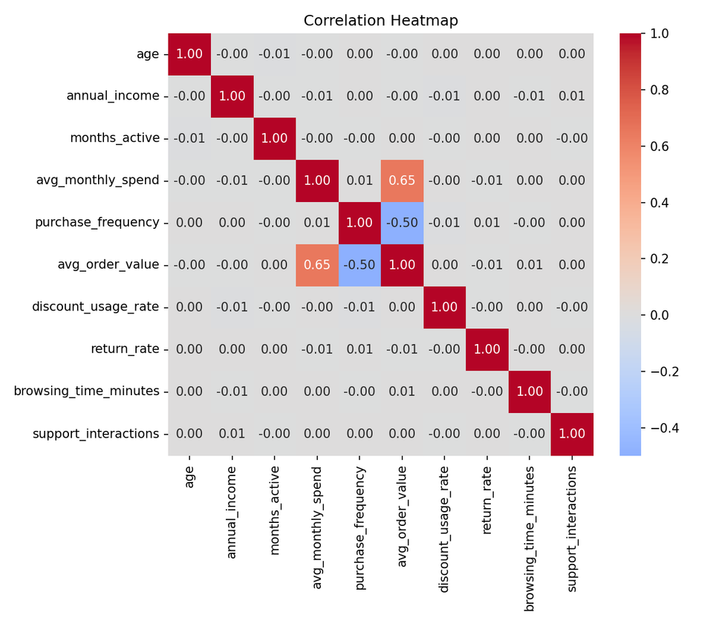
EDA
Exploratory Data Analysis
VISUALIZATIONS USED
Missing value bar chart & heatmap
Numerical histograms & boxplots
Categorical countplots
Target distribution
Correlation heatmap
Feature vs. target boxplots
Scatterplots & pairplot
EDA helps understand distributions, spot missing/unusual values, uncover feature relationships, and reveal how customer categories differ.
10
Notes:
10

Slide 15
TARGET VARIABLE
Identifying the Prediction Target
target_column = "customer_segment"
print(df[target_column]
.value_counts(dropna=False))
print(df[target_column].nunique())
OUTPUT
Occasional 22109
Regular 13455
Loyal 9163
High_Value 5273
Number of classes: 4
11
Notes:
11

Slide 16
DATA CLEANING
Preparing a Clean, Consistent Dataset
1
df = df.drop_duplicates().copy()
Removes exact duplicate records.
2
df = df.dropna(subset=[target_column]).copy()
Removes records where the target category is missing.
3
df[target_column] = df[target_column].astype(str)
Converts target labels into a consistent text format.
Result: The cleaned dataset (50,000 rows × 14 columns) is now ready for Machine Learning.
12
Notes:
12

Slide 17
FEATURE ENGINEERING
Feature and Target Separation
identifier_columns = ["customer_id"]
X = df.drop(
columns=[target_column] + identifier_columns
)
y = df[target_column]
X — input features used by the model
y — customer category to be predicted
WHY REMOVE customer_id ?
customer_id is only an identifier — it does not represent customer behavior. Using it as a feature could let the model learn meaningless, non-generalizable patterns tied to record order rather than real customer traits.
13
Notes:
13

Slide 18
PREPROCESSING
Two Preprocessing Tracks: Numeric & Categorical
NUMERICAL FEATURES
CATEGORICAL FEATURES
SimpleImputer(strategy="median")
SimpleImputer(strategy="most_frequent")
↓
↓
StandardScaler()
OneHotEncoder(handle_unknown="ignore")
Missing values filled with the median; features rescaled to a common, standardized range.
Missing categories filled with the mode; text categories converted into numerical indicator columns.
14
Notes:
14

Slide 19
PREPROCESSING ⭐
Building the Preprocessing Pipeline
KEY CONCEPT
numeric_pipeline = Pipeline([
("imputer",
SimpleImputer(strategy="median")),
("scaler", StandardScaler())
])
categorical_pipeline = Pipeline([
("imputer",
SimpleImputer(strategy="most_frequent")),
("onehot",
OneHotEncoder(handle_unknown="ignore"))
])
preprocessor = ColumnTransformer(
transformers=transformers,
remainder="drop"
)
Wraps all steps into a single reusable pipeline
Numeric and categorical logic run in parallel
Applied consistently during both training and prediction
Prevents data leakage between train and test sets
15
Notes:
15

Slide 20
MODEL SETUP ⭐
Splitting the Dataset
DATASET SPLIT
X_train, X_test, y_train, y_test = \
train_test_split(
X, y,
test_size=0.2,
random_state=42,
stratify=y
)
80% Train
20% Test
40,000
10,000
test_size=0.2
Training records
Testing records
20% of data reserved for testing
random_state=42
Makes the split reproducible
stratify=y
Keeps class proportions consistent across splits
16
Notes:
16

Slide 21
MODEL ⭐⭐⭐
Multinomial Logistic Regression
WHY LOGISTIC REGRESSION?
model = Pipeline([
("preprocessor", preprocessor),
("classifier",
LogisticRegression(max_iter=1000)
)
])
Handles multiple classes at once
Provides class probabilities / scores
Performs well on properly scaled features
Easier to interpret than many complex models
Target has 4 classes → this is inherently a multiclass problem
17
Notes:
17

Slide 22
TRAINING ⭐
Training the Model
model.fit(X_train, y_train)
PIPELINE FLOW
Raw Customer Data
↓
The model learns the relationship between customer features and customer category using the training data, then generalizes that pattern to unseen customers.
Missing Value Handling
↓
Feature Scaling / Encoding
↓
Logistic Regression
↓
Customer Category
18
Notes:
18

Slide 23
PREDICTION
Predicting Customer Categories
y_pred = model.predict(X_test)
comparison = pd.DataFrame({"Actual category": y_test, "Predicted category": y_pred})
comparison.head(10) — ACTUAL vs PREDICTED SAMPLE
Actual Category | Predicted Category
Occasional | Regular
Regular | Occasional
Loyal | Regular
Occasional | Regular
Occasional | Occasional
Occasional | Occasional
Regular | Regular
Occasional | Occasional
Loyal | Loyal
Occasional | Occasional
19
Notes:
19

Slide 24
EVALUATION ⭐⭐⭐
Evaluation Metrics
METRICS USED
accuracy = accuracy_score(
y_test, y_pred)
precision = precision_score(
y_test, y_pred, average="weighted")
recall = recall_score(
y_test, y_pred, average="weighted")
f1 = f1_score(
y_test, y_pred, average="weighted")
Accuracy — % of predictions that are correct
Precision — of predicted-class instances, how many were correct
Recall — of actual-class instances, how many were found
F1-Score — harmonic balance of precision and recall
20
Notes:
20

Slide 25
EVALUATION
Classification Report
Class | Precision | Recall | F1-Score | Support
High_Value | 0.71 | 0.61 | 0.66 | 1,055
Loyal | 0.61 | 0.66 | 0.63 | 1,832
Occasional | 0.72 | 0.82 | 0.77 | 4,422
Regular | 0.55 | 0.43 | 0.48 | 2,691
Accuracy |  |  | 0.66 | 10,000
Weighted Avg | 0.66 | 0.66 | 0.66 | 10,000
Occasional (the majority class) is predicted most reliably; Regular shows the weakest separation, often confused with Occasional and Loyal.
22
Notes:
22

Slide 26
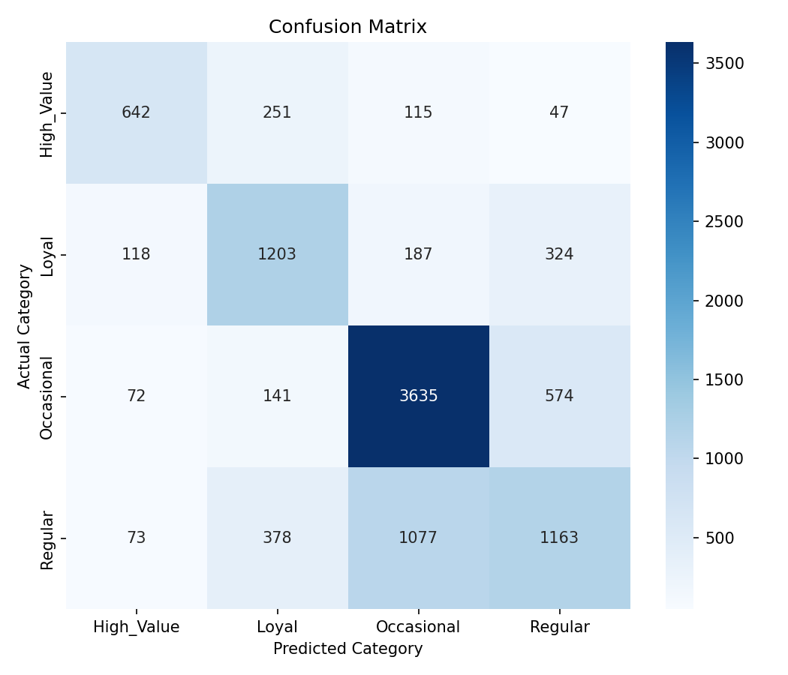
EVALUATION ⭐⭐⭐
Confusion Matrix
WHAT IT SHOWS
Compares each customer's Actual Category against the Predicted Category from the model.
Diagonal values → correct predictions
Off-diagonal values → misclassifications
Regular customers are the most frequently confused, especially with Occasional — reflecting overlapping behavior between adjacent segments.
23
Notes:
23

Slide 27
CASE STUDY
Sample Customer Prediction
sample = X_test.iloc[[0]]
prediction = model.predict(sample)
print("Predicted Customer Category:",
prediction[0])
print("Actual Customer Category:",
y_test.iloc[0])
PREDICTED
Regular
ACTUAL
Occasional
This example was misclassified — a reminder that individual predictions should be read alongside aggregate metrics like the confusion matrix, not in isolation.
24
Notes:
24

Slide 28
INTERPRETABILITY
Logistic Regression Coefficients
PURPOSE
fitted_classifier = model.named_steps[
"classifier"]
feature_names = (
fitted_preprocessor
.get_feature_names_out()
)
coefficients = pd.DataFrame(
fitted_classifier.coef_,
columns=feature_names,
index=fitted_classifier.classes_
)
One coefficient row is produced per class
Larger magnitude → stronger influence on that class's score
Sign indicates direction of the relationship
Helps explain, not just predict, customer behavior
25
Notes:
25

Slide 29
ASSESSMENT
Advantages
Handles multiple customer categories at once
Categorical variables one-hot encoded consistently
✓
✓
Simple, interpretable classification model
Numerical variables standardized
✓
✓
Preprocessing integrated into a single pipeline
Performance measured across multiple metrics
✓
✓
Missing values handled systematically
Extensible into a full customer-segmentation application
✓
✓
27
Notes:
27

Slide 30
ASSESSMENT
Limitations
Logistic Regression assumes a relatively simple relationship between features and class scores
!
Model performance depends heavily on dataset quality
!
Imbalanced customer categories can affect class-level metrics (seen in the Regular class)
!
The current project is based on a static, offline dataset
!
No web application or deployment is included in the current notebook
!
28
Notes:
28

Slide 31
ROADMAP
Future Enhancements
MODEL
DATA & APP
DEPLOYMENT
Compare with Random Forest
Evaluate on a larger, more representative dataset
Connect predictions to a real-time data source
Compare with Decision Tree
Develop a web application for customer input
Deploy the application on a cloud platform
Tune parameters via cross-validation
29
Notes:
29

Slide 32
WRAP-UP
Conclusion
✓
Predicts customer categories from demographic, spending and behavioral information
✓
Dataset: 50,000 customer records across 14 columns
✓
Target variable: customer_segment, with four classes — Occasional, Regular, Loyal, High_Value
✓
Data was cleaned and preprocessed before training
✓
Numerical features imputed and scaled; categorical features imputed and one-hot encoded
✓
A Multinomial Logistic Regression classifier was trained on an 80/20 stratified split
✓
Achieved 66.4% accuracy and 0.656 weighted F1-score on held-out test data
✓
Evaluated via accuracy, precision, recall, F1-score, classification report and confusion matrix
30
Notes:
30

Slide 33
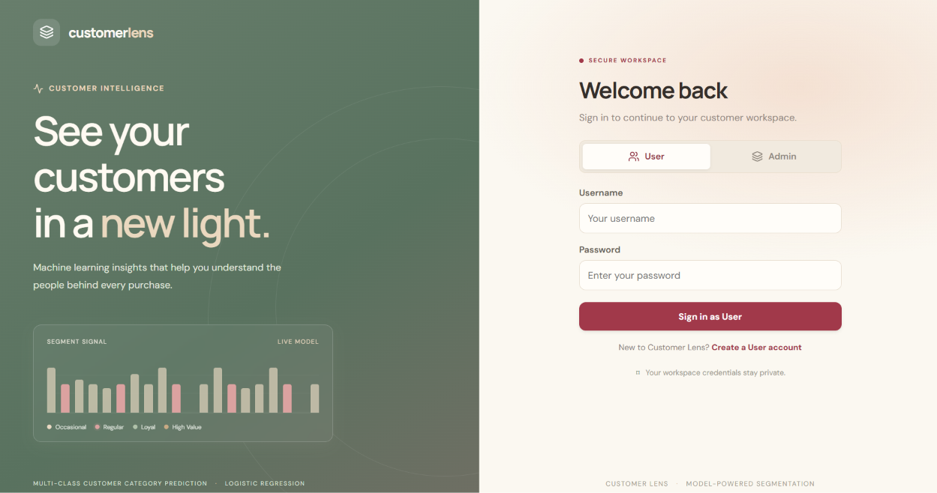
Website pictures:
WRAP-UP
30
Notes:
30

Slide 34
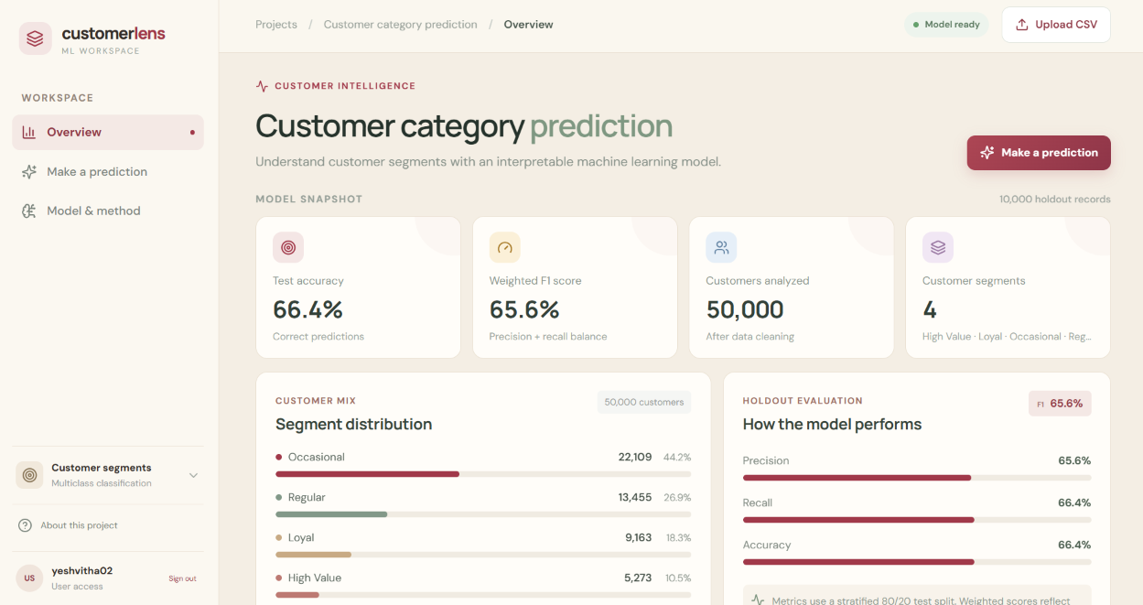
Website pictures:
WRAP-UP
30
Notes:
30

Slide 35
THANK YOU
Questions?
Multi-Class Customer Category Prediction Using Multinomial Logistic Regression
Notes:
31

